Slide 1
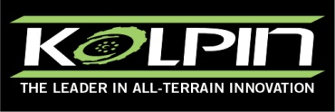
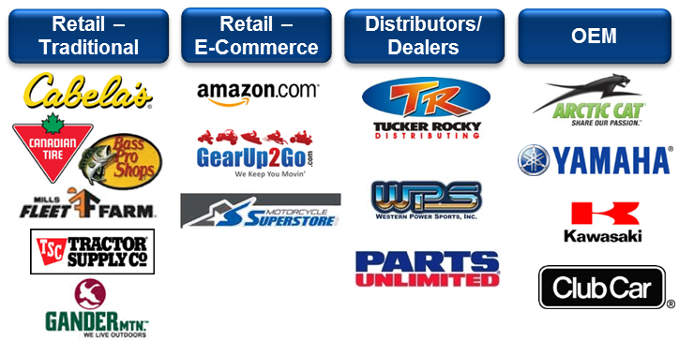
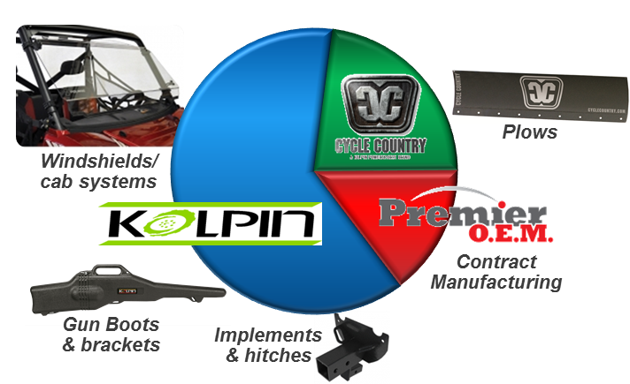
Acquisition – Kolpin Outdoors, Inc.
Kolpin Overview
Strategic Fit for Polaris
Develops innovative, value-focused Powersports aftermarket accessory/outdoor lifestyle products
Highly respected brand, established customer base
2013 Sales ~$20 million, primarily N.A.
  Portfolio of 650+ products, approximately 55 employees
  Headquarters / Distribution in Fox Lake, WI
  Rotational and Injection Molding in Cuyahoga Falls, OH
Extends channel, market and customer reach
Strong brand platform for expansion of value-priced aftermarket/outdoor accessories
Long-term sourcing and operational synergies
Increased credibility for both brands
Strong gross margins – in line with Polaris’ accessory gross margins
Slightly dilutive to operating income in 2014
Distribution Channels
2013 ORV Accessory Sales by Brand
The trademarks and logos depicted in this section are the trademarks of their respective owners and are not affiliated with Polaris Industries Inc.

