Slide 1



Merger of
South State Corporation and
Park Sterling Corporation
April 27, 2017

Slide 2
Forward Looking Statements
CAUTION REGARDING FORWARD-LOOKING STATEMENTS
Statements included in this communication which are not historical in nature or do not relate to current facts are intended to be, and are hereby identified as, forward-looking statements for purposes of the safe harbor provided by Section 27A of the Securities Act of 1933 and Section 21E of the Securities Exchange Act of 1934. The words “may,” “will,” “anticipate,” “could,” “should,” “would,” “believe,” “contemplate,” “expect,” “estimate,” “continue,” “plan,” “project” and “intend,” as well as other similar words and expressions of the future, are intended to identify forward-looking statements. South State Corporation (“South State”) and Park Sterling Corporation (“Park Sterling”) caution readers that forward-looking statements are subject to certain risks and uncertainties that could cause actual results to differ materially from anticipated results. Such risks and uncertainties, include, among others, the following possibilities: the occurrence of any event, change or other circumstances that could give rise to the right of one or both of the parties to terminate the definitive merger agreement between South State and Park Sterling; the outcome of any legal proceedings that may be instituted against South State or Park Sterling; the failure to obtain necessary regulatory approvals (and the risk that such approvals may result in the imposition of conditions that could adversely affect the combined company or the expected benefits of the transaction), and shareholder approvals or to satisfy any of the other conditions to the transaction on a timely basis or at all; the possibility that the anticipated benefits of the transaction are not realized when expected or at all, including as a result of the impact of, or problems arising from, the integration of the two companies or as a result of the strength of the economy and competitive factors in the areas where South State and Park Sterling do business; the possibility that the transaction may be more expensive to complete than anticipated, including as a result of unexpected factors or events; diversion of management’s attention from ongoing business operations and opportunities; potential adverse reactions or changes to business or employee relationships, including those resulting from the announcement or completion of the transaction; South State’s ability to complete the acquisition and integration of Park Sterling successfully; credit risk associated with commercial real estate, commercial business and construction lending; interest risk involving the effect of a change in interest rates on both of South State’s and Park Sterling’s earnings and the market value of the portfolio equity; liquidity risk affecting each bank’s ability to meet its obligations when they come due; price risk focusing on changes in market factors that may affect the value of traded instruments; transaction risk arising from problems with service or product delivery; compliance risk involving risk to earnings or capital resulting from violations of or nonconformance with laws, rules, regulations, prescribed practices, or ethical standards; strategic risk resulting from adverse business decisions or improper implementation of business decisions; reputation risk that adversely affects earnings or capital arising from negative public opinion; cybersecurity risk related to the dependence of South State and Park Sterling on internal computer systems and the technology of outside service providers, as well as the potential impacts of third-party security breaches, which subjects each company to potential business disruptions or financial losses resulting from deliberate attacks or unintentional events; economic downturn risk resulting from changes in the credit markets, greater than expected noninterest expenses, excessive loan losses and other factors and the implementation of federal spending cuts currently scheduled to go into effect; and other factors that may affect future results of South State and Park Sterling. Additional factors that could cause results to differ materially from those described above can be found in South State’s Annual Report on Form 10-K for the year ended December 31, 2016, which is on file with the Securities and Exchange Commission (the “SEC”) and available in the “Investor Relations” section of South State’s website, http://www.southstatebank.com, under the heading “SEC Filings” and in other documents South State files with the SEC, and in Park Sterling’s Annual Report on Form 10-K for the year ended December 31, 2016, which is on file with the SEC and available on the “Investor Relations” page linked to Park Sterling’s website, http://www.parksterlingbank.com, under the heading “Regulatory Filings” and in other documents Park Sterling files with the SEC.
All forward-looking statements speak only as of the date they are made and are based on information available at that time. Neither South State nor Park Sterling assumes any obligation to update forward-looking statements to reflect circumstances or events that occur after the date the forward-looking statements were made or to reflect the occurrence of unanticipated events except as required by federal securities laws. As forward-looking statements involve significant risks and uncertainties, caution should be exercised against placing undue reliance on such statements.
IMPORTANT ADDITIONAL INFORMATION
In connection with the proposed transaction between South State and Park Sterling, South State will file with the SEC a Registration Statement on Form S-4 that will include a Joint Proxy Statement of South State and Park Sterling and a Prospectus of South State, as well as other relevant documents concerning the proposed transaction. The proposed transaction involving South State and Park Sterling will be submitted to Park Sterling’s shareholders and South State’s shareholders for their consideration. This communication shall not constitute an offer to sell or the solicitation of an offer to buy any securities nor shall there be any sale of securities in any jurisdiction in which such offer, solicitation or sale would be unlawful prior to registration or qualification under the securities laws of such jurisdiction. Shareholders of South State and shareholders of Park Sterling are urged to read the registration statement and the joint proxy statement/prospectus regarding the transaction when it becomes available and any other relevant documents filed with the SEC, as well as any amendments or supplements to those documents, because they will contain important information.
Shareholders will be able to obtain a free copy of the definitive joint proxy statement/prospectus, as well as other filings containing information about South State and Park Sterling, without charge, at the SEC’s website (http://www.sec.gov). Copies of the joint proxy statement/prospectus and the filings with the SEC that will be incorporated by reference in the joint proxy statement/prospectus can also be obtained, without charge, by directing a request to South State Corporation, 520 Gervais Street, Columbia, South Carolina 29201, Attention: John C. Pollok, Senior Executive Vice President, CFO and COO, (800) 277-2175 or to Park Sterling Corporation, 1043 E. Morehead Street, Suite 201, Charlotte, North Carolina 28204, Attention: Donald K. Truslow, (704) 323-4292.
Participants in THE Solicitation
South State, Park Sterling and certain of their respective directors, executive officers and employees may be deemed to be participants in the solicitation of proxies in respect of the proposed transaction. Information regarding South State’s directors and executive officers is available in its definitive proxy statement, which was filed with the SEC on March 6, 2017, and certain of its Current Reports on Form 8-K. Information regarding Park Sterling’s directors and executive officers is available in its definitive proxy statement, which was filed with the SEC on April 13, 2017, and certain of its Current Reports on Form 8-K. Other information regarding the participants in the proxy solicitation and a description of their direct and indirect interests, by security holdings or otherwise, will be contained in the joint proxy statement/prospectus and other relevant materials filed with the SEC. Free copies of this document may be obtained as described in the preceding paragraph.

Slide 3







Transaction Rationale
Strategic
Combination of two great companies with complementary strengths
Increases density and depth
Extends footprint throughout the Carolinas, Georgia and into Virginia
Common vision of the future of regional banking
Management continuity and improved team talent across entire franchise
Markets
Improved market share position in several metropolitan markets
Meaningfully enhances competitive position and ability to attract talent in Charlotte
Entrance into growth markets of Richmond and Raleigh
74% of PSTB branches are in MSAs which SSB already operates
Financial
Mid single-digit EPS accretion post integration
Less than 4% tangible book value dilution
Tangible book value earnback in 3 to 4 years
Preservation of strong capital position and balance sheet

Slide 4
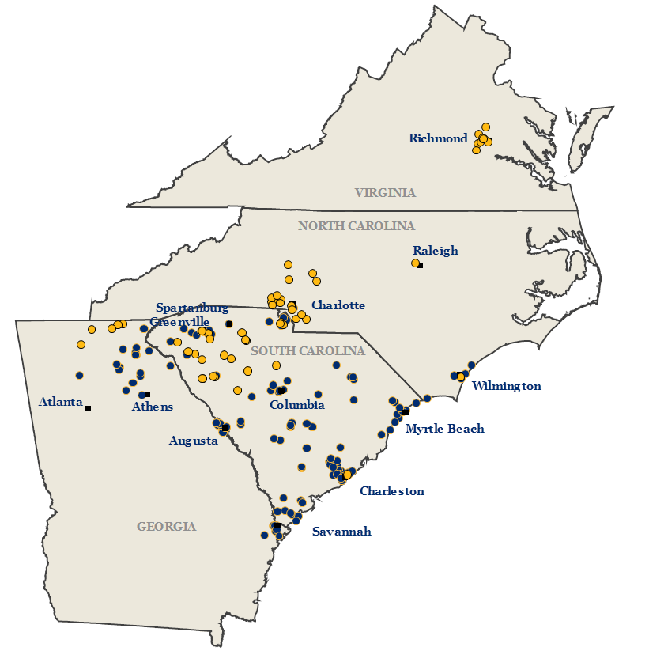
Pro Forma Footprint
Park Sterling Highlights
SSB (129)
PSTB (54)
Source: SNL Financial; Data as of 3/31/17
4

Slide 5
Market Share
Combined Counties of Operation ⁽¹⁾
V A
Richmond
N C
Raleigh
Greenville
Charlotte
Gainsville
S C
Columbia
Wilmington
Atlanta
Athens
Myrtle Beach
G A
Augusta
Charleston
Pro Forma
County Market Share
Savannah
#1 to #5
#6 to #10
Greater than #10
Source: SNL Financial
Deposit data as of 6/30/16
Includes combined counties of operation for SSB and PSTB; excludes money center or super regional bank branches with greater than $1.0 billion in deposits

Slide 6
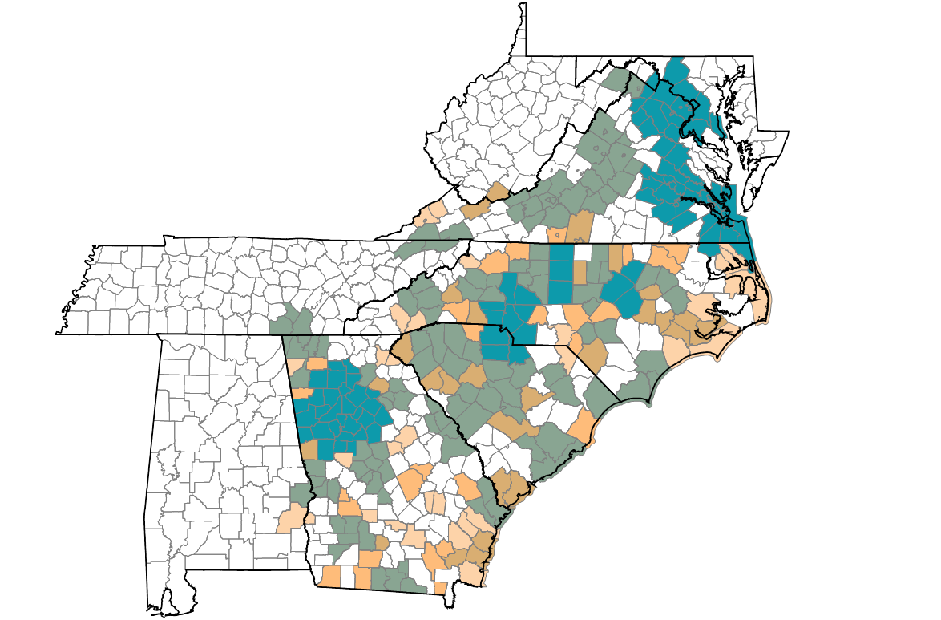
Better Positioned in Top C&I Markets
Top 25 MSAs by C&I Sales
Richmond
Raleigh
Charlotte
Greenville
Gainsville
Columbia
Wilmington
Athens
Atlanta
Augusta
Myrtle Beach
Charleston
Savannah
Total C&I Sales
By MSA
> $40.0 billion
$4.7 billion - $40.0 billion
$2.8 billion - $4.7 billion
Demographic data as of 6/30/16
Note: Gray highlight denotes pro forma market of operation
Includes companies classified with the NAICs as Healthcare and Social Assistance, Wholesale Trade, Manufacturing or Transportation and Warehousing
$1.7 billion - $2.8 billion
< $1.7 billion

Slide 7
Transaction Terms
Buyer
South State Corporation (Nasdaq: SSB)
Seller
Park Sterling Corporation (Nasdaq: PSTB)
Fixed Exchange Ratio
0.14 shares of SSB common stock for each share of PSTB common stock
Consideration
100% stock
Implied Price per Share
$12.87
Aggregate Transaction Value
$690.8 million
Ownership Split
80% SSB / 20% PSTB
Board Representation
2 Directors to be appointed to SSB’s Board of Directors,
including Jim Cherry
Management Retention
Employment Agreements with Bryan Kennedy & Don Truslow
Required Approvals
Regulatory and shareholder approvals from both SSB and PSTB
Expected Closing
4th Quarter 2017

Slide 8

Multiples Comparison
Transaction Multiples
SSB Trading Multiples
Price / Tangible Book Value ⁽¹⁾: 236% 289%
Price / 2017 Earnings ⁽²⁾: 21.8 x 22.0 x
Other Transaction Data
Market Premium ⁽³⁾: 2.8%
PSTB Dividend Increase ⁽⁴⁾: 15.5%
Source: SNL Financial
Pricing data as of 4/26/17
Based on PSTB’s tangible book value per share of $5.45 as of 3/31/2017
Based on FactSet consensus estimates
Based on PSTB’s closing price of $12.52
Based on PSTB’s quarterly dividend per share of $0.04 and SSB’s quarterly dividend per share of $0.33

Slide 9
Transaction Assumptions
Purchase Accounting
Overall credit mark of $61 million
  Comprehensive review process
  57% of total loan balances
  100% of impaired loans
Expense
Savings
Expected to be 35% of PSTB’s noninterest expense
  75% realized in 2018
  100% realized thereafter
Pro Forma
Capital
Tangible Common Equity / Tangible Assets: ~8.7 %
Total Capital Ratio: ~12.6 %
Merger Costs
Approximately $50 million after-tax
Other Assumptions
Includes:
  Full impact of lost interchange revenue caused by Durbin Amendment
  Balance sheet repositioning
Core deposit intangible equal to 1.5%

Slide 10
Loan Concentrations ⁽¹⁾
Source: SNL Financial
Data as of 3/31/17
Dashed lines denote regulatory recommended threshold
Excludes purchase accounting adjustments

Slide 11
Pro Forma Deposit Market Rank
Source: SNL Financial
deposit market share data as of 6/30/16
11

Slide 12
Summary
Adds density and depth
Enhances presence in key metropolitan markets
Combines two teams with exceptional talent
Well positioned for further growth and acquisitions
Financially attractive to shareholders of both companies
12

Slide 13
Combined Company
Pro Forma Highlights ⁽¹⁾
Richmond
Raleigh
Spartanburg
Charlotte
Greenville
Atlanta
Wilmington
Athens
Columbia
Augusta
Myrtle Beach
Charleston
Savannah
SSB + PSTB (183)
Source: SNL Financial
(1) Excludes purchase accounting adjustments
13

Slide 14
Appendix
14

Slide 15
Pro Forma Deposit Market Share by State ⁽¹⁾
South Carolina
North Carolina
Georgia
Virginia
Source: SNL Financial
Deposit data as of 6/30/16; pro forma for announced transactions
Total deposits and branches adjusted to exclude individual money center and super regional bank branches with greater than $1.0 billion in deposits

Slide 16
Pro Forma Deposit Market Share by MSA ⁽¹⁾
Charlotte-Concord-Gastonia, NC-SC
Greenville-Anderson-Mauldin, SC
Richmond, VA
Wilmington, NC
Source: SNL Financial
Deposit data as of 6/30/16; pro forma for announced transactions
Total deposits and branches adjusted to exclude individual money center and super regional bank branches with greater than $1.0 billion in deposits

Slide 17
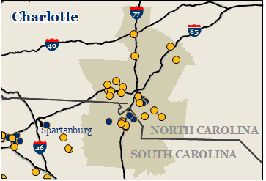
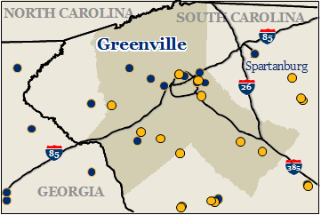
Combined Key Markets
Charlotte
#6
SSB
PSTB
Richmond
Greenville
#9
#5
95
SSB (129)
PSTB (54)
64
295
95
85
Deposit market share data as of 6/30/16
Circle denotes pro forma deposit market share rank in each respective MSA
17

Slide 18







Market Highlights: Charlotte
Charlotte Market Overview
Demographics
Charlotte is the most accessible city between Washington, D.C., and Dallas, Texas
  6.9 million people live within a 100-mile radius
  MSA Population: 2.49 million
  Nation’s second largest banking center, sixth busiest airport and home to seven Fortune 500 companies
  C&I statistics⁽¹⁾:
    Total C&I businesses: 15,854
    Total C&I sales: $90 bn
  Charlotte ranked #8 best big cities for jobs by Forbes
Charlotte was rated the 3rd most attractive real estate market in America (PWC)
Charlotte has been ranked No. 15 of the ‘Best Place to Live in the USA’
Charlotte
North Carolina
Southeast
Projected Population Growth
2017 – 2022 (%)
Projected Median HHI Growth
2017 – 2022 (%)
Companies Headquartered in Charlotte
77
40
85
26
Source: SNL Financial, WalletHub, Forbes, Charlotte Chamber of Economic Development, RLCO, CBRE
Demographic data as of 6/30/16
(1) Includes companies classified with the NAICs as Healthcare and Social Assistance, Wholesale Trade, Manufacturing or Transportation and Warehousing

Slide 19






Market Highlights: Richmond
Richmond Market Overview
Demographics
Focal point of the state of Virginia
  State capital, headquarters of Fifth Federal Reserve District, home to six Fortune 500 companies
  Central location within the Commonwealth
  MSA population: 1.29 million
  Multiple top tier Universities in and around the greater Richmond MSA
  C&I statistics⁽¹⁾:
    Total C&I businesses: 8,253
    Total C&I sales: $50 bn
  Richmond was named was named 4th hottest housing market in 2016 (Zillow)
  Richmond was ranked 11th best metro area to start a business in America (CNBC)
Richmond
Virginia
Southeast
Projected Population Growth
2017 – 2022 (%)
Projected Median HHI
2022 ($)
Companies Headquartered in Richmond
95
64
295
95
85
Source: SNL Financial, Richmond Chamber of Commerce, the City of Richmond Economic & Community Development Authority
Demographic data as of 6/30/16
(1) Includes companies classified with the NAICs as Healthcare and Social Assistance, Wholesale Trade, Manufacturing or Transportation and Warehousing

Slide 20


Focused on High Growth Markets
Projected Change 2017-2022
MSA Population Growth
✓
✓
✓
✓
✓
✓
✓
✓
✓
✓
✓
✓
✓
✓
✓
✓
✓
✓
✓
State Population Growth
✓
✓
✓
✓
✓
✓
✓
Source: SNL Financial
Population data as of 6/30/16

Slide 21


Leverages Presence in Key Markets
Source: SNL Financial
Deposit data as of 6/30/16; pro forma for announced transactions
(1) Per the Bureau of Economic Analysis’ 2015 Regional GDP news release
21

Slide 22


Loan Composition
SSB
PSTB
Pro Forma ⁽¹⁾
Source: SNL Financial
Dollars in thousands
Data as of or for the three months ended 3/31/17
(1) Excludes purchase accounting adjustments
22

Slide 23

Deposit Composition
SSB
PSTB
Pro Forma
Source: SNL Financial
Dollars in thousands
Data as of or for the three months ended 3/31/17
Note: Jumbo time deposits defined as time deposits greater than $100,000

Slide 24
Investor Contacts
Robert R. Hill, Jr.
Chief Executive Officer
John C. Pollok
Senior Executive Vice President
Chief Financial Officer / Chief Operating Officer
James C. Mabry IV
Executive Vice President
Investor Relations and Mergers & Acquisitions
520 Gervais Street
Columbia, South Carolina 29201 800-277-2175
www.southstatebank.com
James C. Cherry
Chief Executive Officer
Bryan F. Kennedy
President
Donald K. Truslow
Executive Vice President
Chief Financial Officer
520 Gervais Street
Columbia, South Carolina 29201
(800) 277-2175
www.southstatebank.com
1043 East Morehead Street
Suite 201
Charlotte, NC 28204
(704) 716-2134
www.parksterlingbank.com

