Slide 1
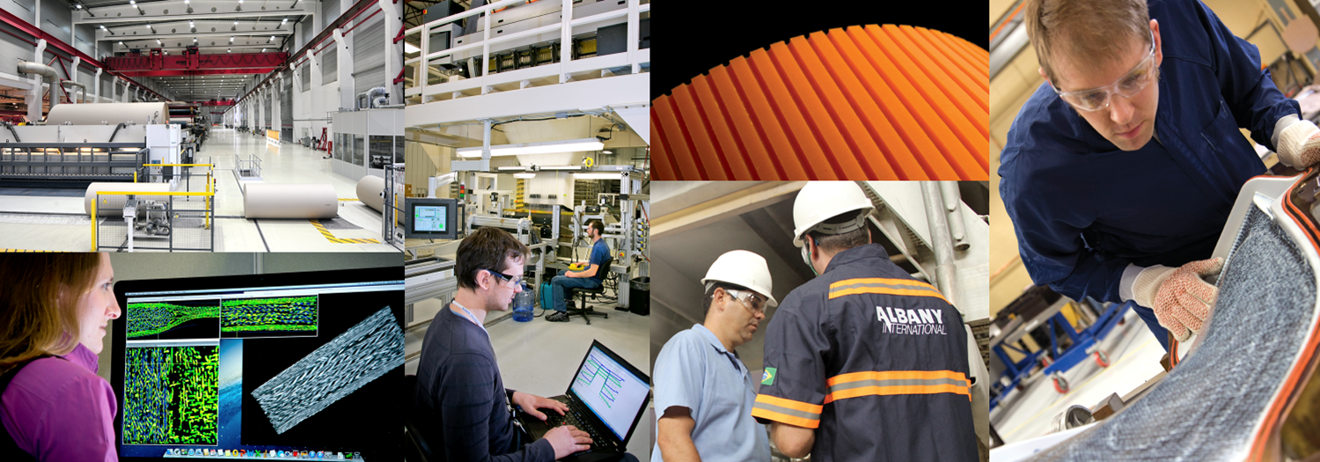

Q1 Financial Performance
May 4, 2017

Slide 2
‘Non-GAAP’ Items and Forward-Looking Statements
This presentation contains the following non-GAAP measures:
  Percentage changes in net sales, excluding currency rate effects (for each segment, and the Company as a whole);
  Adjusted EBITDA (for each segment, and the Company as a whole; absolute and as a percentage of sales);
  Net debt; and
  Net income per share attributable to the Company, excluding adjustments.
We think such items provide useful information to investors regarding the Company’s core operational performance. See the Company’s earnings release (which accompanies this presentation) for additional information including reconciliations to GAAP measures.
This presentation also may contain statements, estimates, or projections that constitute “forward-looking statements” as defined under U.S. federal securities laws. Forward-looking statements are subject to certain risks and uncertainties that could cause actual results to differ materially from the Company’s historical experience and our present expectations or projections. We disclaim any obligation to update any information in this presentation to reflect any changes or developments after the date on the cover page.
Certain additional disclosures regarding our use of these ‘non-GAAP’ items and forward-looking statements are set forth in our first-quarter earnings press release dated May 4, 2017, and in our SEC filings, including our most recent quarterly reports and our annual reports for the years ended December 31, 2014, 2015, and 2016. Our use of such items in this presentation is subject to those additional disclosures, which we urge you to read.
2

Slide 3
Net Sales by Segment
(in thousands, except percentages) | Net Sales Three Months ended March 31, 2017 2016 |  | Percent Change | Impact of Changes in Currency Translation Rates | Percent Change excluding Currency Rate Effect
Machine Clothing (MC) | $142,827 | $145,264 | -1.7% | ($2,122) | - 0.2%
Albany Engineered Composites (AEC) | 56,450 | 27,067 | 108.6% | (263) | 109.5%
Total | $199,277 | $172,331 | 15.6% | ($2,385) | 17.0%
3

Slide 4
Gross Profit Margin by Quarter
Percentage of Net Sales
4

Slide 5
Net Income (GAAP) and Adjusted EBITDA (non-GAAP) by Segment
 | Three Months ended March 31, 2017
(in thousands) | Machine Clothing | Albany Engineered Composites | Corporate expenses and other | Total Company
Operating income/(loss) (GAAP) | $38,261 | $(5,114) | ($11,091) | $22,056
Interest, taxes, other income/expense | - | - | (11,082) | (11,082)
Net income (GAAP) | 38,261 | (5,114) | (22,173) | 10,974
Interest expense, net | - | - | 4,328 | 4,328
Income tax expense/(benefit) | - | - | 6,550 | 6,550
Depreciation and amortization | 8,287 | 7,804 | 1,202 | 17,293
EBITDA (non-GAAP) | 46,548 | 2,690 | (10,093) | 39,145
Restructuring expenses, net | 110 | 2,571 | - | 2,681
Foreign currency revaluation (gains)/losses | 1,663 | 98 | 102 | 1,863
Acquisition expenses | - | - | - | -
Pretax (income)/loss attributable to non-controlling interest in ASC | - | (171) | - | (171)
Adjusted EBITDA (non-GAAP) | $48,321 | $5,188 | ($9,991) | $43,518
Three Months ended March 31, 2016
Machine Clothing | Albany Engineered Composites | Corporate expenses and other | Total Company
$37,139 | $(3,706) | ($11,164) | $22,269
- | - | (8,953) | (8,953)
37,139 | (3,706) | (20,117) | 13,316
- | - | 2,238 | 2,238
- | - | 7,043 | 7,043
9,318 | 3,395 | 2,107 | 14,820
46,457 | (311) | (8,729) | 37,417
698 | - | (19) | 679
1,890 | 5 | (477) | 1,418
- | 1,596 | - | 1,596
- | 187 | - | 187
$49,045 | $1,477 | ($9,225) | $41,297
5

Slide 6
Earnings Per Share
Per share amounts (Basic) | Three Months ended March 31, 2017 2016
Net income attributable to the Company, as reported (GAAP) | $0.34 | $0.42
Adjustments:
Restructuring expenses, net | 0.05 | 0.01
Discrete tax adjustments | 0.03 | (0.03)
Foreign currency revaluation losses | 0.04 | 0.03
Acquisition expenses | - | 0.03
Net income attributable to the Company, excluding adjustments (non-GAAP) | $0.46 | $0.46
5
6

Slide 7
Total Debt (GAAP) and Net Debt* (non-GAAP)
$ thousands
*Total debt less cash see table 12 for reconciliation of total debt to net debt
7

