Slide 1
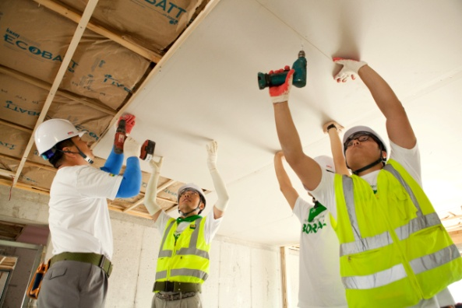
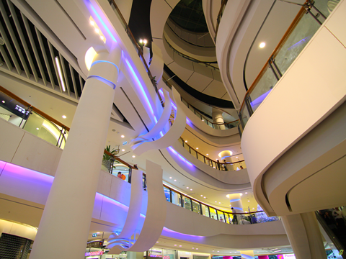
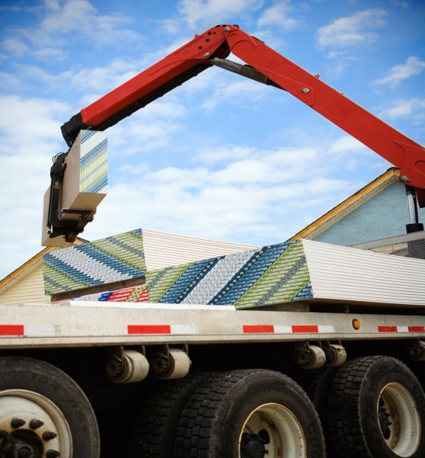
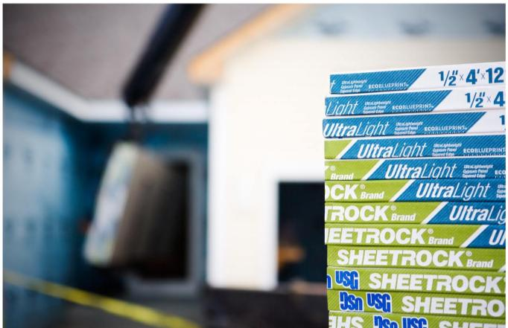
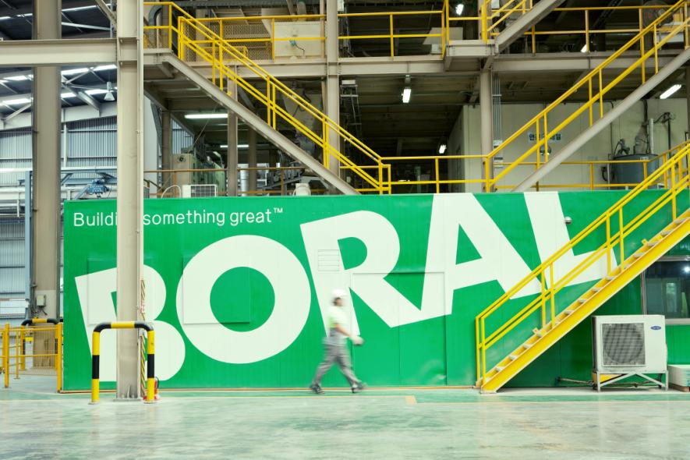


Creating a World Leading Joint Venture
Asia – Australasia – Middle East
®
16 October 2013
Mike Kane
CEO & Managing Director
Jim Metcalf
Chairman, President & CEO

Slide 2
USG Cautionary Statements
This presentation contains forward-looking statements within the meaning of the Private Securities Litigation Reform Act of 1995 related to management’s expectations about future conditions. Actual business, market or other conditions may differ materially from management’s expectations and, accordingly, may affect our sales and profitability or other results and liquidity. Actual results may differ materially due to various other factors, including: economic conditions, such as the levels of new home and other construction activity, employment levels, the availability of mortgage, construction and other financing, mortgage and other interest rates, housing affordability and supply, the levels of foreclosures and home resales, currency exchange rates and consumer confidence; capital markets conditions and the availability of borrowings under our credit agreement or other financings; our substantial indebtedness and our ability to incur substantial additional indebtedness; competitive conditions, such as price, service and product competition; shortages in raw materials; changes in raw material and energy costs; volatility in the assumptions used to determine the funded status of our pension plans; the loss of one or more major customers and our customers’ ability to meet their financial obligations to us; capacity utilization rates for us and the industry; our ability to expand into new geographic markets and the stability of such markets; our ability to successfully enter into and operate the joint venture with Boral Limited, including risks that our joint venture partner, Boral Limited, may not fulfill its obligations as an investor or may take actions that are inconsistent with our objectives; our ability to protect our intellectual property and other proprietary rights; changes in laws or regulations, including environmental and safety regulations; the satisfactory performance of certain business functions by third party service providers; our ability to achieve anticipated savings from cost reduction programs; the outcome in contested litigation matters; the effects of acts of terrorism or war upon domestic and international economies and financial markets; and acts of God. We assume no obligation to update any forward-looking information contained in this presentation. Additional information concerning these and other factors may be found in our filings with the Securities and Exchange Commission, including the “Risk Factors” in our most recent Annual Report on Form 10-K.
Notes:
2

Slide 3
Content
Overview of the transaction / strategic rationale
USG’s IP / Technology and adjacent products
JV’s combined footprint and markets
Synergies
Key transaction terms
Company specific factors
Summary
Appendix
Notes:
Intro by Mike Kane -

Slide 4
Boral and USG are forming a US $1.6 billion¹ plasterboard and
ceilings joint venture, USG Boral Building Products, bringing together Boral’s leading plasterboard manufacturing and distribution footprint in Asia and Australia with USG’s world-leading building products technologies and strategic assets in Asia and the Middle East.
®
Asset value of US$1.6bn subject to finalisation of fair valuation, completion adjustments and final foreign exchange rates at the date of completion
Notes:
Jim

Slide 5
Overview of the transaction
50:50 US$1.6bn¹ plasterboard and ceilings joint venture, USG Boral Building Products, will encompass the following assets:
  Boral’s Gypsum operations in Asia and Australia, including its holdings in, or portions of, Gypsum Resources Australia (GRA) and Rondo joint ventures with CSR
  USG’s wholly owned operations in Asia, New Zealand, and its holdings in, or portions of, current joint ventures in the Middle East², Oman and China
  Exclusive rights to use USG’s intellectual property including its world-leading plasterboard, joint compound and ceilings technologies
To achieve 50% ownership interest, USG will make a US$500m upfront cash payment to Boral
  Boral will also have the potential to receive earn out payments of up to US$75m, based on three- and five-year earnings targets
US$1.6bn asset valuation subject to finalisation of fair valuation, completion adjustments and final foreign exchange rates at the date of completion
Middle East joint venture refers to assets held in Saudi Arabia
Notes:
Jim

Slide 6
Creating a leading building products partnership in Asia, Australasia and the Middle East
  The joint venture will be the market leader in its Territory¹ in sales, scale, distribution, coverage (product and geography) and technology
  USG is a world leader in building products technologies with strategic assets in the Middle East, New Zealand and Asia
  BORAL has a leading plasterboard manufacturing and distribution footprint in Asia and Australia
  Combined business delivers:
  #1 or #2 position in most markets served
  Sustainable long-term competitive advantage through game-changing technologies
  Substantial synergies, expected from
    Roll-out of USG technology across Boral’s Gypsum operations
    Leveraging Boral’s distribution network to offer USG’s adjacent products
  Capability to pursue and self-fund new opportunities
  Over 150 years of combined industry leadership and experience
Includes Asia, Australasia and the Middle East
Notes:
Mike

Slide 7
The joint venture partners
Overview of BORAL (ASX: BLD)
A$3.7bn market cap (US$3.5bn)¹
A$5.3bn (US$5.4bn)² revenue in FY2013³
12,610 employees as of 30 June 2013
Construction Materials, Building Products and Gypsum
Australia, Asia and US
Overview of USG (NYSE: USG)
US$3.0bn market cap¹
US$3.2bn revenue in FY2012³
8,500 employees as of 31 December 2012
Gypsum, Ceilings and Product Distribution
North America, South America, Asia and Middle East
Segment revenue – FY2013
Geographic revenue – FY2013
Segment revenue – FY2012
Geographic revenue – FY2012
Boral USA 11%
USA 11%
Product distribution⁴
31%
Boral Gypsum 18%
Asia 11%
Building Products 11%
Construction Materials & Cement 60%
Australia 78%
Source: Company reports. Share price from IRESS and Factset as at 10 October 2013. Based on A$/US$ exchange rate of 0.95 as at 10 October 2013
Based on average A$/US$ exchange rate of 1.02 for the year ended 30 June 2013
Boral’s financial year ended 30 June 2013; USG’s financial year ended 31 December 2012
USG’s Product Distribution business outside Asia and the Middle East and Boral’s Building Products division (which includes Bricks, Roofing, Timber & Windows) are not a part of the Joint Venture transaction
Notes:
Mike and then Jim

Slide 8
Overview of joint venture operations in Asia, Australasia and the Middle East
BLD
USG
50%
50%
USG Boral Building
Products¹
Korea
Thailand/ Philippines
Indonesia
Vietnam
Aus/NZ
China
Malaysia/
Singapore
India
Middle East
Boral operations
USG operations
USG TECHNOLOGY
153m m² (1.6 BSF)² capacity & Boral sales presence
USG sales presence
105m m² (1.1 BSF) capacity in Thailand & Boral sales presence (71% interest)
Gypsum mine
Boral metal products
USG sales presence
65m m² (0.7 BSF) capacity & Boral sales presence
Boral metal products
USG sales presence
42m m² (0.5 BSF) capacity³ & Boral sales presence
Boral metal products
USG sales presence
86m m²
(0.9 BSF) capacity & Boral sales presence in Australia
50% Rondo metal products
50% GRA gypsum mine
USG NZ grid manufacturing
USG sales presence
155m m² (1.7 BSF) capacity³ & Boral sales presence
Boral metal products
50% interest in USG ceiling tile, metal ceiling grid & mineral wool manufacturing
10m m²
(0.1 BSF) capacity in Malaysia & Boral sales presence
50% Rondo metal products
USG joint compound manufacturing
USG sales presence
9m m²
(0.1 BSF) capacity & Boral sales presence
Boral metal products
50% Rondo metal products
USG Joint Compound plant⁴
USG sales presence
Boral sales presence
50% interest in 8m m² (0.1 BSF) plant in Oman³
55% interest in Oman gypsum mine
45% interest in ceiling, metal ceiling grid, metal stud, and joint compound plant in Saudi Arabia
Actual structure will be via two JV legal entities
m m² refers to million square metres; BSF refers to billion square feet
Post completion of capacity expansion at Ho Chi Minh City (Vietnam) and Chongqing (China) in financial year ending 30 June 2014 and construction of new plant in Oman in calendar year 2014 (CY2014)
Post completion of manufacturing facility expected in 1Q CY2014
Notes:
Mike

Slide 9
Content
Overview of the transaction / strategic rationale
USG’s IP / Technology and adjacent products
JV’s combined footprint and markets
Synergies
Key transaction terms
Company specific factors
Summary
Appendix
Notes:
Intro by Mike Kane -

Slide 10
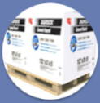
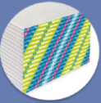
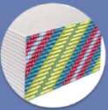
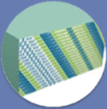
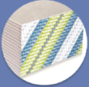
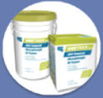
USG: A history of differentiating through innovation
USG has led every major industry innovation¹
  US$170m invested in R&D since 2003 with 2,000+ patents received
  Dedicated research & development facility in Libertyville, Illinois, US
Significant recognition received for innovations
  2011 – Global Gypsum Magazine’s Product of the Year Award and The Home Depot’s Product Innovation of the Year Award (SHEETROCK® Brand UltraLight Panels)
  2013 – Ranked a Top Innovator in the Industrial Materials Sector by the Patent Board
Superior performing, lower weight products in plasterboard, cement board and joint compound
  UltraLight products command a price premium, can be produced at equivalent cost² and reduce freight
  Better score and snap, superior sag resistance, and lighter weight characteristics improve contractor and distributor productivities
2010:
SHEETROCK® Brand UltraLight Panels up to 30% lighter
2012:
SHEETROCK® Brand UltraLightWeight
All Purpose Joint Compound up to 40% lighter
2009:
Durock® Cement Board Next-Gen up to 25% lighter
2011:
SHEETROCK® Brand UltraLight Panels FIRECODE® 30 up to 30% lighter
2011:
SHEETROCK® Brand UltraLight Panels FIRECODE® X up to 15% lighter
2013:
SHEETROCK® Brand UltraLight Panels Mold Tough® up to 20% lighter
See slide in appendix for an overview of USG’s technology journey and leading innovations
Equivalent cost compared to USG’s previous generation technology plasterboard, but at a lower cost relative to industry standard / Boral Gypsum plasterboard
Notes:
10
Jim

Slide 11
Strong market response and rapid adoption of UltraLight technology
United States
50% conversion across full USG plasterboard portfolio in 3 years
~80% of ½” wallboard converted to SHEETROCK® Brand UltraLight Panels
Side by side comparison drives rapid adoption in the retail channel
Superior performance attributes encourage residential adoption
Productivity enhancements yield strong commercial conversion
US: Total Board Volumes
millions of square feet
¹
Mexico
  Improved performance attributes speeds adoption in emerging market
  Lighter weight generates freight savings and improved profitability
  Positioned as a premium price, superior performance product
Canada
  Strong conversion rate attributed to performance characteristics
  Lighter weight increases contractor productivity and profitability
  High adoption rates in all end use markets
Classic volume refers to USG’s technologies preceding UltraLight third generation technology

Slide 12
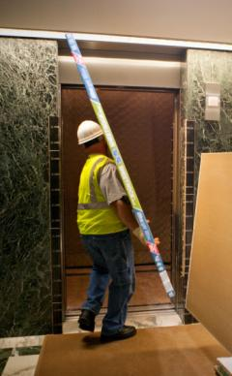
Customer testimonials illustrate the strong value proposition of USG’s UltraLight portfolio
“When we started tracking board counts on this product we began seeing production rate increases”
– Commercial Contractor, US
“We will use the product whenever possible”
– Residential Contractor, US
“I could do easily 5-10 more sheets”
– Installer, US
“All attributes are excellent, I prefer this board”
– Contractor, Mexico
“Lighter, easier to screw, easier to install, and has no difficulty cutting”
– Contractor, Mexico
"Panel weight makes it easier to install & work with”
– Contractor, Mexico
“It just flows onto the walls”
– Contractor, US regarding SHEETROCK® Brand UltraLightweight Joint Compound
For additional information : www.theweighthasbeenlifted.com

Slide 13
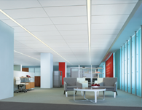
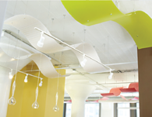
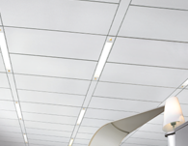
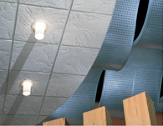
High-performance ceilings business provides a strong, complementary adjacency that further differentiates the joint venture
#2 USG global share in the industry with leading brands
International manufacturing and market coverage
Profitable business with stable margins through the US cycle
Solutions focused on performance, sustainability and aesthetics
 | Acoustical Tile Full-line high performance offering Sustainable solutions Architectural specification focused |  | Specialty Solutions Innovator Leading brands Enhances the aesthetics of finished space Creates a basis of design for the specifier
 | Suspension Systems Globally recognised DONN® grid World class manufacturing Complete code approvals Partnered with GE for integrated LED lighting solution |  | Commercial Segments Extends the portfolio for commercial projects Strong in all commercial segments Broadens the portfolio of product solutions for commercial projects

Slide 14
Content
Overview of the transaction / strategic rationale
USG’s IP / Technology and adjacent products
JV’s combined footprint and markets
Synergies
Key transaction terms
Company specific factors
Summary
Appendix
Notes:
Intro by Mike Kane -

Slide 15
Joint venture has leading positions across Asia, Australasia and the Middle East
SOUTH KOREA
Manufacturing footprint
(number of operations)
Boral plasterboard plant
Boral gypsum mine³
Boral other production^{2,3}
CHINA
3
5
3
SAUDI ARABIA
6
3
18
3
OMAN
INDIA
2
1
1
1
28
1
2
THAILAND
VIETNAM
2
1
USG plasterboard plant^{1,3}
USG gypsum mine³
USG other production^{1,2,3}
1
3
1
3
MALAYSIA
PHILIPPINES
1
1
1
1
3
9
INDONESIA
 | USG/ Boral JV
Capacity (m m²)¹ | 633
Capacity (BSF)¹ | 6.8
2
3
AUSTRALIA
3
1
4
1
NEW ZEALAND
Production either online or expected to be online in CY2014
Production may be at the same physical location. Other production includes ceiling tile, metal ceiling grid, metal products, joint compounds, mineral wool and cornice production
Certain manufacturing facilities and gypsum quarries held in joint venture with third parties (refer to page 8 of this presentation)
Notes:
15

Slide 16
Joint venture market positions
Country | Board Capacity |  | Board lines | Non-board production³ | Sales offices | Gypsum mine
 | (m m²) | (BSF)
China | 155² | 1.7¹ | 7¹ | 9³ | 7 | -
Korea | 153 | 1.6 | 4 | 3 | 6 | -
Thailand | 105 | 1.1 | 3 | 3 | 3 | 1
Australia | 86 | 0.9 | 3 | 4³ | 9 | 1²
Indonesia | 65 | 0.7 | 3 | 3 | 5 | -
Vietnam | 42¹ | 0.5¹ | 2¹ | 3 | 5 | -
Malaysia/ Singapore | 10 | 0.1 | 1 | 4³ | 4 | -
India | 9 | 0.1 | 1 | 3³ | 7 | -
Other⁴ | - | - | - | 1 | 8 | -
New Zealand | - | - | - | 1 | 1 | -
Saudi Arabia | - | - | - | 3³ | 3 | -
Oman | 8¹ | 0.1¹ | 1¹ | - | - | 1
Total | 633 | 6.8 | 25 | 37 | 58 | 3
JV plasterboard market share 2013⁵
Revenue contribution from largest to smallest
Production either online or expected to be online in CY2014
Includes metal stud, metal ceiling grid, joint compound, ceiling tile, cornice and/or mineral wool facilities
Certain manufacturing facilities and gypsum mines held in joint venture with third parties (refer to page 8 of this presentation)
Other includes metal plant in the Philippines and export business in UAE, Philippines, and Hong Kong
Source: management estimates based on plasterboard sales volume, excluding ceiling tiles
Notes:
16
Mike

Slide 17
Asian markets represent strong growth potential for JV building products
2013 Market size in JV region¹
(million m²)
2013 Market size in JV region − except China¹
(million m²)
Total
2,262
Total
682
2
  Market Highlights
  Korea: mature market with strong potential in residential wall penetration
  Australia: mature market with appetite for high performance and high quality products
  Indonesia: strong growth in third most populated country in Asia, with large consumer market
  Thailand: solid growth with opportunity to increase plasterboard penetration
  China: largest market with continued growth due to government limitations on brick and clay
  India: demand for faster building construction is accelerating modern product usage
  Middle East: steady growth resulting from strong government investment in numerous markets
USG and Boral estimates for plasterboard market (excluding ceiling tiles)
Middle East defined as including UAE, Oman and Saudi Arabia
Notes:
17
Mike

Slide 18
Strong macro fundamentals driving growing market demand
Real GDP growth – Asian countries¹
Plasterboard demand/GDP per capita¹
Strong economic growth forecast across most Asian markets
Increasing commercial projects expected to drive growth in non-residential construction
Increasing urbanisation will drive growth in residential new build
Historically plasterboard use starts in ceilings then moves to walls, and starts in commercial then moves to housing
Lightweight, flexible and easy to install characteristics make plasterboard the interior lining product of choice
  USG technology expected to enhance this attribute
Asia expected to become the world’s largest plasterboard market by 2015
Forecast real GDP growth − 5 year CAGR to 2018¹
Revenue contribution from largest to smallest
Source: IMF data at October 2013
Boral management estimates for plasterboard demand. GDP per capital and population based on IMF 2013 forecast data.
Notes:
18
Mike

Slide 19
Content
Overview of the transaction / strategic rationale
USG’s IP / Technology and adjacent products
JV’s combined footprint and markets
Synergies
Key transaction terms
Company specific factors
Summary
Appendix
Notes:
Intro by Mike Kane -

Slide 20
Substantial synergies expected from both the application of USG’s gypsum technologies (manufacturing and freight cost savings plus revenue enhancements) and leveraging Boral’s customer relationships and distribution platform
(USG’s adjacent products)
®
Notes:
Jim

Slide 21
Anticipated synergies exceed US$50m per annum within 3 years of completing technology roll-out
Expect substantial synergies from:
Roll-out of USG’s technologies:
  lower manufacturing & freight costs
  enhanced revenues through price premium
Adjacent product sales through Boral market channels
    ceiling products, metal products, cement and fibre board,
    joint compounds
  Synergies:
  Adjacent product synergies to commence immediately
  Other synergies to ramp up following 2 year phased technology roll-out and as market penetration increases
  Upfront operational expenditure will exceed synergies in first
  two years
  Based on extensive due diligence undertaken, including product testing
Targeted synergy breakdown
Adjacent products
through Boral channels
Manufacturing, freight & other cost savings
Revenue
growth
Synergies −
geographic allocation
Other
Australia
Thailand
Korea
China
Notes:
Mike

Slide 22
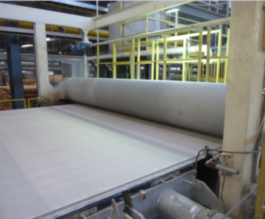
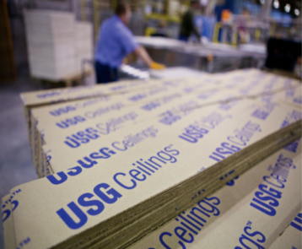
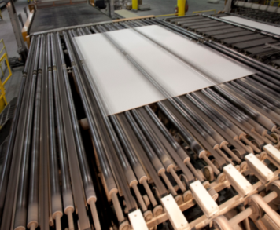

Implementation of technology expected to be self-funded
Targeted roll-out of technologies across all gypsum manufacturing lines
Phased over approximately 2 years
Approximately US$50m of capital expenditure expected to implement technology upgrades
Includes equipment modification, staff training, secondment of USG technology team and other upgrades
Expected to be funded through JV cash flows
Notes:
22
Jim

Slide 23
Content
Overview of the transaction / strategic rationale
USG’s IP / Technology and adjacent products
JV’s combined footprint and markets
Synergies
Key transaction terms
Company specific factors
Summary
Appendix
Notes:
Intro by Mike Kane -

Slide 24
Estimated transaction value¹
Estimated asset value of the joint venture is US$1.6bn¹
  US$1.35bn for assets contributed by Boral; US$0.25bn for assets contributed by USG
USG’s contributed assets include a perpetual licence in the JV’s Territory to USG’s current plasterboard technology, and the ceilings, joint compound and grid technologies currently used in the Territory (including improvements to current technologies)
Up to US$575m total payment from USG to Boral:
  US$500m cash upfront
  Earn out payments totalling up to US$75m² (net present value of ~US$50m)
USD | BORAL |  | USG
Assets | $1,350m¹ |  | $250m¹
Cash | ($500m) | Balancing cash payment | $500m
NPV of earn out | ($50m)² | From JV earnings | $50m²
Net contribution to JV | $800m |  | $800m
Subject to finalisation of fair valuation, completion adjustments and final foreign exchange rates at the date of completion
Including USG’s and Boral’s respective shares in non-controlling and controlled interests
Subject to achieving three- and five-year earnings targets
Notes:
Jim
24

Slide 25
Key transaction terms
Structure | USG’s and Boral’s respective assets to be contributed into the joint venture USG to make US$500m initial payment, then two potential earn outs: US$25m after 3 years and US$50m after 5 years upon achieving earnings targets
Management | CEO will be Frederic de Rougemont, Boral Gypsum CFO will be Paul Monzella, USG Corporation Joe Holmes, Chief Technology Officer, and Bill Hogan, VP Product Adjacencies, from USG Corporation will be executives Finance and Technical Committees will provide oversight and assistance to joint venture management
Governance | Chairman will be Jennifer Scanlon, USG Corporation (no casting vote) Right to appoint chairman will rotate every two years Board will consist of equal nominee directors from Boral and USG for as long as they hold 50:50 interests
Funding | Joint venture expected to be self funding with ability to borrow in its own right, subject to JV Board approval Targeted dividend distribution of 50% of after-tax profit
Notes:
Jim
25

Slide 26
Key transaction terms
Intellectual Property | Joint venture granted exclusive royalty-fee rights in the Territory to current Boral IP and USG IP, including improvements to current technology Exclusive option during the term to licence future “breakthrough IP” developed by USG and Boral Exclusive option during the term to licence “adjacent IP” generated by USG
Distribution rights | Exclusive distribution rights for USG products in the JV Territory during the term
Non-compete | Joint venture parties will not compete with the joint venture in the defined Territory Party who exits the joint venture will not compete until the later of the third anniversary of their exit, or 10 years from the commencement of the joint venture
Transfer of interest / change of control | 7 year standstill on transfer of interest in joint venture Pre-emptive rights including right of first offer, last right to buy and tag-along right for non-selling party Change of control, which applies to any entity in the chain of ownership, including the parent companies, triggers a call option for the other party at fair market value
Notes:
Jim
26

Slide 27
Content
Overview of the transaction / strategic rationale
USG’s IP / Technology and adjacent products
JV’s combined footprint and markets
Synergies
Key transaction terms
Company specific factors
Summary
Appendix
Notes:
Intro by Mike Kane -

Slide 28
USG funding and earnings implications
Calendar year 2014 expected impact to USG earnings¹
Accretive – US$7-$12m expected contribution to USG bottom line in CY2014 ⁵. Results are expected to increase over time as technology is propagated and capabilities are optimised
NPV positive – expected future returns exceed present value of cash contributions as synergies are realised
Balance Sheet positive – expected EBITDA to offset additional leverage, with higher cash contribution and lower debt/EBITDA over time
USG expects to fund the joint venture through US$350m in long-term debt and US$150m of cash from its balance sheet, with earn out payments of up to US$75m⁶
 | US$m
Projected JV earnings² | $35 - $45
Adjustment for USG’s contribution to the JV³ | ($6 - $8)
USG projected interest expense⁴ | ($22 - $25)
Total projected JV impact to USG’s net income in CY2014⁵ | $7 - $12
Guidance will not be provided on a quarterly or annual basis
JV results will be reflected in USG’s Equity Method Income on its Statement of Operations, below the Operating Profit line and may vary based on finalization of fair valuation at the date of completion and foreign exchange rates
Represents full projected earnings contributions from USG’s contributed entities in 2014
Expected interest payment related to the long-term debt used to fund the joint venture
Expected contribution is based on 12 months of operations, results may vary based on the actual commencement date of JV operations
$75m earn out payments have a Net Present Value of $50m based on the three- and five-year performance targets

Slide 29
Strengthening BORAL’s Balance Sheet
As at 30 June 2013 – Proforma Gearing
US$500m upfront cash:
  Majority of proceeds to be applied to reducing Boral’s debt
  May also consider capital management initiatives, subject to market conditions
  Reduction in proforma gearing reflects group net debt reducing to ~ A$0.9bn
JV self funding
 | 30 June 2013 | Proforma¹
Gearing (Net debt / net debt + equity) | 30% | 22%
Gearing (covenant calculation ) | 40% | 29%
Impact to financial statements
Transaction will be reflected in Boral’s accounts as an equity accounted interest (50%) in joint ventures following
  De-consolidation of existing Australian and Asian subsidiaries
  Recognition of single balance sheet asset, equity accounted investment in joint ventures, at fair value
Final accounting impact will be finalised following transaction completion
Value accretive for Boral shareholders
Illustrative impact on balance sheet ratios if the transaction had occurred on 30 June 2013. Unaudited figures for illustrative purposes only, assumes FX AUD/ USD of 0.9257.

Slide 30
BORAL – impact on Income Statement
Year ended 30 June 2013 – Proforma Income Statement
Illustrative FY2013 Income Statement as if transaction had occurred on 1 July 2012
FY2013 proforma assumptions:
  Interest savings based on initial debt repayment of A$250m⁴ and A$250m⁴ cash on deposit
  Excludes: impact from USG contributed operations⁵, benefits from synergies, integration costs and any gain/ loss on disposal at date of transaction (after fair value adjustments) – will be treated as a significant item
In FY2014, expect Boral’s NPAT
to reduce by around A$15m
Expect ~US$35-$45m⁶ as 50%
share of JV post-tax earnings in
first full year
 | Group | Proforma adj² | Proforma adj³ | Proforma Group
Revenue | 5,286 | (919) | - | 4,367
EBIT¹ | 228 | (83) | 27 | 172
Net interest | (97) | 4 | 20 | (73)
Income tax expense¹ | (20) | 16 | (6) | (10)
Non-controlling interest | (6) | 8 | - | 2
Profit after tax¹ | 104 | (55) | 41 | 91
Excluding significant items
Illustrative deconsolidation of Gypsum Australian and Asian entities
Illustrative impact of equity accounted post-tax earnings and interest savings (excludes earnings from USG entities and synergies)
Initial proceeds of US$500m at July 2012 FX rate 1:1
Net contribution from USG in FY2013 is negligible
Assumes a negligible level of net debt within the JV
Figures may not add due to rounding.

Slide 31
Content
Overview of the transaction / strategic rationale
USG’s IP / Technology and adjacent products
JV’s combined footprint and markets
Synergies
Key transaction terms
Company specific factors
Summary
Appendix
Notes:
Intro by Mike Kane -

Slide 32
Creating a world-leading plasterboard and ceilings partnership in Asia, Australasia and the Middle East
Core Competitive Advantages
Strengthened platform to drive revenue and margin growth
World Class Capacity
World leading gypsum, ceilings, and joint compound technologies
Market leader across Asia Pacific region
Experienced management and operating team
World class production capacity across Asia, Australasia and the Middle East
Sales, marketing, and logistics excellence and commercial leverage
BORAL asset platform
+
USG technology platform
Strong Growth Potential
Market Leading Positions
Strong underlying economic
growth forecast across key markets
Combined platform provides unrivalled foundation for growth
Volume growth supported by >200m m² currently unused capacity¹
Strong brands respected for quality and reliability
Extensive logistics and distribution network in Asia, Australasia and the Middle East
Deep customer relationships
Combined capability to deliver significant synergies
Based on 69% asset utilisation for year ended 30 June 2013 and includes capacity expansion projects at Ho Chi Minh City (Vietnam) and Chongqing (China) and construction of new plant in Oman to be completed in CY2014
Notes:
32
Mike
The Asian Gypsum business is a critically important growth platform for Boral
Sales volumes have grown at a compounded rate of 7% per annum since FY2007 despite the global financial crisis and lower growth of 4% in FY2013
This growth has been supported by investment in over 200m m² of additional capacity since FY2009, including the Shandong acquisition, the recent expansion in Indonesia, and expansions to be completed in Vietnam and China in FY2014
With over 195m m² of well located capacity available for future growth, we are well positioned without the need for significant capacity additions over the next few years
As volume growth continues in the region, this will allow capacity utilisation to catch up and margins and earnings to benefit once capacity utilisation lifts back toward 80%

Slide 33
QUESTIONS
Transaction completion targeted for January 2014
®
Build Something Great
It’s your world. Build it.
Notes:
Jim

Slide 34
APPENDIX
®
Build Something Great
It’s your world. Build it.
Notes:
Jim

Slide 35



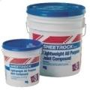




Differentiate Through Innovation
1900
1920
1940
1960
1980
2000
2010
Sheetrock®
Sheetrock Gypsum Panels
Pyrobar Gypsum Partition Tile
Acoustone®
Rocklath®
Gyplap® Gypsum Sheathing
Rocklath Gypsum Lath
Acoustone Ceiling Tiles
Perf-A-Tape® Joint Reinforcement
Pyrofill®
Firecode®
Structo-Gauge® Gauging Plaster
Pyrofill® Poured Gypsum Roof Deck
Water Repellent Wallboard
Structo-Lite Perlited Plaster
Sheetrock Firecode Core (Type X)
Tapered Edge Panels
Ready-Mixed Joint Compound
2" Solid Gypsum Wall Board System
Ultrawall®
Structocore
Structocore™ Wall System
First Metal Stud Drywall System
RC-1 Channel
Sheetrock WR Gypsum Panels
Chemically Hardening Joint Compound
SW Gypsum Panels
Blendtex Gypsum Panels
Exterior Ceiling Board
Ultrawall Relocatable Wall System
USG Shaft Wall System
Textone SW Gypsum Panels
Area Separation Wall System
Light Steel Framing
Durock®
Fiberock®
Structocore Security System
Durock Cement Board
Sheetrock Plus 3™ Joint Compound
X-Technology Ceiling Panels
Firecode® Compound
3/4" Ultracode® Core Gypsum Panels
Compässo™ Suspension Trim
Quick Release II Clip
Cuvatura™3-D System
Radar™ ClimaPlus™ Ceiling Panels
Fiberock Panels
USG Drywall Suspension System
Humitek®
Levelrock®
Next Generation Gypsum Panels
Levelrock Floor Underlayment System
USG™ Decorative Interior Finish System
Geometrix™ Metal Ceiling Panels
Astro™ ClimaPlus™ Ceiling Panels
Translucents™ Luminous Panels
Topo™ 3-D Ceiling Panels
Humitek Gypsum Panels
Securock® Roof Board
Sheetrock® All Purpose Joint Compound with Dust Control
Sheetrock® Mold-Tough panels
Zero-emitting ceiling tiles
High Recycled Content Suspension Systems
True Wood Ceiling Panels
Securock® Glass-Mat Sheathing
Securock® Glass-Mat Liner Panels
Sheetrock® Brand UltraLight Panels
Securock® Glass-Mat Roof Board
Durock® Cement Board Next-Gen
SHEETROCK® Brand UltraLightWeight All Purpose Joint Compound
  Sept 2013, USG ranked 9th in innovation out of 112 companies in the Industrial Materials Industry by the Patent Board
2000 – 2012
1,100+ US Patents

