Slide 1
CA Cloud Service Management
User Interface and Experience Examples
June 16, 2014

Slide 2
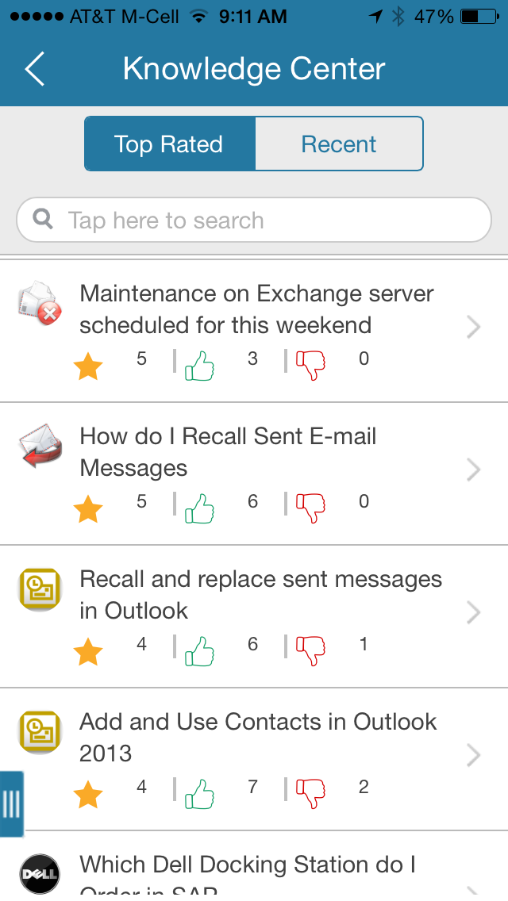
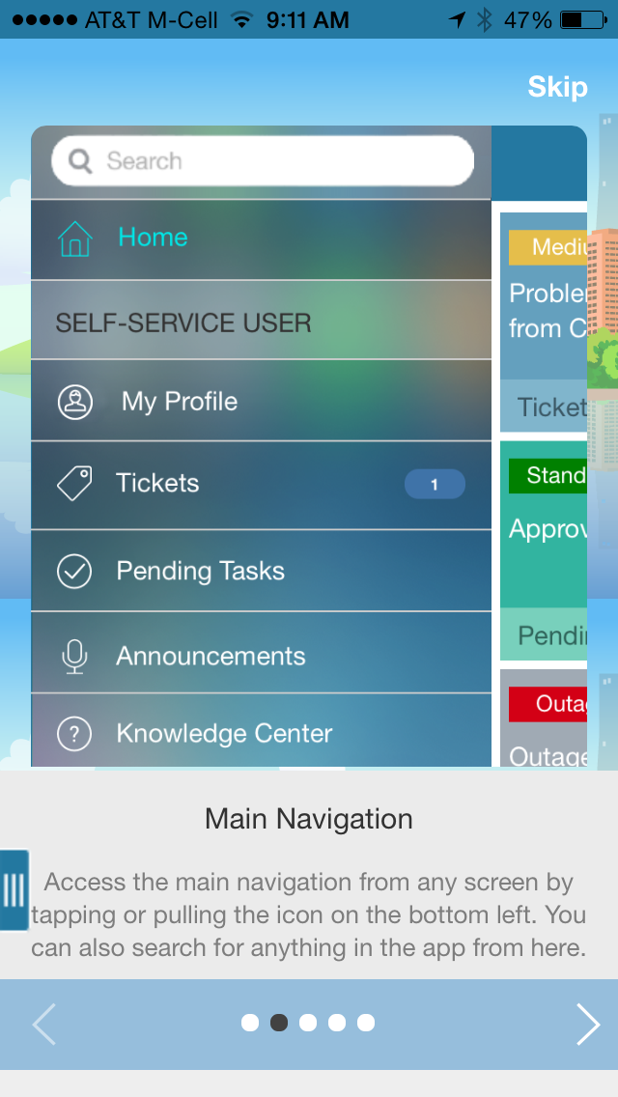
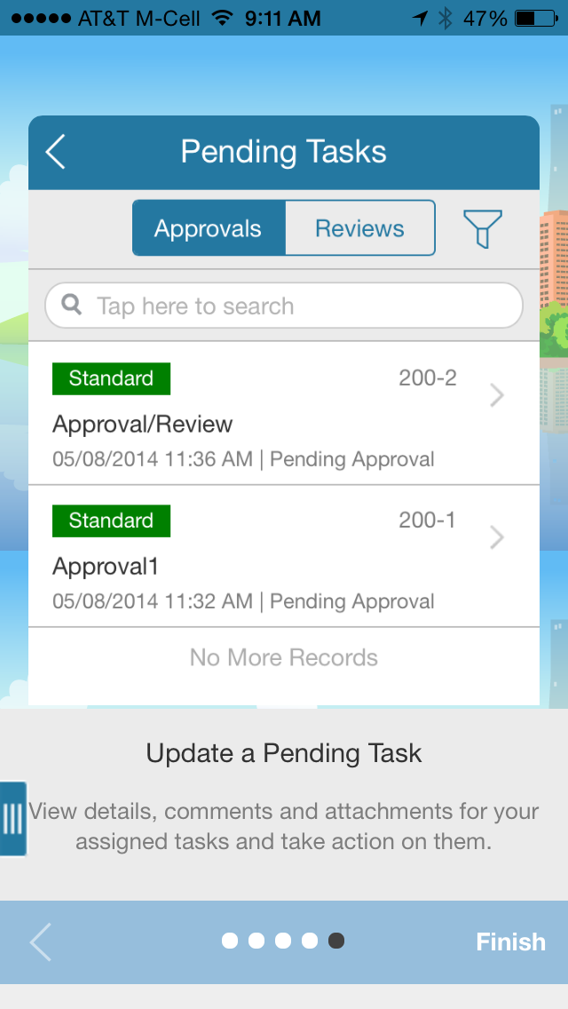
CA Cloud Service Management: Mobility for end-users and administrators. Anytime, anywhere service support.
Notes:
Mobility for end-users and administrators. Anytime, anywhere service support.
.

Slide 3
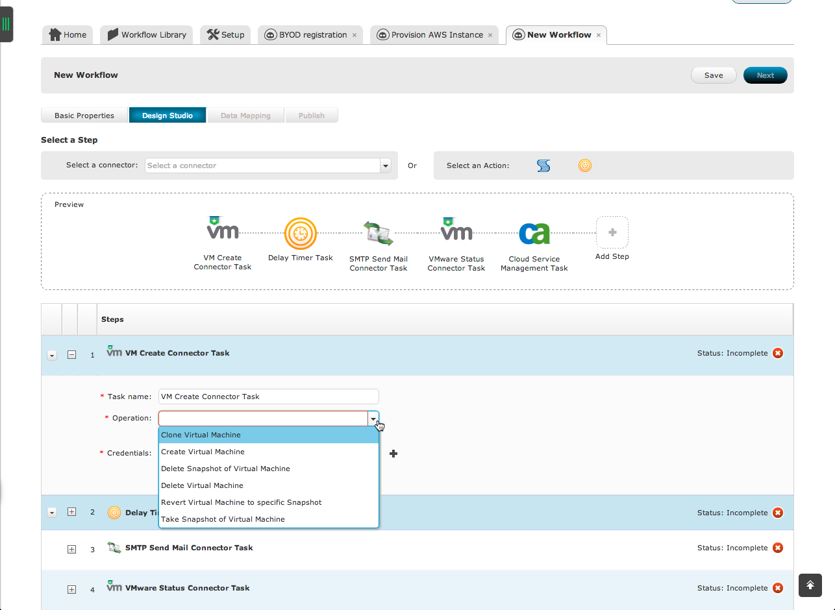
CA Cloud Service Management: Flexible and configurable. Simplified workflow and integrations.
Notes:
Flexible and configurable. Simplified workflow and integrations. We’ve made the solution more powerful with hybrid automations that allow you to drag and drop to create workflows that communicate with your other installed or cloud-based tools. It’s not that pretend drag and drop workflow that you may have seen in the marketplace that has a programmer furiously typing away behind the curtain either. This is a truly codeless solution that allows you to do things like create services with automations that integrate to Amazon to provision cloud environments at the push of a button.

Slide 4
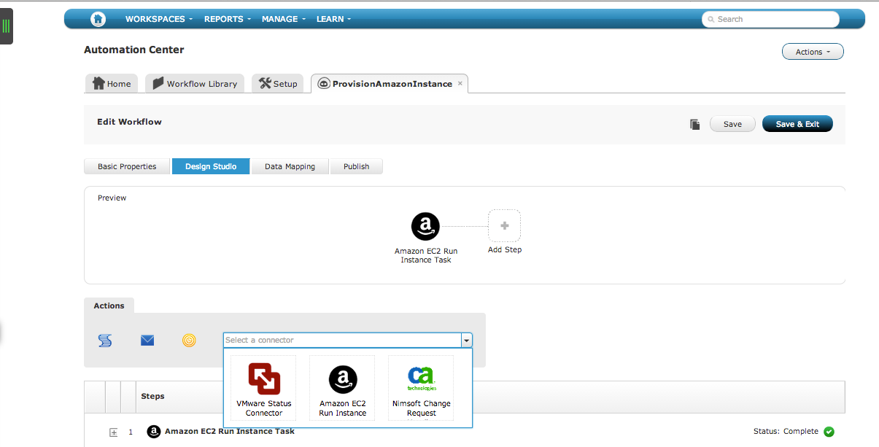
CA Cloud Service Management: Flexible and configurable. Simplified workflow and integrations.
Notes:
Flexible and configurable. Simplified workflow and integrations. We’ve made the solution more powerful with hybrid automations that allow you to drag and drop to create workflows that communicate with your other installed or cloud-based tools. It’s not that pretend drag and drop workflow that you may have seen in the marketplace that has a programmer furiously typing away behind the curtain either. This is a truly codeless solution that allows you to do things like create services with automations that integrate to Amazon to provision cloud environments at the push of a button.

Slide 5
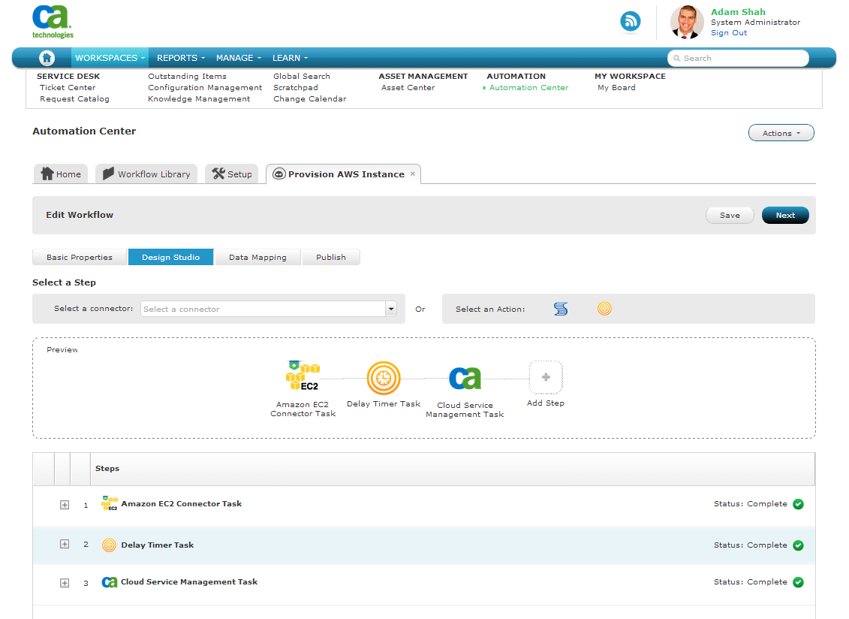
CA Cloud Service Management: Flexible and configurable. Simplified workflow and integrations.
Notes:
Flexible and configurable. Simplified workflow and integrations. We’ve made the solution more powerful with hybrid automations that allow you to drag and drop to create workflows that communicate with your other installed or cloud-based tools. It’s not that pretend drag and drop workflow that you may have seen in the marketplace that has a programmer furiously typing away behind the curtain either. This is a truly codeless solution that allows you to do things like create services with automations that integrate to Amazon to provision cloud environments at the push of a button.

Slide 6
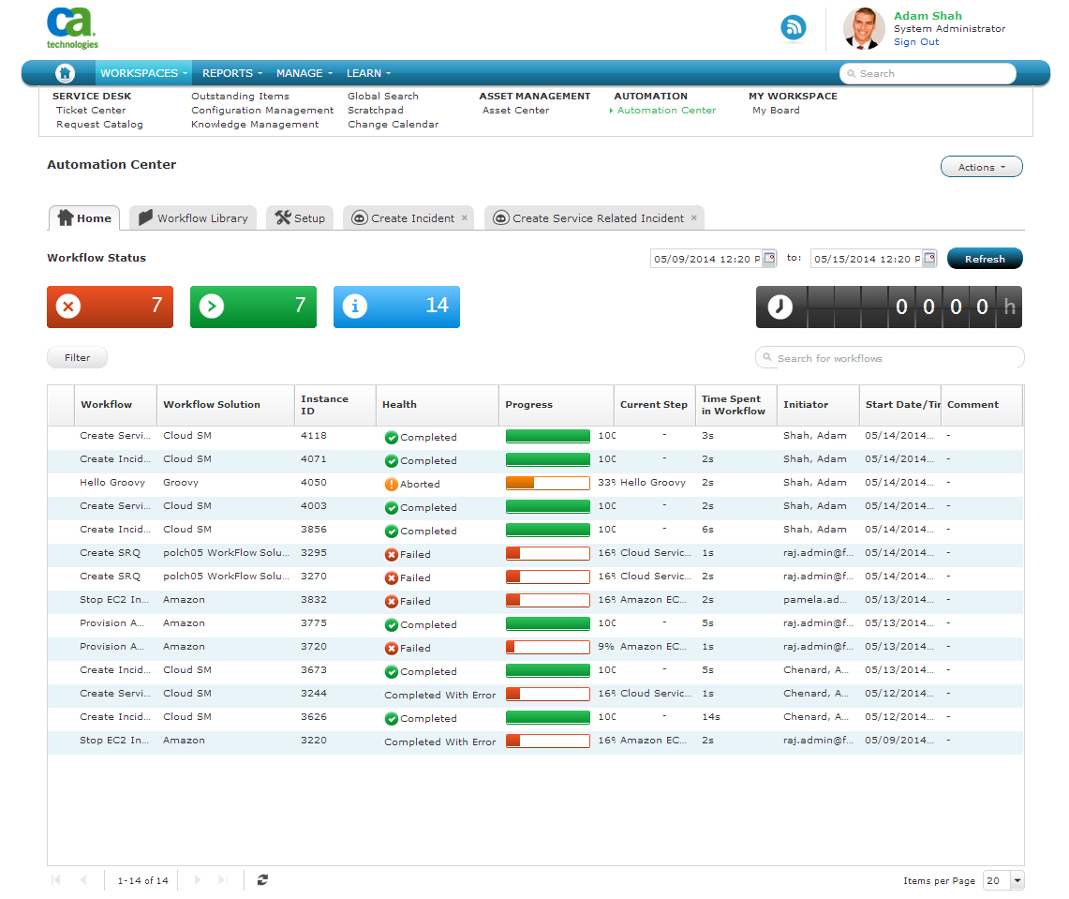
CA Cloud Service Management: Powerful automation. Automated provisioning of resources in minutes.
Notes:
Powerful automation. Automated provisioning of resources in minutes. This is another view of automations in flight or recently completed so you know not just what’s happening, but the performance you’re getting as well. You’re always in control.

Slide 7
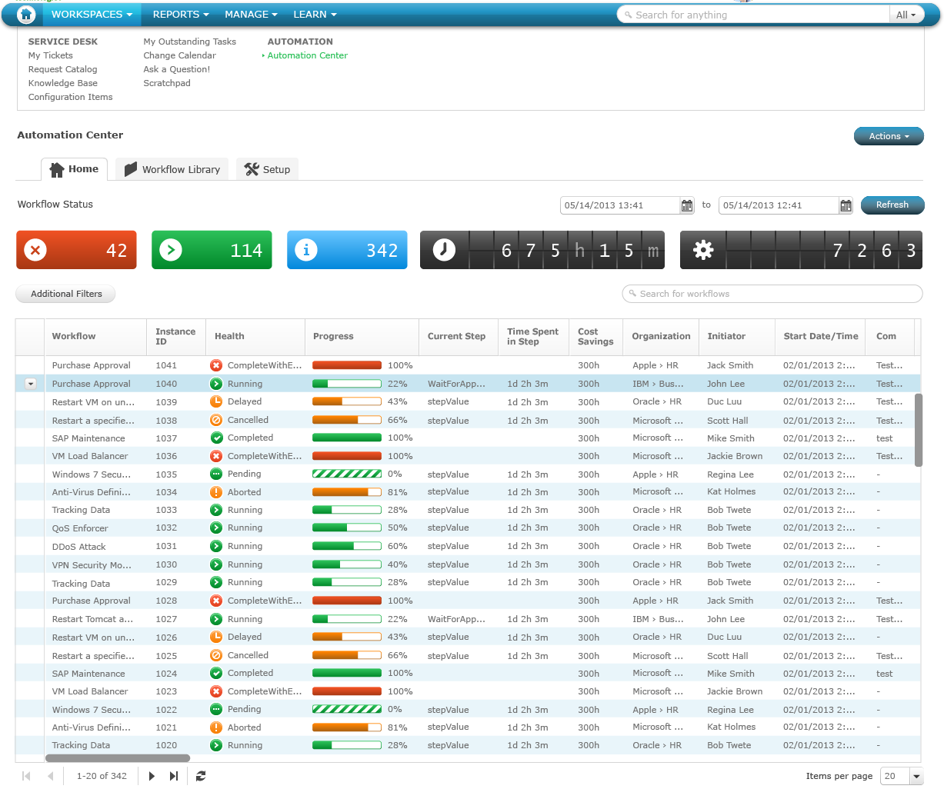
CA Cloud Service Management: Powerful automation. Automated provisioning of resources in minutes.
Notes:
Powerful automation. Automated provisioning of resources in minutes. This is another view of automations in flight or recently completed so you know not just what’s happening, but the performance you’re getting as well. You’re always in control.

Slide 8
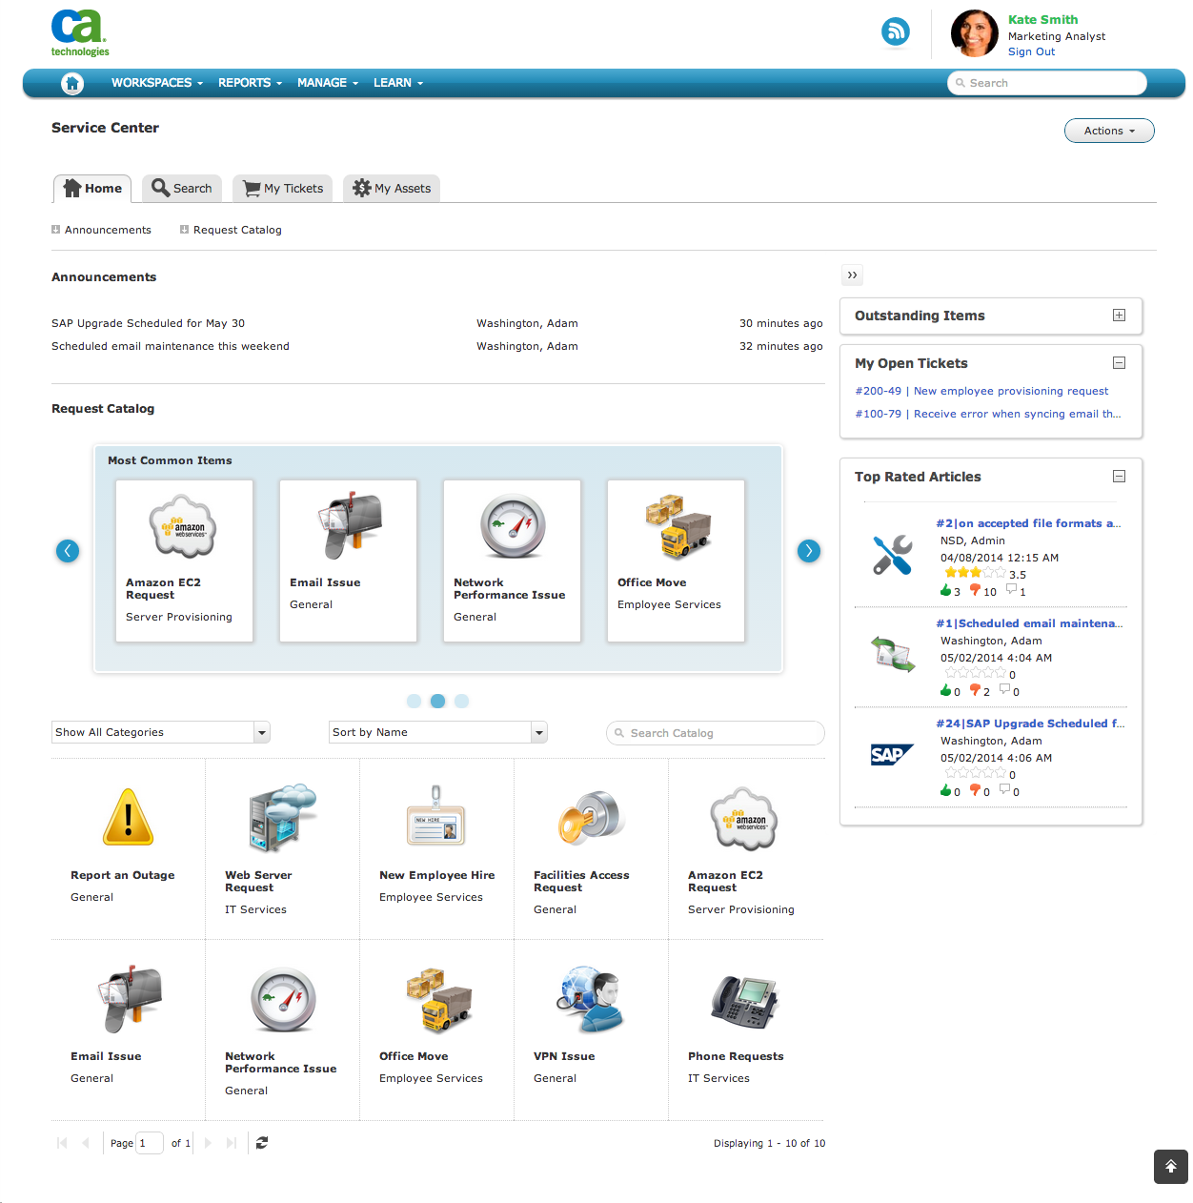
CA Cloud Service Management: Modern and Intuitive. Single point of contact for help, collaboration, and requests.
Notes:
Modern and Intuitive. Single point of contact for help, collaboration, and requests. With the Spring release we are making it easier than ever for users to consume services, wherever they are. Think about it, depending on what time of day it is, you may be working at your desk, from a car or in your living room. Shouldn’t your service management solution do the same? CA Cloud Service Management offers a centralized hub for everything you need, support, new services, information and collaboration with peers or IT. And it’s available as a native mobile app that’s not just easy to use, it’s something you want to use.

Slide 9
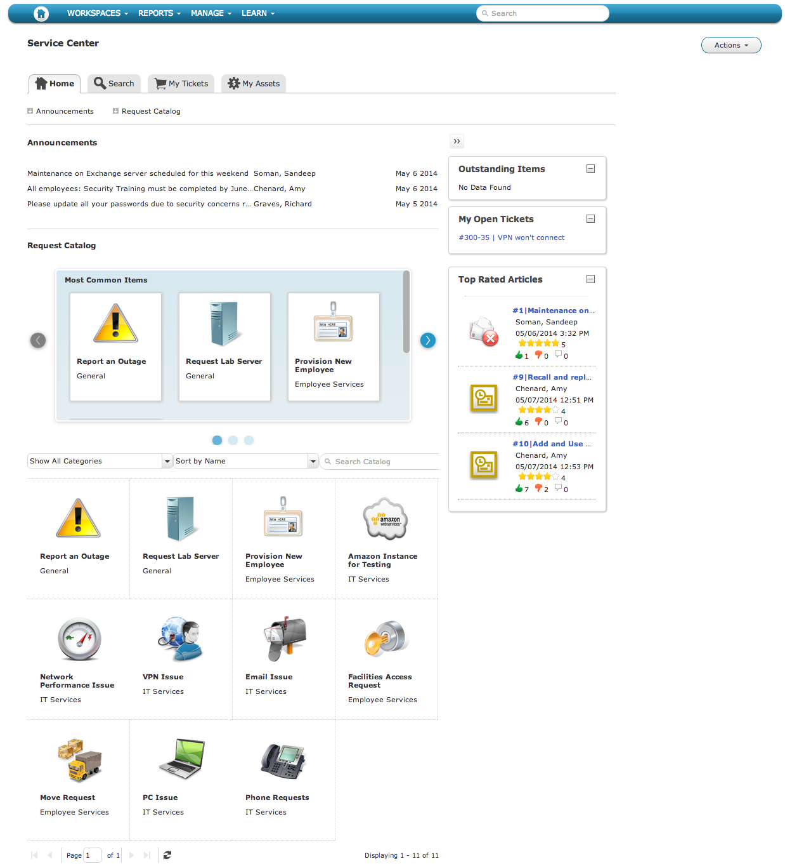
CA Cloud Service Management: Modern and Intuitive. Single point of contact for help, collaboration, and requests.
Notes:
Modern and Intuitive. Single point of contact for help, collaboration, and requests. With the Spring release we are making it easier than ever for users to consume services, wherever they are. Think about it, depending on what time of day it is, you may be working at your desk, from a car or in your living room. Shouldn’t your service management solution do the same? CA Cloud Service Management offers a centralized hub for everything you need, support, new services, information and collaboration with peers or IT. And it’s available as a native mobile app that’s not just easy to use, it’s something you want to use.

Slide 10
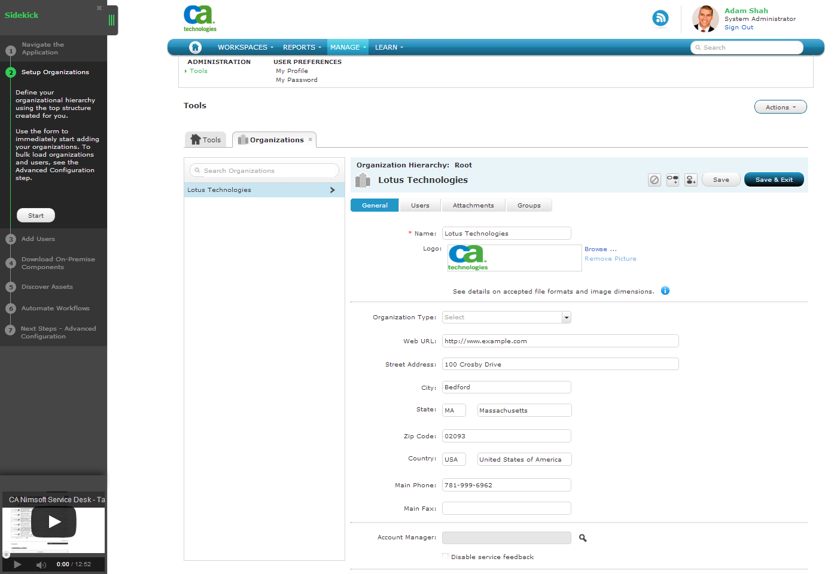
CA Cloud Service Management: In-app guidance. Drive usage and adoption.
Notes:
In-app guidance. Drive usage and adoption. One of the coolest things about the release is Sidekick, which is an in-app guidance system that helps you get started on the crucial initial set up tasks with step by step instructions on setup and configuration, including in-context videos to ensure you’re in production and getting return on your investment quickly.

Slide 11
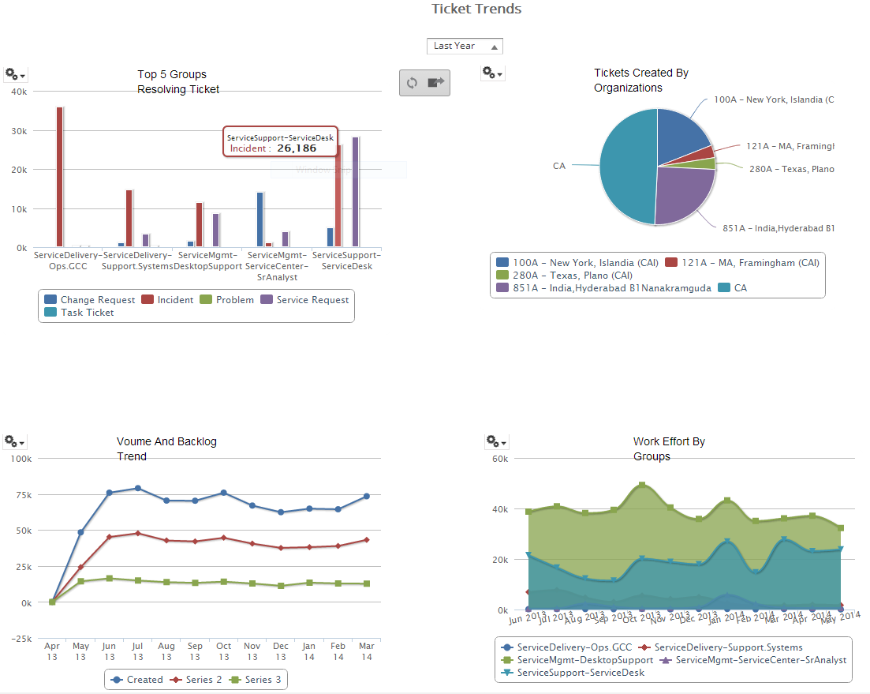
CA Cloud Service Management: Simpler reporting. Analyze and improve resource productivity
Note: Simulated data for purposes of illustration only
Notes:
Simpler reporting. Analyze and improve resource productivity. We haven’t left out the decision makers with this release. Brand new advanced reporting within CA Cloud Service Management makes it easier than ever for even non-technical people to engage with the data they need to make critical decisions. Drag and drop fields, charts, graphs and tailored dashboards make it a truly powerful, yet personal tool.

Slide 12
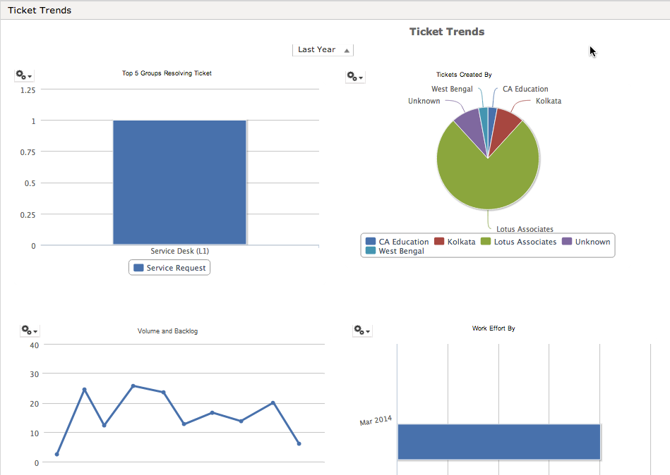
CA Cloud Service Management: Simpler reporting. Analyze and improve resource productivity
Note: Simulated data for purposes of illustration only
Notes:
Simpler reporting. Analyze and improve resource productivity. We haven’t left out the decision makers with this release. Brand new advanced reporting within CA Cloud Service Management makes it easier than ever for even non-technical people to engage with the data they need to make critical decisions. Drag and drop fields, charts, graphs and tailored dashboards make it a truly powerful, yet personal tool.

