Slide 1
Top 5
eHealth Trends

Slide 2
Five trends prove that digital is dramatically
influencing the industry, today, and well
into tomorrow.
Copyright © 2015 Accenture All rights reserved.

Slide 3
1.The Internet of Me:
Your healthcare, personalized
Welcome to the era of personalized healthcare defined by meaningful and convenient individual health experiences.
Copyright © 2015 Accenture All rights reserved.

Slide 4
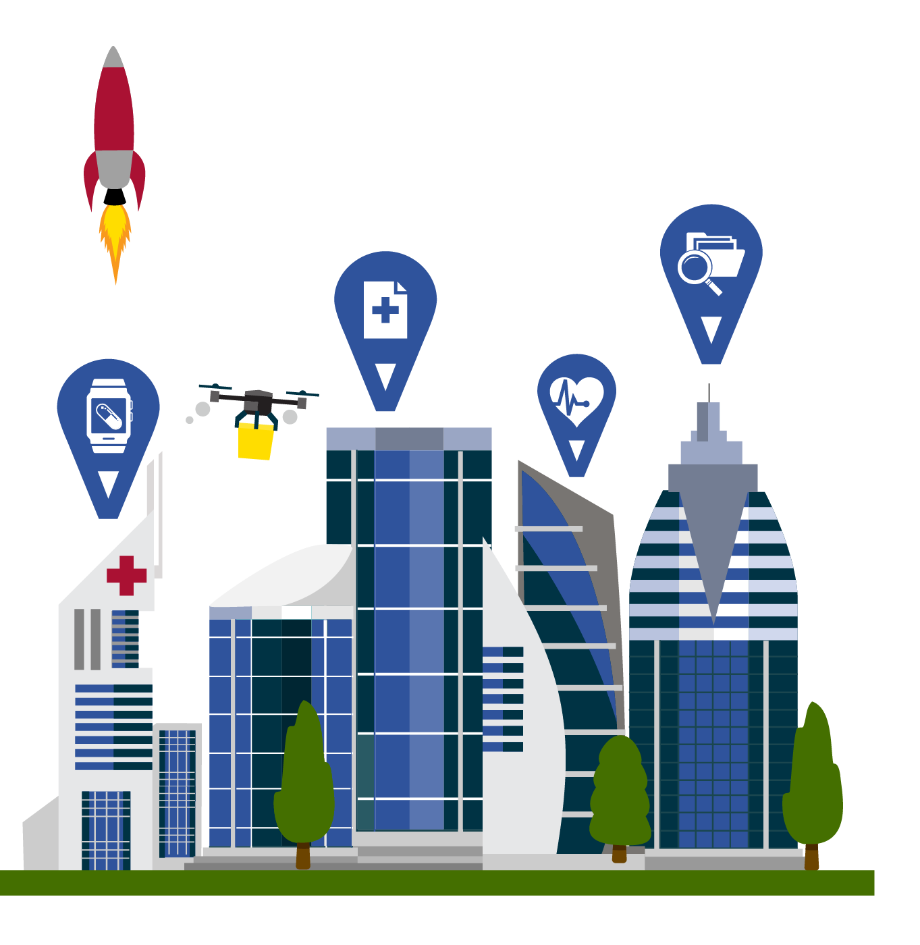
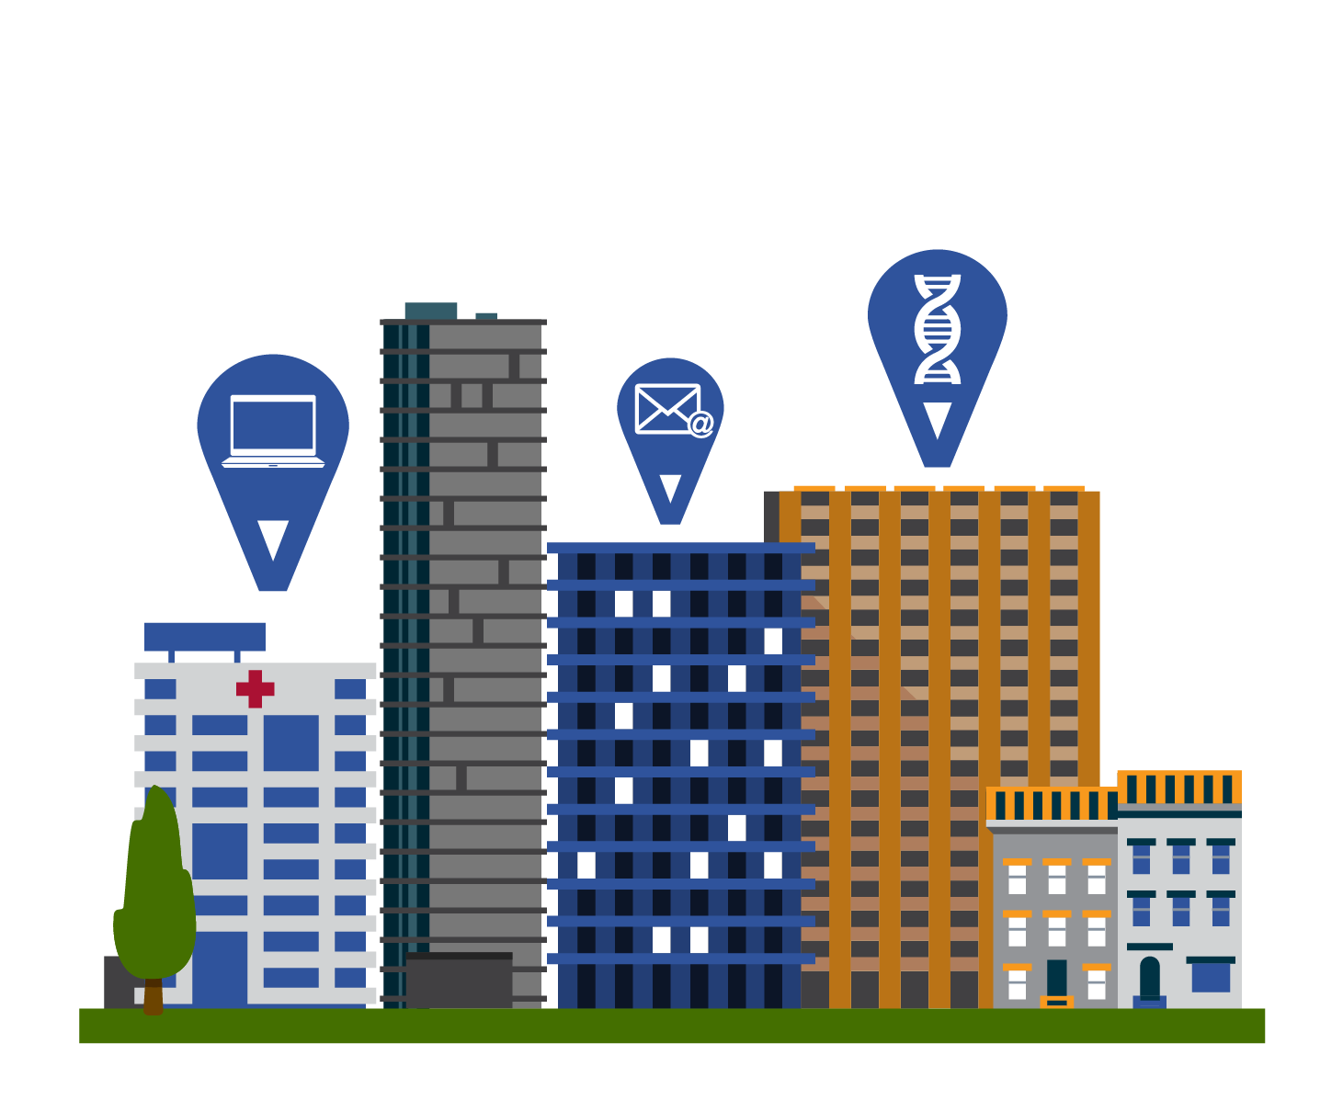
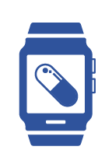
Today
Tomorrow
Personalized Plan
Screening
Patients
Simple Bill
Health
Insurance
Text
Alert
Email
Smartwatch
People are shopping for health insurance online
Doctors are emailing patients
Clinics are screening patients to see how they react to certain medications based on their DNA
Request meds from your smartwatch
Receive one simple bill for care
Get a real-time text alert that your blood pressure is too high
Access personalized plan options from your insurer
Copyright © 2015 Accenture All rights reserved.

Slide 5
49%
73%
of patients globally wear or would be willing to wear technology that measures and tracks both fitness/lifestyle and vital signs.
of health executives
surveyed see positive ROI from
personalization technologies.
A higher healthcare IQ
Predictive health analytics tool PhysIQ creates a personalized baseline for an
individual’s health by collecting data from wearable devices or sensors.
PhysIQ can be paired with most any device to constantly weigh an
individual’s readings against their norms, detect anomalies and
then alert healthcare providers, if necessary.
Copyright © 2015 Accenture All rights reserved.

Slide 6
2.Outcome Economy:
Hardware producing
healthy results
New intelligence is bridging the digital enterprise and the physical world. It’s about more than technology; it’s about delivering results.
Copyright © 2015 Accenture All rights reserved.

Slide 7
Today
Tomorrow
Tracking
Wait Time
Notifications
Pre-appointments
Remote
Monitoring
Directions
App
Wearables
High-tech operating rooms allow tracking of patient, staff and tools so everything is at the right place at the right time
Wearables provide customized feedback on your health
Remote monitoring tools (blood pressure cuffs, glucometers) keep people safe and healthy in their homes
Bypass the lengthy check-in process by receiving a wearable band pre-appointment
Use an app for turn-by-turn directions through a hospital facility
Be notified of your caregiver and the wait time before a clinician even steps into the room
Copyright © 2015 Accenture All rights reserved.

Slide 8
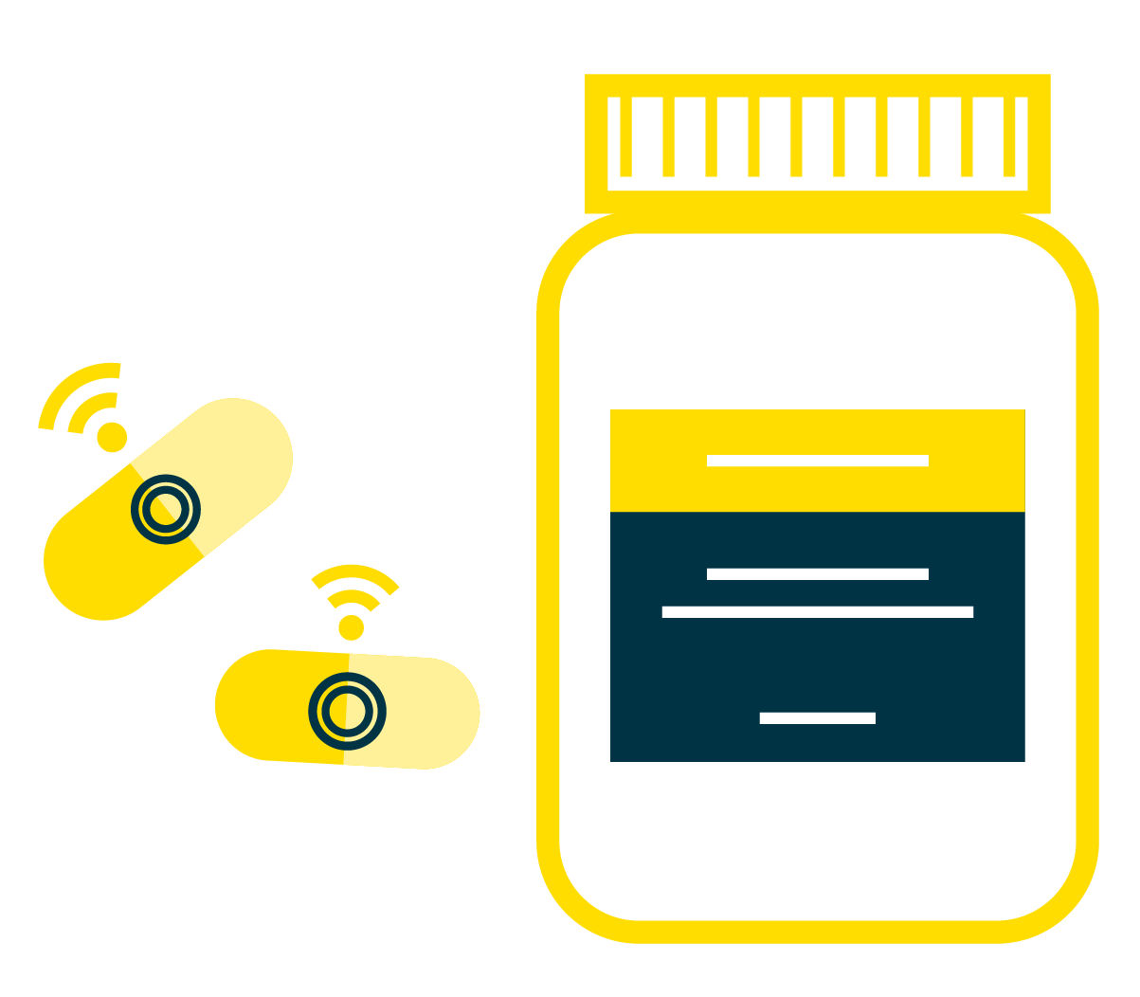
85%
76%
of doctors say their
patients’ use of wearable health
devices helps patient engagement
with their own health.
patients say the use of technology to manage their health has the potential to improve their health.
Smarter medicine
Proteus Digital Health integrates a tiny sensor in the pills it produces. The sensor
works with a wearable device and mobile app to provide full “adherence
transparency” for patients, healthcare providers and payers. The outcomes?
Greater adherence, more effective treatments and cost savings.
Copyright © 2015 Accenture All rights reserved.

Slide 9
3. The Platform
(R)evolution: Defining
ecosystems, redefining healthcare
Healthcare IT platforms capture data from disparate sources (e.g., wearables, phones, glucometers), and connect it to provide patients and caregivers a holistic and real-time view of your health.
Copyright © 2015 Accenture All rights reserved.

Slide 10
Today
Tomorrow
Platforms
Immediate Results
Healthcare
IT Innovations
Identify
Asthma Triggers
Smarter
Platforms
More platforms are starting to appear— Welltok, TicTrac, Social Wellth
Healthcare IT innovations are allowing providers to deliver a variety of services faster, and for less
Smarter platforms will influence daily choices that impact your health
Platforms will help identify asthma triggers
A device connected to your mobile phone can do a finger prick test for immediate results
Copyright © 2015 Accenture All rights reserved.

Slide 11
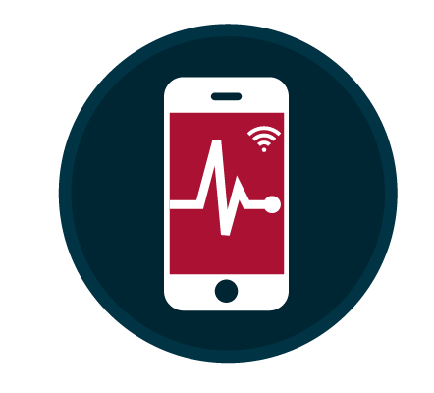
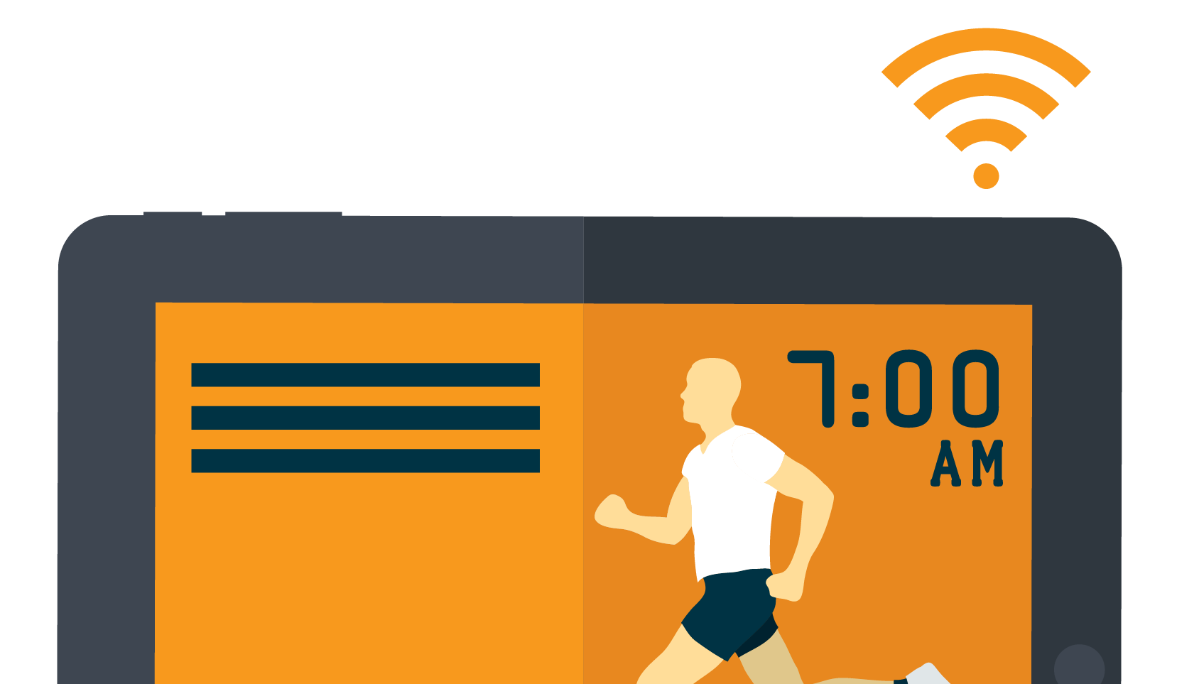
41%
Health monitoring:
of health executives
strongly agree that the next generation
of platforms will be led by industry
players and leaders, not tech leaders.
the #1 reason why 54% of patients
use mobile phone apps.
Connected care
Kaiser Permanente invested $4 billion (roughly $444 per member) in building its HealthConnect platform. The platform provides its clinicians and 9 million members real-time access to medical records, stretching the company beyond traditional boundaries by engaging with members through mobile apps, self-management services, in-home monitoring and virtual consultations.
Copyright © 2015 Accenture All rights reserved.

Slide 12
4. Intelligent Enterprise:
Huge data, smarter systems,
better healthcare
A data explosion, accompanied by advances in processing power, health analytics and cognitive technology, is fueling software intelligence. Medical devices and wearables can now recognize, “think” and respond accordingly.
Copyright © 2015 Accenture All rights reserved.

Slide 13
Today
Tomorrow
Cancer Software
Personalized
EMR
More
Time
Health
Analytics
Intelligent
Systems
Machine
Diagnosis
Software is helping oncologists determine the right therapy for cancer patients
Intelligent systems at hospitals securely connect data from multiple systems and devices
Nurses are able to spend more time with patients
Take a picture of your rash and health analytics will help triage the issue
Get diagnosed by a machine that detects you are running a fever
Access your electronic medical record to enable more personalized protocols
Copyright © 2015 Accenture All rights reserved.

Slide 14
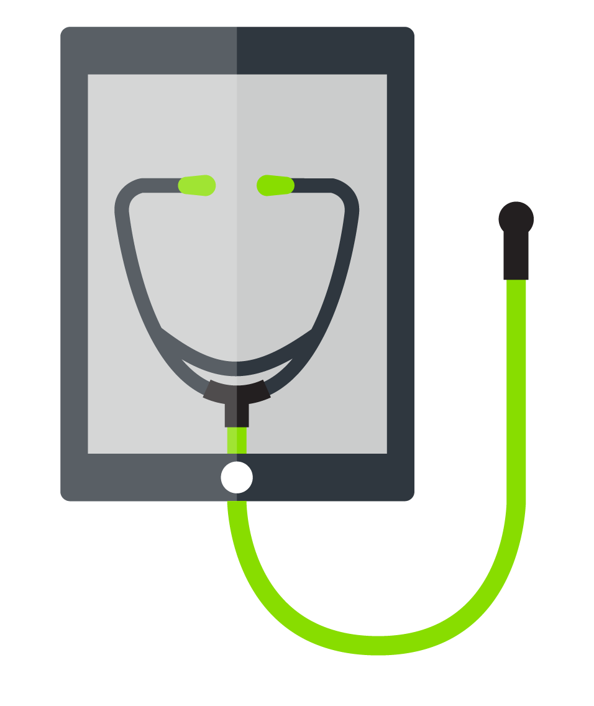
41%
52%
of health executives
say their organization’s data volume has grown more than 50% in one year.
of patients want
access to EMR data related to
physician notes.
Dr. Roboto
IBM has put $1 billion toward its Watson Group early in 2014. After defeating two “Jeopardy!” game show champions in 2011, Watson is now taking on vertical industry challenges, with an emphasis on healthcare. Watson is helping doctors deliver better, more personalized care in situations that may not be well defined or clear.
Copyright © 2015 Accenture All rights reserved.

Slide 15
5.Workforce Reimagined:
Collaboration at the intersection
of humans and healthcare
As the digital revolution gains momentum, doctors and healthcare workers are now using machines to be more efficient, provide better care and take on increasingly more complex tasks.
Copyright © 2015 Accenture All rights reserved.

Slide 16
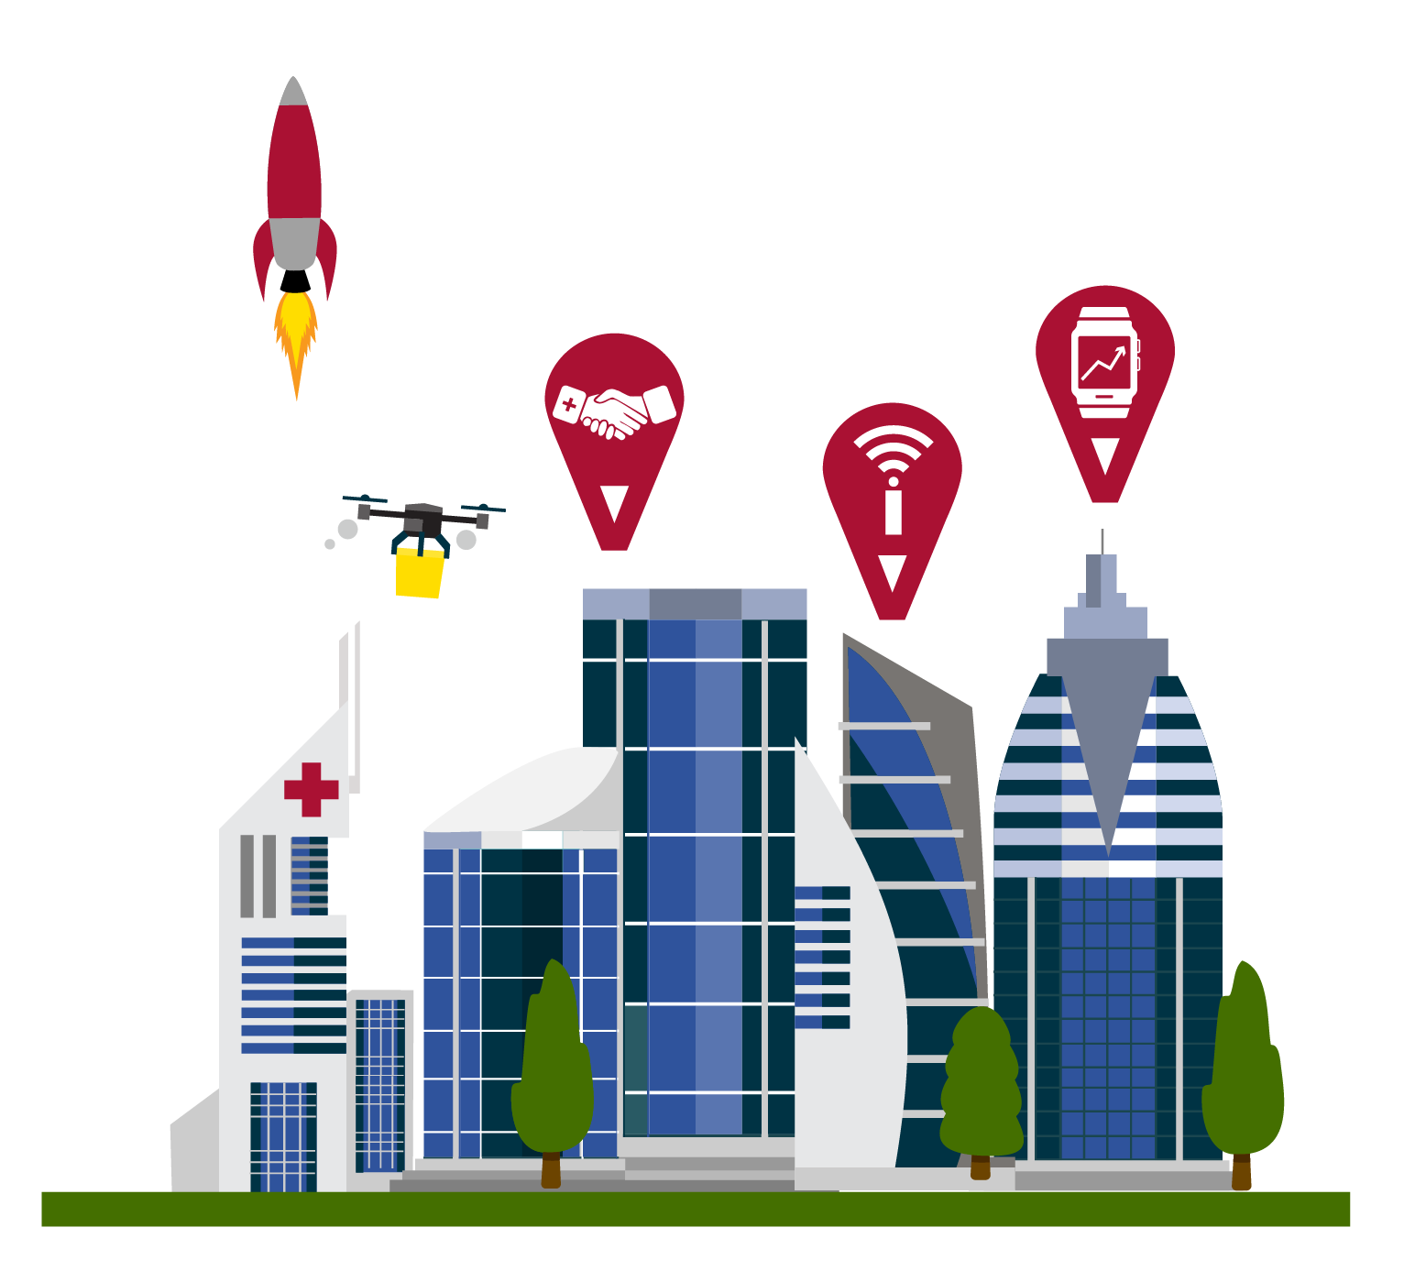
Today
Tomorrow
Phone Apps
Real-Time
Data
Caregiving
Team
Alzheimer's
Diagnostic Test
Implantable
Devices
Social
Media
Phone apps are helping doctors and patients calculate the risk of heart surgery
Mental health patients in the UK are using social media to anonymously interact
A software-based Alzheimer's diagnostic test can detect impairments on the hippocampus (the first area of the brain to be affected by the disease) by evaluating your eye movement
Develop your own caregiving team when you use social media or connect with peers facing similar conditions
Ingestible or implantable devices collect newfound levels of data that can better inform a doctor’s care plan
Surgeons using wearable devices have real-time access to data from monitoring equipment, so they can make more informed decisions about the patient during a procedure
Copyright © 2015 Accenture All rights reserved.

Slide 17
66%
84%
of US health systems
will offer digital self-scheduling
by the end of 2019.
of health executives agree or strongly agree that within 3 years, companies will need to focus as much on training machines as on training people.
Digital Doctors
Accenture and Philips demonstrated how a doctor wearing Google Glass in an operating room could use the display to monitor a patient’s vital signs while performing surgical procedures. Augmented devices provide doctors with additional degrees of freedom, portability and unprecedented contextual information. Taking this one step further, some hospitals are making plans to improve training by using cameras to stream and record live surgeries,
as seen through the eyes—and smart glasses—of a surgeon.
Copyright © 2015 Accenture All rights reserved.

Slide 18
For More Information:
Accenture Healthcare IT Vision 2015
Copyright © 2015 Accenture
All rights reserved.

