Slide 1
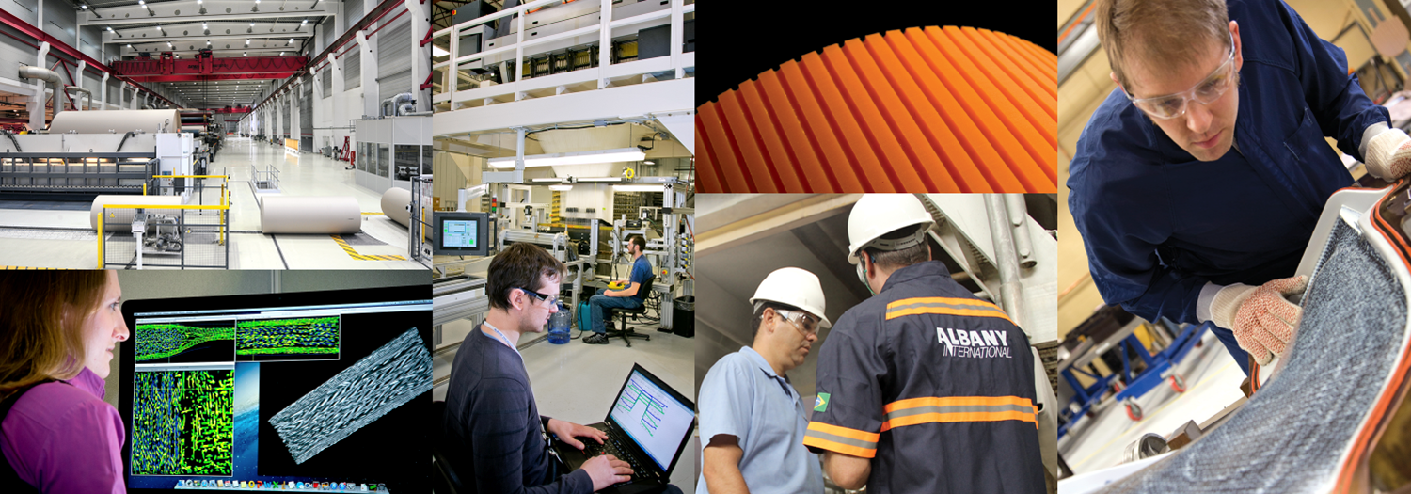
Q4 Financial Performance
February 5, 2018

Slide 2
‘Non-GAAP’ Items and Forward-Looking Statements
This presentation contains the following non-GAAP measures:
Percentage changes in net sales, excluding currency rate effects (for each segment, and the Company as a whole);
Adjusted EBITDA (for each segment, and the Company as a whole; absolute and as a percentage of sales);
Net debt; and
Net income per share attributable to the Company, excluding adjustments.
We think such items provide useful information to investors regarding the Company’s core operational performance. See the Company’s earnings release (which accompanies this presentation) for additional information including reconciliations to GAAP measures.
This presentation also may contain statements, estimates, or projections that constitute “forward-looking statements” as defined under U.S. federal securities laws. Forward-looking statements are subject to certain risks and uncertainties that could cause actual results to differ materially from the Company’s historical experience and our present expectations or projections. We disclaim any obligation to update any information in this presentation to reflect any changes or developments after the date on the cover page.
Certain additional disclosures regarding our use of these ‘non-GAAP’ items and forward-looking statements are set forth in our fourth-quarter earnings press release dated February 5, 2018, and in our SEC filings, including our most recent quarterly reports and our annual reports for the years ended December 31, 2014, 2015, and 2016. Our use of such items in this presentation is subject to those additional disclosures, which we urge you to read.
2

Slide 3
Net Sales by Segment
(in thousands, except percentages) | Net Sales Three Months ended December 31, 2017 2016 |  | Percent Change | Impact of Changes in Currency Translation Rates | Percent Change excluding Currency Rate Effect
Machine Clothing (MC) | $150,263 | $144,744 | 3.8% | $4,382 | 0.8%
Albany Engineered Composites (AEC) | 76,465 | 68,302 | 12.0% | 937 | 10.6%
Total | $226,728 | $213,046 | 6.4% | $5,319 | 3.9%
(in thousands, except percentages) | Net Sales Years ended December 31, 2017 2016 |  | Percent Change | Impact of Changes in Currency Translation Rates | Percent Change excluding Currency Rate Effect
Machine Clothing (MC) | $590,357 | $582,190 | 1.4% | $3,071 | 0.9%
Albany Engineered Composites (AEC) | 273,360 | 197,649 | 38.3% | 674 | 38.0%
Total | $863,717 | $779,839 | 10.8% | $3,745 | 10.3%
3

Slide 4
Gross Profit Margin by Quarter Percentage of Net Sales
Includes 7.3% impact from profitability revision in two AEC contracts
4

Slide 5
Net Income (GAAP) and Adjusted EBITDA (non-GAAP) by Segment
 | Three Months ended December 31, 2017
(in thousands) | Machine Clothing | Albany Engineered Composites | Corporate expenses and other | Total Company
Operating income/(loss) (GAAP) | $34,584 | $585 | $(12,605) | $22,564
Interest, taxes, other income/expense | - | - | (17,406) | (17,406)
Net income (GAAP) | 34,584 | 585 | (30,011) | 5,158
Interest expense, net | - | - | 4,049 | 4,049
Income tax expense | - | - | 9,985 | 9,985
Depreciation and amortization | 8,429 | 8,920 | 1,351 | 18,700
EBITDA (non-GAAP) | 43,013 | 9,505 | (14,626) | 37,892
Restructuring expenses, net | 2,417 | 854 | - | 3,271
Foreign currency revaluation losses/(gains) | (524) | 44 | 2,325 | 1,845
Adjustment to write-off of inventory in a discontinued product line | - | (355) | - | (355)
Pretax loss/(income) attributable to non-controlling interest in ASC | - | 746 | - | 746
Adjusted EBITDA (non-GAAP) | $44,906 | $10,794 | $(12,301) | $43,399
Three Months ended December 31, 2016
Machine Clothing | Albany Engineered Composites | Corporate expenses and other | Total Company
$39,946 | $(1,280) | $(11,836) | $26,830
- | - | (10,844) | (10,844)
39,946 | (1,280) | (22,680) | 15,986
- | - | 3,854 | 3,854
- | - | 4,841 | 4,841
8,583 | 6,433 | 1,221 | 16,237
48,529 | 5,153 | (12,764) | 40,918
150 | 526 | 47 | 723
(2,050) | 11 | (1,170) | (3,209)
- | - | - | -
- | (160) | - | (160)
$46,629 | $5,530 | ($13,887) | $38,272
5

Slide 6
Net Income (GAAP) and Adjusted EBITDA (non-GAAP) by Segment
 | Year ended December 31, 2017
(in thousands) | Machine Clothing | Albany Engineered Composites* | Corporate expenses and other | Total Company
Operating income/(loss) (GAAP) | $153,936 | $(31,657) | $(46,128) | $76,151
Interest, taxes, other income/expense | - | - | (43,566) | (43,566)
Net income (GAAP) | 153,936 | (31,657) | (89,694) | 32,585
Interest expense, net | - | - | 17,091 | 17,091
Income tax expense | - | - | 22,123 | 22,123
Depreciation and amortization | 33,527 | 33,533 | 4,896 | 71,956
EBITDA (non-GAAP) | 187,463 | 1,876 | (45,584) | 143,755
Restructuring expenses, net | 3,429 | 10,062 | - | 13,491
Foreign currency revaluation (gains)/losses | 3,903 | 214 | 4,644 | 8,761
Write-off of inventory in discontinued product line in 2017 / Acquisition expenses in 2016 | - | 2,800 | - | 2,800
Pretax loss/(income) attributable to non-controlling interest in ASC | - | 567 | - | 567
Adjusted EBITDA (non-GAAP) | $194,795 | $15,519 | $(40,940) | $169,374
Year ended December 31, 2016
Machine Clothing | Albany Engineered Composites | Corporate expenses and other | Total Company
$152,529 | $(15,363) | $(45,390) | $91,776
- | - | (38,964) | (38,964)
152,529 | (15,363) | (84,354) | 52,812
- | - | 13,464 | 13,464
- | - | 25,454 | 25,454
36,428 | 24,211 | 6,822 | 67,461
188,957 | 8,848 | (38,614) | 159,191
6,069 | 2,314 | (7) | 8,376
(404) | 16 | (3,525) | (3,913)
- | 5,367 | - | 5,367
- | (125) | - | (125)
$194,622 | $16,420 | $(42,146) | $168,896
* Includes Q2 charge of $15.8 million for AEC contract revisions
6

Slide 7
Earnings Per Share
Per share amounts (Basic) | Three Months ended December 31, 2017 2016 |  | Years ended December 31, 2017 2016
Net income attributable to the Company, as reported (GAAP) | $0.18 | $0.49 | $1.03* | $1.64
Adjustments:
Restructuring expenses, net | 0.07 | 0.01 | 0.27 | 0.16
Discrete tax adjustments and effect of change in income tax rate | 0.16 | (0.08) | 0.14 | (0.07)
Foreign currency revaluation losses/(gains) | 0.04 | (0.06) | 0.18 | (0.07)
Write-off of inventory in a discontinued product line | (0.01) | - | 0.05 | -
Acquisition expenses | - | - | - | 0.11
Net income attributable to the Company, excluding adjustments (non-GAAP) | $0.44 | $0.36 | $1.67 | $1.77
* Includes Q2 charge of $0.31 for AEC contract revisions
7

Slide 8
Impact of U.S. Tax Reform
Fourth Quarter 2017:
Discrete, mostly non-cash, tax charge of $7 million related to:
Revaluation of net U.S. deferred tax assets to 21% - $1 million
Mandatory deemed repatriation liability - $6 million
Based on Company’s current estimates, to be refined as more information becomes available and more guidance is issued
2018 Estimates:
Global tax rate from continuing operations estimated to range from 27% to 31% (driven by income mix), a decrease from the 32% rate in 2017
Cash taxes, globally, estimated to range from $22 million to $24 million
Foreign cash repatriation program to continue, anticipate long-term benefit
8

Slide 9
Total Debt (GAAP) and Net Debt* (non-GAAP) $ thousands
*Total debt less cash see table 20 for reconciliation of total debt to net debt
9

