Slide 1
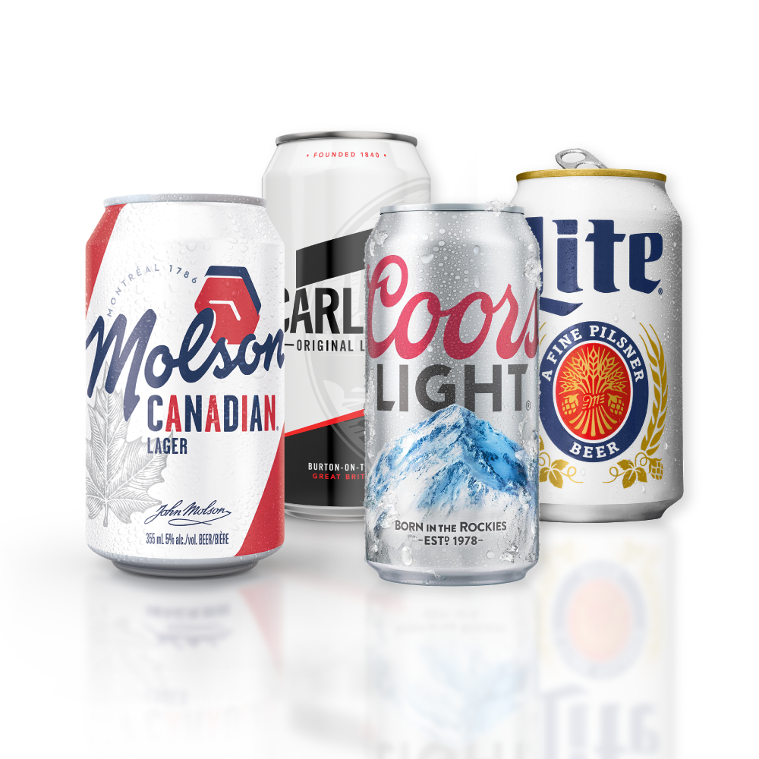
Q3’19 Results &
Revitalization Plan
October 30, 2019

Slide 2
Forward Looking Statements
This presentation includes “forward-looking statements” within the meaning of the U.S. federal securities laws. Generally, the words “believe,” “expect,” “intend,” “anticipate,” “project,” “will,” “outlook,” and similar expressions identify forward-looking statements, which generally are not historic in nature. Although the Company believes that the assumptions upon which its forward-looking statements are based are reasonable, it can give no assurance that these assumptions will prove to be correct. Important factors that could cause actual results to differ materially from the Company’s historical experience, and present projections and expectations are disclosed in the Company’s filings with the Securities and Exchange Commission (“SEC”). These factors include, among others, the impact of increased competition resulting from further consolidation of brewers, competitive pricing and product pressures; health of the beer industry and our brands in our markets; economic conditions in our markets; additional impairment charges; our ability to maintain manufacturer/distribution agreements; changes in our supply chain system; availability or increase in the cost of packaging materials; success of our joint ventures; risks relating to operations in developing and emerging markets; changes in legal and regulatory requirements, including the regulation of distribution systems; fluctuations in foreign currency exchange rates; increase in the cost of commodities used in the business; the impact of climate change and the availability and quality of water; loss or closure of a major brewery or other key facility; our ability to implement our strategic initiatives, including executing and realizing cost savings; our ability to successfully integrate newly acquired businesses; cost reduction strategies, including the 2019 revitalization plan and the estimated range of related restructuring charges and timing of cash charges; pension plan and other post-retirement benefit costs; failure to comply with debt covenants or deterioration in our credit rating; our ability to maintain good labor relations; our ability to maintain brand image, reputation and product quality; and other risks discussed in our filings with the SEC, including our most recent Annual Report on Form 10-K and our Quarterly Reports on Form 10-Q. All forward-looking statements in this presentation are expressly qualified by such cautionary statements and by reference to the underlying assumptions. You should not place undue reliance on forward-looking statements, which speak only as of the date they are made. We do not undertake to update forward-looking statements, whether as a result of new information, future events or otherwise.
Non-GAAP Information
Please see our most recent earnings release or visit the investor relations page of our website – www.molsoncoors.com – to find disclosure and applicable reconciliations of non-GAAP financial measures discussed in this presentation.
STABILIZE BELOW PREMIUM
2

Slide 3
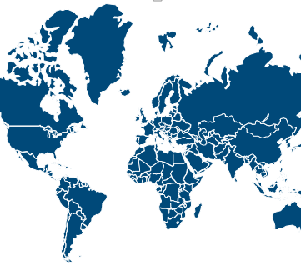
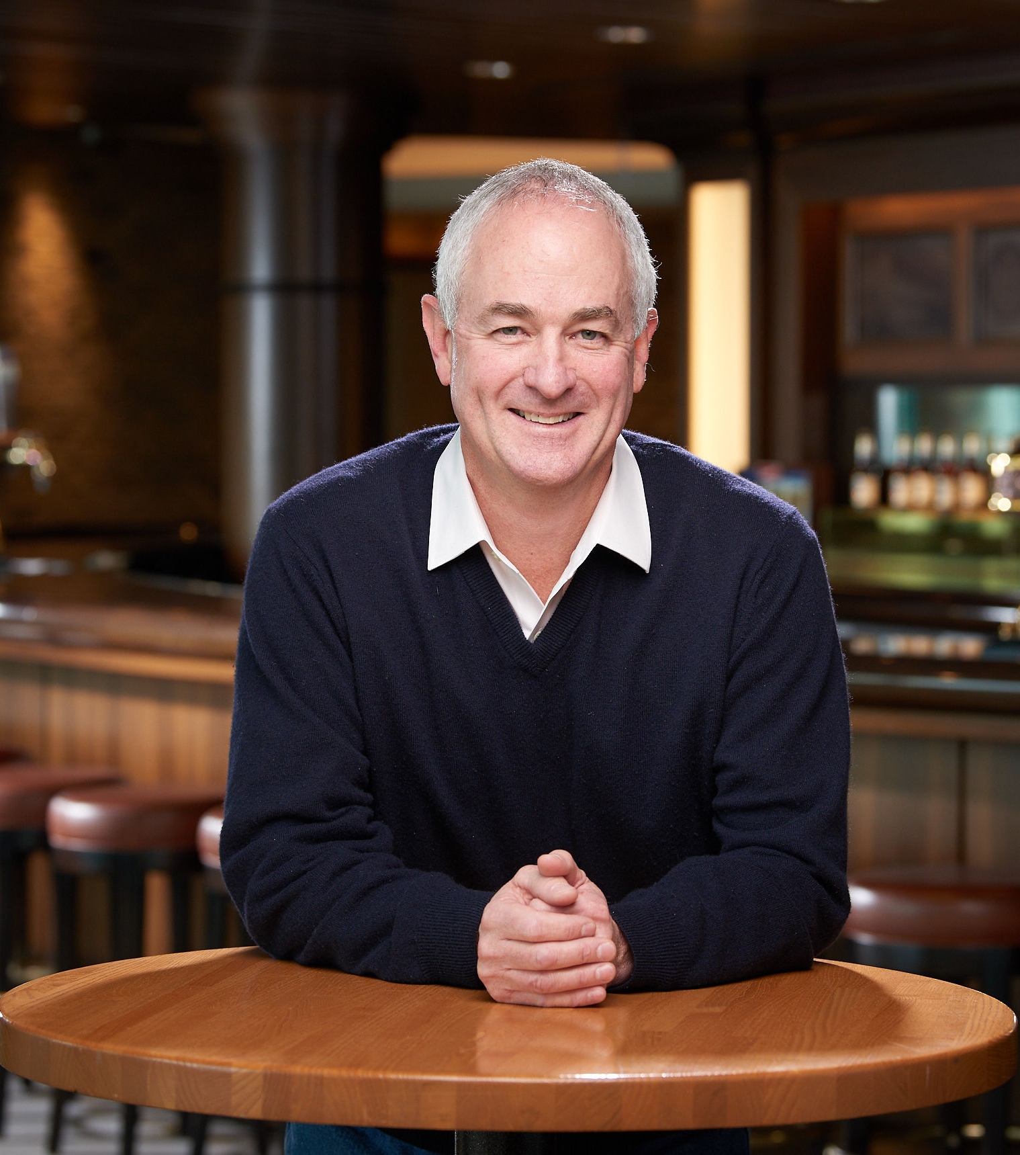




Reinvigorating Our Big Brands
Introduction
We are one of the world’s leading brewers with beers that have stood the test of time
In the face of changing consumer behavior and taste, we must change to get to consistent topline growth
We are implementing a plan to invest in our brands, making hard choices to unlock resources
President &
Chief Executive Officer
Gavin Hattersley
We will streamline decision-making, move faster as a company and take calculated risks

Slide 4
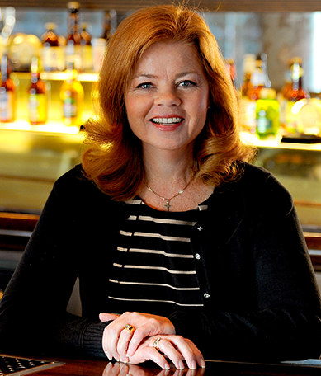
Chief Financial Officer
Tracey Joubert

Slide 5
Third Quarter 2019
KEY TAKEAWAYS
NSR
(constant currency)
UNDERLYING COGS/HL
(constant currency)
UNDERLYING EBITDA
(constant currency)
Strong pricing in all BUs
Positive global sales mix
Offset by volume declines
Inflation, volume deleverage, partially offset by savings
Lower incentive compensation
Marketing spend per hectoliter up slightly in Q3 and YTD
Maintained cash flow focus
-2.0%
+5.9%
-5.6%
-1.6% YoY YTD’19
+5.8% YoY YTD’19
-7.2% YoY YTD’19
____________________
Note: Non-GAAP underlying earnings before interest, tax, depreciation and amortization (EBITDA) is calculated by excluding special and other non-core items from the nearest U.S. GAAP earnings. See reconciliation to nearest U.S. GAAP measures on our website. COGS/HL on a financial volume basis in constant currency.
5

Slide 6
United States
Q3 2019 Performance
KEY TAKEAWAYS
NSR
COGS/HL
UNDERLYING EBITDA
Strong pricing, mix positive for first time since Q2 2017
Unfavorable brand volume and negative impacts of timing of distributor inventory levels
Inflation, volume deleverage, unanticipated increase in property tax in Golden, partially offset by savings
Cycling a net benefit from amicable resolution of vendor dispute
Marketing spend up for premiumization priorities, including Blue Moon, Peroni, Cape Line
-2.3%
+6.6%
-8.6%
____________________
Note: Non-GAAP underlying earnings before interest, tax, depreciation and amortization (EBITDA) is calculated by excluding special and other non-core items from the nearest U.S. GAAP earnings. See reconciliation to nearest U.S. GAAP measures on our website. COGS/HL on a financial volume basis.
6

Slide 7
Europe
Q3 2019 Performance
KEY TAKEAWAYS
NSR
(constant currency)
COGS/HL
(constant currency)
UNDERLYING EBITDA
(constant currency)
Positive pricing and mix
Volume down slightly
COGS/HL increase driven by inflation
Lower incentive compensation
Higher total marketing investment focused on national champion brands and premiumization
+1.7%
+3.5%
+0.6%
____________________
Note: Non-GAAP underlying earnings before interest, tax, depreciation and amortization (EBITDA) is calculated by excluding special and other non-core items from the nearest U.S. GAAP earnings. See reconciliation to nearest U.S. GAAP measures on our website. NSR/HL on a brand volume basis in constant currency. COGS/HL on a financial volume basis in constant currency.
7

Slide 8
Canada
Q3 2019 Performance
NSR
(constant currency)
COGS/HL
(constant currency)
UNDERLYING EBITDA
(constant currency)
KEY TAKEAWAYS
Continued positive pricing
Lower brand and contract volumes
Volume deleverage, cycling PY distribution gains, brewery start-up costs and inflation, partially offset by savings
Lower marketing spend and incentive compensation
Impairment charge of $668M
-4.9%
+9.7%
-12.3%
____________________
Note: Non-GAAP underlying earnings before interest, tax, depreciation and amortization (EBITDA) is calculated by excluding special and other non-core items from the nearest U.S. GAAP earnings. See reconciliation to nearest U.S. GAAP measures on our website. NSR/HL on a brand volume basis in constant currency. COGS/HL on a financial volume basis in constant currency.
8

Slide 9
International
Q3 2019 Performance
KEY TAKEAWAYS
NSR
(constant currency)
COGS/HL
(constant currency)
UNDERLYING EBITDA
(USD millions, % constant currency)
Volume decline driven by Paraguay, India, Puerto Rico, and shipment timing
Net sales decrease driven by geographic mix
Geographic mix, inflation
Lower marketing spend and incentive compensation expense
-15.5%
+6.1%
+189.7%
____________________
Note: Non-GAAP underlying earnings before interest, tax, depreciation and amortization (EBITDA) is calculated by excluding special and other non-core items from the nearest U.S. GAAP earnings. See reconciliation to nearest U.S. GAAP measures on our website. COGS/HL on a financial volume basis in constant currency.
9

Slide 10
2019 Outlook
COST SAVINGS
~$700M 2017-2019
2019 CONSOLIDATED
UNDERLYING COGS/HL
Mid-single digit percentage increase constant currency
2019 CONSOLIDATED INTEREST EXPENSE
$275M +/- 5%
2019 CAPITAL SPENDING
$700M +/- 10%
2019 UNDERLYING D&A
~$850M
2019 UNDERLYING FCF
$1.4 billion +/- 10%
10

Slide 11
Revitalization Plan

Slide 12
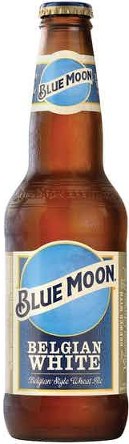
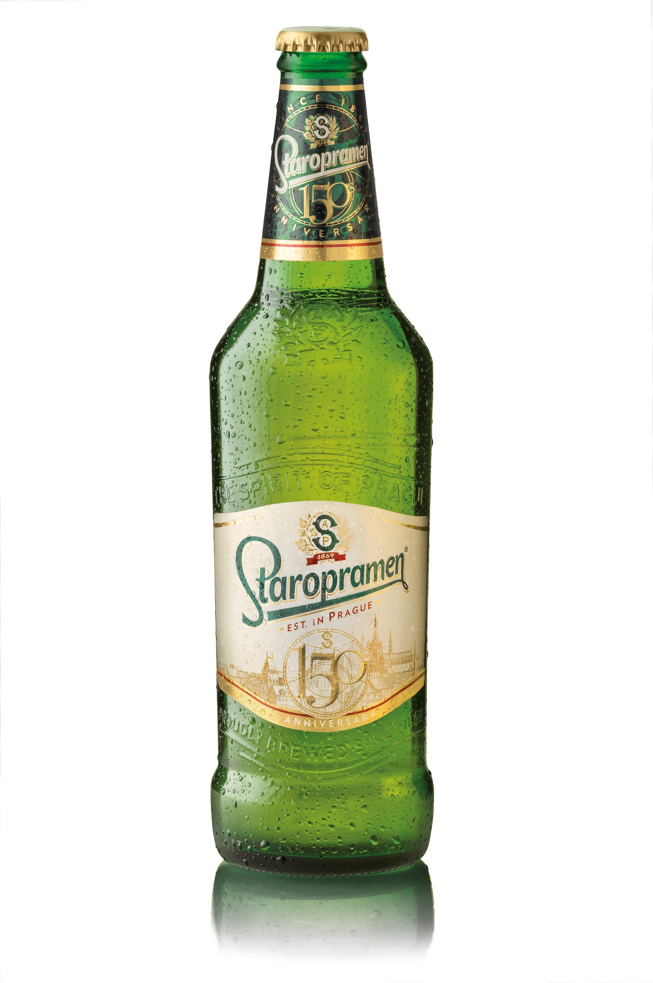

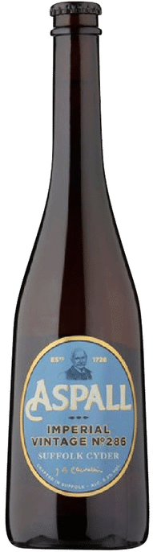
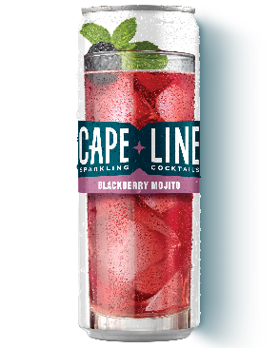
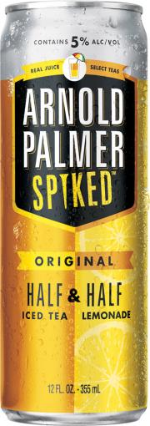
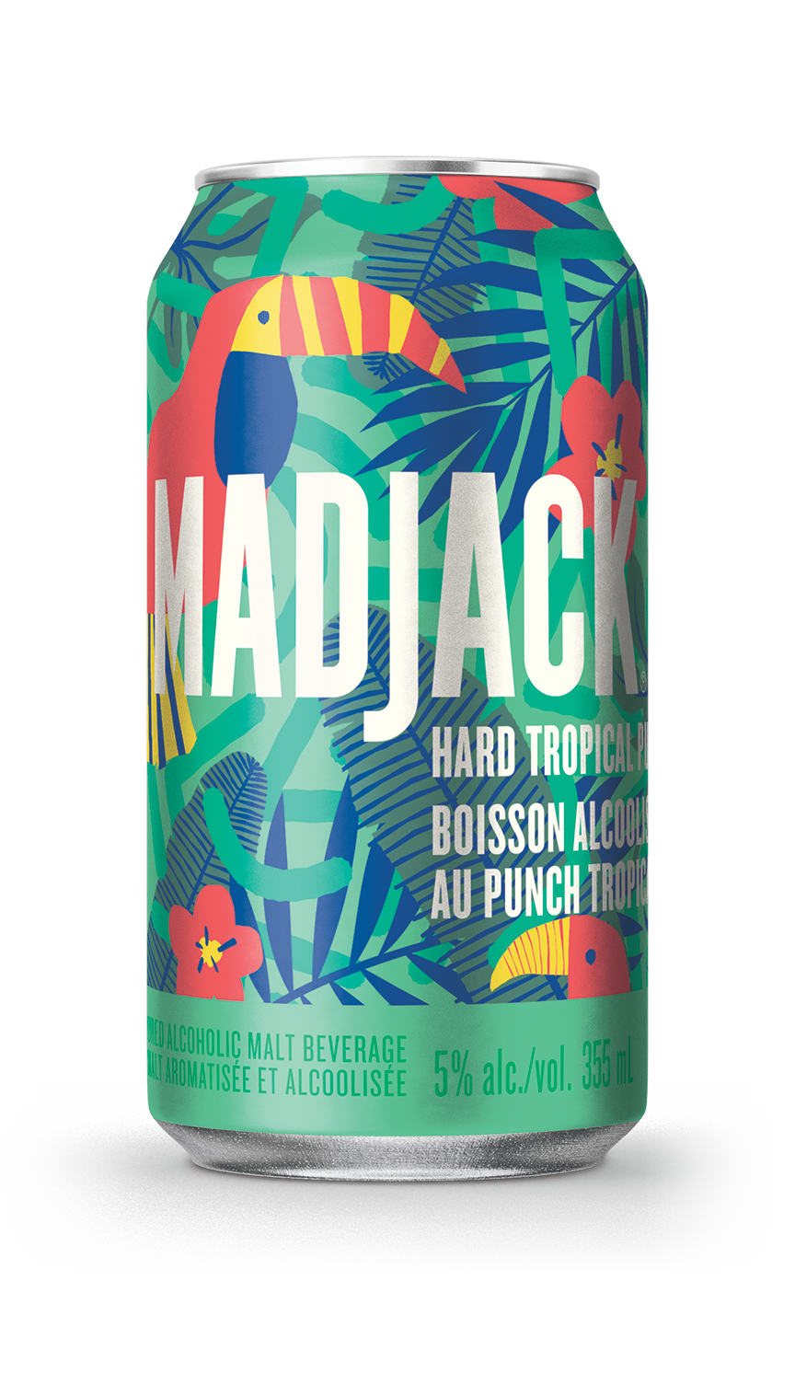
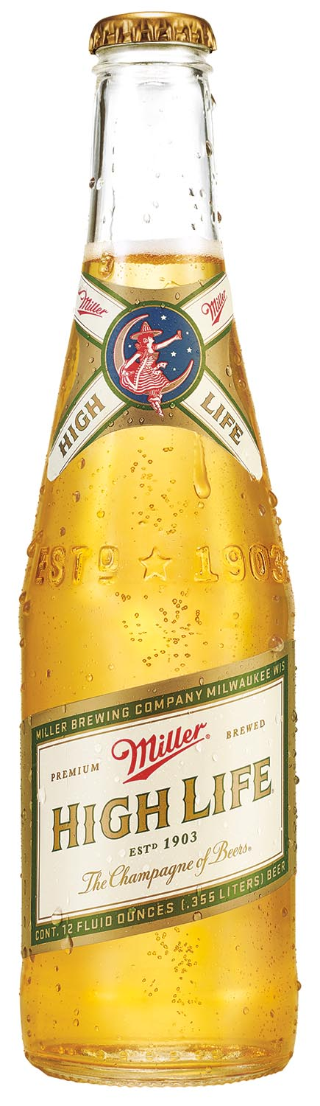
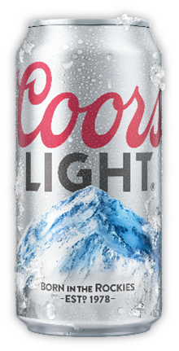
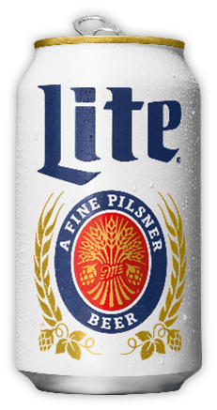
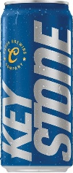
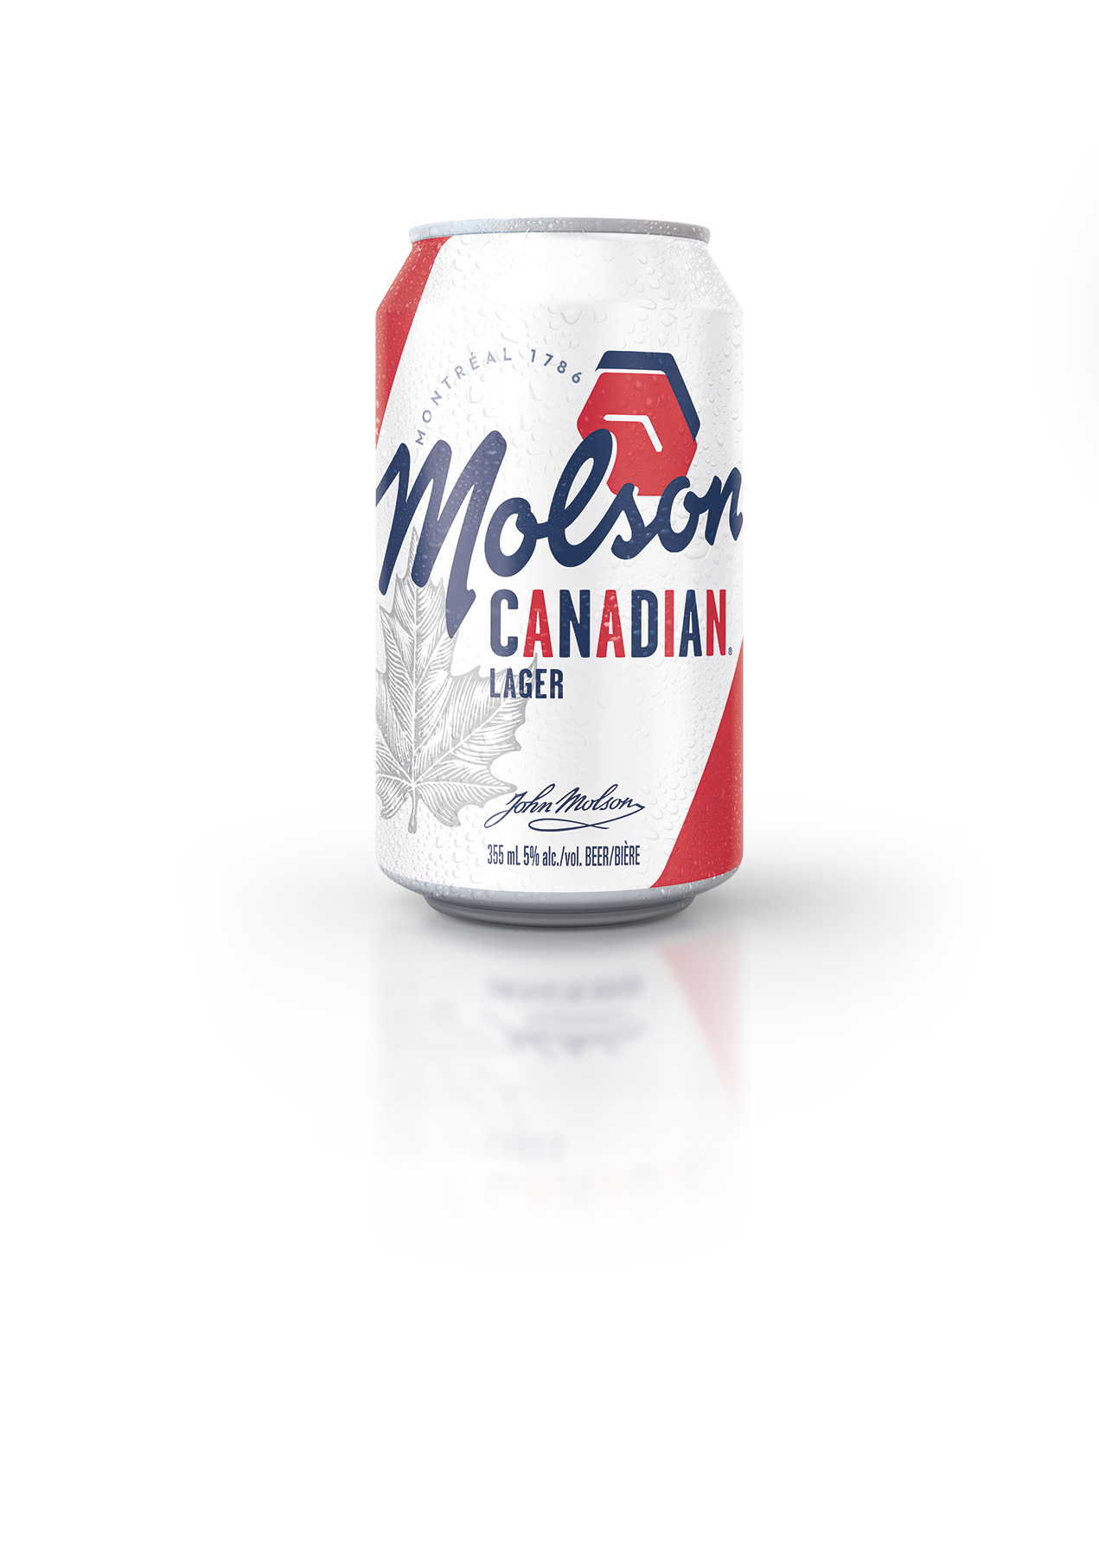
We Have The Firepower To Succeed Long-Term
We Have The Scale & Brands To Compete Successfully
Above Premium
Adjacencies
$10.5 billion in net sales revenue
Nearly 90 million HL brand volume
$2.3 billion in underlying EBITDA
$1.3 billion in underlying free cash flow
Premium
Economy
____________________
Note: For the 12-months ended September 30, 2019

Slide 13
Outlook and Capital Allocation
Financial Discipline
Cost Savings
$700M expected savings from 2017-2019
Strong
Cash Flow
Anticipated 3 year average FCF delivery of more than $1.4B ⁽¹⁾
Balance Sheet Strength
$2.7B debt reduction ⁽²⁾
Strong Cash Return
Increased dividend by ~40% in September 2019
____________________
(1) Fiscal years 2017 - 2019
(2) Debt reduction since Q4’16

Slide 14
Our Industry Has Faced Unprecedented Challenges
What Has Affected Molson Coors Performance
Fundamental Changes in Growth Drivers…
…Opportunity to improve
Rapidly shifting drinking preferences and behaviors
Innovation and direct customer communication led by disruptive brands
Overall beer losing share to other alcoholic and non alcoholic beverages
Fast growing segments: Above Premium, Imports and FMBs
Increase exposure to growing segments
Bigger and faster innovations
Simplify structure and decision making
Increase brand investments
Increase marketing spend and innovation capabilities

Slide 15





Our Approach To Delivering The Growth Target
Our Revitalization Plan
Strategic
Organizational
Invest in our iconic brands
Aggressively grow above premium
beer
Expand in adjacencies and beyond beer
Increase investment in marketing and capabilities
Streamline our company to enable growth

Slide 16
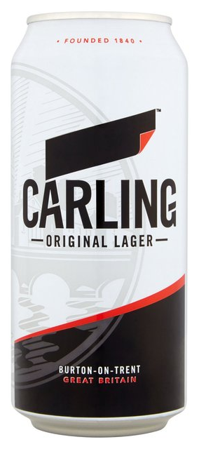
Reinvigorating Our Big Brands
Invest In Iconic Brands
Stabilize brand performance and position for sustainable growth
  Accelerating investment behind our largest brands
  Focusing on recruitment of new legal drinking age consumers
  Driving relevance with breakthrough marketing
  Innovating on core brands to attract new legal age drinkers

Slide 17

Reinvigorating Our Big Brands
Making Progress on Coors Light, Our Top Priority
Coors Light Sales Volume % Change ⁽¹⁾
2 billion PR impressions earned in Q3
Attracting new legal age drinkers
Refreshed brand purpose; stronger emotional relevancy
Breakthrough new creative highlighting new occasions
Driving talkability in culture
____________________
Nielsen All Outlet as of October 19, 2019.

Slide 18
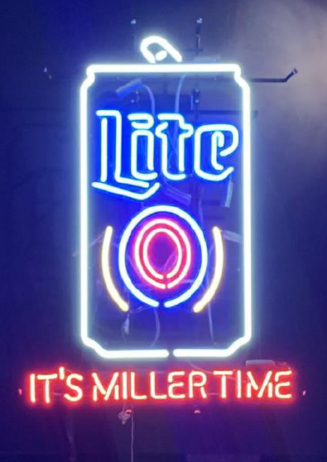
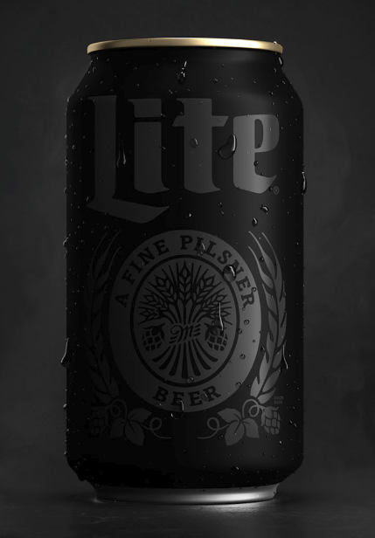
Reinvigorating Our Big Brands
Redefining “Miller Time” For a New Generation
Miller Lite Volume % Change ⁽¹⁾
20 quarters of consecutive segment share gain
____________________
Nielsen All Outlet as of October 19, 2019.

Slide 19
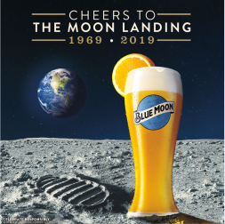
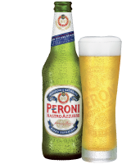
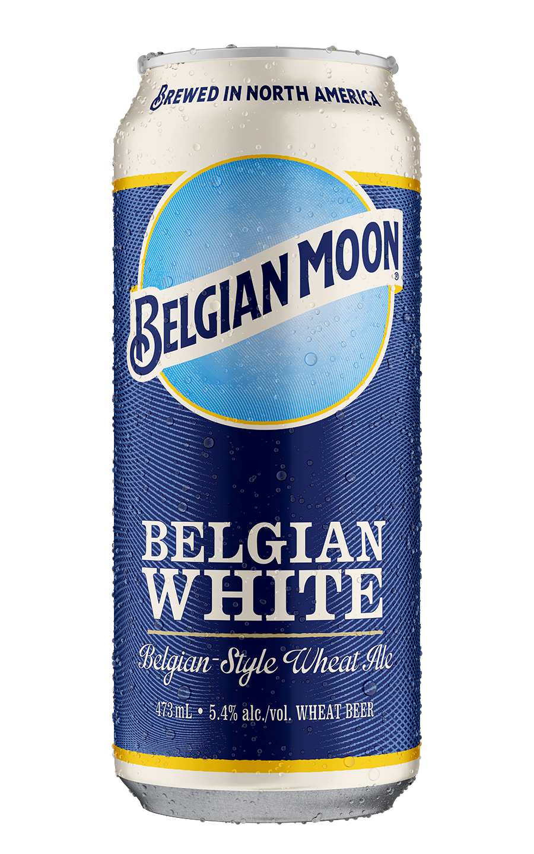
Delivering Customer Excellence
Aggressively Grow Above Premium
Blue Moon Belgian White’s Best Quarter since 2017 in the US
Over 30% of Europe portfolio is above premium ⁽¹⁾
+53% Year over Year, fastest growing top-30 import in the us ⁽²⁾
+40% YTD
in Canada ⁽¹⁾
____________________
Internal data. YTD through September 30,2019
Nielsen All Outlet through October 19, 2019

Slide 20
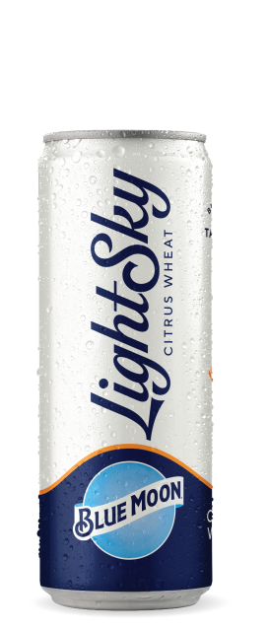

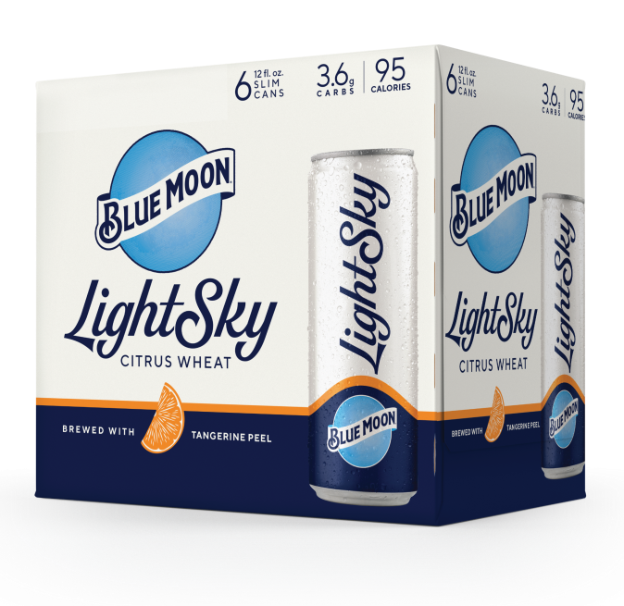
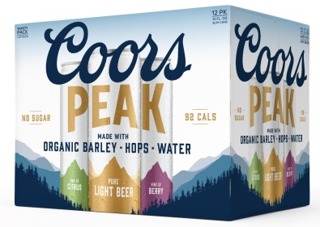
Exciting New Innovation Pipeline for 2020
Premiumize
Develop Above Premium Brands to Enhance Value
The ultimate light beer
National distribution to start in 2020
One-of-a-kind taste, lower calories
To launch in 2020
Pure light beer – organic ingredients
To launch in March 2020
20

Slide 21
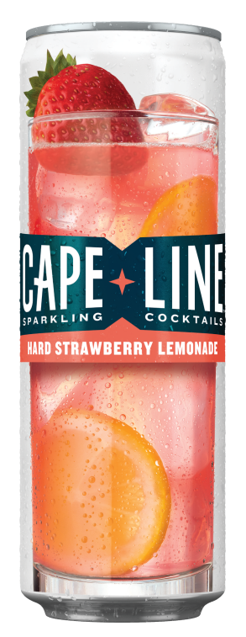
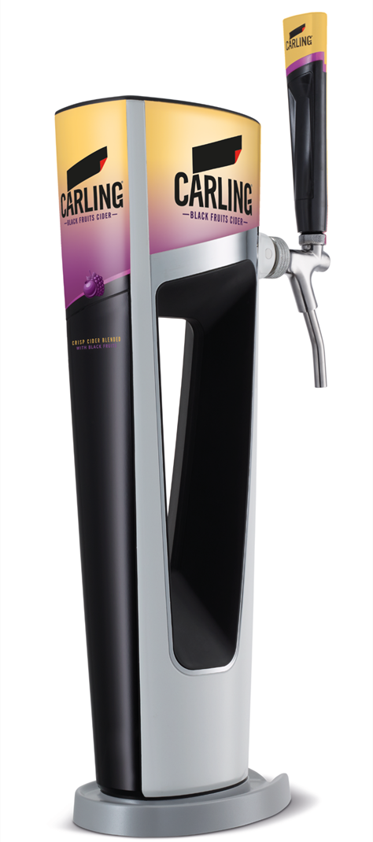
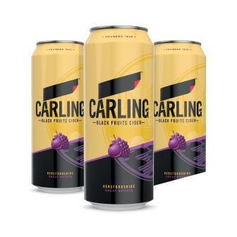
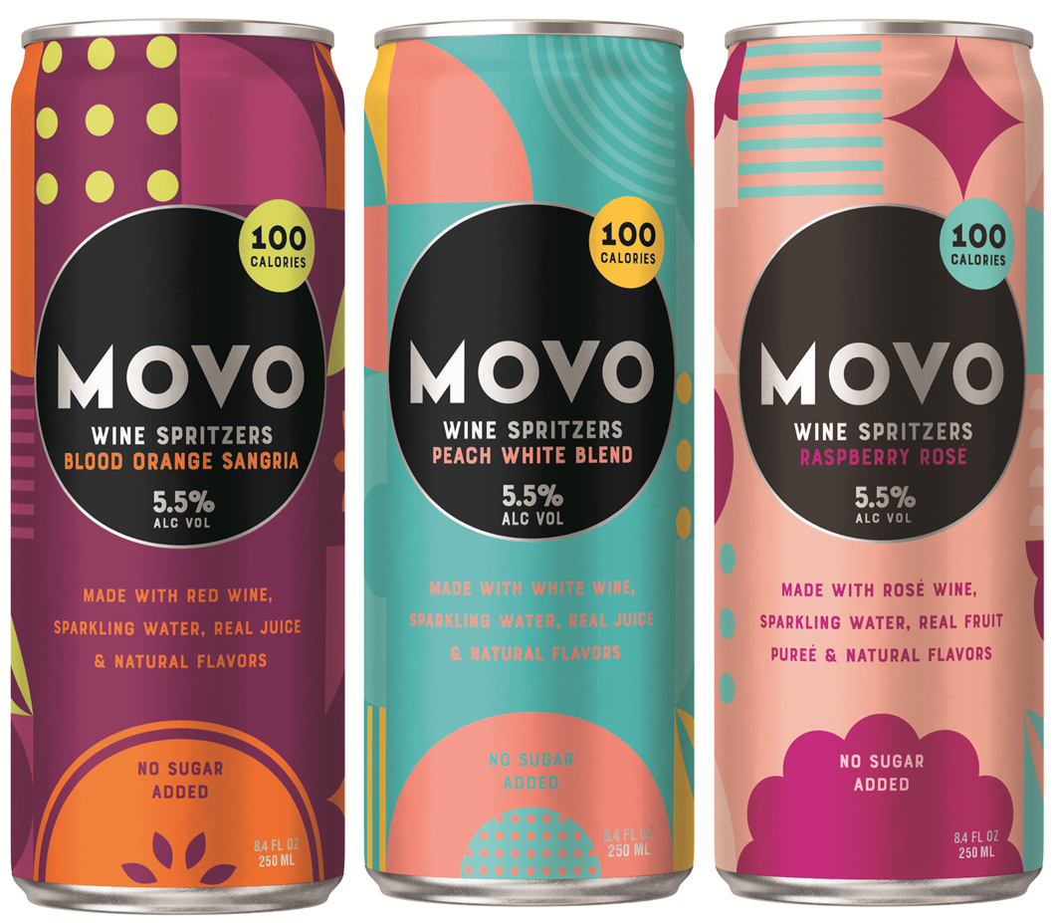
Delivering Customer Excellence
Recent Success Expanding into Adjacencies
Carling Black Fruits Draught
+75% Year Over Year ⁽¹⁾
Top 10 Growth Brand ⁽²⁾
Two #1 New FMB brand franchise in 2018 and 2019
Wine spritzers, a light & refreshing alternative to beer,
4 months to market
Rapid scale-up leveraging distribution platform
____________________
Internal data. YTD through September 30,2019
Nielsen All Outlet for the 14 weeks ended September 16, 2019

Slide 22
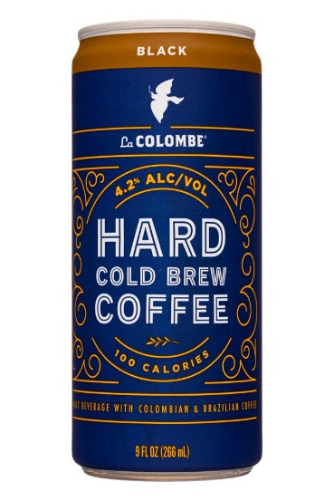
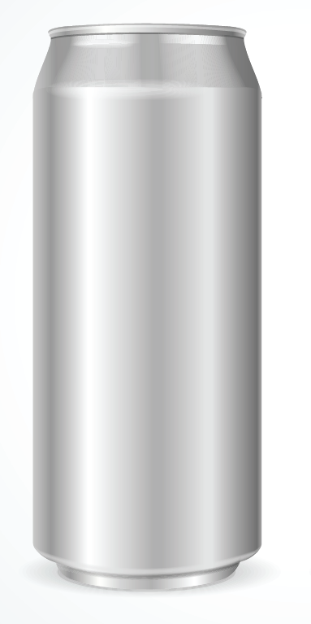
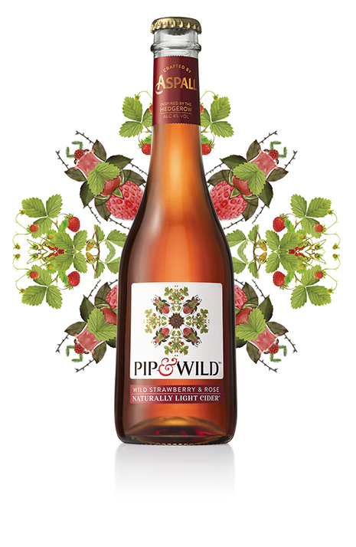

Delivering Customer Excellence
Strong Pipeline of Additional Adjacencies
Introducing Vizzy!
the First hard seltzer infused with super fruits
Positive market test results capitalizing on RTD coffee growth
Early mover advantage
full portfolio of thc and cbd non-alc beverages
Iconic brand delivering a low sugar and low calorie recipe

Slide 23
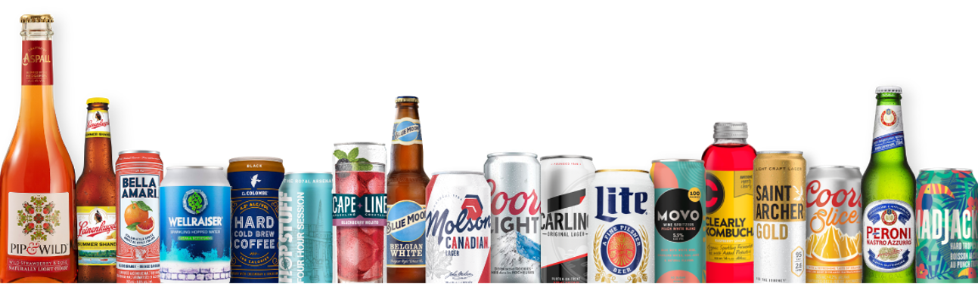
Molson Coors Beverage Company

Slide 24

Increase Investment Behind Commercial and M&A Capabilities to Unlock Growth
Increased Investment in Capabilities
Targeted Insights and New Forms of Innovation
eCommerce
Next-Gen In-House Marketing Capabilities
Precision Marketing

Slide 25
We Are More Powerful Together
Reorganizing to Simplify and Fund Growth
Streamlining our company…
…To Support Our Growth
Consolidating operations for the U.S. and Canada
Two business units: North America and Europe
Consolidating and reorganizing North America office locations
Integrated and streamlined leadership team
Incremental $150M of cost savings, taking 2020 – 2022 cost savings program to $600M
Delivers nimble, faster moving company
Creates more accountability within the leadership team
All cost savings reinvested in brand building and organizational capabilities
$120M - $180M in costs to achieve synergies, to be spread over the balance of this year, 2020 and 2021

Slide 26
Outlook And Capital Allocation
2020 Guidance
A Transition Year
Net Sales Revenue expected to be flat to down low-single-digits on a constant currency basis
Underlying EBITDA expected to be down mid-single-digits on a constant currency basis from trailing twelve months ⁽¹⁾
Expected Underlying Free Cash Flow of $1.1 billion +/- 10%
Expected Cost Savings upsized from $450M to $600M for the 2020-2022 program
Post-2020 Guidance
Improvement in Net Sales Revenue expected
Expected Underlying EBITDA to grow in constant currency
Incremental ~$150M Annual Cost Savings, included within the $600M program, expected to be reinvested once achieved
Balance Sheet and Return of Capital
Intend to maintain investment grade rating
Intend to maintain current dividend payout of 20–25% of trailing annual underlying EBITDA
More Details to Be Provided on 4Q 2019 Call
____________________
Note: The change in structure to two business units will not be effective until January 1, 2020, and therefore the resulting financial reporting changes will not be reflected until our first quarter 2020 results
Based on $2,289 million Underlying EBITDA for the 12-months ended September 30, 2019.
26

Slide 27
Molson Coors Beverage Company

Slide 28
Questions & Answers

