Slide 1
Data-Driven High Value Healthcare
Clinical Research ◆ Academic Scholarship
Performance Improvement
COVID-19 RESPONSE CENTER
Sapan S. Desai, MD, PhD, MBA, FACS
President and Chief Executive Officer
Surgisphere Corporation

Slide 2
We are a research collaboration with over 1,200 healthcare organizations around the world
Machine Learning ◆ Automated Data Entry
World’s Most Complete Healthcare Database
Zero Cost
Dedicated to improving the quality of clinical research and the health of all patients
Achieving Better Clinical Outcomes
Improving Quality of
Care Using Data
Decreasing Supply
Costs
Producing High Impact Publications

Slide 3
Next Generation Informatics
Missing Values
Incomprehensive
Incomplete
Other large registries and public data sets
Automated data acquisition
Recovery of missing values from source
Cloud-based data warehouse
Complete and comprehensive data
Independently audited and certified
AI and machine learning capabilities
Exceeds data collection standards of NSQIP, NCDR, STS, VQI, and NCDB
Established in 2007

Slide 4
Study Design and Technology
Data Acquisition
Data Analytics
Publications
Cohort analysis
Clinical outcomes
Clinical algorithms
Change practice
Study Group
Implementation
N = 65,207
37 hospitals
9 countries
Real-time data
Benchmarks
Data Warehouse
Machine Learning
DMAIC
Machine learning
AI
Pattern recognition
Cost/benefit
Decision tree
Lean six sigma
Process change
PI / QI

Slide 5
COVID-19 Demographics & Comorbidities
 | N | Mean
Age (years) | 6,103 | 49.4 +/- 16.7
Female | 2,465 | 40.4%
White | 3,815 | 62.5%
Black | 391 | 6.4%
Hispanic | 348 | 5.7%
Asian | 1,386 | 22.7%
Native American | 0 | 0.0%
Other | 163 | 2.7%
CAD / MI | 733 | 12.0%
Diabetes | 878 | 14.4%
COPD | 160 | 2.6%
Current Smoker | 1,380 | 22.6%
Hypertension | 1,671 | 27.4%
Hyperlipidemia | 1,349 | 22.1%
Chronic Kidney Disease | 147 | 2.4%
Peripheral Artery Disease | 192 | 3.1%

Slide 6
COVID-19 Initial Clinical Findings
 | Mean
Fever | 97.1%
Cough | 74.8%
Shortness of Breath | 69.8%
Tachypnea | 34.2%
Fatigue | 20.5%
Malaise | 13.5%
Mucus Production | 8.9%
Headache | 7.1%
GI Symptoms | 3.4%
Sore Throat | 1.0%
Interval to Respiratory Symptoms After Fever | 8.1 +/- 1.6

Slide 7
COVID-19 Initial Clinical Findings
 | Mean | Reference Range
WBC (x 10⁹/L) | 6.2 +/- 2.5 | 4.5 – 11
Neutrophil (x 10⁹/L) | 5.0 +/- 2.0 | 2.5 – 8
Lymphocyte (x 10⁹/L) | 0.8 +/- 0.2 | 1.0 – 4.0
Platelets (x 10⁹/L) | 190.0 +/- 30.4 | 150 – 450
LDH (U/L) | 286.2 +/- 40.7 | 140 – 280
ALT (U/L) | 32.1 +/- 10.2 | 7 – 56
AST (U/L) | 34.1 +/- 6.0 | 10 – 40
TB (mg/dL) | 1.3 +/- 0.4 | 0.1 – 1.2
Cr (mg/dL) | 1.1 +/- 0.2 | 0.7 – 1.2
TnI (ng/mL) | 0.05 +/- 0.04 | < 0.04
D-dimer (mcg/mL) | 0.5 +/- 0.1 | < 0.4
Procalcitonin (ng/mL) | 0.2 +/- 0.1 | 0.10 – 0.49
CRP (mg/L) | 4.0 +/- 1.5 | 0.0 – 3.0
PT (s) | 11.1 +/- 1.0 | 11.0 – 13.5
Albumin (g/dL) | 31.4 +/- 3.0 | 34.0 – 54.0

Slide 8
COVID-19 Predictors & Outcomes
Outcome | Average (N = 4,296)
Routine LOS (days) | 4.6 +/- 7.2
ICU LOS (days) | 3.4 +/- 5.2
Respiratory Failure | 9.0%
Renal Failure | 1.1%
Septic Shock | 2.2%
Mortality: 0-9 Years | 1/37 (2.7%)
Mortality: 10-19 Years | 1/120 (0.8%)
Mortality: 20-29 Years | 6/355 (1.7%)
Mortality: 30-39 Years | 11/674 (1.6%)
Mortality: 40-49 Years | 21/921 (2.3%)
Mortality: 50-59 Years | 31/995 (3.1%)
Mortality: 60-69 Years | 31/700 (4.4%)
Mortality: 70-79 Years | 21/333 (6.3%)
Mortality: 80+ Years | 6/161 (3.7%)
Overall Inpatient Mortality | 129/4,296 (3.0%)
Model Accuracy: 99.99%
Prospectively Validated

Slide 9
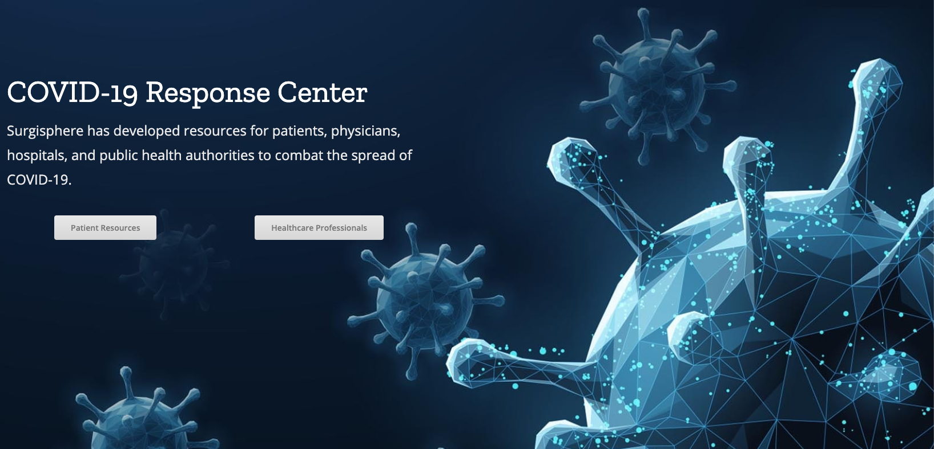
www.Surgisphere.com

Slide 10
COVID-19 Decision Support Tool
Mortality Risk Calculator
Diagnosis Decision Support Tool

Slide 11
Limitations
Sample size (N = 6,103) is small for a machine learning model
Introduces selection bias and error
Susceptible to treatment bias
Incomplete lab testing at sites
Bias toward commonly performed labs
May reflect treatment bias and severity of illness in some patients
This is a decision support tool intended to help physicians with clinical decision making
This is NOT intended for standalone diagnosis
Always complete definitive testing and follow CDC / hospital protocols
A high pretest probability for COVID-19 exposure is required to use this test, otherwise false positives are likely

Slide 12
HEALTHCARE DATA ACQUISITION | WAREHOUSING
ANALYTICS | PERFORMANCE IMPROVEMENT
sapan.desai@Surgisphere.com

