Slide 1
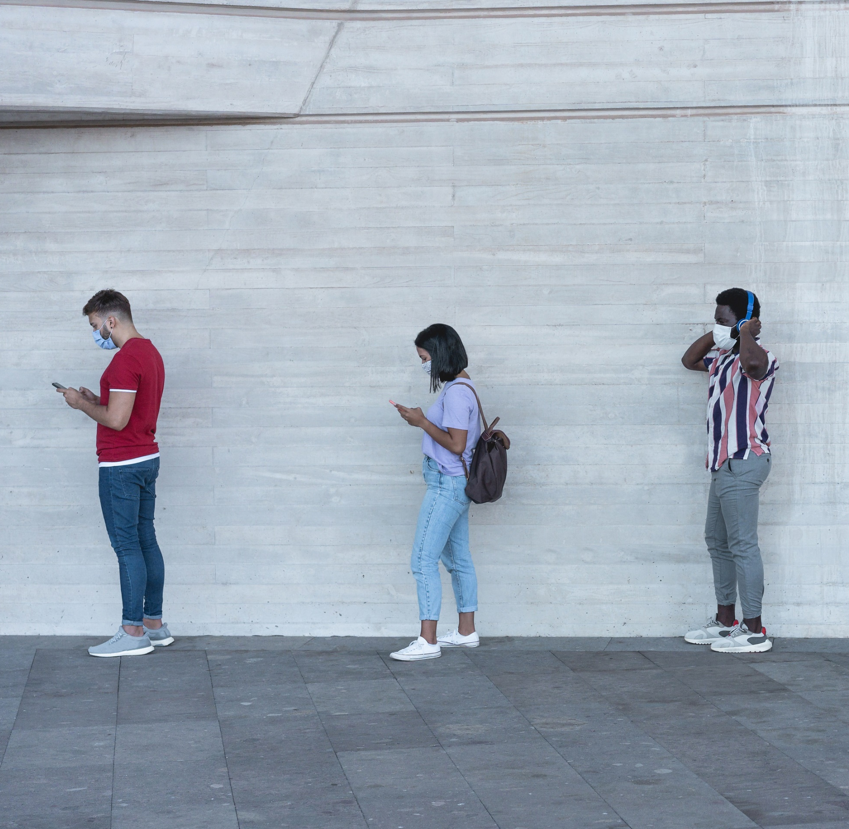
Introducing BOXpoll. A weekly consumer survey on current events, culture and ecommerce logistics.
It’s so this year.

Slide 2
35%
More than 1 in 3 consumers say they’ve yet to start recovering from the pandemic.
30%
‘In the midst’
‘Recovering’
4%
10%
‘Early stages’
‘Back to normal’
START
END
* remaining consumers “don’t know”
BOXpoll by Pitney Bowes, a weekly consumer survey on current events, culture, and ecommerce logistics. Conducted by Pitney Bowes with Morning Consult // 2094 US consumers surveyed Sep. 25-27, 2020. © Copyright 2020 Pitney Bowes Inc.

Slide 3
Thought exercise: once the COVID-19 virus is eradicated, what do you plan to do more (or less) of compared to before the pandemic started?
Working
out at home
Attending concerts and sporting events
In-store shopping
Dining
out
Air
travel
Hugging
Shaking hands
Cooking
at home
Wearing a mask during flu season
Shopping
online
Consuming electronic media
Working out at home
Working from home
Seeing friends and family
* Chart depicts NET difference between % of “More” and “Less” responses
BOXpoll by Pitney Bowes, a weekly consumer survey on current events, culture, and ecommerce logistics. Conducted by Pitney Bowes with Morning Consult // 2094 US consumers surveyed Sept. 2020. © Copyright 2020 Pitney Bowes Inc.

Slide 4
54%
More than half of consumers are still shopping more often online versus pre-pandemic.
Shopping more online vs. before pandemic
About the same
35%
More
often
Less often
6%
BOXpoll by Pitney Bowes, a weekly consumer survey on current events, culture, and ecommerce logistics. Conducted by Pitney Bowes with Morning Consult // 2094 US consumers surveyed Sep. 25-27, 2020. © Copyright 2020 Pitney Bowes Inc.

Slide 5
2.8X
increase
The percentage of consumers doing more than half of their shopping online is still nearly triple pre-pandemic levels.
45%
16%
BOXpoll by Pitney Bowes, a weekly consumer survey on current events, culture, and ecommerce logistics. Conducted by Pitney Bowes with Morning Consult // 2094 US consumers surveyed Sept. 3-7, 2020. © Copyright 2020 Pitney Bowes Inc.

Slide 6
Would you rather buy online from a company that…
shares your beliefs
one that offers these order experiences
Value wins over Values
3 in 4 consumers pick easy order experiences over buying based on their beliefs.
Top three (of six) order experiences
Free
shipping
Fast
shipping
Free
returns
BOXpoll by Pitney Bowes, a weekly consumer survey on current events, culture, and ecommerce logistics. Conducted by Pitney Bowes with Morning Consult // 2094 US consumers surveyed Aug. 21-24, 2020. © Copyright 2020 Pitney Bowes Inc.

Slide 7
Are you shopping more…
because you’re bored
other reasons
Boredom is getting expensive
1 in 4 consumers (and half of Gen Z) admit to getting more retail therapy online.
?
BOXpoll by Pitney Bowes, a weekly consumer survey on current events, culture, and ecommerce logistics. Conducted by Pitney Bowes with Morning Consult // 2094 US consumers surveyed Aug. 21-24, 2020. © Copyright 2020 Pitney Bowes Inc.

Slide 8
What measures do you take when receiving a package?
Washing hands
Playing it safe?
7 in 10 consumers wash their hands, at minimum, after handling a package.
Hand sanitizer
71%
55%
Face mask
44%
Wipe down package
40%
Gloves
31%
Return package
23%
BOXpoll by Pitney Bowes, a weekly consumer survey on current events, culture, and ecommerce logistics. Conducted by Pitney Bowes with Morning Consult // 2094 US consumers surveyed Aug. 21-24, 2020. © Copyright 2020 Pitney Bowes Inc.

