Slide 1
FIRST QUARTER 2021 RESULTS
NASDAQ: FULT
Data as of or for the three months ended March 31, 2021 unless otherwise noted

Slide 2
FORWARD-LOOKING STATEMENTS
This presentation may contain forward-looking statements with respect to the Corporation’s financial condition, results of operations and business. Do not unduly rely on forward-looking statements. Forward-looking statements can be identified by the use of words such as "may," "should," "will," "could," "estimates," "predicts," "potential," "continue," "anticipates," "believes," "plans," "expects," "future," "intends," “projects,” the negative of these terms and other comparable terminology. These forward-looking statements may include projections of, or guidance on, the Corporation’s future financial performance, expected levels of future expenses, including future credit losses, anticipated growth strategies, descriptions of new business initiatives and anticipated trends in the Corporation’s business or financial results. Management’s 2021 Outlook contained herein is comprised of forward-looking statements.
Forward-looking statements are neither historical facts, nor assurance of future performance. Instead, they are based on current beliefs, expectations and assumptions regarding the future of the Corporation’s business, future plans and strategies, projections, anticipated events and trends, the economy and other future conditions. Because forward-looking statements relate to the future, they are subject to inherent uncertainties, risks and changes in circumstances that are difficult to predict and many of which are outside of the Corporation’s control, and actual results and financial condition may differ materially from those indicated in the forward-looking statements. Therefore, you should not unduly rely on any of these forward-looking statements. Any forward-looking statement is based only on information currently available and speaks only as of the date when made. The Corporation undertakes no obligation, other than as required by law, to update or revise any forward-looking statements, whether as a result of new information, future events or otherwise.
A discussion of certain risks and uncertainties affecting the Corporation, and some of the factors that could cause the Corporation’s actual results to differ materially from those described in the forward-looking statements, can be found in the sections entitled “Risk Factors” and “Management’s Discussion and Analysis of Financial Condition and Results of Operations” in the Corporation’s Annual Report on Form 10-K for the year ended December 31, 2020 and other current and periodic reports, which have been, or will be, filed with the Securities and Exchange Commission and are or will be available in the Investor Relations section of the Corporation’s website (www.fult.com) and on the Securities and Exchange Commission’s website (www.sec.gov).
The Corporation uses certain non-GAAP financial measures in this presentation. These non-GAAP financial measures are reconciled to the most comparable GAAP measures at the end of this presentation.
2

Slide 3
INCOME STATEMENT SUMMARY
 |  |  |  | Change From
 | 1Q21 |  |  | 4Q20 |  |  | 1Q20
 | (dollars in thousands, except per-share data)
Net Interest Income | $ | 164,448 |  | $ | 2,857 |  | $ | 3,702
Provision for Credit Losses | (5,500 |  | ) | (11,740 |  | ) | (49,530 |  | )
Non-Interest Income | 61,922 |  |  | 6,348 |  |  | 7,324
Securities Gains | 33,475 |  |  | 33,475 |  |  | 33,429
Non-Interest Expense | 178,384 |  |  | 23,647 |  |  | 35,832
Income before Income Taxes | 86,961 |  |  | 30,774 |  |  | 58,153
Income Taxes | 13,898 |  |  | 8,536 |  |  | 11,137
Net Income | 73,063 |  |  | 22,238 |  |  | 47,016
Preferred Stock Dividends | (2,591 |  | ) | (456 |  | ) | (2,591 |  | )
Net Income Available to Common Shareholders | $ | 70,472 |  | $ | 21,782 |  | $ | 44,425
Net income per share (diluted) | $ | 0.43 |  | $ | 0.13 |  | $ | 0.27
ROA (1) | 1.14 |  | % | 0.35 |  | % | 0.67 |  | %
ROE (2) | 11.24 |  | % | 3.29 |  | % | 6.76 |  | %
ROE (tangible) (3) | 15.00 |  | % | 4.69 |  | % | 9.16 |  | %
Efficiency ratio (3) | 63.0 |  | % | 0.5 |  | % | (1.5 |  | )%
  ROA is return an average assets calculated as net income for the period divided by average assets, annualized.
  ROE is return on average shareholders’ equity calculated as net income for the period divided by average shareholders’ equity, annualized.
  Non-GAAP financial measure. Please refer to the calculation and management’s reasons for using this measure on the slide titled “Non-GAAP Reconciliation” at the end of this presentation.
3

Slide 4
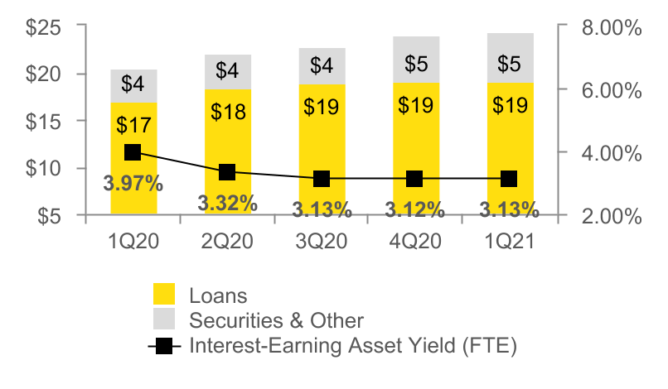
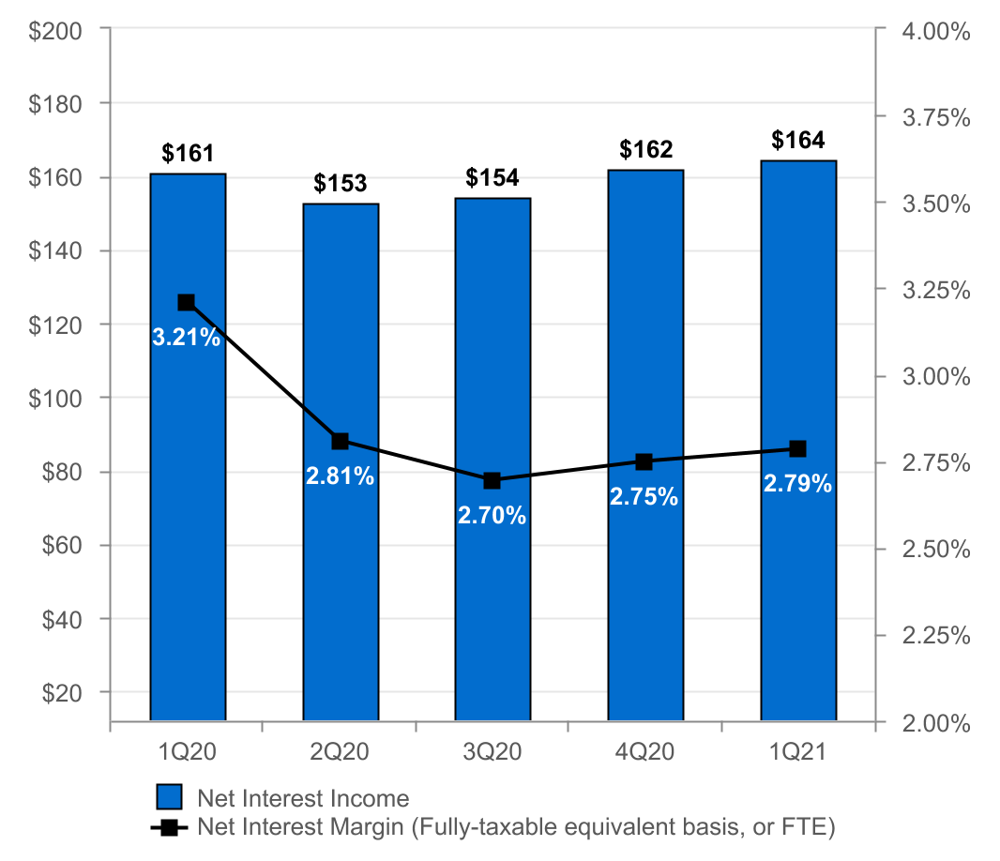
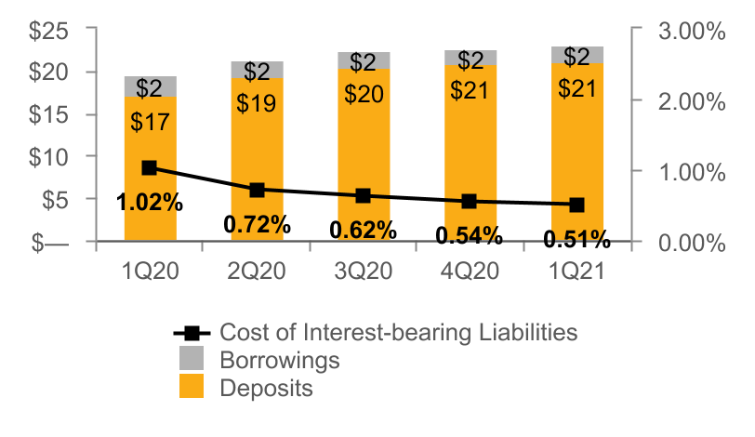
NET INTEREST INCOME AND MARGIN
Net Interest Income & Net Interest Margin
Average Interest-Earning Assets & Yields
($ IN MILLIONS)
($ IN BILLIONS)
Average Liabilities & Rates
($ IN BILLIONS)
4

Slide 5
2021 Balance Sheet Restructuring
Why:
  Reduce exposure to interest rate risk
  Opportunity to reduce interest expense
What:
  Sold Visa Class B restricted shares - $34 million pre-tax gain
  Tendered for $75 million of 4.50% subordinated debt due 2024
  Tendered for $60 million of 3.60% senior notes due 2022
  Prepaid $535 million of term FHLB advances
  Sold $23 million of auction rate securities
  Executed $500 million of receive-fixed, pay-variable interest rate swaps
1Q21 Impact:
Non-interest income:
  $34 million gain on the sale of Visa Class B restricted Shares
  $.5 million loss on the sale of other securities
Non-interest expense:
  $33 million in debt extinguishment costs, including:
    $21 million in prepayment penalties of FHLB advances;
    $11 million of expenses associated with tender offer to purchase subordinated and senior note debt
    $1 million of deferred issuance costs recognized in net interest income
Anticipated Future Impact:
  Increase in net interest income of ~$17 million on an annualized basis
  Increase in earnings per share of ~$0.08 per share on an annualized basis
5

Slide 6
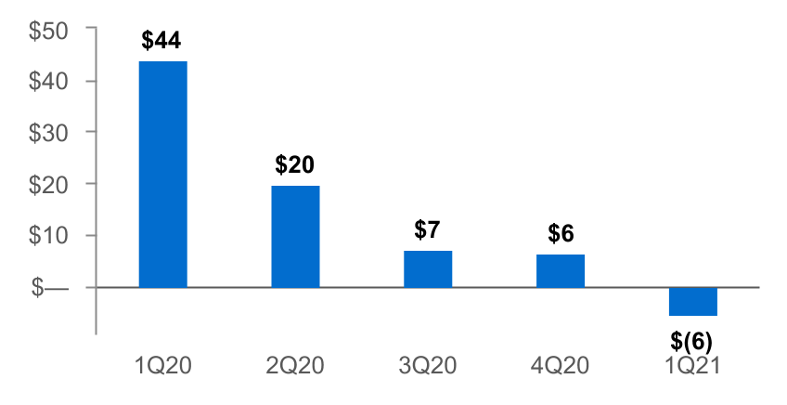
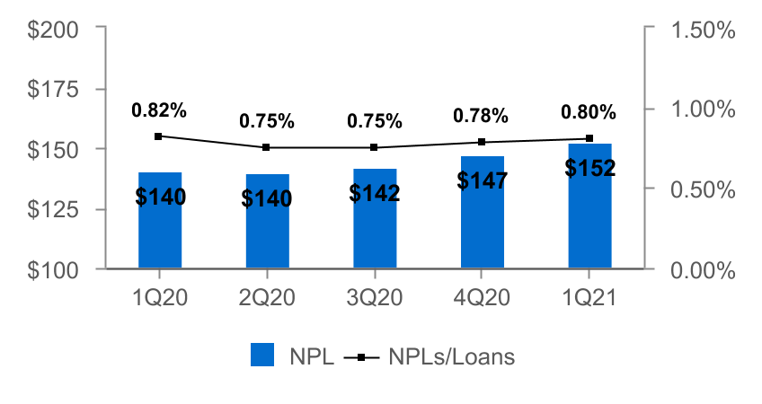
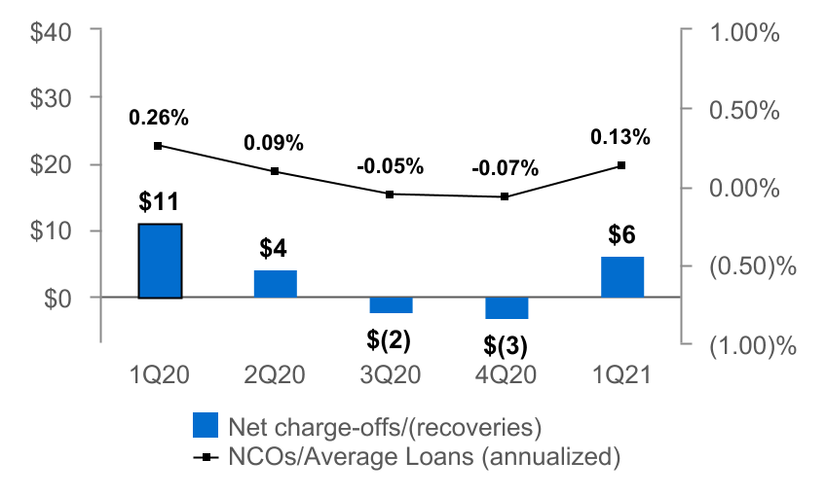
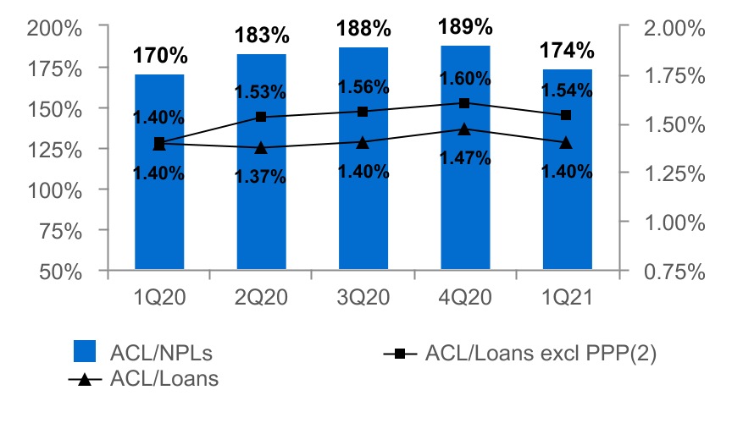
ASSET QUALITY
($ IN MILLIONS)
Provision for Credit Losses
Non-Performing Loans (NPLs) & NPLs to Loans
Net Charge-offs (NCOs) and NCOs to Average Loans
ACL(1) to NPLs & Loans
  The allowance for credit losses (“ACL”) relates specifically to "Loans, net of unearned income" and does not include the ACL related to off-balance-sheet credit exposures.
  Non-GAAP financial measure. Please refer to the calculation and management's reasons for using this measure on the slide titled "Non-GAAP Reconciliation" at the end of this presentation.
6

Slide 7
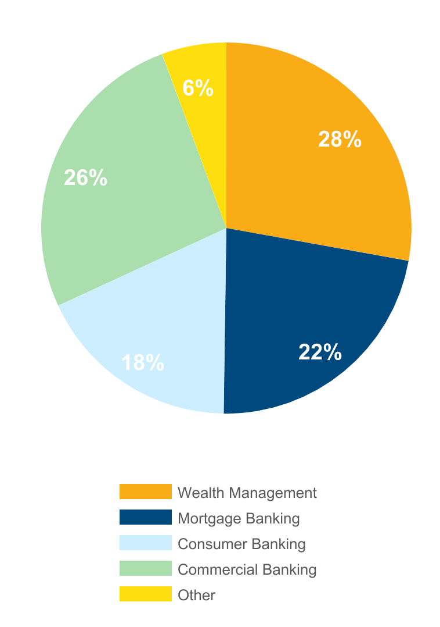
NON-INTEREST INCOME⁽¹⁾
Three months ended March 31, 2021
(percent of total non-interest income)
 |  | 1Q21 |  |  | 4Q20 |  |  | Change
 |  | (dollars in thousands)
n Wealth Management |  | $ | 17,347 |  | $ | 15,653 |  | $ | 1,694
n Mortgage Banking |  | 13,960 |  |  | 9,311 |  |  | 4,649
n Consumer Banking |  | 10,754 |  |  | 10,797 |  |  | (43 |  | )
n Commercial Banking |  | 16,342 |  |  | 16,809 |  |  | (467 |  | )
n Other |  | 3,519 |  |  | 3,004 |  |  | 515
Total |  | $ | 61,922 |  | $ | 55,574 |  | $ | 6,348
Non-interest income⁽¹⁾ increased 11% from 4Q20
Increases in:
n Mortgage Banking driven by a reversal of a mortgage service assets valuation allowance of $6 million
n Wealth management income, specifically brokerage income
Partially offset by a decrease in:
n Capital markets revenue - primarily commercial loan interest rate swaps
⁽¹⁾ Excluding investment securities gains
7

Slide 8
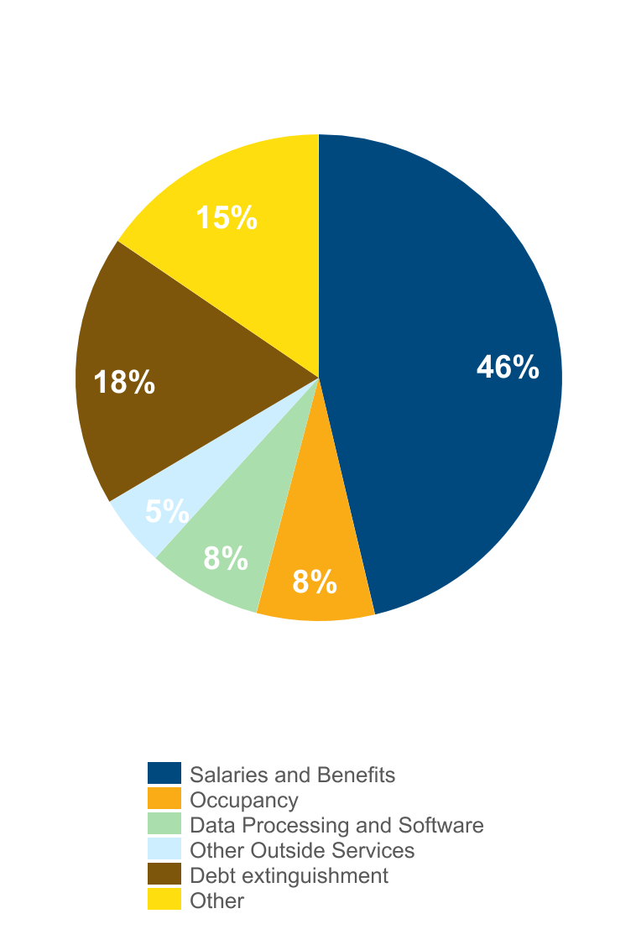
NON-INTEREST EXPENSE
Three months ended March 31, 2021
(percent of total non-interest expense)
 |  | 1Q21 |  |  | 4Q20 |  |  | Change
 |  | (dollars in thousands)
n Salaries and Benefits |  | $ | 82,586 |  | $ | 83,929 |  | $ | (1,343 | )
n Occupancy |  | 13,982 |  |  | 13,161 |  |  | 821
n Data Processing and Software |  | 13,561 |  |  | 11,951 |  |  | 1,610
n Other Outside Services |  | 8,490 |  |  | 8,334 |  |  | 156
n Debt Extinguishment |  | 32,163 |  |  | — |  |  | 32,163
n Other |  | 27,602 |  |  | 37,362 |  |  | (9,760 |  | )
Total |  | $ | 178,384 |  | $ | 154,737 |  | $ | 23,647
Non-interest expense increased 15% from 4Q20
Driven primarily by balance sheet restructuring:
n $21 million in prepayment penalties of FHLB advances and $12 million in other long-term debt extinguishment costs
Other increases were due to:
n Higher incentive compensation accrual in Q1 2021 due to 2021 performance
n Technology investments
n Snow removal
Offset by elevated expenses in Q4 2020 related to cost saving initiatives:
n $11 million due to financial center closures (fixed asset write-offs and lease termination charges)
n $4 million of severance expense
8

Slide 9
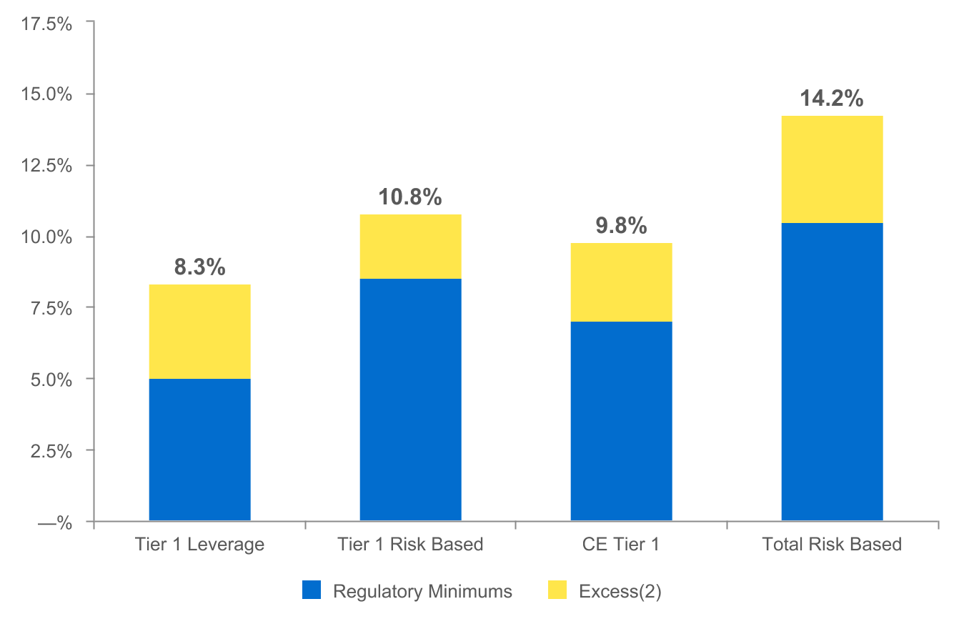
CAPITAL POSITION REMAINS STRONG
(as of March 31, 2021)
$736
$443
$546
$836
  Regulatory capital ratios as of March 31, 2021 are preliminary.
  Excesses shown are to regulatory minimums, including the 250 basis point capital conservation buffer, except for Tier 1 Leverage which is the well-capitalized minimum. Dollars are in millions.
9

Slide 10
2021 OUTLOOK
Net interest income: $640 - $660 million
Provision for credit losses: $20 - $40 million
Non-interest income: $220 - $230 million
Non-interest expense ⁽¹⁾: $555 - $575 million
⁽¹⁾ Excluding charges related to the 1Q 2021 balance sheet restructuring
10

Slide 11
NON-GAAP RECONCILIATION
Note: The Corporation has presented the following non-GAAP (Generally Accepted Accounting Principles) financial measures because it believes that these measures provide useful and comparative information to assess trends in the Corporation's results of operations and financial condition. Presentation of these non-GAAP financial measures is consistent with how the Corporation evaluates its performance internally and these non-GAAP financial measures are frequently used by securities analysts, investors and other interested parties in the evaluation of companies in the Corporation's industry. Investors should recognize that the Corporation's presentation of these non-GAAP financial measures might not be comparable to similarly-titled measures of other companies. These non-GAAP financial measures should not be considered a substitute for GAAP basis measures and the Corporation strongly encourages a review of its condensed consolidated financial statements in their entirety.
(dollars in thousands) |  | Three months ended
 |  | Mar 31 |  |  |  | Dec 31 |  |  |  | Mar 31
Return on average common shareholders' equity (tangible) |  | 2021 |  |  |  | 2020 |  |  |  | 2020
Net income available to common shareholders |  | $ | 70,472 |  |  | $ | 48,690 |  |  | $ | 26,047
Plus: Intangible amortization, net of tax |  | 90 |  |  |  | 104 |  |  |  | 104
(Numerator) |  | 70,562 |  |  |  | 48,794 |  |  |  | 26,151
Average shareholders' equity |  | $ | 2,637,098 |  |  | $ | 2,544,866 |  |  | $ | 2,337,016
Less: Average preferred stock |  | (192,878 |  | ) |  | (127,639 |  | ) |  | —
Less: Average goodwill and intangible assets |  | (536,601 |  | ) |  | (535,474 |  | ) |  | (535,235 |  | )
Average tangible common shareholders' equity (denominator) |  | 1,907,619 |  |  |  | 1,881,753 |  |  |  | 1,801,781
Return on average common shareholders' equity (tangible), annualized |  | 15.00 |  | % |  | 10.32 |  | % |  | 5.84 |  | %
11

Slide 12
NON-GAAP RECONCILIATION
(dollars in thousands) |  | Three months ended
 |  | Mar 31 |  |  |  | Dec 31 |  |  |  | Mar 31
Efficiency ratio |  | 2021 |  |  |  | 2020 |  |  |  | 2020
Non-interest expense |  | $ | 178,384 |  |  | $ | 154,737 |  |  | $ | 142,552
Less: Debt extinguishment costs |  | (32,163 |  | ) |  | — |  |  |  | —
Less: Amortization of tax credit investments |  | (1,531 |  | ) |  | (1,532 |  | ) |  | (1,450 |  | )
Less: Intangible amortization |  | (115 |  | ) |  | (132 |  | ) |  | (132 |  | )
Non-interest expense (numerator) |  | 144,575 |  |  |  | 137,673 |  |  |  | 140,970
Net interest income (fully taxable equivalent) |  | $ | 167,428 |  |  | $ | 164,578 |  |  | $ | 163,970
Plus: Total Non-interest income |  | 95,397 |  |  |  | 55,574 |  |  |  | 54,644
Less: Investment securities gains, net |  | (33,475 |  | ) |  | — |  |  |  | (46 |  | )
Total revenue (denominator) |  | $ | 229,350 |  |  | $ | 220,152 |  |  | $ | 218,568
Efficiency ratio |  | 63.0 |  | % |  | 62.5 |  | % |  | 64.5 |  | %
 | Mar 31 |  |  |  | Dec 31 |  |  |  | Sep 30 |  |  |  | Jun 30 |  |  |  | Mar 31
Asset Quality, excluding PPP | 2021 |  |  |  | 2020 |  |  |  | 2020 |  |  |  | 2020 |  |  |  | 2020
ACL - loans (numerator) | $ | 265,986 |  |  | $ | 277,567 |  |  | $ | 266,825 |  |  | $ | 256,537 |  |  | $ | 238,508
Loans, net of unearned income | $ | 18,990,986 |  |  | $ | 18,900,820 |  |  | $ | 19,028,621 |  |  | $ | 18,704,722 |  |  | $ | 17,077,403
Less: PPP loans | (1,688,394 |  | ) |  | (1,581,712 |  | ) |  | (1,960,165 |  | ) |  | (1,937,034 |  | ) |  | —
Total adjusted loans (denominator) | $ | 17,302,592 |  |  | $ | 17,319,108 |  |  | $ | 17,068,456 |  |  | $ | 16,767,688 |  |  | $ | 17,077,403
ACL - loans to adjusted total loans | 1.54 |  | % |  | 1.60 |  | % |  | 1.56 |  | % |  | 1.53 |  | % |  | 1.40 |  | %
12

Slide 13
APPENDIX - CREDIT DISCLOSURES
Additional detail on deferrals and selected industries
(data as of March 31, 2021; all industry classifications based on NAICS codes)
13

Slide 14
Active COVID Deferrals⁽¹⁾ Continue to Decline
Commercial
  At March 31, 2021, active deferrals declined to ~$153 million, or 1.1% of the commercial portfolio⁽²⁾
  Majority of active deferrals are in the hospitality, entertainment, and fitness industries
  Continued focus to obtain credit enhancements where appropriate to support the additional deferrals
Consumer
  At March 31, 2021, active deferrals and forbearances declined to ~$94 million, or 1.9%, of the consumer portfolio⁽³⁾
1) Deferrals consist of deferrals of principal and interest payments or deferrals of principal payments.
2) Includes real estate - commercial mortgage, commercial and industrial and equipment lease financing.
3) Includes real estate - residential mortgage, real estate - home equity and consumer.
14

Slide 15
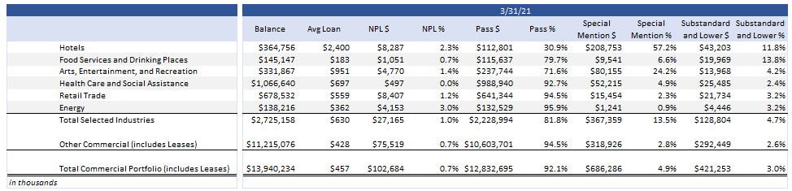
Selected Industries With Heightened Risk Due to COVID-19
some numbers may not sum due to rounding
(1) Based on regulatory classifications. Commercial Portfolio consists of Commercial and Industrial, Commercial Mortgage, and Construction loans to commercial borrowers. Note: "Pass," "Special Mention" and "Substandard or Lower" are the Corporation's internal risk rating categories. Please see Note 1 - Basis of Presentation in the Corporation's Form 10-K for the year ended December 31, 2020 for a description of these categories.
15

