Slide 1
FOURTH QUARTER 2021 RESULTS
NASDAQ: FULT
Data as of or for the periods ended December 31, 2021 unless otherwise noted

Slide 2
FORWARD-LOOKING STATEMENTS
This presentation may contain forward-looking statements with respect to the Corporation’s financial condition, results of operations and business. Do not unduly rely on forward-looking statements. Forward-looking statements can be identified by the use of words such as "may," "should," "will," "could," "estimates," "predicts," "potential," "continue," "anticipates," "believes," "plans," "expects," "future," "intends," “projects,” the negative of these terms and other comparable terminology. These forward-looking statements may include projections of, or guidance on, the Corporation’s future financial performance, expected levels of future expenses, including future credit losses, anticipated growth strategies, descriptions of new business initiatives and anticipated trends in the Corporation’s business or financial results. Management’s 2022 Outlook contained herein is comprised of forward-looking statements.
Forward-looking statements are neither historical facts, nor assurance of future performance. Instead, the statements are based on current beliefs, expectations and assumptions regarding the future of the Corporation’s business, future plans and strategies, projections, anticipated events and trends, the economy and other future conditions. Because forward-looking statements relate to the future, they are subject to inherent uncertainties, risks and changes in circumstances that are difficult to predict and many of which are outside of the Corporation’s control, and actual results and financial condition may differ materially from those indicated in the forward-looking statements. Therefore, you should not unduly rely on any of these forward-looking statements. Any forward-looking statement is based only on information currently available and speaks only as of the date when made. The Corporation undertakes no obligation, other than as required by law, to update or revise any forward-looking statements, whether as a result of new information, future events or otherwise.
A discussion of certain risks and uncertainties affecting the Corporation, and some of the factors that could cause the Corporation’s actual results to differ materially from those described in the forward-looking statements, can be found in the sections entitled “Risk Factors” and “Management’s Discussion and Analysis of Financial Condition and Results of Operations” in the Corporation’s Annual Report on Form 10-K for the year ended December 31, 2020, Quarterly Reports on Form 10-Q for the quarters ended March 31, 2021, June 30, 2021 and September 30, 2021, and other current and periodic reports, which have been, or will be, filed with the Securities and Exchange Commission and are or will be available in the Investor Relations section of the Corporation’s website (www.fultonbank.com) and on the Securities and Exchange Commission’s website (www.sec.gov).
The Corporation uses certain non-GAAP financial measures in this presentation. These non-GAAP financial measures are reconciled to the most comparable GAAP measures at the end of this presentation.
2

Slide 3
INCOME STATEMENT SUMMARY
 | 4Q21 | 3Q21 | 4Q20
 | (dollars in thousands, except per-share data)
Net Interest Income | $165,613 | $171,270 | $161,591
Provision for Credit Losses | (5,000) | (600) | 6,240
Non-Interest Income | 63,876 | 62,577 | 55,574
Securities Gains | 5 | — | —
Non-Interest Expense | 154,019 | 144,596 | 154,738
Income before Income Taxes | 80,475 | 89,851 | 56,187
Income Taxes | 18,588 | 14,268 | 5,362
Net Income | 61,887 | 75,583 | 50,825
Preferred Stock Dividends | (2,562) | (2,562) | (2,135)
Net Income Available to Common Shareholders | $59,325 | $73,021 | $48,690
Net income per share (diluted) | $0.37 | $0.45 | $0.30
ROA⁽¹⁾ | 0.94% | 1.13% | 0.79%
ROE⁽²⁾ | 9.34% | 11.45% | 8.21%
ROE (tangible)⁽³⁾ | 11.89% | 14.56% | 10.32%
Efficiency ratio⁽³⁾ | 65.2% | 60.3% | 62.5%
ROA is return an average assets calculated as net income for the period divided by average assets, annualized.
ROE is return on average common shareholders’ equity calculated as net income available to common shareholders for the period divided by average common shareholders’ equity, annualized.
Non-GAAP financial measure. Please refer to the calculation and management’s reasons for using this measure on the slide titled “Non-GAAP Reconciliation” at the end of this presentation.
3

Slide 4
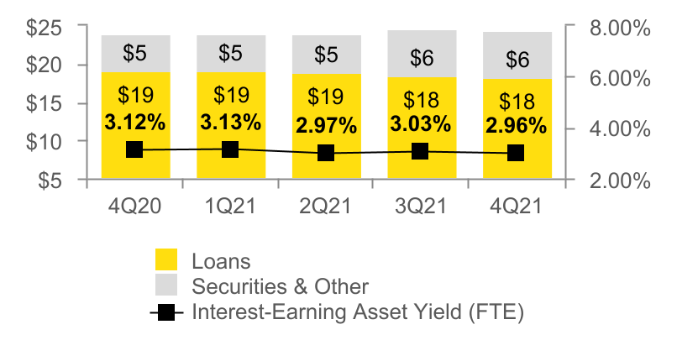
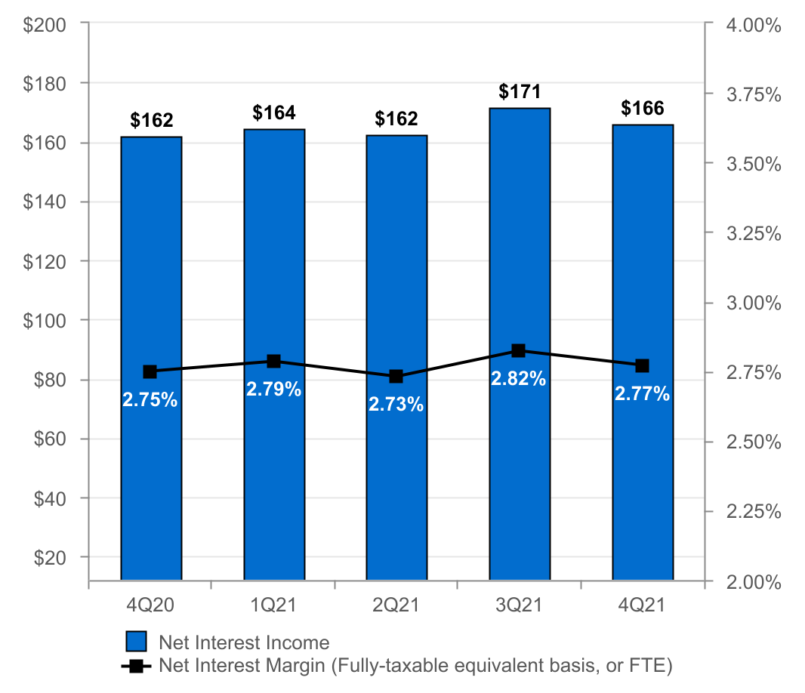
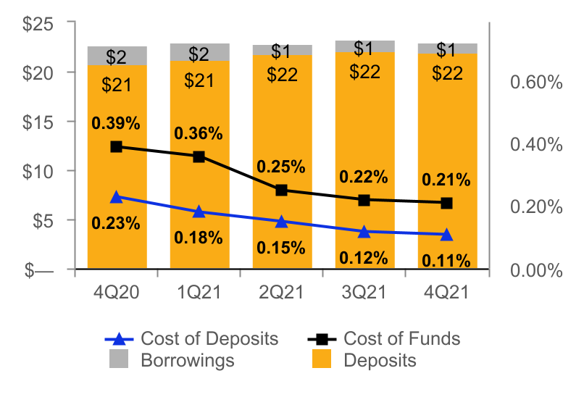
NET INTEREST INCOME AND MARGIN
Net Interest Income & Net Interest Margin
Average Interest-Earning Assets & Yields
($ IN MILLIONS)
($ IN BILLIONS)
Average Deposits and Borrowings & Cost of Funds
($ IN BILLIONS)
4

Slide 5
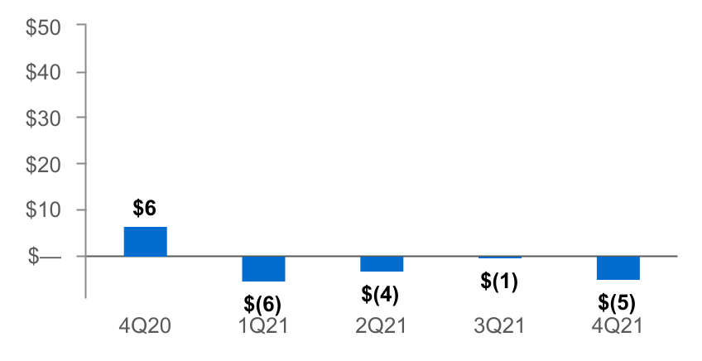
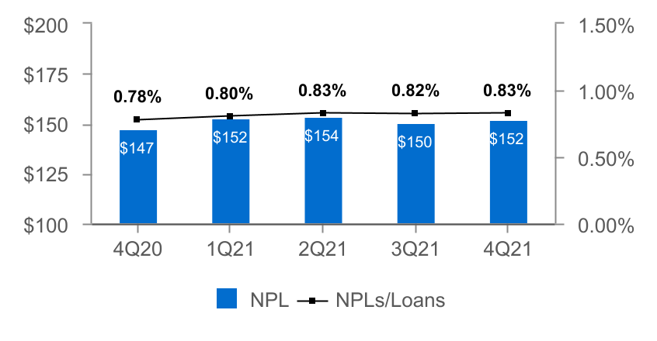
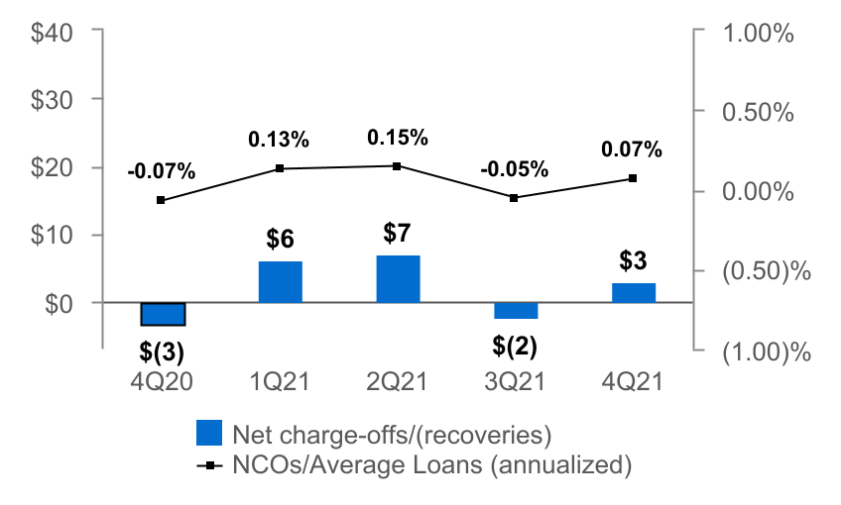
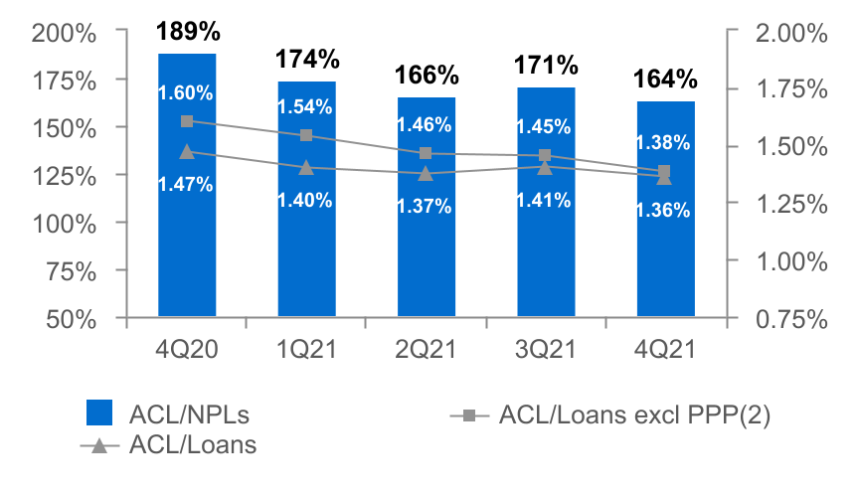
ASSET QUALITY
($ IN MILLIONS)
Provision for Credit Losses
Non-Performing Loans (NPLs) & NPLs to Loans
Net Charge-offs (NCOs) and NCOs to Average Loans
ACL⁽¹⁾ to NPLs & Loans
The allowance for credit losses (“ACL”) relates specifically to "Loans, net of unearned income" and does not include the ACL related to off-balance-sheet credit exposures.
Non-GAAP financial measure. Please refer to the calculation and management's reasons for using this measure on the slide titled "Non-GAAP Reconciliation" at the end of this presentation.
5

Slide 6
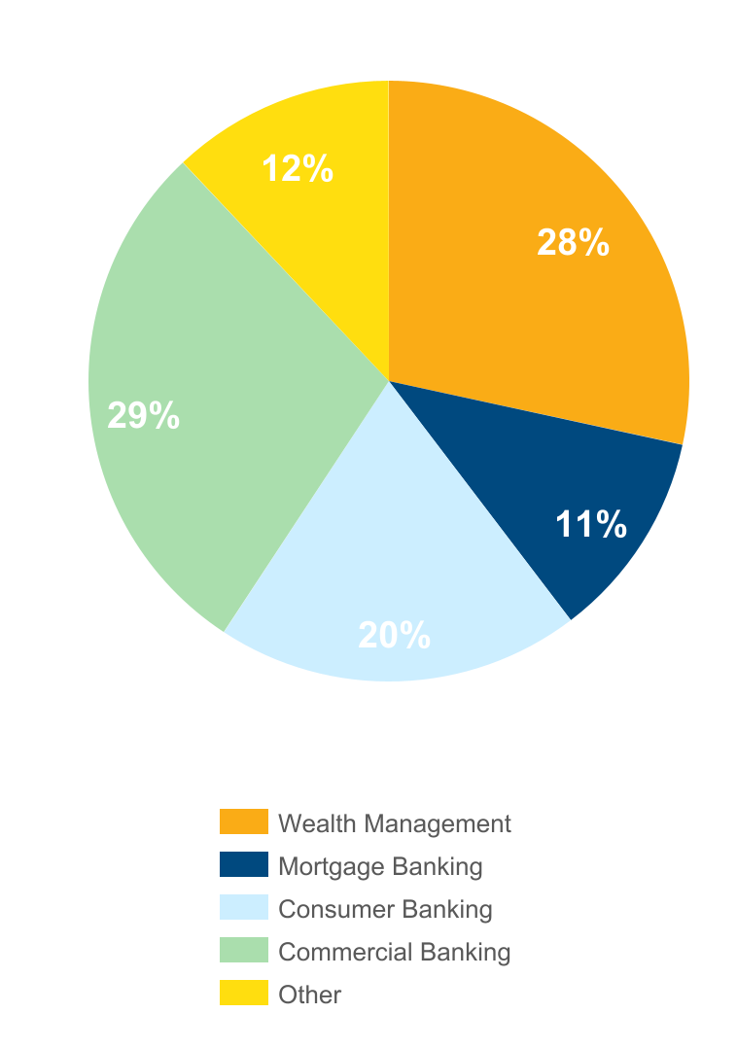
NON-INTEREST INCOME⁽¹⁾
Three months ended December 31, 2021
(percent of total non-interest income)
 |  | 4Q21 | 3Q21 | Change
 |  | (dollars in thousands)
n Wealth Management |  | $18,285 | $18,532 | ($247)
n Mortgage Banking |  | 7,243 | 9,535 | (2,292)
n Consumer Banking |  | 12,129 | 11,801 | 328
n Commercial Banking |  | 18,480 | 16,738 | 1,742
n Other |  | 7,739 | 5,971 | 1,768
Total |  | $63,876 | $62,577 | $1,299
Non-interest income increased 2% from 3Q21⁽¹⁾
Increases in:
n Commercial banking due to an increase in swap fees and an increase in income from SBA loan sales.
n Other due to an increase in income from equity method investments.
Partially offset by a decrease in:
n Mortgage banking income due to a decline in volume and a tightening of spreads on mortgage loans sales.
⁽¹⁾ Excluding investment securities gains
6

Slide 7
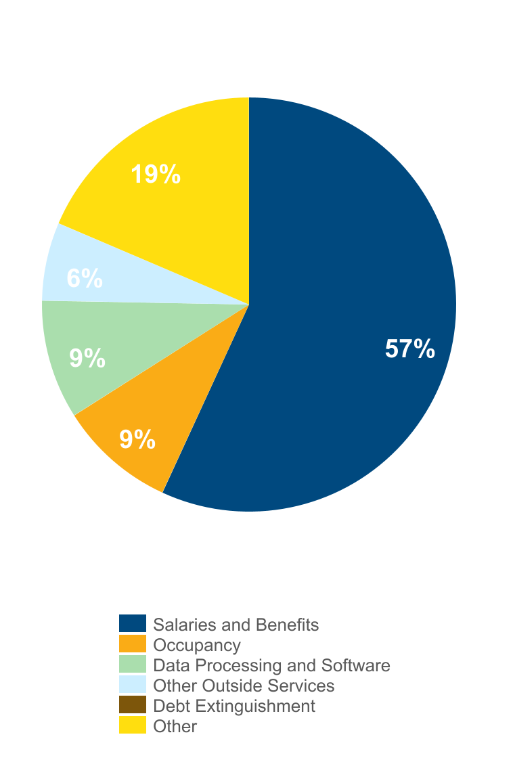
NON-INTEREST EXPENSE
Three months ended December 31, 2021
(percent of total non-interest expense)
 |  | 4Q21 | 3Q21 | Change
 |  | (dollars in thousands)
n Salaries and Benefits |  | $85,506 | $82,679 | $2,827
n Occupancy |  | 14,366 | 12,957 | 1,409
n Data Processing and Software |  | 14,612 | 14,335 | 277
n Other Outside Services |  | 9,637 | 7,889 | 1,748
n Debt Extinguishment |  | 674 | — | 674
n Other |  | 29,224 | 26,736 | 2,488
Total |  | $154,019 | $144,596 | $9,423
Non-interest expense increased 7% from 3Q21
Driven primarily by:
n Salaries and benefits as a result of higher incentive compensation and bonuses.
n Other Outside Services driven by technology-related services.
n Other due to charitable contributions, which included a $1.0 million contribution to the Fulton Forward Foundation.
7

Slide 8
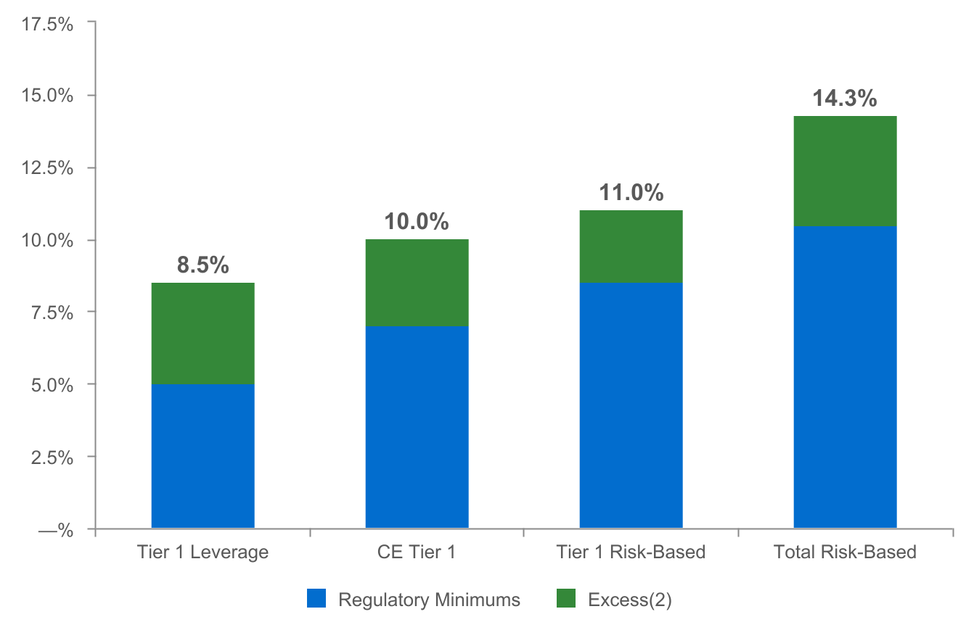
CAPITAL POSITION REMAINS STRONG⁽¹⁾
(as of December 31, 2021)
$753
$500
$605
$907
Regulatory capital ratios as of December 31, 2021 are preliminary.
Excesses shown are to regulatory minimums, including the 250 basis point capital conservation buffer, except for Tier 1 Leverage which is the well-capitalized minimum. Dollars are in millions.
8

Slide 9
2022 OUTLOOK
Net interest income: $660 - $680 million
Non-interest income: $230 - $245 million⁽¹⁾
Non-interest expense: $580 - $600 million
Effective tax rate: 16.5% - 17.5%
⁽¹⁾ Excludes investment securities gains.
9

Slide 10
NON-GAAP RECONCILIATION
Note: The Corporation has presented the following non-GAAP (Generally Accepted Accounting Principles) financial measures because it believes that these measures provide useful and comparative information to assess trends in the Corporation's results of operations and financial condition. Presentation of these non-GAAP financial measures is consistent with how the Corporation evaluates its performance internally and these non-GAAP financial measures are frequently used by securities analysts, investors and other interested parties in the evaluation of companies in the Corporation's industry. Investors should recognize that the Corporation's presentation of these non-GAAP financial measures might not be comparable to similarly-titled measures of other companies. These non-GAAP financial measures should not be considered a substitute for GAAP basis measures and the Corporation strongly encourages a review of its condensed consolidated financial statements in their entirety.
(dollars in thousands) |  | Three months ended
 |  | Dec 31 |  | Sep 30 |  | Dec 31
Return on average common shareholders' equity (tangible) |  | 2021 |  | 2021 |  | 2020
Net income available to common shareholders |  | $59,325 |  | $73,021 |  | $48,690
Plus: Intangible amortization, net of tax |  | 114 |  | 118 |  | 104
Net income available to common shareholder's (numerator) |  | 59,439 |  | 73,139 |  | 48,794
Average shareholders' equity |  | $2,713,198 |  | $2,722,833 |  | $2,544,866
Less: Average preferred stock |  | (192,878) |  | (192,878) |  | (127,639)
Less: Average goodwill and intangible assets |  | (536,638) |  | (536,772) |  | (535,474)
Average tangible common shareholders' equity (denominator) |  | $1,983,682 |  | $1,993,183 |  | $1,881,753
Return on average common shareholders' equity (tangible), annualized |  | 11.89 % |  | 14.56 % |  | 10.32 %
10

Slide 11
NON-GAAP RECONCILIATION
(dollars in thousands) |  | Three months ended
 |  | Dec 31 |  | Sep 30 |  | Dec 31
Efficiency ratio |  | 2021 |  | 2021 |  | 2020
Non-interest expense |  | $154,019 |  | $144,596 |  | $154,738
Less: Amortization of tax credit investments |  | (1,547) |  | (1,546) |  | (1,532)
Less: Intangible amortization |  | (146) |  | (150) |  | (132)
Less: 2020 cost savings initiatives |  | — |  | — |  | (15,400)
Less: Debt extinguishment costs |  | (674) |  | — |  | —
Non-interest expense (numerator) |  | $151,652 |  | $142,900 |  | $137,674
Net interest income |  | $165,613 |  | $171,270 |  | $161,591
Tax equivalent adjustment |  | 3,184 |  | 3,114 |  | 2,987
Plus: Total non-interest income |  | 63,881 |  | 62,577 |  | 55,574
Less: Investment securities gains, net |  | (5) |  | — |  | —
Total revenue (denominator) |  | $232,673 |  | $236,961 |  | $220,152
Efficiency ratio |  | 65.2% |  | 60.3% |  | 62.5%
 | Dec 31 |  | Sep 30 |  | Jun 30 |  | Mar 31 |  | Dec 31
Asset Quality, excluding PPP | 2021 |  | 2021 |  | 2021 |  | 2021 |  | 2020
ACL - loans (numerator) | $249,001 |  | $256,727 |  | $255,032 |  | $265,986 |  | $277,567
Net loans | $18,325,350 |  | $18,269,407 |  | $18,586,756 |  | $18,990,986 |  | $18,900,820
Less: PPP loans | (301,253) |  | (590,447) |  | (1,114,401) |  | (1,688,394) |  | (1,581,712)
Total adjusted loans (denominator) | $18,024,097 |  | $17,678,960 |  | $17,472,355 |  | $17,302,592 |  | $17,319,108
ACL - loans to total adjusted loans | 1.38% |  | 1.45% |  | 1.46% |  | 1.54% |  | 1.60%
11

