Slide 1
Acquisition of Prudential Bancorp, Inc.
Filed by: Fulton Financial Corporation
Pursuant to Rule 425 under the Securities Act of 1933
and deemed filed under Rule 14a-12 of the
Securities Exchange Act of 1934
Subject Company: Prudential Bancorp, Inc.
SEC File No. 000-55084
March 2, 2022

Slide 2

FORWARD LOOKING STATEMENTS
Safe Harbor Statement
This communication contains "forward-looking statements" within the meaning of the Private Securities Litigation Reform Act of 1995. Forward-looking statements can be identified by the use of words such as "may," "should," "will," "could," "estimates," "predicts," "potential," "continue," "anticipates," "believes," "plans," "expects," "future," "intends," “projects,” the negative of these terms and other comparable terminology. These forward-looking statements include, but are not limited to, statements regarding the outlook and expectations of Fulton and Prudential with respect to the merger, the strategic benefits and financial benefits of the merger, including the expected impact of the transaction on Fulton’s future financial performance (including anticipated accretion to earnings per share and other metrics), and the timing of the closing of the transaction.
Forward-looking statements are neither historical facts, nor assurance of future performance. Instead, the statements are based on current beliefs, expectations and assumptions regarding the future of the businesses of Fulton and Prudential, future plans and strategies, projections, anticipated events and trends, the economy and other future conditions. Because forward-looking statements relate to the future, they are subject to inherent uncertainties, risks and changes in circumstances that are difficult to predict and many of which are outside of Fulton’s and Prudential’s control, and actual results and financial condition may differ materially from those indicated in the forward-looking statements. Therefore, you should not unduly rely on any of these forward-looking statements. Any forward-looking statement is based only on information currently available and speaks only as of the date when made. Fulton and Prudential undertake no obligation, other than as required by law, to update or revise any forward-looking statements, whether as a result of new information, future events or otherwise.
Annualized, pro forma, projected and estimated numbers are used for illustrative purpose only, are not forecasts and may not reflect actual results.
Forward-looking statements contained in this communication are subject to, among others, the following risks, uncertainties and assumptions:
The possibility that the anticipated benefits of the transaction, including anticipated cost savings and strategic gains, are not realized when expected or at all, including as a result of the impact of, or challenges arising from, the integration of Prudential into Fulton or as a result of the strength of the economy, competitive factors in the areas where Fulton and Prudential do business, or as a result of other unexpected factors or events;
The timing and completion of the merger transaction is dependent on the satisfaction of customary closing conditions, including approval by Prudential shareholders, which cannot be assured, the satisfaction of certain other conditions that are specific to this transaction (see disclosure in the Form 8-K filed by Fulton with the SEC on the date hereof) and various factors that cannot be predicted with precision at this point
The occurrence of any event, change or other circumstances that could give rise to the right of one or both of the parties to terminate the Merger Agreement;
Completion of the merger is subject to bank regulatory approvals and such approvals may not be obtained in a timely manner or at all, or may be subject to conditions that may cause additional significant expense or delay the consummation of the merger;
Potential adverse reactions or changes to business or employee relationships, including those resulting from the announcement or completion of the merger;
The outcome of any legal proceedings related to the merger which may be instituted against Fulton or Prudential;
Unanticipated challenges or delays in the integration of Prudential’s business into Fulton’s business and or the conversion of Prudential’s operating systems and customer data onto Fulton’s may significantly increase the expense associated with the merger; and
Other factors that may affect future results of Fulton and Prudential.
These forward-looking statements are also subject to the principal risks and uncertainties applicable to Fulton’s and Prudential’s respective businesses and activities generally that are disclosed in Fulton’s Annual Report on Form 10-K for its fiscal year ended December 31, 2021 and in other documents Fulton files with the SEC, and in Prudential’s Annual Report on Form 10-K, as amended, for its fiscal year ended September 30, 2021 and in other documents Prudential files with the SEC. Fulton’s and Prudential’s SEC filings are accessible on the SEC website at www.sec.gov.

Slide 3
NON-GAAP FINANCIAL MEASURES AND ADDITIONAL INFORMATION
Non-GAAP Financial Measures
The Corporation uses certain non-GAAP financial measure in this presentation. These non-GAAP financial measures are reconciled to the most comparable GAAP measurers at the end of this presentation.
Additional Information About the Proposed Merger and Where to Find It
Fulton will file a registration statement with the SEC under the Securities Act of 1933, as amended, which will include a proxy statement/prospectus and other relevant documents in connection with the proposed Merger. PRUDENTIAL SHAREHOLDERS ARE URGED TO READ THE PROXY STATEMENT/PROSPECTUS CAREFULLY WHEN IT BECOMES AVAILABLE, INCULDING ANY AMENDMENTS OR SUPPLEMENTS TO IT, BECAUSE IT WILL CONTAIN IMPORTANT INFORMATION ABOUT THE PROPOSED MERGER.
The proxy statement/prospectus (when it becomes available) and any other documents Fulton has filed and will file with the SEC may be obtained free of charge at the SEC’s website (www.sec.gov). In addition, copies of the documents Fulton has filed or will file with the SEC may be obtained free of charge on Fulton’s website at www.fult.com or by contacting Matt Jozwiak, Fulton Financial Corporation, One Penn Square, Lancaster, PA 17602.
Participants in the Transaction
The directors, executive officers, and certain other members of management, and employees of Fulton and Prudential are participants in the solicitation of proxies in favor of the proposed Merger from the shareholders of Prudential. Information regarding the director and executive officers of Fulton and Prudential, and the interests of such participants, will be included in the proxy statement/prospectus and the other relevant documents filed with the SEC when they become available. Free copies of this document may be obtained as described in the preceding paragraph.
No Offer of Solicitation
This presentation and related communications are not intended to and shall not constitute an offer to sell or the solicitation of an offer to sell or the solicitation of an offer to buy any securities or a solicitation of any vote of approval, nor shall there be any sale of securities in any jurisdiction in which such offer, solicitation or sale, would be unlawful prior to registration or qualification under the securities laws of any such jurisdiction. No offer of securities shall be made except by means of a prospectus that meets the requirements of Section 10 of the Securities Act of 1933, as amended.

Slide 4
TRANSACTION HIGHLIGHTS
Enhances Presence in Highly Attractive & Strategically Important Philadelphia Metro Market
  Increases our presence, balance sheet and customer base
  Further establishes our brand in the market
  Solidifies our commitment to serving the Philadelphia communities and our urban market strategies
Financially Compelling with Favorable Risk/Reward Dynamics
  3.5% EPS accretion in 2023 calculated based on consensus analyst estimates
  Tangible book value dilution under 1% with earn back period of 1.2 years (utilizing the cross-over method)
  45% cost savings (80% phase-in for post close 2022, 100% thereafter)
  Significantly more accretive relative to utilizing capital for a share buyback
Immediate Opportunities To:
  Re-price higher cost time deposits and restructure wholesale liabilities
  Leverage Fulton’s technology investments and optimize the acquired branch footprint
  Expand Prudential’s commercial lending relationships due to increased lending limit (not modeled)
Lower Integration Risk
  4% of Fulton’s balance sheet as of December 31, 2021
  40+ Fulton team members participating in due diligence process
  Both companies utilize the same core processor
  Acquisition is not disruptive to internal initiatives

Slide 5

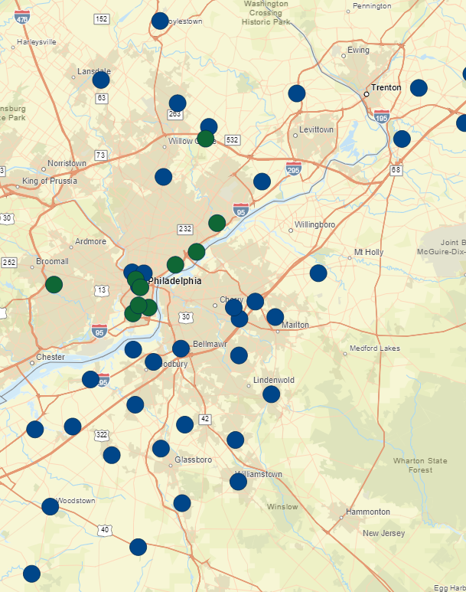
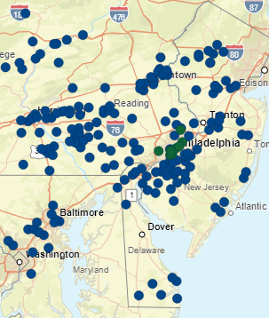
OVERVIEW OF PRUDENTIAL BANCORP, INC.
FULT
PBIP
Financial Highlights
$ in millions; data as of or for the quarter ended December 31, 2021
Source: S&P Global Market Intelligence.
(1) Market Capitalization as of 3/1/2022.
(2) Non-GAAP financial measure. Please refer to the calculation for this measure on the slide titled “Non-GAAP Reconciliation” at the end of this presentation.
(3) Annualized.

Slide 6
COMPLEMENTARY BUSINESS MODEL, BALANCE SHEET & ASSET QUALITY PROFILE
Gross Loans
Total Deposits
For the quarter ended 12/31/2021
For the quarter ended 12/31/2021
4.15%
Yield on Loans
1.09%
Cost of Total Deposits
Credit Highlights
Core Deposit Highlights
~1.42%
ALLL / Loans
~104%
ALLL / NPLs⁽¹⁾
~1.1%
NPAs⁽¹⁾ / Assets
Non-maturity, non-wholesale deposits are highly granular and long-dated customers
Continued tailwind in cost of funds reduction with maturing CDs
Ability to run-off wholesale funding and replace with Fulton core deposits
~0.02%
NCOs / Avg. Loans⁽²⁾
~0.06%
Average 5 year NCOs / Avg. Loans
Source: S&P Global Market Intelligence, SEC Filings.
Note: Data as of 12/31/2021 unless otherwise stated.
(1) Excludes performing TDRs.
(2) For the twelve months ended 12/31/3021.

Slide 7

EXPANDS ON OUR EXISTING PHILADELPHIA PRESENCE
Opportunity Overview
Philadelphia County Deposit Market Share
Strategic, in-market acquisition, accelerating our Philadelphia and urban market strategies
Strategically important market for Fulton's organic growth & expansion
Fulton’s current Philadelphia presence and expansion efforts:
  4 financial centers opened since 2019 with plans to open another in early 2023
  21 team members, primarily commercial revenue producing roles, located in Philadelphia today
  $500 million in loans and $140 million in deposits at year end 2021
Ability to overlay Fulton’s product suite onto Prudential’s predominantly commercial customer base
Complements existing momentum in Fulton C&I lending growth with additional inroads to consumers and small businesses
Enhances our ability to benefit from larger bank M&A-related disruption
Favorable market demographics and competitive landscape
Average Branch Size in Philadelphia County
$ in millions
Source: S&P Global Market Intelligence, FDIC. Note: FDIC data as of 6/30/2021.

Slide 8
TRANSACTION TERMS & FINANCIAL IMPACT
Consideration
Approximately $142 million aggregate deal value with $140 million in common stock⁽¹⁾ and cash for Prudential common stockholders and $2 million in cash for Prudential optionholders⁽²⁾
80% stock and 20% cash consideration for each outstanding common share of Prudential, representing 6.2 million Fulton shares issued (fixed exchange ratio of 0.7974) and $28 million cash consideration ($3.65 per share)
Outstanding stock options to be exchanged for cash
Prudential shareholders will own approximately 3.8% of Fulton shares on a pro forma basis
Key Transaction Assumptions
45% cost savings (80% phase-in for post close 2022, 100% thereafter)
$16.5 million pre-tax deal charges / $14.0 million after-tax deal charges
1.86% loan credit mark (81% non-PCD / 19% PCD)
  Non-PCD assumes 5 year accretion using SOYD methodology
0.68% loan interest rate mark-up
$900k in additional pre-tax net purchase accounting marks (downward adjustment to TCE)
Pro forma modeling includes re-positioning of Prudential’s long-term wholesale funding
0.75% core deposit intangible (amortized over 10 years using SOYD methodology)
Financial Impacts
3.5% EPS accretion in 2023 calculated based on consensus estimates
Less than 1% dilution to tangible book value with earn back period of 1.2 years (utilizing the cross-over method)
+30% IRR and 14% ROIC
Neutral impact to capital ratios
Closing & Other
Targeted close in Q3’2022
Requires regulatory approvals and approval of Prudential’s stockholders
Note: PCD = Purchase Credit Deteriorated, SOYD = Sum of Years Digits.
(1) Based on Fulton 10 day VWAP of $18.01 as of 3/1/2022.
(2) Based on $18.25 per Prudential Share.

Slide 9
HIGHLY ATTRACTIVE TRANSACTION ECONOMICS
Valuation In-Line or Better Than Comparable Deals
Compelling Utilization of Capital
Source: S&P Global Market Intelligence, Company documents. Note: Transaction data as of deal announcement date.
(1) Criteria based on Mid-Atlantic bank and thrift transactions since 1/1/2019, where target assets were between $500 million and $2 billion and stock consideration was 50%+ of total consideration, excluding merger of equals, where deal value was disclosed.
(2) Criteria based on Nationwide bank and thrift transactions since 1/1/2021, where target assets were between $750 million and $1.5 billion and stock consideration was 50%+ of total consideration, excluding merger of equals, where deal value was disclosed.
(3) Criteria based on Nationwide bank and thrift transactions since 1/1/2019, where target assets were less than or equal to 10% of buyer assets and stock consideration was 50%+ of total consideration, excluding merger of equals, where deal value was greater than $50 million.
(4) Adjusted TBV defined as 12/31/21 tangible book value per share adjusted for $7.6 million in after-tax charges related to certain litigation expected to be resolved prior to closing.
(5) Based on Fulton management’s forecast developed during the due diligence process
(6) Cost savings of 45% of PBIP’s 2022E noninterest expense.
(7) Pay-to-Trade multiple defined as transaction Price/TBV divided by Buyer P/TBV.
(8) Assumes $30 million dollar buyback at $18.01 per share (10 day VWAP as of 3/1/2022).

Slide 10
COMPREHENSIVE DUE DILIGENCE PERFORMED
Comprehensive diligence process focusing on 8 workstreams: Commercial Banking, Consumer Banking, Operations, IT, Risk/Compliance, Legal, Human Resources and Finance involving 40+ professionals
Coordinated by and between key executives from FULT and PBIP, including external counsel and financial advisors
Oversight and Governance provided by Fulton’s Senior Management, Executive Steering Committee and Board
Key areas of focus:
Commercial & Consumer Banking
Loan and deposits portfolios and key relationships
Branch performance and costs
Product offerings
Key talent (jointly with HR)
Customer profiles and Market opportunities
Credit Risk
Reviewed 49% of loans outstanding, focusing on the commercial portfolio, with a sampling of consumer
All loans over $4 million, watchlist loans over $500k
All special mention and substandard loans and all loans to office space, hospitality, and recreation industries.
Underwriting criteria and credit risk appetite
Operations & Technology
Technology, systems, processing, security and cyber security
Key vendors and contracts
Physical locations and security
Operational processes and risk
Legal & Compliance
Regulatory, compliance and audit
Legal and litigation
Corporate governance
Human Resources & Finance
Human capital, benefit & incentive plans and culture
Staffing and Covid protocols
Balance sheet, liquidity and capital
Business plan and outlook
Real estate, taxes and vendor spend

Slide 11
SUMMARY
High-quality partner with a track record of strong asset quality
Significantly enhancing our presence in the strategically important Philadelphia market
Lower execution risk given relative size and Fulton’s familiarity with Prudential market
  Only 4% of Fulton’s assets
  Achievable cost synergies given overlap and same core IT processor
  Extensive due diligence performed
Financially attractive with incremental benefit to earnings while preserving tangible book value / capital

Slide 12
NON-GAAP RECONCILIATION
Prudential Bancorp, Inc.
Source: S&P Global Market Intelligence.

