Slide 1
FIRST QUARTER 2022 RESULTS
NASDAQ: FULT
Data as of or for the periods ended March 31, 2022 unless otherwise noted

Slide 2
FORWARD-LOOKING STATEMENTS
This presentation may contain forward-looking statements with respect to the Corporation’s financial condition, results of operations and business. Do not unduly rely on forward-looking statements. Forward-looking statements can be identified by the use of words such as "may," "should," "will," "could," "estimates," "predicts," "potential," "continue," "anticipates," "believes," "plans," "expects," "future," "intends," “projects,” the negative of these terms and other comparable terminology. These forward-looking statements may include projections of, or guidance on, the Corporation’s future financial performance, expected levels of future expenses, including future credit losses, anticipated growth strategies, descriptions of new business initiatives and anticipated trends in the Corporation’s business or financial results. Management’s "2022 Outlook "contained herein is comprised of forward-looking statements.
Forward-looking statements are neither historical facts, nor assurance of future performance. Instead, the statements are based on current beliefs, expectations and assumptions regarding the future of the Corporation’s business, future plans and strategies, projections, anticipated events and trends, the economy and other future conditions. Because forward-looking statements relate to the future, they are subject to inherent uncertainties, risks and changes in circumstances that are difficult to predict and many of which are outside of the Corporation’s control, and actual results and financial condition may differ materially from those indicated in the forward-looking statements. Therefore, you should not unduly rely on any of these forward-looking statements. Any forward-looking statement is based only on information currently available and speaks only as of the date when made. The Corporation undertakes no obligation, other than as required by law, to update or revise any forward-looking statements, whether as a result of new information, future events or otherwise.
A discussion of certain risks and uncertainties affecting the Corporation, and some of the factors that could cause the Corporation’s actual results to differ materially from those described in the forward-looking statements, can be found in the sections entitled “Risk Factors” and “Management’s Discussion and Analysis of Financial Condition and Results of Operations” in the Corporation’s Annual Report on Form 10-K for the year ended December 31, 2021 and other current and periodic reports, which have been or will be filed with the Securities and Exchange Commission (the "SEC"), including the risks, uncertainties and assumptions regarding the Corporation's pending acquisition of Prudential Bancorp, Inc. set forth under the heading "Safe Harbor Statement" in the Corporation's Current Report on Form 8-K filed on March 2, 2022, and are or will be available in the Investor Relations section of the Corporation’s website (www.fultonbank.com) and on the SEC’s website (www.sec.gov).
The Corporation uses certain non-GAAP financial measures in this presentation. These non-GAAP financial measures are reconciled to the most comparable GAAP measures at the end of this presentation (GAAP: Generally Accepted Accounting Principles).
2

Slide 3
INCOME STATEMENT SUMMARY
 | 1Q22 | 4Q21 | 1Q21
 | (dollars in thousands, except per-share data)
Net Interest Income | $161,310 | $165,613 | $164,449
Provision for Credit Losses | (6,950) | (5,000) | (5,500)
Non-Interest Income | 55,237 | 63,876 | 61,921
Securities Gains | 19 | 5 | 33,475
Non-Interest Expense | 145,978 | 154,019 | 178,384
Income before Income Taxes | 77,538 | 80,475 | 86,961
Income Taxes | 13,250 | 18,588 | 13,898
Net Income | 64,288 | 61,887 | 73,063
Preferred Stock Dividends | (2,562) | (2,562) | (2,591)
Net Income Available to Common Shareholders | $61,726 | $59,325 | $70,472
Net income per share (diluted) | $0.38 | $0.37 | $0.43
ROA⁽¹⁾ | 1.02% | 0.94% | 1.14%
ROE⁽²⁾ | 10.03% | 9.34% | 11.73%
ROE (tangible)⁽³⁾ | 12.88% | 11.89% | 15.00%
Efficiency ratio⁽³⁾ | 65.8% | 65.2% | 63.0%
ROA is return an average assets calculated as net income for the period divided by average assets, annualized.
ROE is return on average common shareholders’ equity calculated as net income available to common shareholders for the period divided by average common shareholders’ equity, annualized.
Non-GAAP financial measure. Please refer to the calculation and management’s reasons for using this measure on the slide titled “Non-GAAP Reconciliation” at the end of this presentation.
3

Slide 4
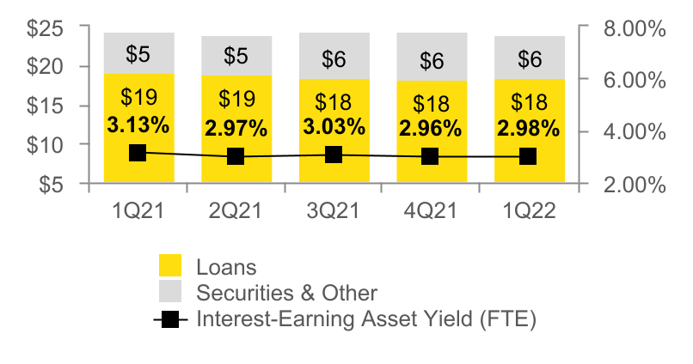
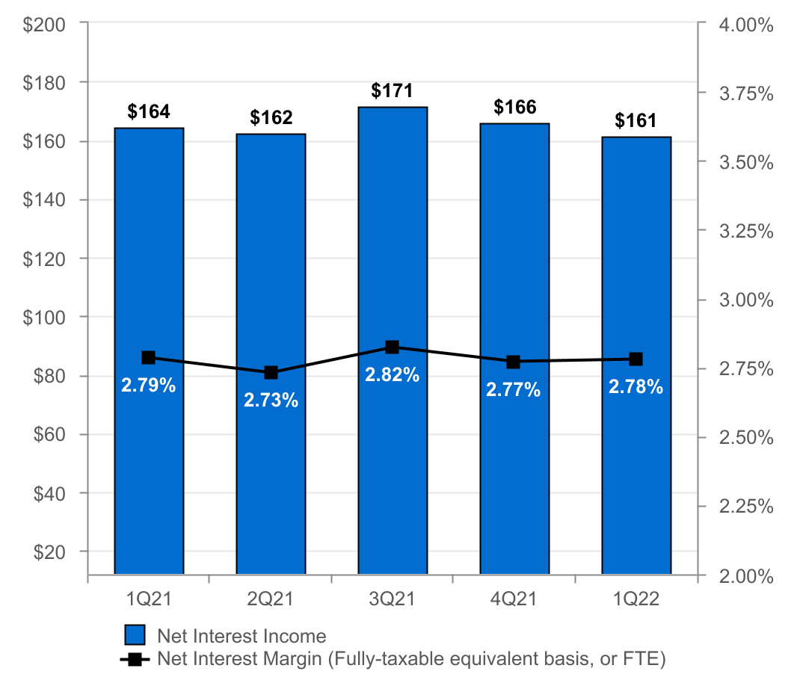
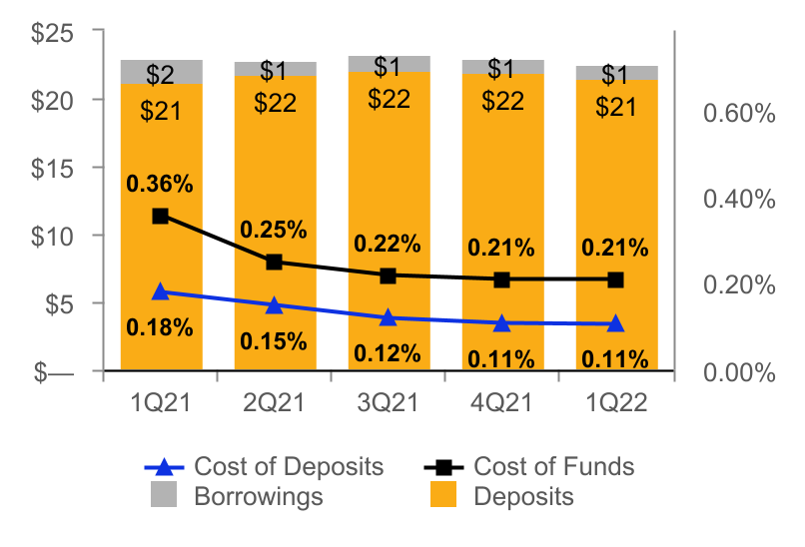
NET INTEREST INCOME AND MARGIN
Net Interest Income & Net Interest Margin
Average Interest-Earning Assets & Yields
($ IN MILLIONS)
($ IN BILLIONS)
Average Deposits and Borrowings & Cost of Funds
($ IN BILLIONS)
4

Slide 5
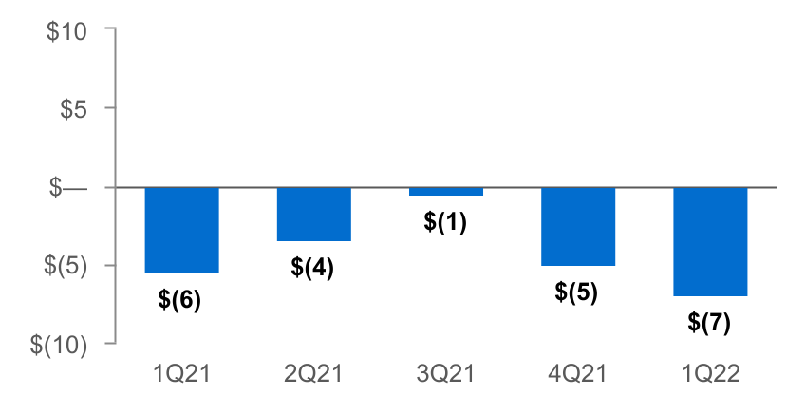
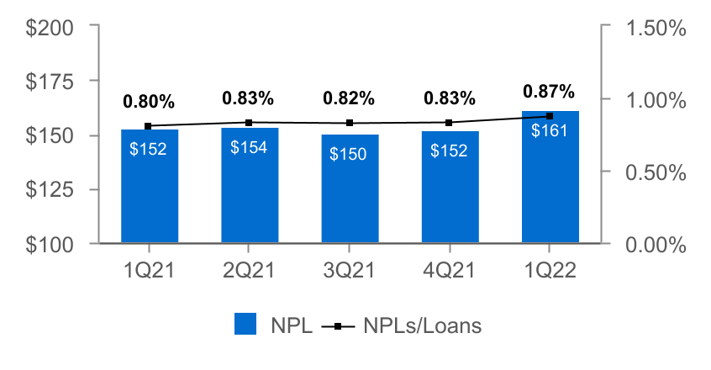
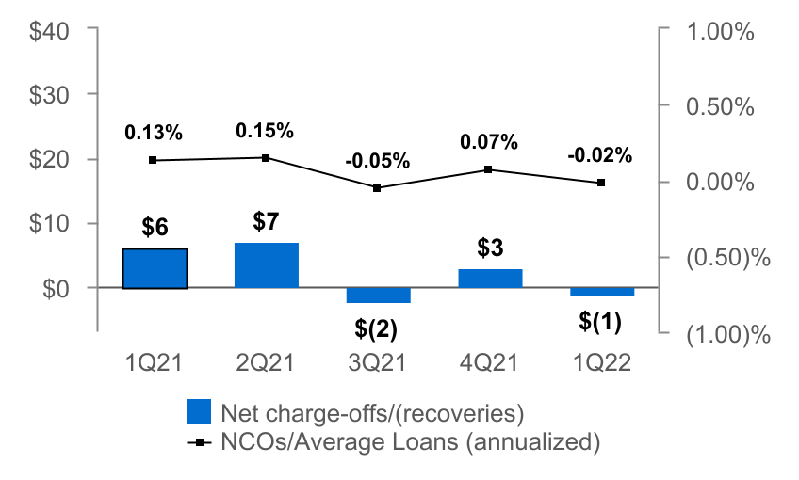
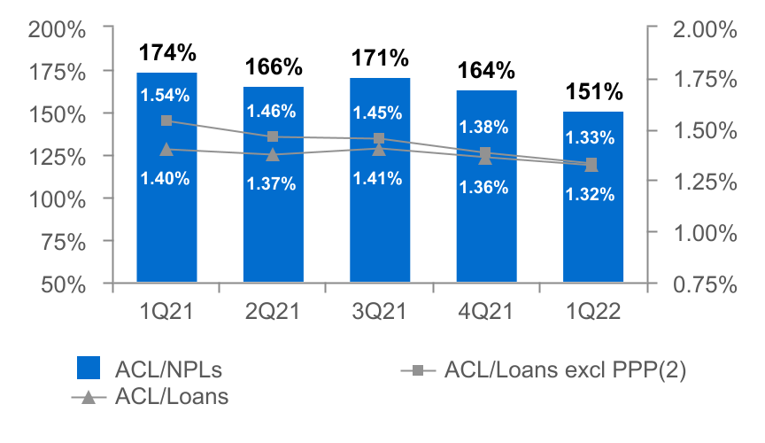
ASSET QUALITY
($ IN MILLIONS)
Provision for Credit Losses
Non-Performing Loans (NPLs) & NPLs to Loans
Net Charge-offs (NCOs) and NCOs to Average Loans
ACL⁽¹⁾ to NPLs & Loans
The allowance for credit losses (“ACL”) relates specifically to "Loans, net of unearned income" and does not include the ACL related to off-balance-sheet credit exposures.
Non-GAAP financial measure. Please refer to the calculation and management's reasons for using this measure on the slide titled "Non-GAAP Reconciliation" at the end of this presentation.
5

Slide 6
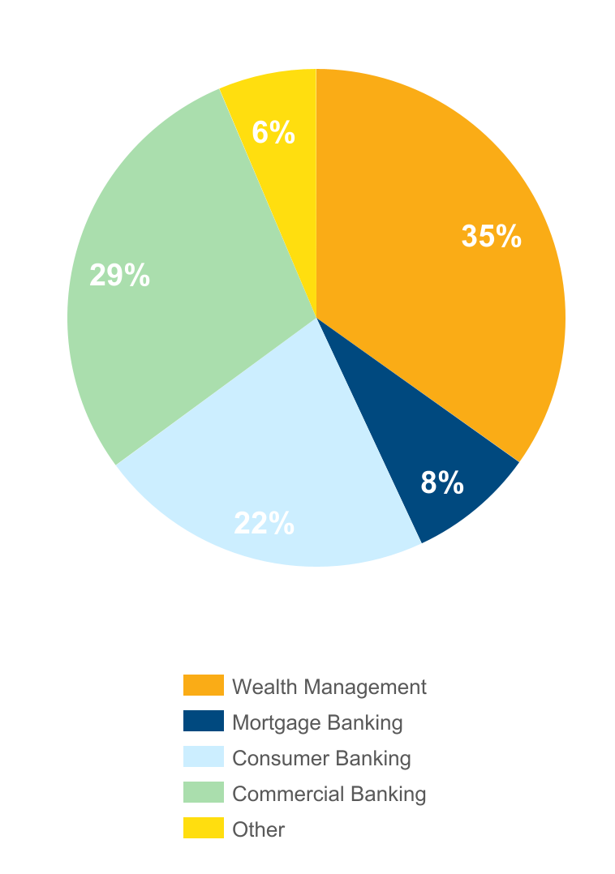
NON-INTEREST INCOME⁽¹⁾
Three months ended March 31, 2022
(percent of total non-interest income)
 |  | 1Q22 | 4Q21 | Change
 |  | (dollars in thousands)
n Wealth Management |  | $19,428 | $18,285 | $1,143
n Mortgage Banking |  | 4,576 | 7,243 | (2,667)
n Consumer Banking |  | 11,674 | 12,129 | (455)
n Commercial Banking |  | 16,008 | 18,480 | (2,472)
n Other |  | 3,551 | 7,739 | (4,188)
Total |  | $55,237 | $63,876 | ($8,639)
Non-interest income decreased 14% from 4Q21⁽¹⁾
Increases in:
n Wealth Management due to solid fee income growth during the quarter.
Decreases in:
n Mortgage banking income due to a decline in volume and a tightening of spreads on mortgage loans sales.
n Commercial banking primarily due to a decrease in customer interest rate swap fee income.
n Other income primarily due to a decline in income from equity method investments.
⁽¹⁾ Excluding investment securities gains
6

Slide 7
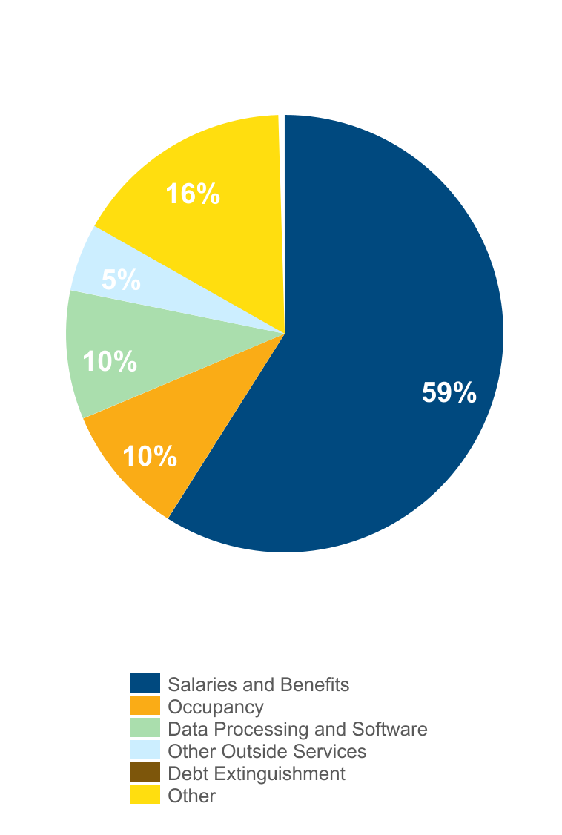
NON-INTEREST EXPENSE
Three months ended March 31, 2022
(percent of total non-interest expense)
 |  | 1Q22 | 4Q21 | Change
 |  | (dollars in thousands)
n Salaries and Benefits |  | $84,464 | $85,506 | ($1,042)
n Occupancy |  | 14,522 | 14,366 | 156
n Data Processing and Software |  | 14,315 | 14,612 | (297)
n Other Outside Services |  | 8,167 | 9,637 | (1,470)
n Debt Extinguishment |  | — | 674 | (674)
n Other |  | 24,510 | 29,224 | (4,714)
Total |  | $145,978 | $154,019 | ($8,041)
Non-interest expense decreased 5% from 4Q21
Driven primarily by:
n Salaries and benefits as a result of lower expense for incentive compensation and bonuses.
n Other Outside Services driven by technology-related services.
n Other expense due to declines of $2.2 million, $1.7 million and $1.5 million in charitable contributions and donations, state-related taxes and a net gain for owned-fixed assets, respectively.
7

Slide 8
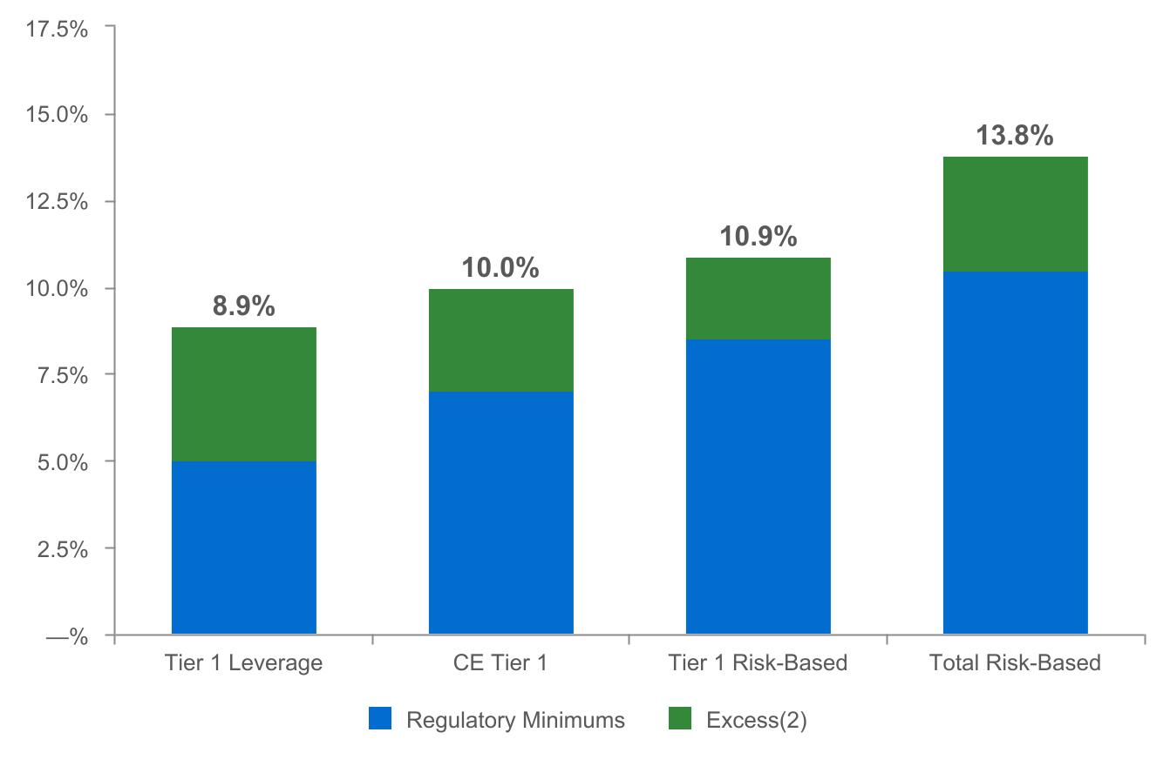
CAPITAL POSITION REMAINS STRONG⁽¹⁾
(as of March 31, 2022)
($ in millions)
$681
$492
$605
$972
Regulatory capital ratios and excess capital amounts as of March 31, 2022 are preliminary.
Excesses shown are to regulatory minimums, including the 250 basis point capital conservation buffer, except for Tier 1 Leverage which is the well-capitalized minimum. Dollars are in millions.
8

Slide 9
2022 OUTLOOK
Net interest income: $690 - $705 million⁽¹⁾
Non-interest income: $225 - $235 million⁽²⁾
Non-interest expense: $595 - $605 million⁽³⁾
Effective tax rate: 17.0% - 17.5%⁽⁴⁾
⁽¹⁾ Assumes Fed Funds Rate increases of: 50 bps in May 2022, 25 bps in June 2022, 25 bps in July 2022 and 25 bps in
September 2022. Updated as of 1Q 2022; previously $660 - $680 million.
⁽²⁾ Excludes investment securities gains. Updated as of 1Q 2022; previously $230 - $245 million.
⁽³⁾ Excludes merger-related expenses. Updated as of 1Q 2022; previously $580 - $600 million.
⁽⁴⁾ Updated as of 1Q 2022; previously 16.5% - 17.5%
9

Slide 10
NON-GAAP RECONCILIATION
Note: The Corporation has presented the following non-GAAP (Generally Accepted Accounting Principles) financial measures because it believes that these measures provide useful and comparative information to assess trends in the Corporation's results of operations and financial condition. Presentation of these non-GAAP financial measures is consistent with how the Corporation evaluates its performance internally and these non-GAAP financial measures are frequently used by securities analysts, investors and other interested parties in the evaluation of companies in the Corporation's industry. Investors should recognize that the Corporation's presentation of these non-GAAP financial measures might not be comparable to similarly-titled measures of other companies. These non-GAAP financial measures should not be considered a substitute for GAAP basis measures and the Corporation strongly encourages a review of its condensed consolidated financial statements in their entirety.
(dollars in thousands) |  | Three months ended
 |  | Mar 31 |  | Dec 31 |  | Mar 31
Return on average common shareholders' equity (tangible) |  | 2022 |  | 2021 |  | 2021
Net income available to common shareholders |  | $61,726 |  | $59,325 |  | $70,472
Plus: Merger-related expenses, net of tax |  | 317 |  | — |  | —
Plus: Intangible amortization, net of tax |  | 138 |  | 114 |  | 90
Net income available to common shareholder's (numerator) |  | 62,181 |  | 59,439 |  | 70,562
Average shareholders' equity |  | $2,688,834 |  | $2,713,198 |  | $2,637,098
Less: Average preferred stock |  | (192,878) |  | (192,878) |  | (192,878)
Less: Average goodwill and intangible assets |  | (537,976) |  | (536,638) |  | (536,601)
Average tangible common shareholders' equity (denominator) |  | $1,957,980 |  | $1,983,682 |  | $1,907,619
Return on average common shareholders' equity (tangible), annualized |  | 12.88 % |  | 11.89 % |  | 15.00 %
10

Slide 11
NON-GAAP RECONCILIATION
(dollars in thousands) |  | Three months ended
 |  | Mar 31 |  | Dec 31 |  | Mar 31
Efficiency ratio |  | 2022 |  | 2021 |  | 2021
Non-interest expense |  | $145,978 |  | $154,019 |  | $178,384
Less: Amortization of tax credit investments |  | (696) |  | (1,547) |  | (1,531)
Less: Intangible amortization |  | (176) |  | (146) |  | (115)
Less: Merger-related expenses |  | (401) |  | — |  | —
Less: Debt extinguishment costs |  | — |  | (674) |  | (32,163)
Non-interest expense (numerator) |  | $144,705 |  | $151,652 |  | $144,575
Net interest income |  | $161,310 |  | $165,613 |  | $164,449
Tax equivalent adjustment |  | 3,288 |  | 3,184 |  | 2,979
Plus: Total non-interest income |  | 55,256 |  | 63,881 |  | 95,396
Less: Investment securities gains, net |  | (19) |  | (5) |  | (33,475)
Total revenue (denominator) |  | $219,835 |  | $232,673 |  | $229,349
Efficiency ratio |  | 65.8% |  | 65.2% |  | 63.0%
 | Mar 31 |  | Dec 31 |  | Sep 30 |  | Jun 30 |  | Mar 31
Asset Quality, excluding PPP | 2022 |  | 2021 |  | 2021 |  | 2021 |  | 2021
ACL - loans (numerator) | $243,705 |  | $249,001 |  | $256,727 |  | $255,032 |  | $265,986
Net loans | $18,476,119 |  | $18,325,350 |  | $18,269,407 |  | $18,586,756 |  | $18,990,986
Less: PPP loans | (164,277) |  | (301,253) |  | (590,447) |  | (1,114,401) |  | (1,688,394)
Total adjusted loans (denominator) | $18,311,842 |  | $18,024,097 |  | $17,678,960 |  | $17,472,355 |  | $17,302,592
ACL - loans to total adjusted loans | 1.33% |  | 1.38% |  | 1.45% |  | 1.46% |  | 1.54%
11

