Slide 1
2nd Quarter 2022

Slide 2
DISCLAIMER
This presentation includes “forward-looking statements” within the meaning of the safe harbor provisions of the United States Private Securities Litigation Reform Act of 1995. Actual results may differ from expectations, estimates and projections and, consequently, readers should not rely on these forward-looking statements as predictions of future events. Words such as “goal” “expect,” “target,” “assume,” “estimate,” “project,” “budget,” “forecast,” “anticipate,” “intend,” “plan,” “may,” “will,” “could,” “should,” “believe,” “predicts,” “potential,” “continue,” and similar expressions are intended to identify such forward-looking statements. These forward-looking statements involve significant risks and uncertainties that could cause actual results to differ materially from expected results, including, among other things, those described in our most recent Annual Report on Form 10-K, and any subsequent Quarterly Reports on Form 10-Q and Current Report on Form 8-K, under the caption “Risk Factors.” Factors that could cause actual results to differ include, but are not limited to:our business and investment strategy; our ability to accurately forecast the payment of future dividends on our common and preferred stock, and the amount of such dividends; our ability to determine accurately the fair market value of our assets; availability of investment opportunities in real estate-related and other securities, including our valuation of potential opportunities that may arise as a result of current and future market dislocations; effect of the novel coronavirus (or COVID-19) pandemic on real estate market, financial markets and our Company, including the impact on the value, availability, financing and liquidity of mortgage assets; how COVID-19 may affect us, our operations and our personnel; our expected investments; changes in the value of our investments, including negative changes resulting in margin calls related to the financing of our assets; changes in interest rates and mortgage prepayment rates; prepayments of the mortgage and other loans underlying our mortgage-backed securities, or RMBS, or other asset-backed securities, or ABS; rates of default, delinquencies or decreased recovery rates on our investments; general volatility of the securities markets in which we invest; our ability to maintain existing financing arrangements and our ability to obtain future financing arrangements; our ability to effect our strategy to securitize residential mortgage loans; interest rate mismatches between our investments and our borrowings used to finance such purchases; effects of interest rate caps on our adjustable-rate investments; the degree to which our hedging strategies may or may not protect us from interest rate volatility; the impact of and changes to various government programs, including in response to COVID-19; impact of and changes in governmental regulations, tax law and rates, accounting guidance, and similar matters; market trends in our industry, interest rates, the debt securities markets or the general economy; estimates relating to our ability to make distributions to our stockholders in the future; our understanding of our competition; availability of qualified personnel; our ability to maintain our classification as a real estate investment trust, or, REIT, for U.S. federal income tax purposes; our ability to maintain our exemption from registration under the Investment Company Act of 1940, as amended, or 1940 Act; our expectations regarding materiality or significance; and the effectiveness of our disclosure controls and procedures.
Readers are cautioned not to place undue reliance upon any forward-looking statements, which speak only as of the date made. Chimera does not undertake or accept any obligation to release publicly any updates or revisions to any forward-looking statement to reflect any change in its expectations or any change in events, conditions or circumstances on which any such statement is based. Additional information concerning these and other risk factors is contained in Chimera’s most recent filings with the Securities and Exchange Commission (SEC). All subsequent written and oral forward-looking statements concerning Chimera or matters attributable to Chimera or any person acting on its behalf are expressly qualified in their entirety by the cautionary statements above.
This presentation may include industry and market data obtained through research, surveys, and studies conducted by third parties and industry publications. We have not independently verified any such market and industry data from third-party sources. This presentation is provided for discussion purposes only and may not be relied upon as legal or investment advice, nor is it intended to be inclusive of all the risks and uncertainties that should be considered. This presentation does not constitute an offer to purchase or sell any securities, nor shall it be construed to be indicative of the terms of an offer that the parties or their respective affiliates would accept.
Readers are advised that the financial information in this presentation is based on company data available at the time of this presentation and, in certain circumstances, may not have been audited by the company’s independent auditors.

Slide 3
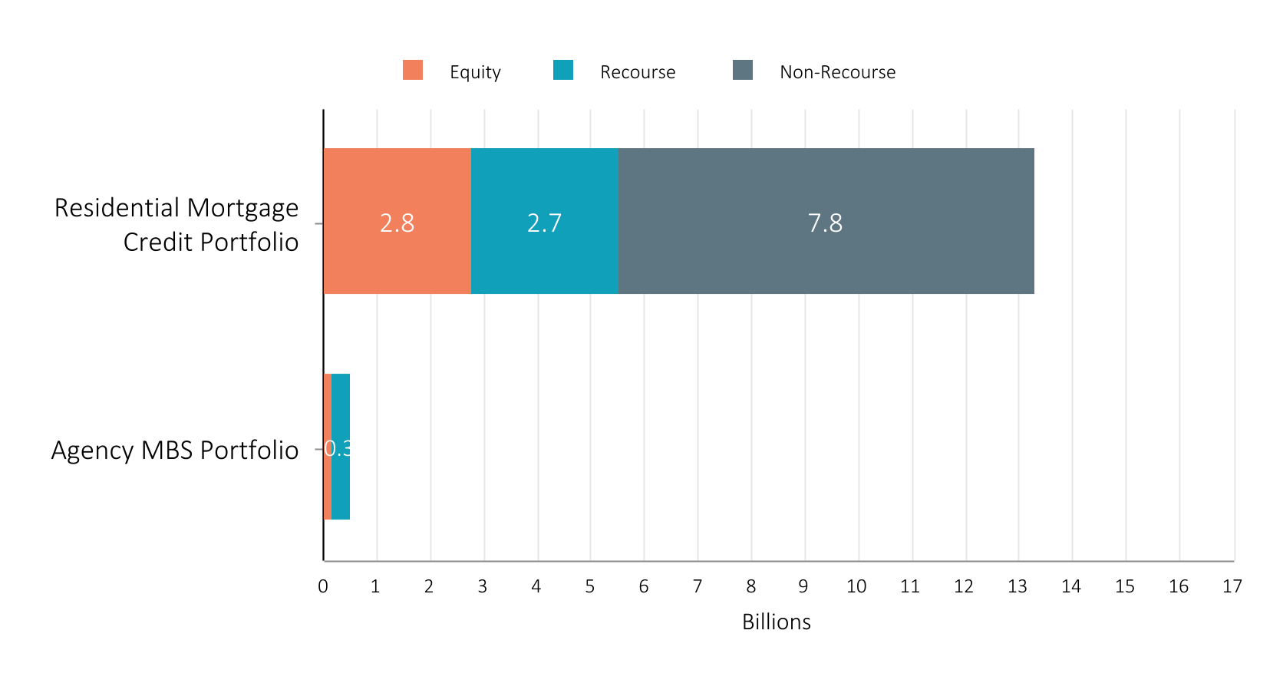
PORTFOLIO COMPOSITION
94% of Chimera's equity capital is allocated to mortgage credit
Total Assets: 13.2 billion
Equity
Recourse
Non-Recourse
Total Assets: 0.5 billion
All data is shown at carrying value as of June 30, 2022

Slide 4
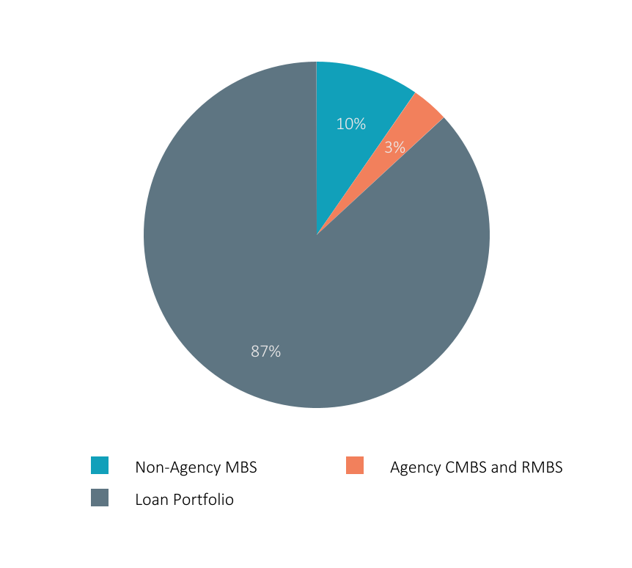
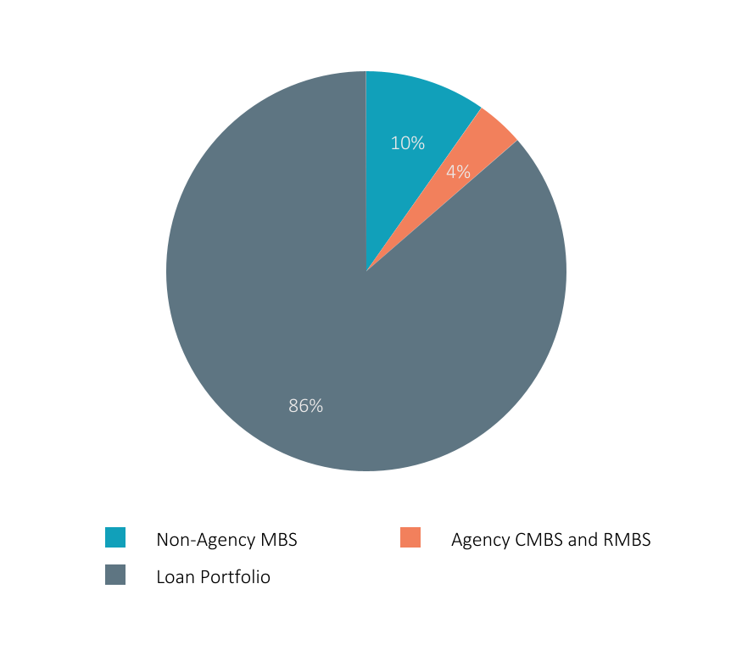
GAAP ASSET ALLOCATION
Chimera continues to focus on its Residential Credit portfolios
June 30, 2022
March 31, 2022
Total Portfolio: $13.7 billion
Total Portfolio: $14.9 billion
Based on fair value.

Slide 5
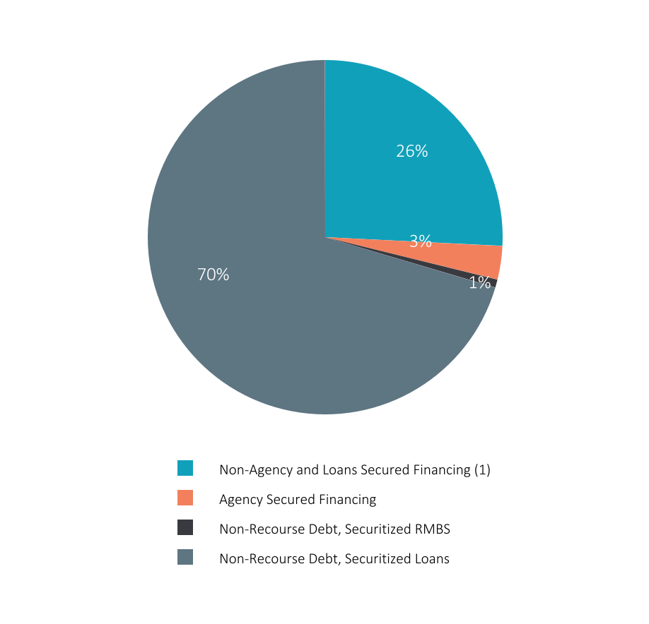

GAAP FINANCING SOURCES
Securitized debt provides optimal long-term non-recourse financing for Chimera's loan portfolio
June 30, 2022
March 31, 2022
(Rate: 3.5%)
(Rate: 2.8%)
(Rate: 1.4%)
(Rate: 0.4%)
(Rate: 2.6%)
(Rate: 2.5%)
Total Portfolio: $10.9 billion
Total Portfolio: $11.5 billion
  Includes secured financing of retained tranches from loan securitizations that are eliminated in consolidation.

Slide 6
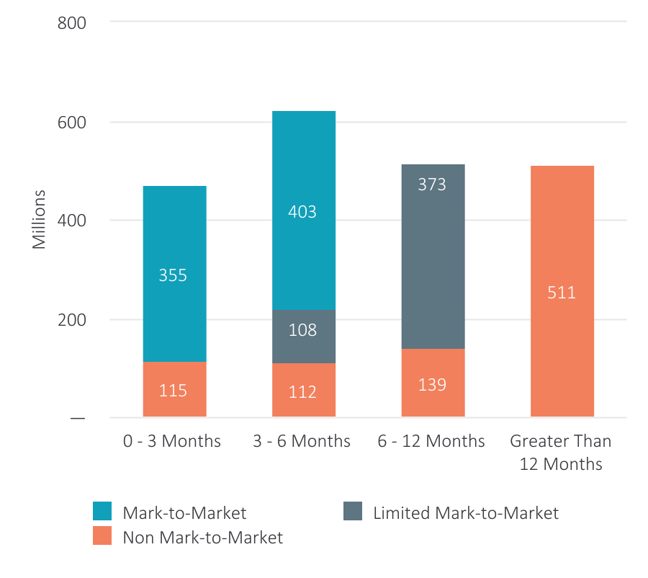
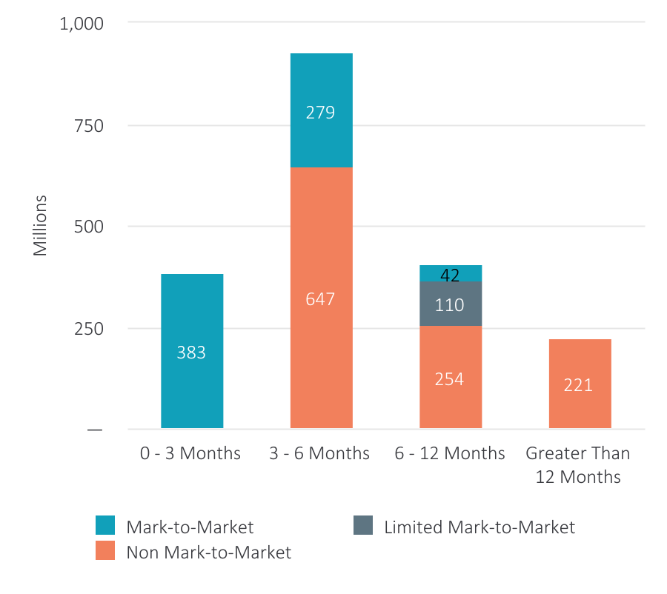
NON-AGENCY FINANCING
Chimera continues to focus on longer term and non-mark-to-market financing for its non-agency portfolio
June 30, 2022
March 31, 2022
Total Non-Agency Secured Financing: $2.1 billion⁽¹⁾
Total Non-Agency Secured Financing: $1.9 billion⁽¹⁾
  Excludes secured financing on residential mortgage loans.

Slide 7
NET INVESTMENT ANALYSIS
Continued strong net interest spread
 | Quarter ended June 30, 2022 |  |  |  | Quarter ended March 31, 2022
 | RESIDENTIAL MORTGAGE CREDIT PORTFOLIO | AGENCY PORTFOLIO | TOTAL PORTFOLIO |  | RESIDENTIAL MORTGAGE CREDIT PORTFOLIO | AGENCY PORTFOLIO | TOTAL PORTFOLIO
GROSS ASSET YIELD: | 5.6% | 4.0% | 5.5% |  | 5.5% | 3.3% | 5.4%
FINANCING COSTS: | 2.7% | 0.9% | 2.7% |  | 2.4% | 0.3% | 2.3%
NET INTEREST SPREAD: | 2.9% | 3.1% | 2.8% |  | 3.1% | 3.0% | 3.1%
NET INTEREST MARGIN: | 3.3% | 3.5% | 3.3% |  | 3.6% | 3.1% | 3.5%
Information above excludes Agency CMBS prepayment penalties for the quarter ended June 30, 2022 and March 31, 2022

Slide 8
NET ASSET BREAKDOWN
Chimera invests in RMBS securities and securities created through the CIM Sponsored securitizations. Loans are financed through Financing Trusts.
 | Chimera Subsidiaries | Securitization Trusts | Financing Trusts | Total
Investments
Non-Agency RMBS, at fair value | $ 1,012,368 | $ 309,407 | $ — | $ 1,321,775
Agency RMBS, at fair value | 73,454 | — | — | 73,454
Agency CMBS, at fair value | 455,637 | — | — | 455,637
Residential Mortgage Loans | — | 11,082,782 | 811,639 | 11,894,421
Total Invested Assets | $ 1,541,459 | $ 11,392,189 | $ 811,639 | $ 13,745,287
Securitized Debt (Non-Recourse), collateralized by:
Non-Agency RMBS | $ — | $ 81,732 | $ — | $ 81,732
Residential Mortgage Loans | — | 7,682,291 | — | 7,682,291
Total Securitized Debt (Non-recourse) | $ — | $ 7,764,023 | $ — | $ 7,764,023
Invested Assets less Securitized Debt | $ 1,541,459 | $ 3,628,166 | $ 811,639 | $ 5,981,264
Secured Financing Agreements (Recourse):
Non-Agency RMBS | $ 776,530 | $ 82,487 | $ — | $ 859,017
Agency RMBS | 7,816 | — | — | 7,816
Agency CMBS | 326,571 | — | — | 326,571
Residential Mortgage Loans | — | 1,256,448 | 698,980 | 1,955,428
Total Secured Financing Agreements | $ 1,110,917 | $ 1,338,935 | $ 698,980 | $ 3,148,832
Net Assets | $ 430,542 | $ 2,289,231 | $ 112,659 | $ 2,832,432
All data as of June 30, 2022
$ in thousands

Slide 9
CONSOLIDATED LOAN SECURITIZATIONS
VINTAGE | DEAL |  | TOTAL ORIGINAL FACE | TOTAL OF TRANCHES SOLD | TOTAL OF TRANCHES RETAINED |  | TOTAL REMAINING FACE | REMAINING FACE OF TRANCHES SOLD | REMAINING FACE OF TRANCHES RETAINED | Call Date
2022 | CIM 2022-I1 |  | $219,442 | $122,997 | $96,445 |  | $219,442 | $122,997 | $96,445 | June 2024
2022 | CIM 2022-R2 |  | $508,202 | $380,389 | $127,813 |  | $500,244 | $372,431 | $127,813 | May 2027
2022 | CIM 2022-R1 |  | $328,226 | $263,729 | $64,497 |  | $306,976 | $242,499 | $64,476 | February 2027
2019 | CMLTI 2019-E |  | 231,205 | 178,490 | $52,716 |  | 191,234 | 138,566 | 52,716 | November 2021
2019 | SLST 2019-1 |  | 1,217,441 | 941,719 | $275,722 |  | 877,148 | 614,337 | 258,370 | May 2023
2021 | CIM 2021-NR4 |  | 167,596 | 125,747 | 41,849 |  | 148,406 | 107,521 | 40,885 | November 2022
2021 | CIM 2021-R6 |  | 353,797 | 336,284 | 17,513 |  | 282,189 | 264,676 | 17,513 | September 2026
2021 | CIM 2021-R5 |  | 450,396 | 382,836 | 67,560 |  | 399,311 | 331,912 | 67,360 | August 2024
2021 | CIM 2021-R4 |  | 545,684 | 463,831 | 81,853 |  | 439,012 | 356,827 | 81,853 | June 2024
2021 | CIM 2021-R3 |  | 859,735 | 730,775 | 128,960 |  | 655,281 | 525,300 | 128,960 | April 2024
2021 | CIM 2021-NR3 |  | 117,373 | 82,161 | 35,212 |  | 89,393 | 53,667 | 35,726 | April 2022
2021 | CIM 2021-R2 |  | 1,497,213 | 1,272,631 | 224,582 |  | 1,090,073 | 862,813 | 224,582 | March 2025
2021 | CIM 2021-NR2 |  | 240,425 | 180,318 | 60,107 |  | 187,782 | 125,052 | 62,730 | March 2022
2021 | CIM 2021-R1 |  | 2,098,584 | 1,783,797 | 314,787 |  | 1,528,076 | 1,208,149 | 314,787 | February 2025
2021 | CIM 2021-NR1 |  | 232,682 | 162,877 | 69,805 |  | 172,218 | 99,846 | 72,372 | February 2022
2020 | CIM 2020-NR1 |  | 131,860 | 79,115 | 52,745 |  | 108,935 | 55,911 | 52,799 | November 2021
2020 | CIM 2020-R7 |  | 653,192 | 562,023 | 91,169 |  | 472,180 | 380,980 | 91,168 | November 2023
2020 | CIM 2020-R6 |  | 418,390 | 334,151 | 84,239 |  | 314,218 | 229,981 | 84,142 | October 2023
2020 | CIM 2020-R5 |  | 338,416 | 257,027 | 81,389 |  | 205,544 | 124,031 | 81,389 | Clean-up Call
2020 | CIM 2020-R4 |  | 276,316 | 207,237 | 69,079 |  | 213,546 | 144,270 | 69,079 | June 2022
2020 | CIM 2020-R3 |  | 438,228 | 328,670 | 109,558 |  | 308,544 | 199,317 | 109,227 | May 2022
2020 | CIM 2020-R2 |  | 492,347 | 416,761 | 75,586 |  | 343,095 | 268,874 | 74,220 | Clean-up Call
2020 | CIM 2020-R1 |  | 390,761 | 317,608 | 73,153 |  | 293,149 | 219,830 | 72,753 | February 2023
2019 | CIM 2019-R5 |  | 315,039 | 252,224 | 62,815 |  | 196,835 | 134,061 | 61,981 | Clean-up Call
2019 | CIM 2019-R4 |  | 320,802 | 256,641 | 64,161 |  | 205,240 | 142,038 | 63,201 | November 2022
2019 | CIM 2019-R3 |  | 342,633 | 291,237 | 51,396 |  | 202,343 | 150,801 | 51,316 | October 2022
2019 | CIM 2019-R2 |  | 464,327 | 358,172 | 106,155 |  | 333,960 | 228,987 | 104,693 | Clean-up Call
2019 | CIM 2019-R1 |  | 371,762 | 297,409 | 74,353 |  | 255,764 | 182,233 | 73,531 | August 2022
2018 | CIM 2018-R6 |  | 478,251 | 334,775 | 143,476 |  | 255,762 | 115,152 | 140,610 | October 2021
2018 | CIM 2018-R5 |  | 380,194 | 266,136 | 114,058 |  | 186,059 | 75,870 | 110,188 | July 2021
2018 | CIM 2018-R3 |  | 181,073 | 146,669 | 34,404 |  | 79,292 | 46,559 | 32,476 | April 2023
2017 | CIM 2017-7 |  | 512,446 | 348,719 | 163,727 |  | 256,929 | 101,298 | 155,631 | September 2022
2016 | CIM 2016-FRE1 |  | 185,811 | 115,165 | 70,646 |  | 80,005 | 22,939 | 57,066 | November 2021
2008 | PHHMC 2008-CIM1 |  | 619,710 | 549,142 | 70,568 |  | 9,981 | 7,354 | 2,604 | Clean-up Call
 | TOTAL |  | $16,379,559 | $13,127,462 | $3,252,098 |  | $11,408,166 | $8,257,079 | $3,134,662
All data as of June 30, 2022
$ in thousands

Slide 10


