Slide 1
THIRD QUARTER 2022 RESULTS
NASDAQ: FULT
Data as of or for the period ended September 30, 2022 unless otherwise noted

Slide 2
FORWARD-LOOKING STATEMENTS
This presentation may contain forward-looking statements with respect to the Corporation’s financial condition, results of operations and business. Do not unduly rely on forward-looking statements. Forward-looking statements can be identified by the use of words such as "may," "should," "will," "could," "estimates," "predicts," "potential," "continue," "anticipates," "believes," "plans," "expects," "future," "intends," “projects,” the negative of these terms and other comparable terminology. These forward-looking statements may include projections of, or guidance on, the Corporation’s future financial performance, expected levels of future expenses, including future credit losses, anticipated growth strategies, descriptions of new business initiatives and anticipated trends in the Corporation’s business or financial results. Management’s "2022 Outlook "contained herein is comprised of forward-looking statements.
Forward-looking statements are neither historical facts, nor assurance of future performance. Instead, the statements are based on current beliefs, expectations and assumptions regarding the future of the Corporation’s business, future plans and strategies, projections, anticipated events and trends, the economy and other future conditions. Because forward-looking statements relate to the future, they are subject to inherent uncertainties, risks and changes in circumstances that are difficult to predict and many of which are outside of the Corporation’s control, and actual results and financial condition may differ materially from those indicated in the forward-looking statements. Therefore, you should not unduly rely on any of these forward-looking statements. Any forward-looking statement is based only on information currently available and speaks only as of the date when made. The Corporation undertakes no obligation, other than as required by law, to update or revise any forward-looking statements, whether as a result of new information, future events or otherwise.
A discussion of certain risks and uncertainties affecting the Corporation, and some of the factors that could cause the Corporation’s actual results to differ materially from those described in the forward-looking statements, can be found in the sections entitled “Risk Factors” and “Management’s Discussion and Analysis of Financial Condition and Results of Operations” in the Corporation’s Annual Report on Form 10-K for the year ended December 31, 2021, Quarterly Reports on Form 10-Q for the quarters ended March 31, 2022 and June 30, 2022 and other current and periodic reports, which have been or will be filed with the Securities and Exchange Commission (the "SEC") and are or will be available in the Investor Relations section of the Corporation’s website (www.fultonbank.com) and on the SEC’s website (www.sec.gov).
The Corporation uses certain financial measures in this presentation that have been derived by methods other than Generally Accepted Accounting Principles ("GAAP"). These non-GAAP financial measures are reconciled to the most comparable GAAP measures at the end of this presentation.
2

Slide 3
INCOME STATEMENT SUMMARY
 | 3Q22 | 2Q22 | 3Q21
 | (dollars in thousands, except per-share data)
Net Interest Income | $215,582 | $178,831 | $171,270
Provision for Credit Losses | 18,958 | 1,500 | (600)
Non-Interest Income | 59,215 | 58,383 | 62,577
Securities Gains | (53) | 8 | —
Non-Interest Expense | 162,552 | 148,703 | 144,596
Merger-Related Expenses | 7,006 | 1,027 | —
Income before Income Taxes | 86,228 | 85,992 | 89,851
Income Taxes | 15,357 | 16,003 | 14,268
Net Income | 70,871 | 69,989 | 75,583
Preferred Stock Dividends | (2,562) | (2,562) | (2,562)
Net Income Available to Common Shareholders | $68,309 | $67,427 | $73,021
Net income available to common shareholders, per share (diluted) | $0.40 | $0.42 | $0.45
Operating net income available to common shareholders, per share (diluted)⁽¹⁾ | $0.48 | $0.42 | $0.45
ROAA | 1.07% | 1.10% | 1.13%
Operating ROAA⁽¹⁾ | 1.25% | 1.11% | 1.13%
ROAE | 11.24% | 11.57% | 11.45%
ROAE (tangible)⁽¹⁾ | 17.31% | 15.23% | 14.56%
Efficiency ratio⁽¹⁾ | 57.8% | 61.4% | 60.3%
⁽¹⁾ Non-GAAP financial measure. Please refer to the calculation and management’s reasons for using this measure on the slide titled “Non-GAAP
Reconciliation” at the end of this presentation.
3

Slide 4
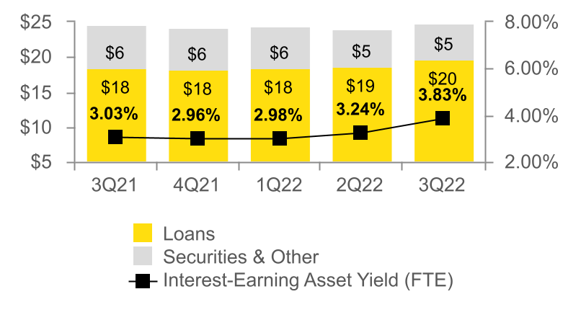
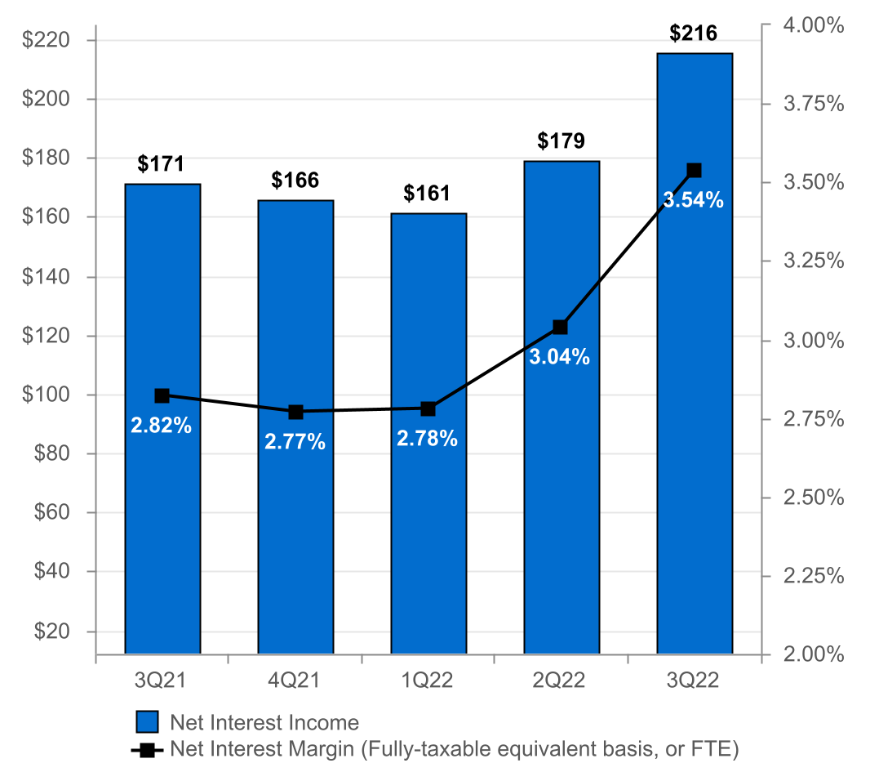
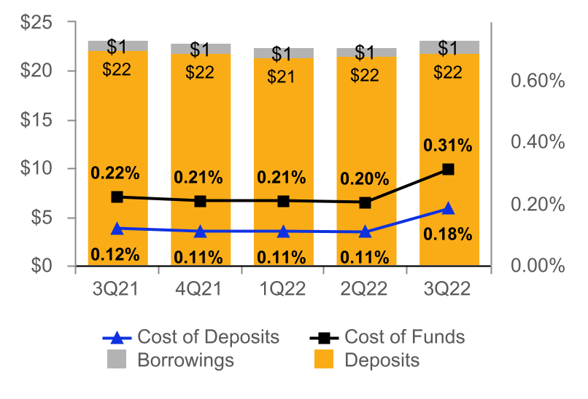
NET INTEREST INCOME AND MARGIN
Net Interest Income & Net Interest Margin
Average Interest-Earning Assets & Yields
($ IN MILLIONS)
($ IN BILLIONS)
Average Deposits and Borrowings & Cost of Funds
($ IN BILLIONS)
4

Slide 5
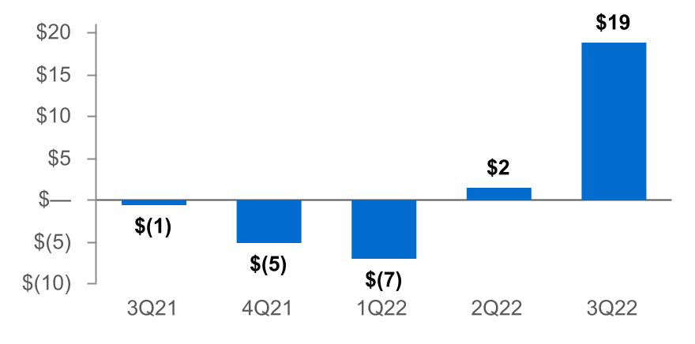
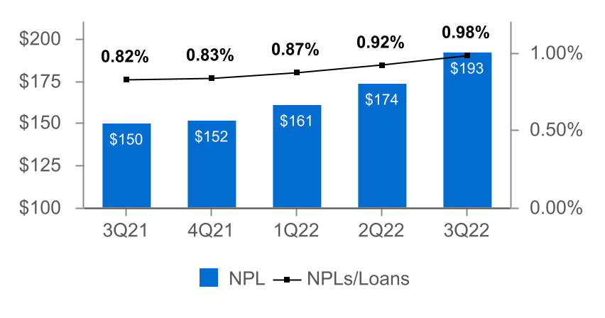
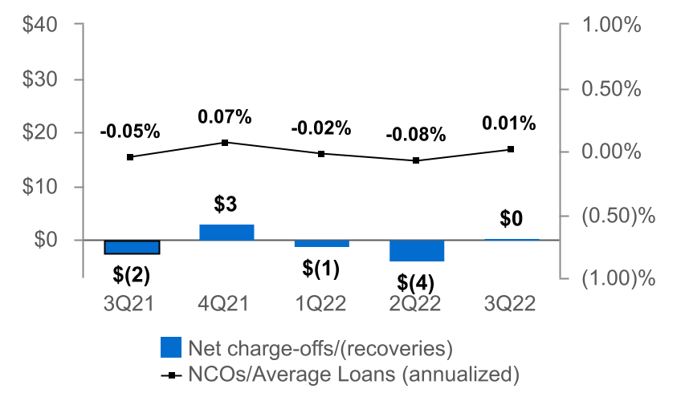
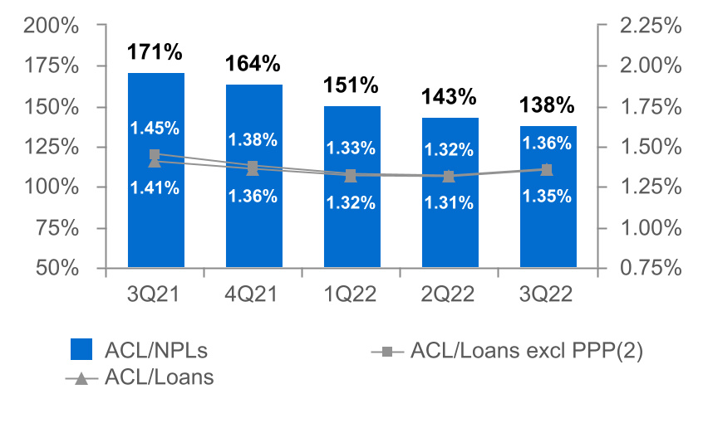
ASSET QUALITY
($ IN MILLIONS)
Provision for Credit Losses
Non-Performing Loans (NPLs) & NPLs to Loans
Net Charge-offs (NCOs) and NCOs to Average Loans
ACL⁽¹⁾ to NPLs & Loans
The allowance for credit losses (“ACL”) relates specifically to "Loans, net of unearned income" and does not include the ACL related to off-balance-sheet credit exposures.
Non-GAAP financial measure. Please refer to the calculation and management's reasons for using this measure on the slide titled "Non-GAAP Reconciliation" at the end of this presentation.
5

Slide 6
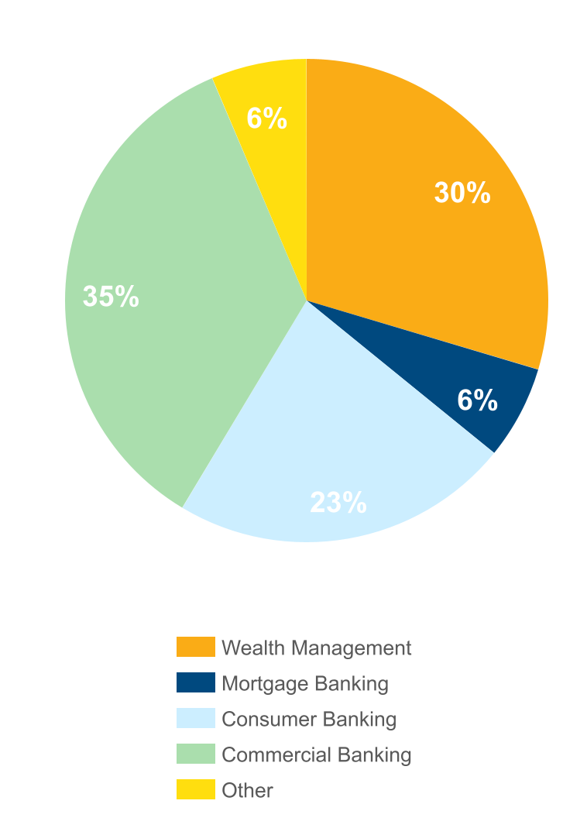
NON-INTEREST INCOME⁽¹⁾
Three months ended September 30, 2022
(percent of total non-interest income)
 |  | 3Q22 | 2Q22 | Change
 |  | (dollars in thousands)
n Commercial Banking |  | $20,808 | $20,359 | $449
n Wealth Management |  | 17,610 | 18,274 | (664)
n Consumer Banking |  | 13,275 | 12,472 | 803
n Mortgage Banking |  | 3,720 | 3,768 | (48)
n Other |  | 3,802 | 3,510 | 292
Total |  | $59,215 | $58,383 | $832
Non-interest income increased 1% from 2Q22⁽¹⁾
Increases in:
n Commercial banking merchant and card income and cash management fees.
n Consumer banking overdraft and debit card fees.
Decreases in:
n Wealth management revenues due to a decline in the market value of assets under management.
⁽¹⁾ Excluding investment securities gains
6

Slide 7
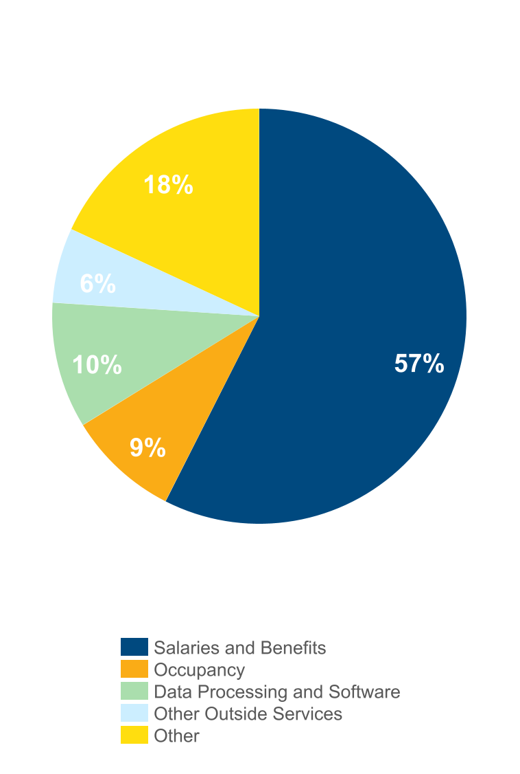
NON-INTEREST EXPENSE⁽¹⁾
Three months ended September 30, 2022
(percent of total non-interest expense)
 |  | 3Q22 | 2Q22 | Change
 |  | (dollars in thousands)
n Salaries and Benefits |  | $94,283 | $85,404 | $8,879
n Data Processing and Software |  | 15,807 | 14,685 | 1,122
n Occupancy |  | 14,025 | 13,587 | 438
n Other Outside Services |  | 9,361 | 8,764 | 597
n Other |  | 29,076 | 26,263 | 2,813
Total |  | $162,552 | $148,703 | $13,849
Non-interest expense, excluding merger-related expenses, increased 9% from 2Q22
Driven primarily by:
n Salaries and benefits primarily as a result of additional performance-based accruals of $2.6 million and a full-quarter of Prudential Bancorp salaries and benefits costs of approximately $2.0 million. The total impact on non-interest expense from Prudential Bancorp for the third quarter of 2022 was $3.6 million.
n Other expense primarily due to an $0.8 million increase in charitable contributions expense due to a $1.0 million contribution made to the Fulton Forward Foundation in the third quarter of 2022.
n Data processing and software and other outside services primarily driven by investments made in technology and system solutions of $1.7 million.
.
⁽¹⁾ Excluding merger-related expenses
7

Slide 8
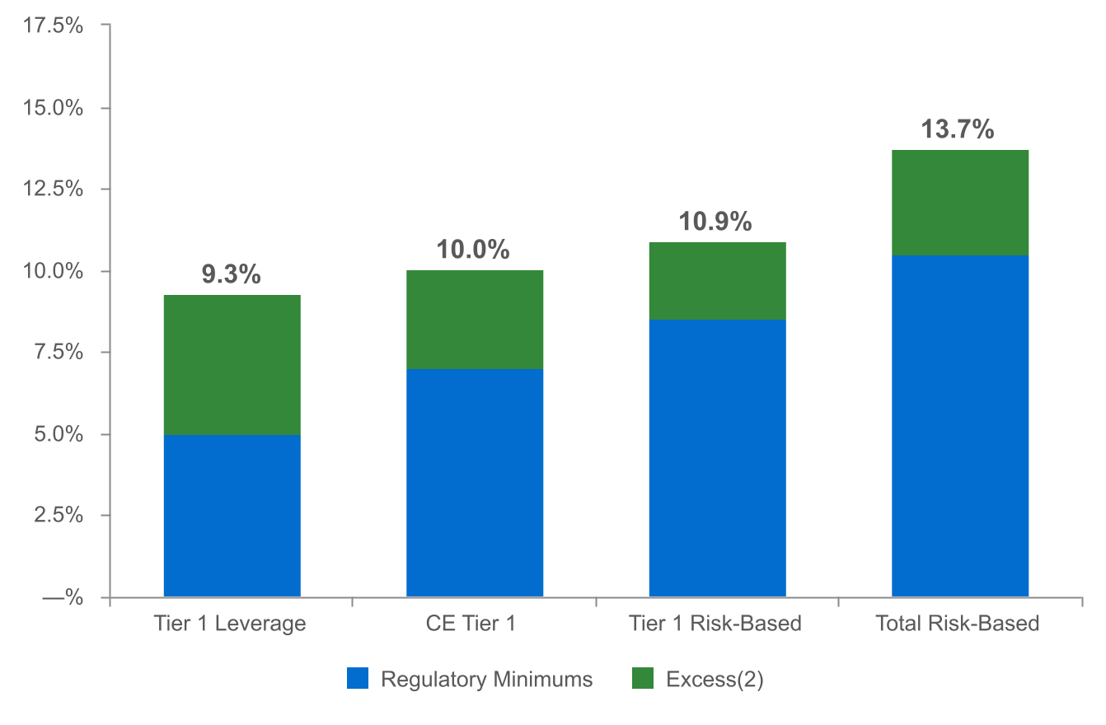
CAPITAL POSITION REMAINS STRONG⁽¹⁾
(as of September 30, 2022)
($ in millions)
$697
$527
$661
$1,096
Regulatory capital ratios and excess capital amounts as of September 30, 2022 are preliminary.
Excesses shown are to regulatory minimums, including the 250 basis point capital conservation buffer, except for Tier 1 Leverage which is the well-capitalized minimum.
8

Slide 9
2022 OUTLOOK⁽⁴⁾
Net interest income: $770 - $780 million⁽¹⁾
Non-interest income: $225 - $230 million⁽²⁾
Non-interest expense: $615 - $620 million⁽³⁾
Effective tax rate: 18.0% +/-
⁽¹⁾ Assumes Fed Funds Rate increases of: 75 bps in November 2022 and 50 bps in December 2022.
Updated as of 3Q 2022; previously $745 - $760 million.
⁽²⁾ Excludes investment securities gains. Updated as of 3Q 2022; previously $220 - $230 million.
⁽³⁾ Updated as of 3Q 2022; previously $600 - $610 million.
⁽⁴⁾ Incorporates impact of the acquisition of Prudential Bancorp, Inc. on July 1, 2022. Non-interest expense excludes merger-related
costs of $17.0 million to $18.0 million.
9

Slide 10
NON-GAAP RECONCILIATION
Note: The Corporation has presented the following non-GAAP financial measures because it believes that these measures provide useful and comparative information to assess trends in the Corporation's results of operations and financial condition. Presentation of these non-GAAP financial measures is consistent with how the Corporation evaluates its performance internally and these non-GAAP financial measures are frequently used by securities analysts, investors and other interested parties in the evaluation of companies in the Corporation's industry. Investors should recognize that the Corporation's presentation of these non-GAAP financial measures might not be comparable to similarly-titled measures of other companies. These non-GAAP financial measures should not be considered a substitute for GAAP basis measures and the Corporation strongly encourages a review of its condensed consolidated financial statements in their entirety.
 | Three months ended
(dollars in thousands) | Sep 30 |  | Jun 30 |  | Sep 30
 | 2022 |  | 2022 |  | 2021
Operating net income available to common shareholders
Net income available to common shareholders | $68,309 |  | $67,427 |  | $73,021
Plus: Core deposit intangible amortization, net of tax | 406 |  | — |  | —
Plus: Merger-related expenses, net of tax | 5,535 |  | 811 |  | —
Plus: CECL day 1 provision expense, net of tax | 6,283 |  | — |  | —
Operating net income available to common shareholders (numerator) | $80,533 |  | $68,238 |  | $73,021
Weighted average shares (diluted) (denominator) | 168,781 |  | 162,075 |  | 163,456
Operating net income available to common shareholders, per share (diluted) | $0.48 |  | $0.42 |  | $0.45
10

Slide 11
NON-GAAP RECONCILIATION
(dollars in thousands) |  | Three months ended
 |  | Sep 30 |  | Jun 30 |  | Sep 30
 |  | 2022 |  | 2022 |  | 2021
Operating return on average assets
Net income |  | $70,871 |  | $69,989 |  | $75,583
Plus: Core deposit intangible amortization, net of tax |  | 406 |  | — |  | —
Plus: Merger-related expenses, net of tax |  | 5,535 |  | 811 |  | —
Plus: CECL day 1 provision expense, net of tax |  | 6,283 |  | — |  | —
Operating net income (numerator) |  | $83,095 |  | $70,800 |  | $75,583
Total average assets (denominator) |  | $26,357,095 |  | $25,578,432 |  | $26,440,876
Operating return on average assets, annualized |  | 1.25 % |  | 1.11 % |  | 1.13 %
11

Slide 12
NON-GAAP RECONCILIATION
 |  | Three months ended
(dollars in thousands) |  | Sep 30 |  | Jun 30 |  | Sep 30
 |  | 2022 |  | 2022 |  | 2021
Return on average common shareholders' equity (tangible)
Net income available to common shareholders |  | $68,309 |  | $67,427 |  | $73,021
Plus: Merger-related expenses, net of tax |  | 5,535 |  | 811 |  | —
Plus: Intangible amortization, net of tax |  | 545 |  | 140 |  | 118
Plus: CECL day 1 provision expense, net of tax |  | 6,283 |  | — |  | —
Operating net income available to common shareholders (numerator) |  | $80,672 |  | $68,378 |  | $73,139
Average shareholders' equity |  | $2,604,057 |  | $2,531,346 |  | $2,722,833
Less: Average preferred stock |  | (192,878) |  | (192,878) |  | (192,878)
Less: Average goodwill and intangible assets |  | (562,285) |  | (537,786) |  | (536,772)
Average tangible common shareholders' equity (denominator) |  | $1,848,894 |  | $1,800,682 |  | $1,993,183
Return on average common shareholders' equity (tangible), annualized |  | 17.31 % |  | 15.23 % |  | 14.56 %
12

Slide 13
NON-GAAP RECONCILIATION
(dollars in thousands) |  | Three months ended
 |  | Sep 30 |  | Jun 30 |  | Sep 30
Efficiency ratio |  | 2022 |  | 2022 |  | 2021
Non-interest expense |  | $169,558 |  | $149,730 |  | $144,596
Less: Amortization of tax credit investments |  | (696) |  | (696) |  | (1,546)
Less: Intangible amortization |  | (690) |  | (177) |  | (150)
Less: Merger-related expenses |  | (7,006) |  | (1,027) |  | —
Non-interest expense (numerator) |  | $161,166 |  | $147,830 |  | $142,900
Net interest income |  | $215,582 |  | $178,831 |  | $171,270
Tax equivalent adjustment |  | 3,970 |  | 3,427 |  | 3,114
Plus: Total non-interest income |  | 59,162 |  | 58,391 |  | 62,577
Less: Investment securities (gains) losses, net |  | 53 |  | (8) |  | —
Total revenue (denominator) |  | $278,767 |  | $240,641 |  | $236,961
Efficiency ratio |  | 57.8% |  | 61.4% |  | 60.3%
 | Sep 30 |  | Jun 30 |  | Mar 31 |  | Dec 31 |  | Sep 30
Asset Quality, excluding PPP | 2022 |  | 2022 |  | 2022 |  | 2021 |  | 2021
ACL - loans (numerator) | $266,838 |  | $248,564 |  | $243,705 |  | $249,001 |  | $256,727
Net loans | $19,695,199 |  | $18,920,950 |  | $18,476,119 |  | $18,325,350 |  | $18,269,407
Less: PPP loans | (32,090) |  | (72,423) |  | (164,277) |  | (301,253) |  | (590,447)
Total adjusted loans (denominator) | $19,663,109 |  | $18,848,527 |  | $18,311,842 |  | $18,024,097 |  | $17,678,960
ACL - loans to total adjusted loans | 1.36% |  | 1.32% |  | 1.33% |  | 1.38% |  | 1.45%
13

