Slide 1
FOURTH QUARTER 2022 RESULTS
NASDAQ: FULT
Data as of or for the period ended December 31, 2022 unless otherwise noted

Slide 2
FORWARD-LOOKING STATEMENTS
This presentation may contain forward-looking statements with respect to the Corporation’s financial condition, results of operations and business. Do not unduly rely on forward-looking statements. Forward-looking statements can be identified by the use of words such as "may," "should," "will," "could," "estimates," "predicts," "potential," "continue," "anticipates," "believes," "plans," "expects," "future," "intends," “projects,” the negative of these terms and other comparable terminology. These forward-looking statements may include projections of, or guidance on, the Corporation’s future financial performance, expected levels of future expenses, including future credit losses, anticipated growth strategies, descriptions of new business initiatives and anticipated trends in the Corporation’s business or financial results. Management’s "2023 Outlook "contained herein is comprised of forward-looking statements.
Forward-looking statements are neither historical facts, nor assurance of future performance. Instead, the statements are based on current beliefs, expectations and assumptions regarding the future of the Corporation’s business, future plans and strategies, projections, anticipated events and trends, the economy and other future conditions. Because forward-looking statements relate to the future, they are subject to inherent uncertainties, risks and changes in circumstances that are difficult to predict and many of which are outside of the Corporation’s control, and actual results and financial condition may differ materially from those indicated in the forward-looking statements. Therefore, you should not unduly rely on any of these forward-looking statements. Any forward-looking statement is based only on information currently available and speaks only as of the date when made. The Corporation undertakes no obligation, other than as required by law, to update or revise any forward-looking statements, whether as a result of new information, future events or otherwise.
A discussion of certain risks and uncertainties affecting the Corporation, and some of the factors that could cause the Corporation’s actual results to differ materially from those described in the forward-looking statements, can be found in the sections entitled “Risk Factors” and “Management’s Discussion and Analysis of Financial Condition and Results of Operations” in the Corporation’s Annual Report on Form 10-K for the year ended December 31, 2021, Quarterly Reports on Form 10-Q for the quarters ended March 31, 2022, June 30, 2022 and September 30, 2022, and other current and periodic reports, which have been or will be filed with the Securities and Exchange Commission (the "SEC") and are or will be available in the Investor Relations section of the Corporation’s website (www.fultonbank.com) and on the SEC’s website (www.sec.gov).
The Corporation uses certain financial measures in this presentation that have been derived by methods other than generally accepted accounting principles ("GAAP"). These non-GAAP financial measures are reconciled to the most comparable GAAP measures at the end of this presentation.
2

Slide 3
INCOME STATEMENT SUMMARY
 | 4Q22 | 3Q22 | 4Q21
 | (dollars in thousands, except per-share data)
Net interest income | $225,911 | $215,582 | $165,613
Provision for credit losses | 14,513 | 18,958 | (5,000)
Non-interest income | 54,322 | 59,215 | 63,876
Securities gains (losses) | (1) | (53) | 5
Non-interest expense | 166,568 | 162,552 | 154,019
Merger-related expenses | 1,894 | 7,006 | —
Income before income taxes | 97,257 | 86,228 | 80,475
Income taxes | 15,424 | 15,357 | 18,588
Net income | 81,833 | 70,871 | 61,887
Preferred stock dividends | (2,562) | (2,562) | (2,562)
Net income available to common shareholders | $79,271 | $68,309 | $59,325
Net income available to common shareholders, per share (diluted) | $0.47 | $0.40 | $0.37
Operating net income available to common shareholders, per share (diluted)⁽¹⁾ | $0.48 | $0.48 | $0.37
ROAA | 1.23% | 1.07% | 0.94%
Operating ROAA⁽¹⁾ | 1.26% | 1.25% | 0.94%
ROAE | 13.70% | 11.24% | 9.34%
ROAE (tangible)⁽¹⁾ | 18.59% | 17.31% | 11.89%
Efficiency ratio⁽¹⁾ | 58.1% | 57.8% | 65.2%
⁽¹⁾ Non-GAAP financial measure. Please refer to the calculation and management’s reasons for using this measure on the slide titled “Non-GAAP
Reconciliation” at the end of this presentation.
3

Slide 4
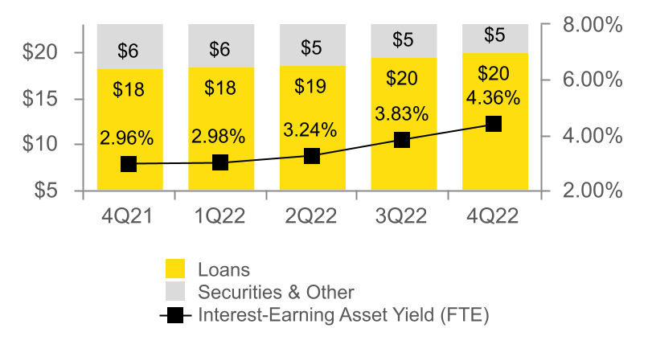
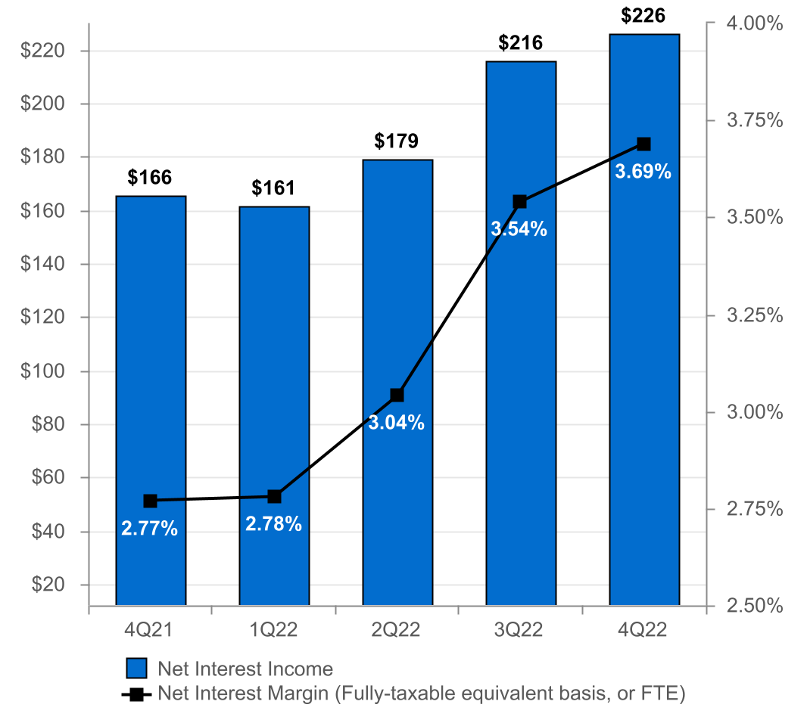
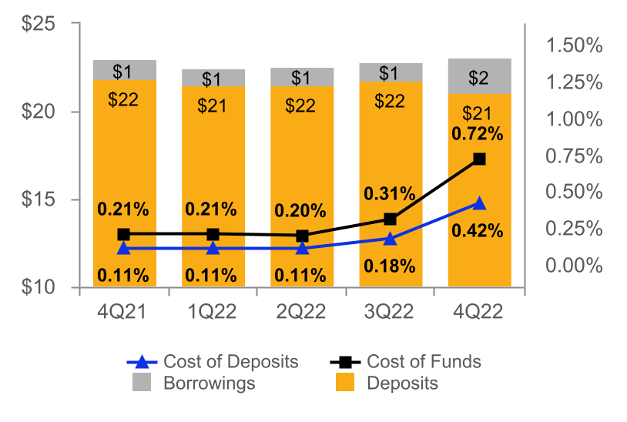
NET INTEREST INCOME AND MARGIN
Net Interest Income & Net Interest Margin
Average Interest-Earning Assets & Yields
(DOLLARS IN MILLIONS)
(DOLLARS IN BILLIONS)
Average Deposits and Borrowings & Cost of Funds
(DOLLARS IN BILLIONS)
4

Slide 5
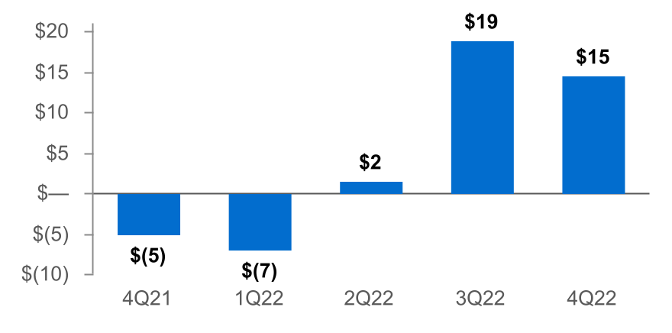
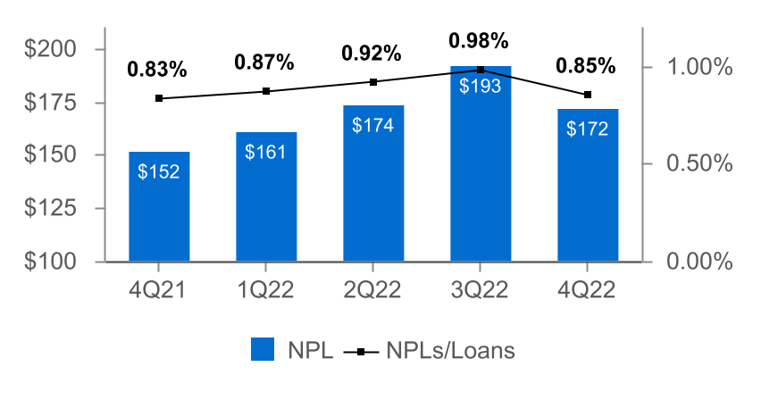
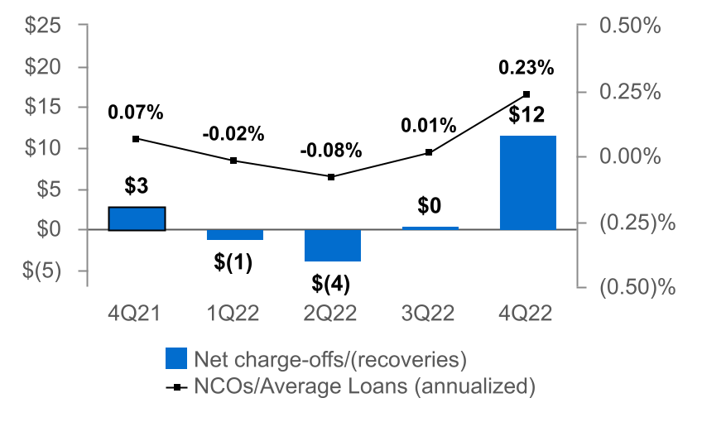
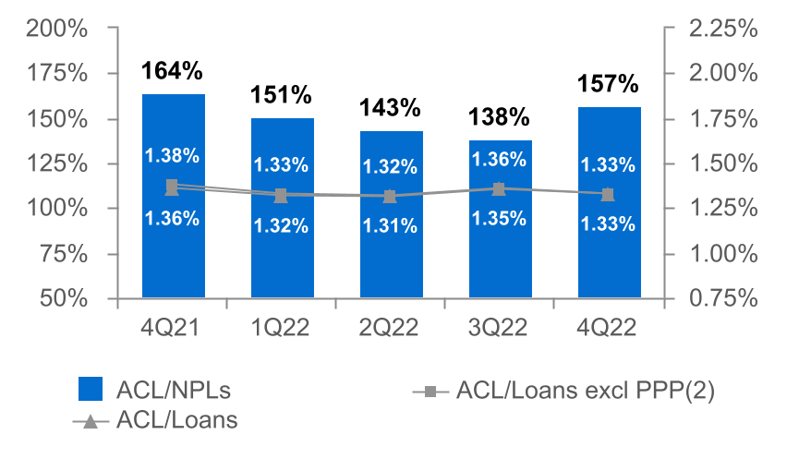
ASSET QUALITY
(DOLLARS IN MILLIONS)
Provision for Credit Losses
Non-Performing Loans (NPLs) & NPLs to Loans
(3)
Net Charge-offs (NCOs) and NCOs to Average Loans
ACL⁽¹⁾ to NPLs & Loans
  The allowance for credit losses (“ACL”) relates specifically to "Loans, net of unearned income" and does not include the ACL related to off-balance-sheet credit exposures.
  Non-GAAP financial measure. Please refer to the calculation and management's reasons for using this measure on the slide titled "Non-GAAP Reconciliation" at the end of this presentation.
  Includes the CECL Day 1 provision for credit losses of $8.0 million for the acquired Prudential Bancorp loan portfolio.
5

Slide 6
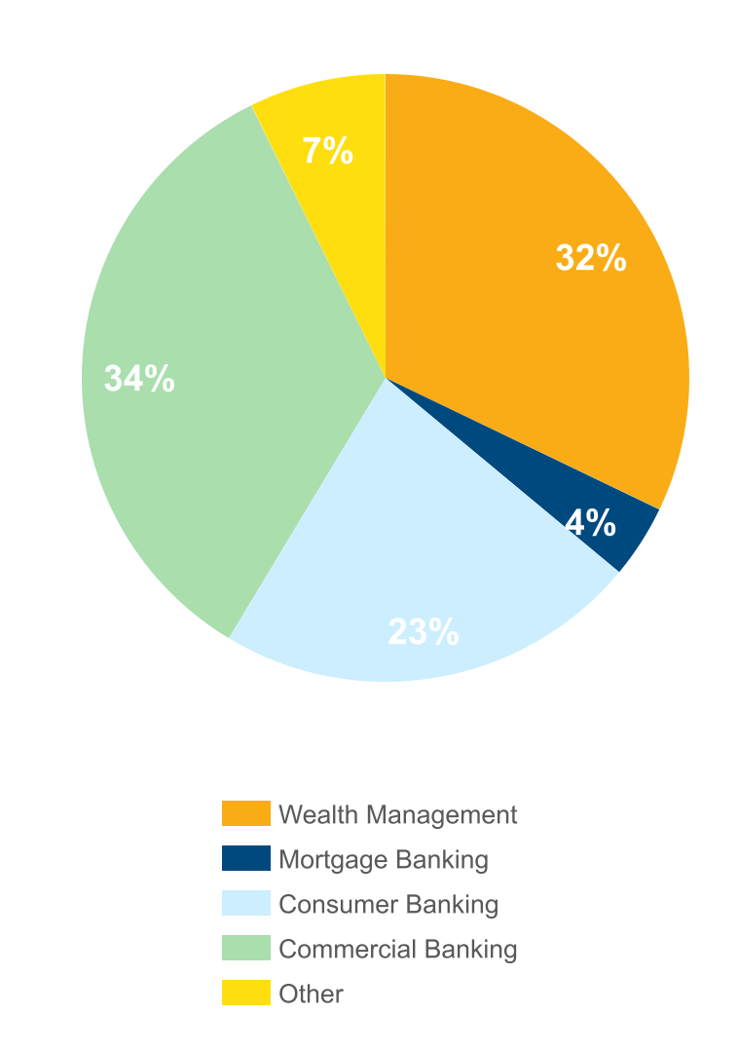
NON-INTEREST INCOME⁽¹⁾
Three months ended December 31, 2022
(percent of total non-interest income)
 |  | 4Q22 | 3Q22 | Change
 |  | (dollars in thousands)
n Commercial Banking |  | $18,604 | $20,808 | ($2,204)
n Wealth Management |  | 17,531 | 17,610 | (79)
n Consumer Banking |  | 12,075 | 13,275 | (1,200)
n Mortgage Banking |  | 2,140 | 3,720 | (1,580)
n Other |  | 3,972 | 3,802 | 170
Total |  | $54,322 | $59,215 | ($4,893)
Non-interest income decreased 8% from 3Q22⁽¹⁾
Driven primarily by:
n Commercial banking customer swap fees and cash management fees.
n Mortgage Banking income as a result of lower volumes and spreads.
n Consumer banking overdraft fees.
⁽¹⁾ Excluding investment securities gains
6

Slide 7
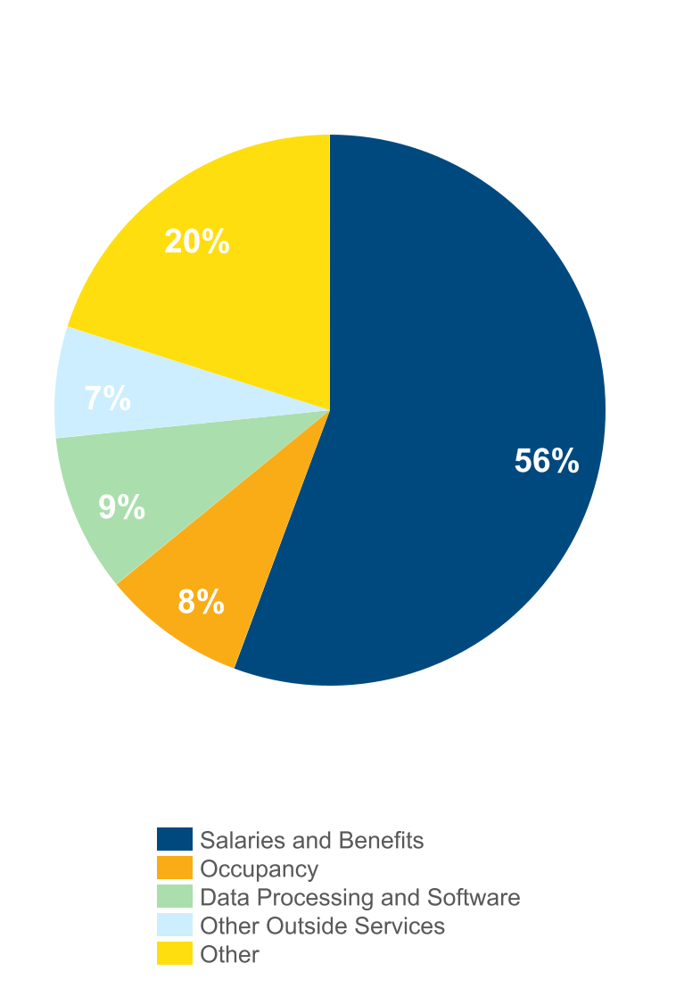
NON-INTEREST EXPENSE⁽¹⁾
Three months ended December 31, 2022
(percent of total non-interest expense)
 |  | 4Q22 | 3Q22 | Change
 |  | (dollars in thousands)
n Salaries and Benefits |  | $92,733 | $94,283 | ($1,550)
n Data Processing and Software |  | 15,448 | 15,807 | (359)
n Occupancy |  | 14,061 | 14,025 | 36
n Other Outside Services |  | 10,860 | 9,361 | 1,499
n Other |  | 33,466 | 29,076 | 4,390
Total |  | $166,568 | $162,552 | $4,016
Non-interest expense, excluding merger-related expenses, increased 2.5% from 3Q22
Driven primarily by:
Increases in:
n Other expense primarily due to a $1.9 million contingent liability, $0.8 million for branch-related closures, $0.6 million in fraud-related losses and $0.5 million in marketing expenses.
n Other Outside Services driven by technology-related services.
Decreases in:
n Salaries and benefits of $1.6 million, or 1.6%.
.
⁽¹⁾ Excluding merger-related expenses
7

Slide 8
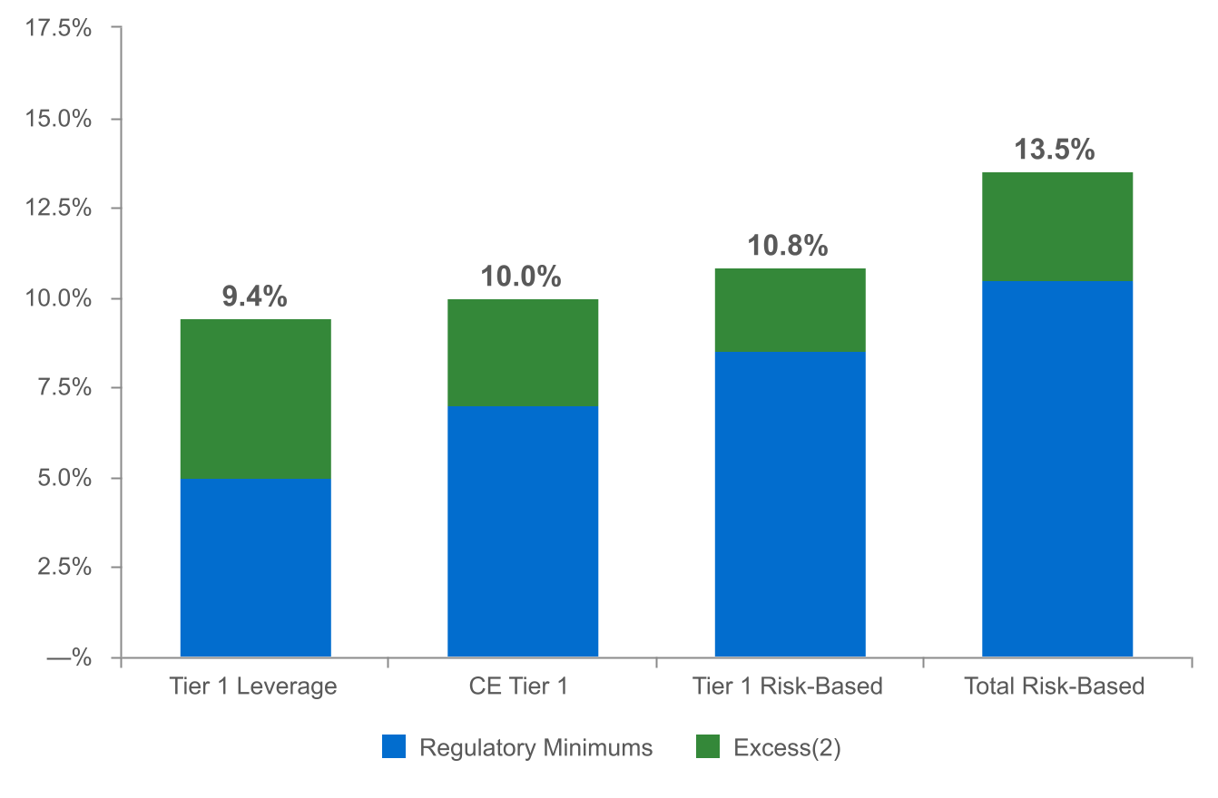
CAPITAL POSITION REMAINS STRONG⁽¹⁾
(as of December 31, 2022)
(dollars in millions)
$681
$524
$668
$1,142
  Regulatory capital ratios and excess capital amounts as of December 31, 2022 are preliminary.
  Excesses shown are to regulatory minimums, including the 250 basis point capital conservation buffer, except for Tier 1 Leverage which is the well-capitalized minimum.
8

Slide 9
2023 OUTLOOK
Net interest income: $895 - $915 million⁽¹⁾
Non-interest income: $220 - $235 million⁽²⁾
Non-interest expense: $645 - $665 million
Effective tax rate: 19.0% +/-
⁽¹⁾ On an fully-taxable equivalent basis and assumes Fed Funds Rate increases of 50 bps in February 2023 and 25 bps in March 2023.
⁽²⁾ Excludes investment securities gains.
9

Slide 10
NON-GAAP RECONCILIATION
Note: The Corporation has presented the following non-GAAP financial measures because it believes that these measures provide useful and comparative information to assess trends in the Corporation's results of operations and financial condition. Presentation of these non-GAAP financial measures is consistent with how the Corporation evaluates its performance internally and these non-GAAP financial measures are frequently used by securities analysts, investors and other interested parties in the evaluation of companies in the Corporation's industry. Investors should recognize that the Corporation's presentation of these non-GAAP financial measures might not be comparable to similarly-titled measures of other companies. These non-GAAP financial measures should not be considered a substitute for GAAP basis measures and the Corporation strongly encourages a review of its condensed consolidated financial statements in their entirety.
 | Three months ended
(dollars in thousands) | Dec 31 |  | Sep 30 |  | Dec 31
 | 2022 |  | 2022 |  | 2021
Operating net income available to common shareholders
Net income available to common shareholders | $79,271 |  | $68,309 |  | $59,325
Plus: Core deposit intangible amortization | 514 |  | 514 |  | —
Plus: Merger-related expenses | 1,894 |  | 7,006 |  | —
Plus: CECL Day 1 Provision expense | — |  | 7,954 |  | —
Less: Tax impact of adjustments | (506) |  | (3,250) |  | —
Operating net income available to common shareholders (numerator) | $81,173 |  | $80,533 |  | $59,325
Weighted average shares (diluted) (denominator) | 169,136 |  | 168,781 |  | 162,355
Operating net income available to common shareholders, per share (diluted) | $0.48 |  | $0.48 |  | $0.37
10

Slide 11
NON-GAAP RECONCILIATION
(dollars in thousands) |  | Three months ended
 |  | Dec 31 |  | Sep 30 |  | Dec 31
 |  | 2022 |  | 2022 |  | 2021
Operating return on average assets
Net income |  | $81,833 |  | $70,871 |  | $61,887
Plus: Core deposit intangible amortization |  | 514 |  | 514 |  | —
Plus: Merger-related expenses |  | 1,894 |  | 7,006 |  | —
Plus: CECL Day 1 Provision expense |  | — |  | 7,954 |  | —
Less: Tax impact of adjustments |  | (506) |  | (3,250) |  | —
Operating net income (numerator) |  | $83,735 |  | $83,095 |  | $61,887
Total average assets (denominator) |  | $26,386,355 |  | $26,357,095 |  | $26,136,536
Operating return on average assets |  | 1.26 % |  | 1.25 % |  | 0.94 %
11

Slide 12
NON-GAAP RECONCILIATION
 |  | Three months ended
(dollars in thousands) |  | Dec 31 |  | Sep 30 |  | Dec 31
 |  | 2022 |  | 2022 |  | 2021
Return on average common shareholders' equity (tangible)
Net income available to common shareholders |  | $79,271 |  | $68,309 |  | $59,325
Plus: Intangible amortization |  | 688 |  | 690 |  | 146
Plus: CECL Day 1 Provision expense |  | — |  | 7,954 |  | —
Plus: Merger-related expenses |  | 1,894 |  | 7,006 |  | —
Less: Tax impact of adjustments |  | (542) |  | (3,287) |  | (32)
Operating net income available to common shareholders (numerator) |  | $81,311 |  | $80,672 |  | $59,439
Average shareholders' equity |  | $2,489,148 |  | $2,604,057 |  | $2,713,198
Less: Average preferred stock |  | (192,878) |  | (192,878) |  | (192,878)
Less: Average goodwill and intangible assets |  | (561,219) |  | (562,285) |  | (536,638)
Average tangible common shareholders' equity (denominator) |  | $1,735,051 |  | $1,848,894 |  | $1,983,682
Return on average common shareholders' equity (tangible) |  | 18.59 % |  | 17.31 % |  | 11.89 %
12

Slide 13
NON-GAAP RECONCILIATION
(dollars in thousands) |  | Three months ended
 |  | Dec 31 |  | Sep 30 |  | Dec 31
Efficiency ratio |  | 2022 |  | 2022 |  | 2021
Non-interest expense |  | $168,462 |  | $169,558 |  | $154,019
Less: Amortization of tax credit investments |  | (696) |  | (696) |  | (1,547)
Less: Intangible amortization |  | (688) |  | (690) |  | (146)
Less: Merger-related expenses |  | (1,894) |  | (7,006) |  | —
Less: Debt extinguishment costs |  | — |  | — |  | (674)
Non-interest expense (numerator) |  | $165,184 |  | $161,166 |  | $151,652
Net interest income |  | $225,911 |  | $215,582 |  | $165,613
Tax equivalent adjustment |  | 4,310 |  | 3,970 |  | 3,184
Plus: Total non-interest income |  | 54,321 |  | 59,162 |  | 63,881
Less: Investment securities (gains) losses, net |  | 1 |  | 53 |  | (5)
Total revenue (denominator) |  | $284,543 |  | $278,767 |  | $232,673
Efficiency ratio |  | 58.1% |  | 57.8% |  | 65.2%
 | Dec 31 |  | Sep 30 |  | Jun 30 |  | Mar 31 |  | Dec 31
Asset Quality, excluding PPP | 2022 |  | 2022 |  | 2022 |  | 2022 |  | 2021
ACL - loans (numerator) | $269,366 |  | $266,838 |  | $248,564 |  | $243,705 |  | $249,001
Net loans | $20,279,547 |  | $19,695,199 |  | $18,920,950 |  | $18,476,119 |  | $18,325,350
Less: PPP loans | (20,398) |  | (32,090) |  | (72,423) |  | (164,277) |  | (301,253)
Total adjusted loans (denominator) | $20,259,149 |  | $19,663,109 |  | $18,848,527 |  | $18,311,842 |  | $18,024,097
ACL - loans to total adjusted loans | 1.33% |  | 1.36% |  | 1.32% |  | 1.33% |  | 1.38%
13

