Slide 1
FIRST QUARTER 2023 RESULTS
NASDAQ: FULT
Data as of or for the period ended March 31, 2023 unless otherwise noted

Slide 2
FORWARD-LOOKING STATEMENTS
This presentation may contain forward-looking statements with respect to the Corporation’s financial condition, results of operations and business. Do not unduly rely on forward-looking statements. Forward-looking statements can be identified by the use of words such as "may," "should," "will," "could," "estimates," "predicts," "potential," "continue," "anticipates," "believes," "plans," "expects," "future," "intends," “projects,” the negative of these terms and other comparable terminology. These forward-looking statements may include projections of, or guidance on, the Corporation’s future financial performance, expected levels of future expenses, including future credit losses, anticipated growth strategies, descriptions of new business initiatives and anticipated trends in the Corporation’s business or financial results. Management’s "2023 Outlook "contained herein is comprised of forward-looking statements.
Forward-looking statements are neither historical facts, nor assurance of future performance. Instead, the statements are based on current beliefs, expectations and assumptions regarding the future of the Corporation’s business, future plans and strategies, projections, anticipated events and trends, the economy and other future conditions. Because forward-looking statements relate to the future, they are subject to inherent uncertainties, risks and changes in circumstances that are difficult to predict and many of which are outside of the Corporation’s control, and actual results and financial condition may differ materially from those indicated in the forward-looking statements. Therefore, you should not unduly rely on any of these forward-looking statements. Any forward-looking statement is based only on information currently available and speaks only as of the date when made. The Corporation undertakes no obligation, other than as required by law, to update or revise any forward-looking statements, whether as a result of new information, future events or otherwise.
A discussion of certain risks and uncertainties affecting the Corporation, and some of the factors that could cause the Corporation’s actual results to differ materially from those described in the forward-looking statements, can be found in the sections entitled “Risk Factors” and “Management’s Discussion and Analysis of Financial Condition and Results of Operations” in the Corporation’s Annual Report on Form 10-K for the year ended December 31, 2022 and other current and periodic reports, which have been, or will be, filed with the Securities and Exchange Commission (the "SEC") and are, or will be, available in the Investor Relations section of the Corporation’s website (www.fultonbank.com) and on the SEC’s website (www.sec.gov).
The Corporation uses certain financial measures in this presentation that have been derived by methods other than generally accepted accounting principles ("GAAP"). These non-GAAP financial measures are reconciled to the most comparable GAAP measures at the end of this presentation.
2

Slide 3
INCOME STATEMENT SUMMARY
 | 1Q23 | 4Q22 | 1Q22
 | (dollars in thousands, except per-share data)
Net interest income | $215,587 | $225,911 | $161,310
Provision for credit losses | 24,544 | 14,513 | (6,950)
Non-interest income | 51,730 | 54,322 | 55,237
Securities gains (losses) | 23 | (1) | 19
Non-interest expense | 159,616 | 166,568 | 145,577
Merger-related expenses | — | 1,894 | 401
Income before income taxes | 83,180 | 97,257 | 77,538
Income taxes | 14,866 | 15,424 | 13,250
Net income | 68,314 | 81,833 | 64,288
Preferred stock dividends | (2,562) | (2,562) | (2,562)
Net income available to common shareholders | $65,752 | $79,271 | $61,726
Net income available to common shareholders, per share (diluted) | $0.39 | $0.47 | $0.38
Operating net income available to common shareholders, per share (diluted)⁽¹⁾ | $0.39 | $0.48 | $0.38
ROAA | 1.03% | 1.23% | 1.02%
Operating ROAA⁽¹⁾ | 1.04% | 1.26% | 1.02%
ROAE | 11.02% | 13.70% | 10.03%
ROAE (tangible)⁽¹⁾ | 14.46% | 18.59% | 12.88%
Efficiency ratio⁽¹⁾ | 58.5% | 58.1% | 65.8%
⁽¹⁾ Non-GAAP financial measure. Please refer to the calculation and management’s reasons for using this measure on the slide titled “Non-GAAP
Reconciliation” at the end of this presentation.
3

Slide 4
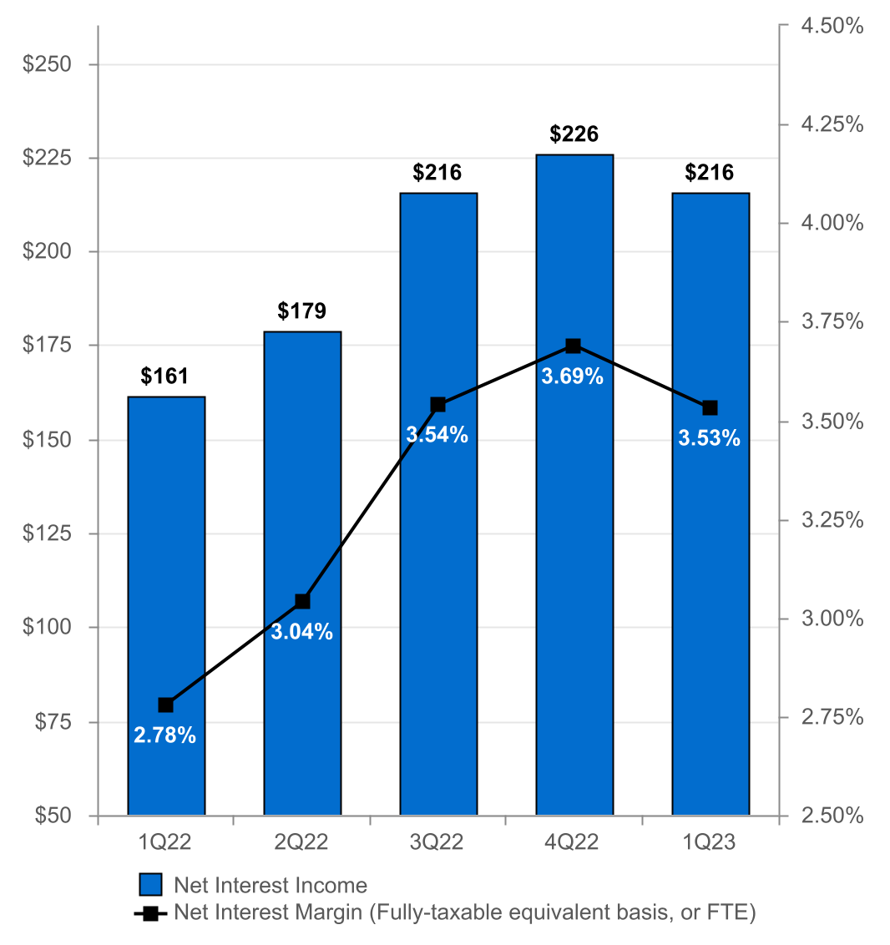
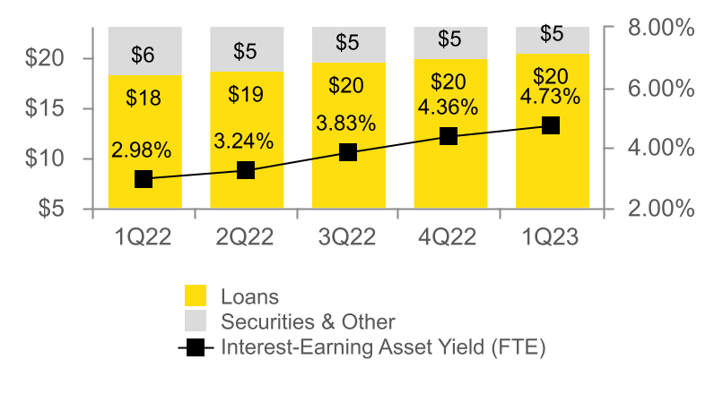
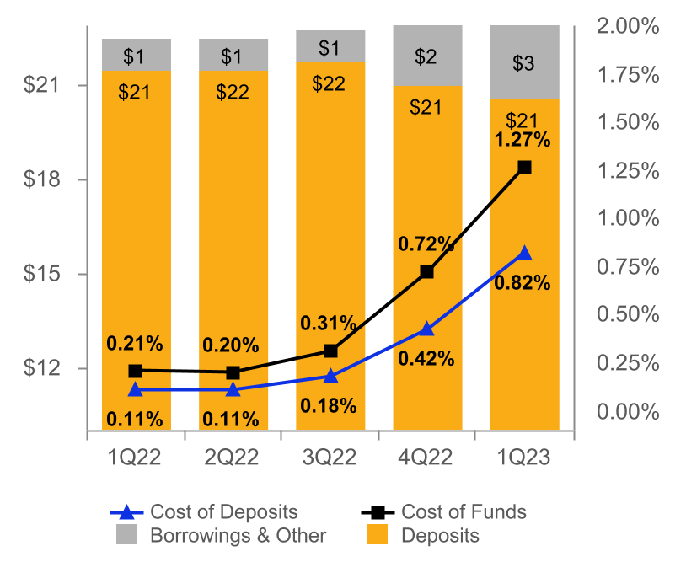
NET INTEREST INCOME AND MARGIN
Net Interest Income & Net Interest Margin
Average Interest-Earning Assets & Yields
(DOLLARS IN MILLIONS)
(DOLLARS IN BILLIONS)
Average Deposits and Borrowings & Other & Cost of Funds
(DOLLARS IN BILLIONS)
4

Slide 5
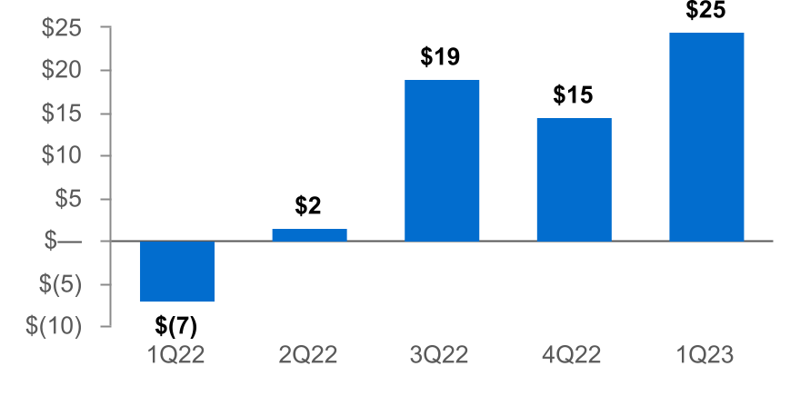
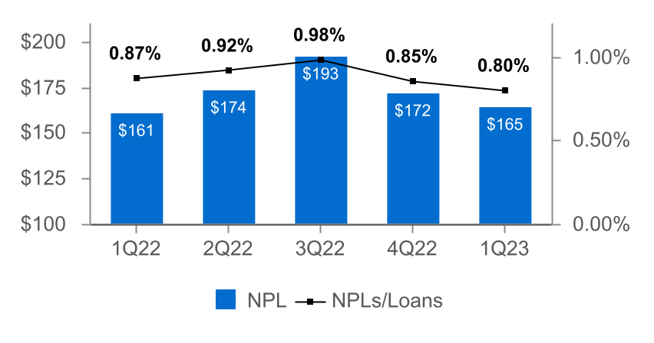
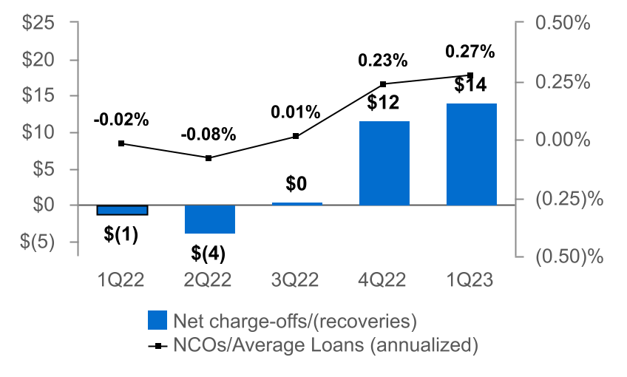
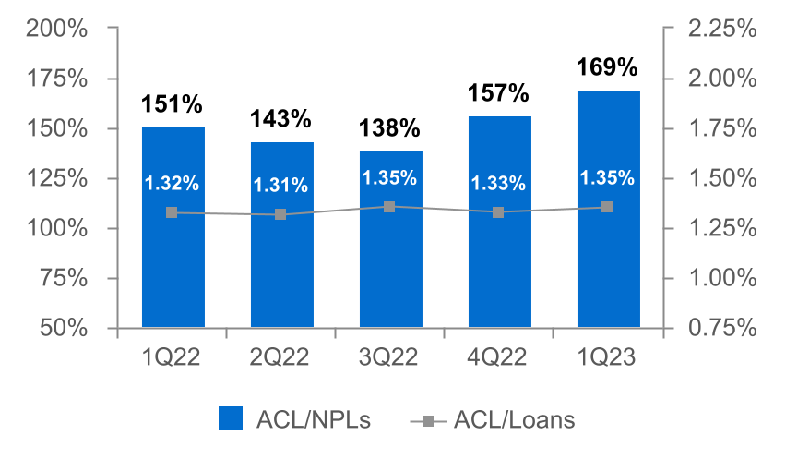
ASSET QUALITY
(DOLLARS IN MILLIONS)
Provision for Credit Losses
Non-Performing Loans (NPLs) & NPLs to Loans
(2)
Net Charge-offs (NCOs) and NCOs to Average Loans
ACL⁽¹⁾ to NPLs & Loans
(1) The allowance for credit losses (“ACL”) relates specifically to "Loans, net of unearned income" and does not include reserves related to off-balance-sheet credit exposures.
(2) Includes the CECL Day 1 provision for credit losses of $8.0 million for the acquired Prudential Bancorp, Inc. loan portfolio.
5

Slide 6

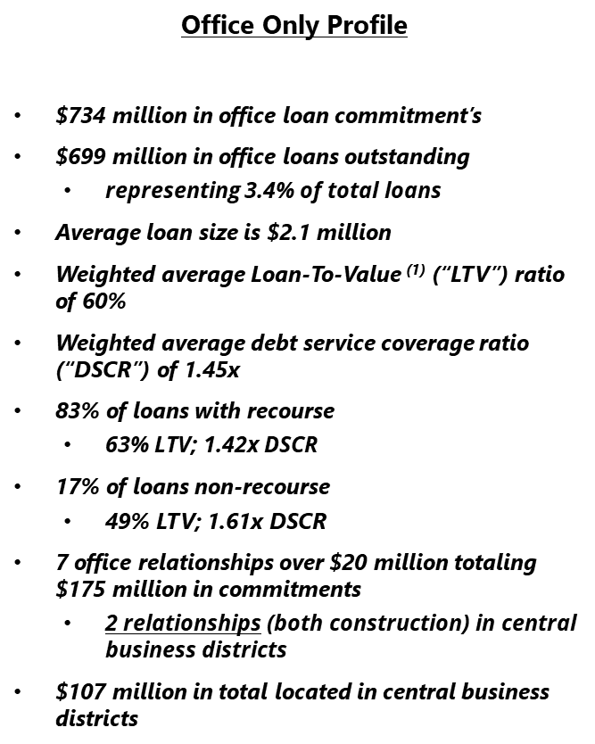
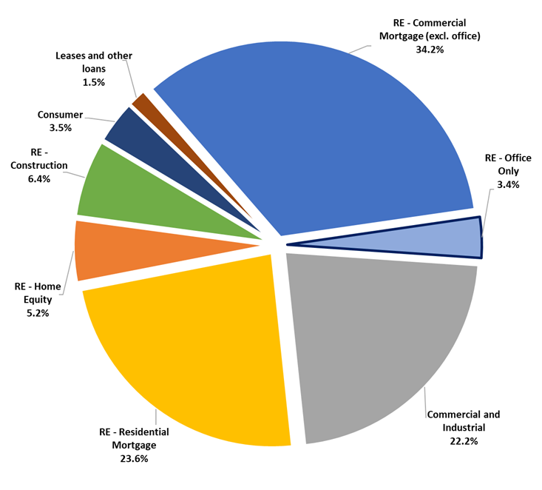

LOAN MIX IS DIVERSIFIED AND GRANULAR WITH OFFICE LOANS REPRESENTING 3.4% OF TOTAL LOANS
6

Slide 7
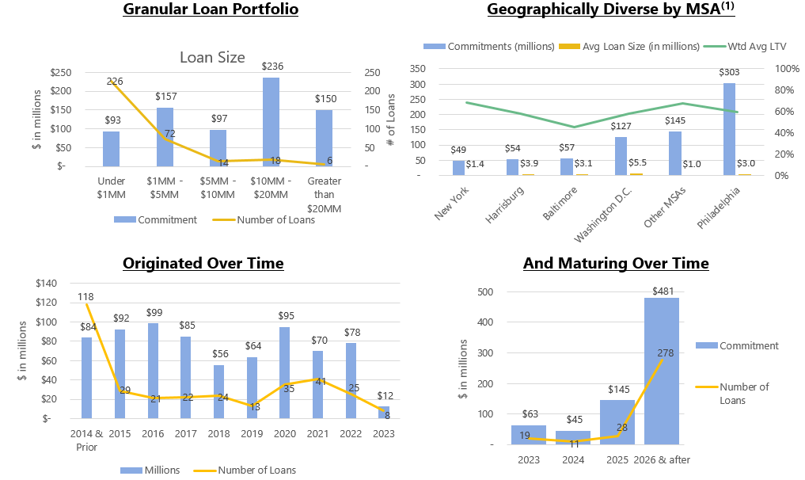
THE OFFICE PORTFOLIO IS GRANULAR, DIVERSIFIED, AND TENURED
7

Slide 8
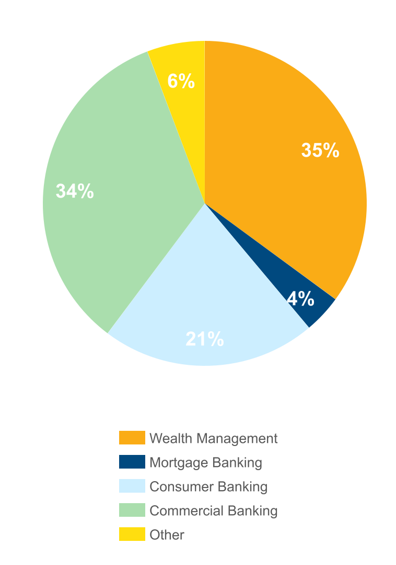
NON-INTEREST INCOME⁽¹⁾
Three months ended March 31, 2023
(percent of total non-interest income)
 |  | 1Q23 | 4Q22 | Change
 |  | (dollars in thousands)
n Wealth Management |  | $18,062 | $17,531 | $531
n Commercial Banking |  | 17,513 | 18,604 | (1,091)
n Consumer Banking |  | 11,217 | 12,075 | (858)
n Mortgage Banking |  | 1,970 | 2,140 | (170)
n Other |  | 2,968 | 3,972 | (1,004)
Total |  | $51,730 | $54,322 | ($2,592)
Non-interest income decreased 5% from 4Q22⁽¹⁾
Driven primarily by:
n Commercial banking customer swap fees and merchant and card fees.
n Equity method investments.
n Consumer banking overdraft fees.
⁽¹⁾ Excluding investment securities gains
8

Slide 9
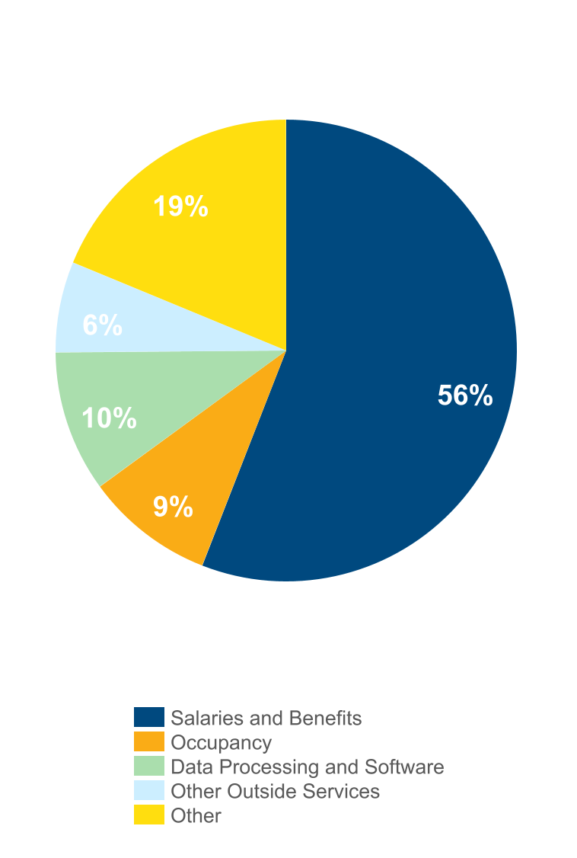
NON-INTEREST EXPENSE⁽¹⁾
Three months ended March 31, 2023
(percent of total non-interest expense)
 |  | 1Q23 | 4Q22 | Change
 |  | (dollars in thousands)
n Salaries and Benefits |  | $89,283 | $92,733 | ($3,450)
n Data Processing and Software |  | 15,796 | 15,448 | 348
n Occupancy |  | 14,438 | 14,061 | 377
n Other Outside Services |  | 10,126 | 10,860 | (734)
n Other |  | 29,973 | 33,466 | (3,493)
Total |  | $159,616 | $166,568 | ($6,952)
Non-interest expense, excluding merger-related expenses, decreased 4.2% from 4Q22
Driven primarily by:
Decreases in:
n Other expense primarily due to a $1.2 million decrease in charitable contributions, $1.1 million for other real estate owned gains on sale and an $0.8 million contingent liability.
n Salaries and benefits of $3.5 million, primarily due to a decrease in variable compensation plan expense.
n Other Outside Services driven by technology-related services.
.
⁽¹⁾ Excluding merger-related expenses
9

Slide 10
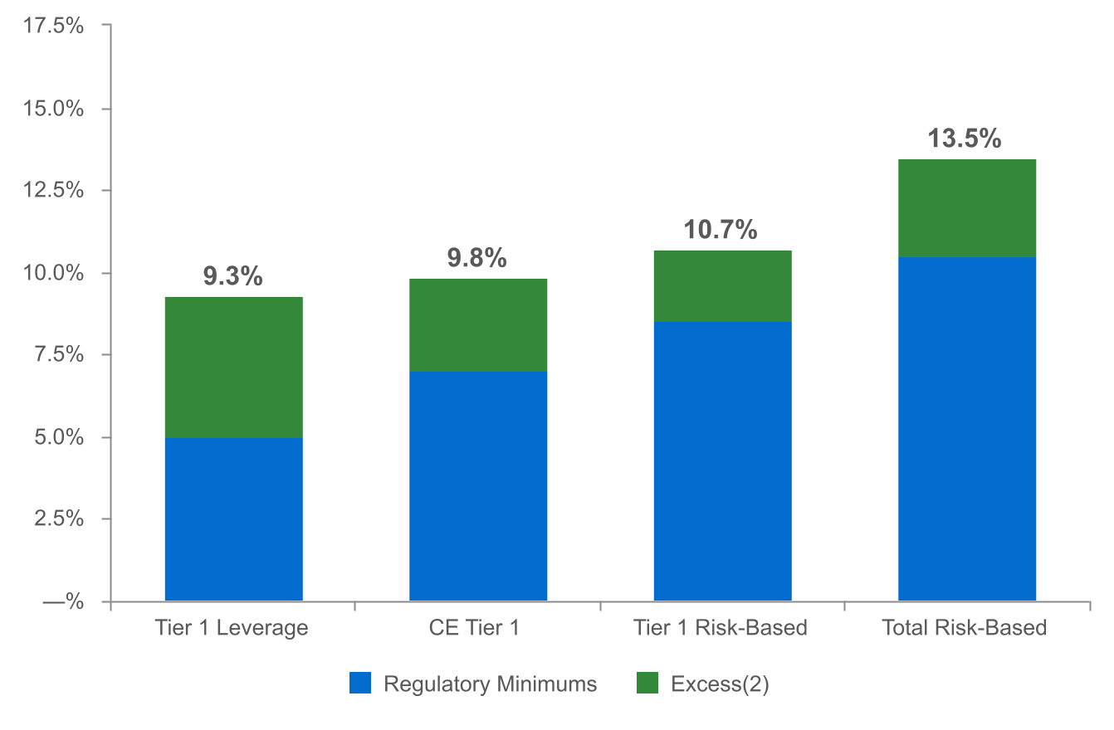
CAPITAL POSITION REMAINS STRONG⁽¹⁾
(as of March 31, 2023)
(dollars in millions)
$675
$498
$1,120
$647
(1) Regulatory capital ratios and excess capital amounts as of March 31, 2023 are preliminary.
(2) Excesses shown are to regulatory minimums, including the 250 basis point capital conservation buffer, except for Tier 1 Leverage which is the well-capitalized minimum.
10

Slide 11
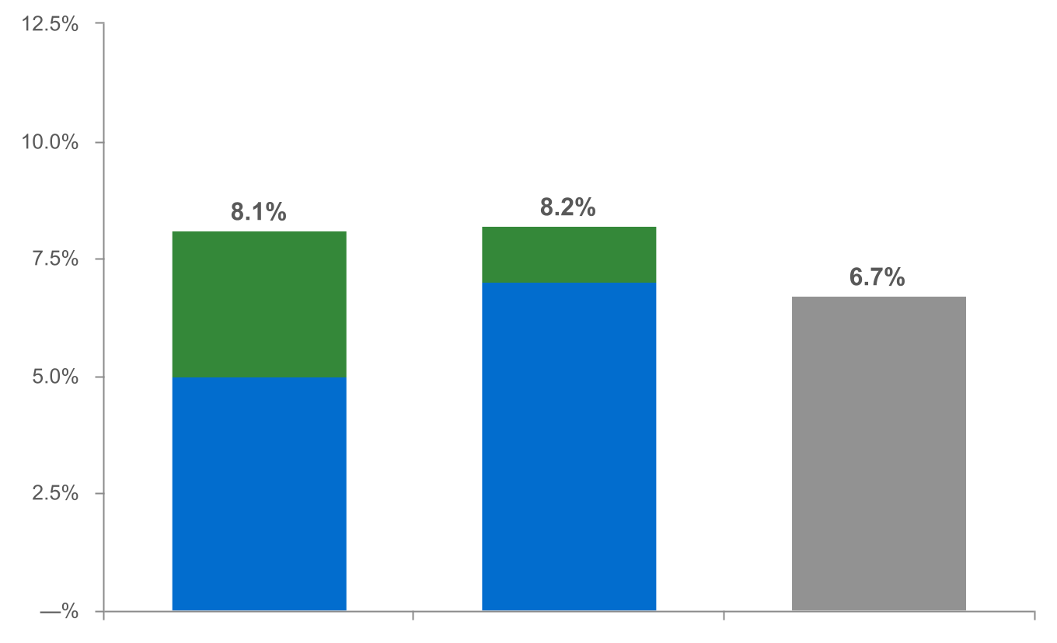
CAPITAL RATIOS ADJUSTED FOR UNREALIZED LOSSES ON INVESTMENT SECURITIES - RATIOS REMAIN STRONG⁽¹⁾
(as of March 31, 2023)
(dollars in millions)
|
|
|
|
|
|
|
|
|
|
|
|
|
$782
$271
Tier 1 Leverage⁽³⁾ CE Tier 1⁽³⁾ TCE⁽⁴⁾
n Regulatory Minimums n Excess⁽²⁾
⁽¹⁾ Regulatory capital ratios and excess capital amounts as of March 31, 2023 are preliminary.
⁽²⁾ Excesses shown are to regulatory minimums, including the 250 basis point capital conservation buffer, except for Tier 1 Leverage which is the well-capitalized minimum.
⁽³⁾ Tier 1 Leverage and CE Tier 1 capital ratios were adjusted to incorporate the unrealized loss, net of tax, on Held-to-Maturity investment securities of $94.0 million and the unrealized loss, net of tax,
on Available-for-Sale investment securities of $282.1 million.
⁽⁴⁾ Non-GAAP financial measure. Please refer to the calculation and management’s reasons for using this measure on the slide titled “Non-GAAP Reconciliation” at the end of this presentation.
11

Slide 12
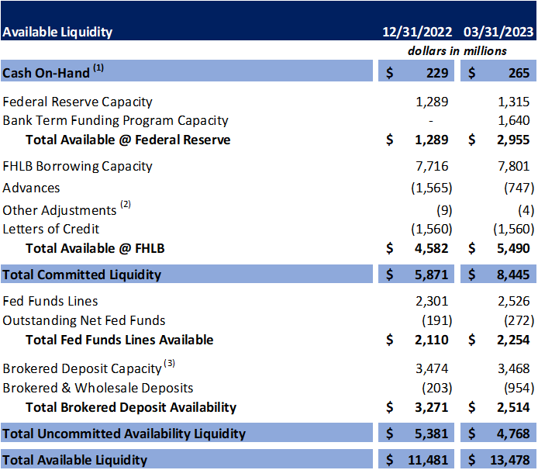
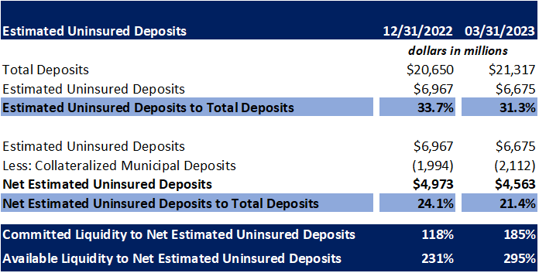

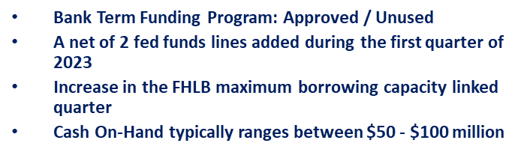
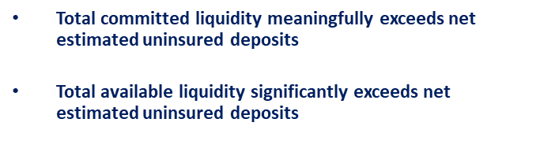
A COMMITTED AND HEALTHY LIQUIDITY PROFILE WITH SIGNIFICANT COVERAGE
12

Slide 13
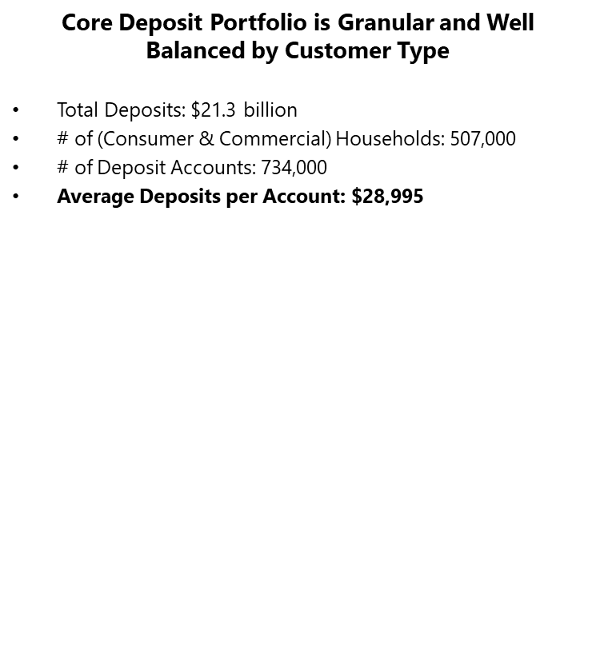

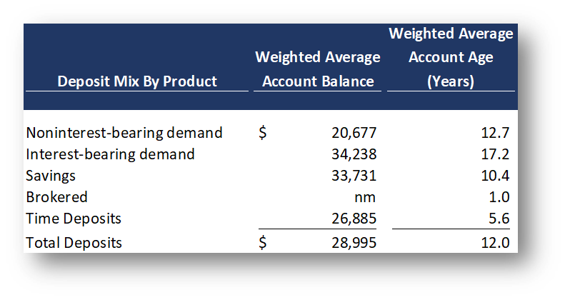
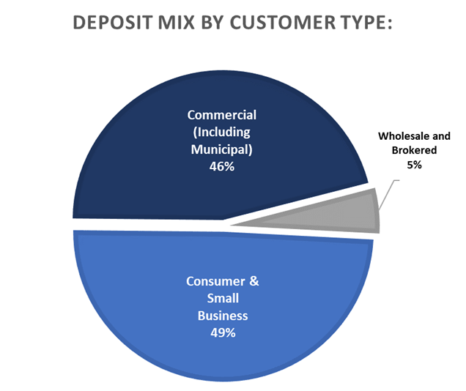
A GRANULAR, TENURED AND DIVERSIFIED DEPOSIT PORTFOLIO
13

Slide 14
2023 OUTLOOK
Net interest income: $850 - $870 million⁽¹⁾
Non-interest income: $220 - $230 million⁽²⁾
Provision for credit losses: $55 - $70 million
Non-interest expense: $645 - $660 million⁽³⁾
Effective tax rate: 18.5% +/-⁽⁴⁾
(1) Assumes Fed Funds Rate increase of 25 bps in May 2023. Updated as of 1Q 22; previously $895 - $915 million.
(2) Excludes investment securities gains. Updated as of 1Q 22; previously $220 - $235 million.
(3) Previously $645 - $665 million.
(4) Previously 19.0% +/-.
14

Slide 15
NON-GAAP RECONCILIATION
Note: The Corporation has presented the following non-GAAP financial measures because it believes that these measures provide useful and comparative information to assess trends in the Corporation's results of operations and financial condition. Presentation of these non-GAAP financial measures is consistent with how the Corporation evaluates its performance internally and these non-GAAP financial measures are frequently used by securities analysts, investors and other interested parties in the evaluation of companies in the Corporation's industry. Investors should recognize that the Corporation's presentation of these non-GAAP financial measures might not be comparable to similarly-titled measures of other companies. These non-GAAP financial measures should not be considered a substitute for GAAP basis measures and the Corporation strongly encourages a review of its condensed consolidated financial statements in their entirety.
 | Three months ended
(dollars in thousands) | Mar 31 |  | Dec 31 |  | Mar 31
 | 2023 |  | 2022 |  | 2022
Operating net income available to common shareholders
Net income available to common shareholders | $65,752 |  | $79,271 |  | $61,726
Plus: Core deposit intangible amortization | 514 |  | 514 |  | —
Plus: Merger-related expenses | — |  | 1,894 |  | 401
Less: Tax impact of adjustments | (108) |  | (506) |  | (84)
Operating net income available to common shareholders (numerator) | $66,158 |  | $81,173 |  | $62,043
Weighted average shares (diluted) (denominator) | 168,401 |  | 169,136 |  | 161,911
Operating net income available to common shareholders, per share (diluted) | $0.39 |  | $0.48 |  | $0.38
15

Slide 16
NON-GAAP RECONCILIATION
 | Three months ended
(dollars in thousands) | Mar 31 |  | Dec 31 |  | Mar 31
 | 2023 |  | 2022 |  | 2022
Operating return on average assets
Net income | $68,314 |  | $81,833 |  | $64,288
Plus: Core deposit intangible amortization | 514 |  | 514 |  | —
Plus: Merger-related expenses | — |  | 1,894 |  | 401
Less: Tax impact of adjustments | (108) |  | (506) |  | (84)
Operating net income (numerator) | $68,720 |  | $83,735 |  | $64,605
Total average assets (denominator) | $26,900,653 |  | $26,386,355 |  | $25,622,462
Operating return on average assets | 1.04 % |  | 1.26 % |  | 1.02 %
16

Slide 17
NON-GAAP RECONCILIATION
 |  | Three months ended
(dollars in thousands) |  | Mar 31 |  | Dec 31 |  | Mar 31
 |  | 2023 |  | 2022 |  | 2022
Return on average common shareholders' equity (tangible)
Net income available to common shareholders |  | $65,752 |  | $79,271 |  | $61,726
Plus: Intangible amortization |  | 674 |  | 688 |  | 176
Plus: Merger-related expenses |  | — |  | 1,894 |  | 401
Less: Tax impact of adjustments |  | (142) |  | (542) |  | (122)
Operating net income available to common shareholders (numerator) |  | $66,284 |  | $81,311 |  | $62,181
Average shareholders' equity |  | $2,613,316 |  | $2,489,148 |  | $2,688,834
Less: Average preferred stock |  | (192,878) |  | (192,878) |  | (192,878)
Less: Average goodwill and intangible assets |  | (561,744) |  | (561,219) |  | (537,976)
Average tangible common shareholders' equity (denominator) |  | $1,858,694 |  | $1,735,051 |  | $1,957,980
Return on average common shareholders' equity (tangible) |  | 14.46 % |  | 18.59 % |  | 12.88 %
17

Slide 18
NON-GAAP RECONCILIATION
(dollars in thousands) |  | Three months ended
 |  | Mar 31 |  | Dec 31 |  | Mar 31
Efficiency ratio |  | 2023 |  | 2022 |  | 2022
Non-interest expense |  | $159,616 |  | $168,462 |  | $145,978
Less: Amortization of tax credit investments |  | — |  | (696) |  | (696)
Less: Merger-related expenses |  | — |  | (1,894) |  | (401)
Less: Intangible amortization |  | (674) |  | (688) |  | (176)
Non-interest expense (numerator) |  | $158,942 |  | $165,184 |  | $144,705
Net interest income |  | $215,587 |  | $225,911 |  | $161,310
Tax equivalent adjustment |  | 4,414 |  | 4,310 |  | 3,288
Plus: Total non-interest income |  | 51,753 |  | 54,321 |  | 55,256
Less: Investment securities (gains) losses, net |  | (23) |  | 1 |  | (19)
Total revenue (denominator) |  | $271,731 |  | $284,543 |  | $219,835
Efficiency ratio |  | 58.5% |  | 58.1% |  | 65.8%
18

Slide 19
NON-GAAP RECONCILIATION
 | Three months ended
(dollars in thousands) | Mar 31
 | 2023
Adjusted tangible common equity to tangible assets (TCE Ratio)
Shareholders' equity | $ 2,618,998
Less: Preferred stock | (192,878)
Less: Goodwill and intangible assets | (563,502)
Less: Unrealized gain/(loss) - HTM | (121,513)
Less: Tax impact of adjustments | 27,523
Adjusted tangible common shareholders' equity (numerator) | $ 1,768,628
Total assets | $ 27,112,176
Less: Goodwill and intangible assets | (563,502)
Less: Unrealized gain/(loss) - HTM | (121,513)
Less: Tax impact of adjustments | 27,523
Adjusted total tangible assets (denominator) | $ 26,454,684
Adjusted tangible common equity to tangible assets | 6.7 %
19

