Slide 1
Ignite your Cybersecurity Transformation
Embracing Security-as-a-Service

Slide 2
“Stratejm is a next-generation managed security services provider, driving superior cybersecurity outcomes through our innovative "Security-as-a-Service" model. Leveraging the potential of the cybersecurity mesh architecture, we achieve unprecedented integration of diverse security tools. This approach, fosters exceptional defensive capabilities, enabling enterprises to effectively confront ever-evolving cyber threats and affirm their security posture in the digital landscape.”
John B. Menezes, President & CEO

Slide 4
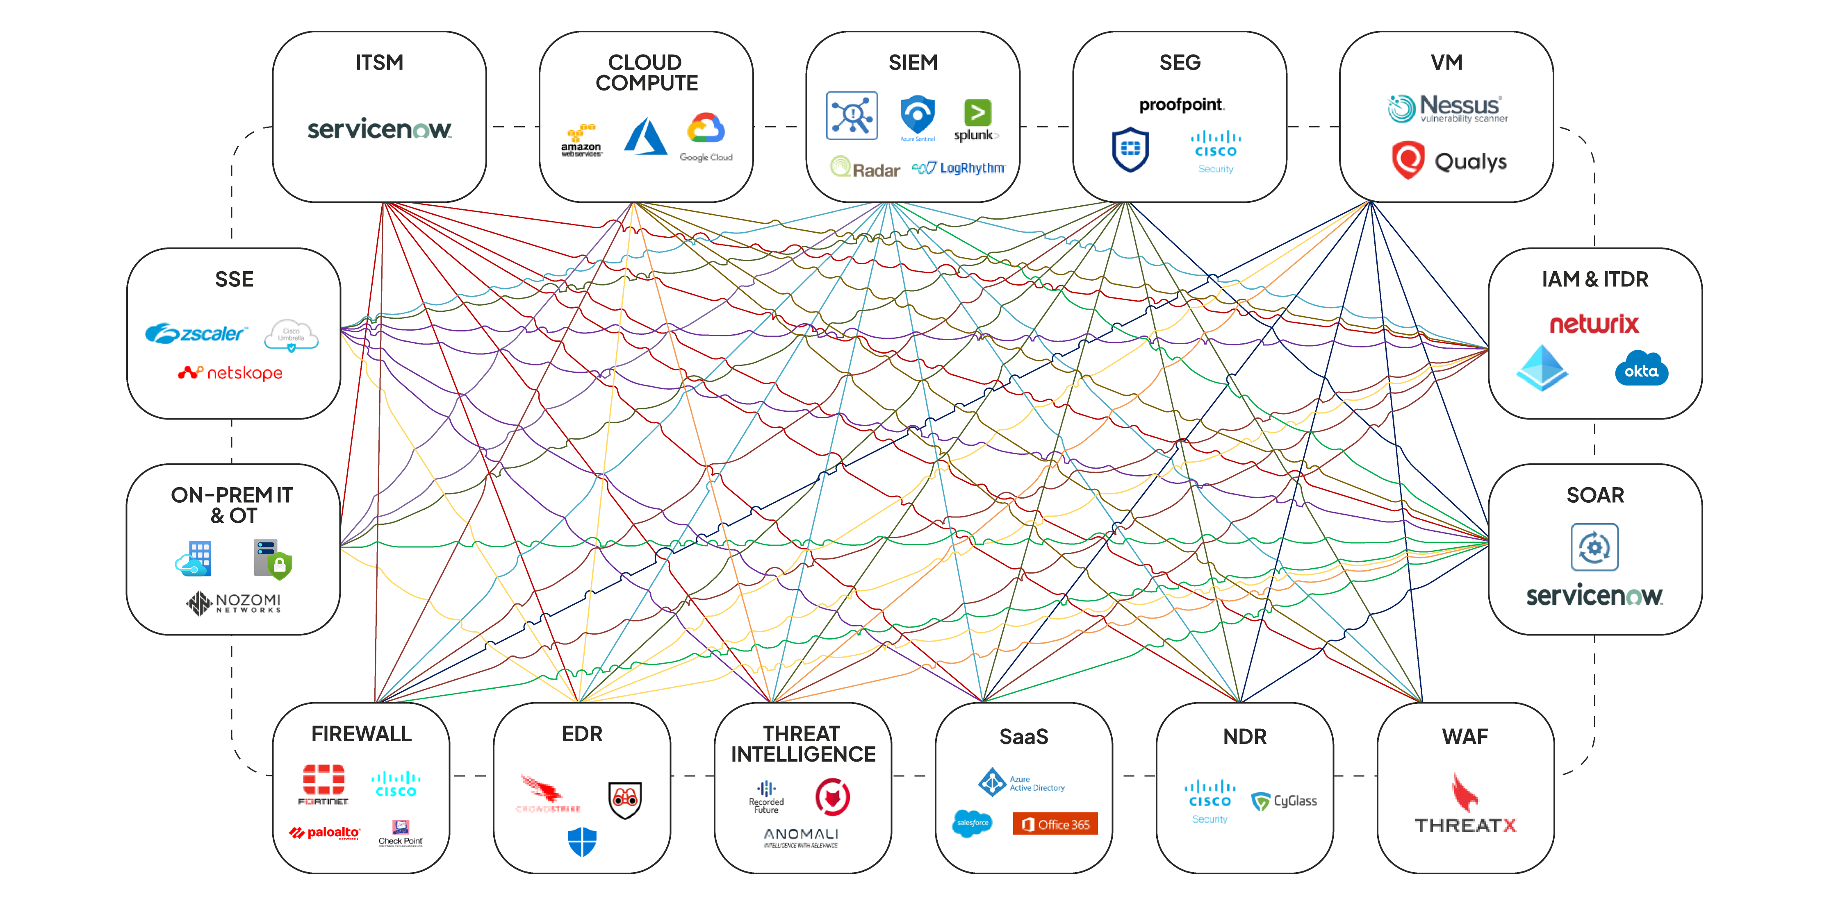
Cybersecurity Mesh Architecture

Slide 5
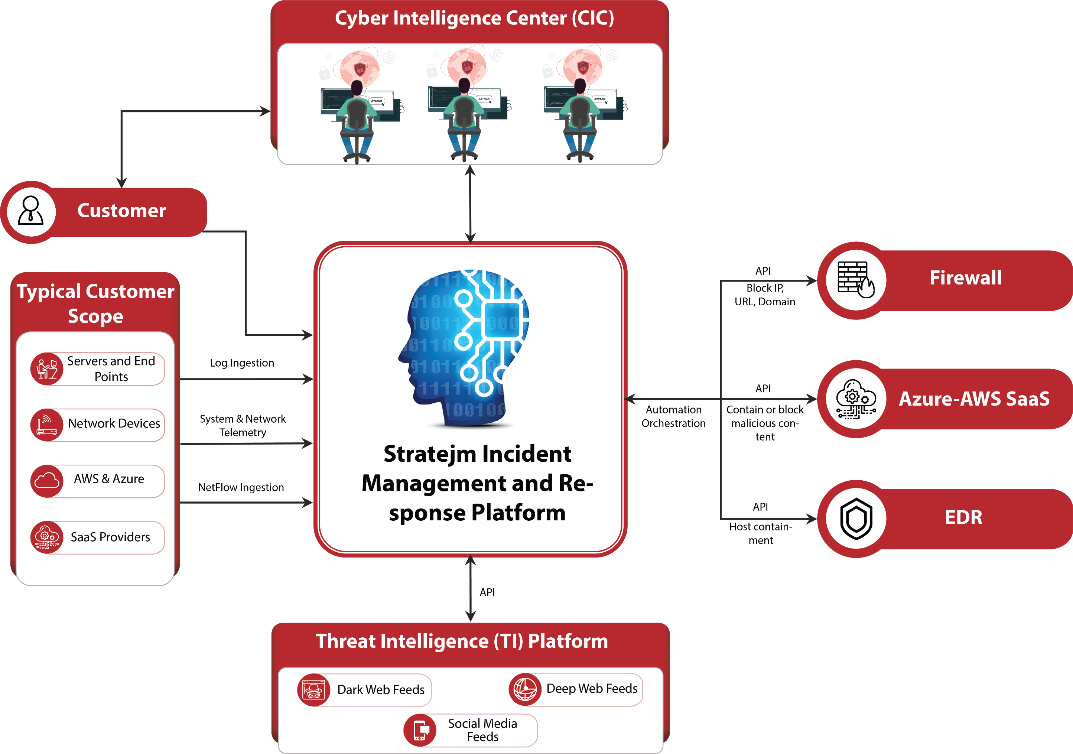
Key Outcome: Enhanced Managed Detection and Response

Slide 6
Our Innovative Approach
Visibility helps prevent loss no matter where threats originate
Eliminate the Threat
The investigations result in threats being eliminated and risk being reduced.
Investigating, Threat Hunting
Leverage Machine Learning, AI, ChatGPT and Data Analytics to detect threats.
Enrich the Data Warehouse
With real time Threat Intelligence Feeds, Geo Location, Vulnerability Data, Performance and Network Events.
Collect All the Logs
Applications, Servers, SaaS, Cloud, Network and Security Devices to create a Security Data Warehouse and CMDB.

Slide 7
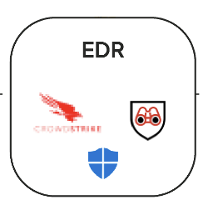
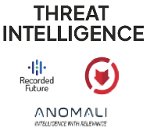
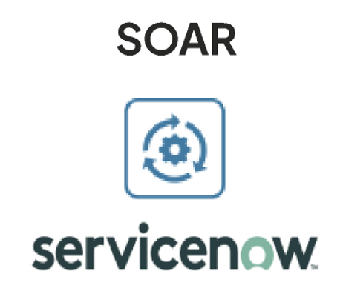
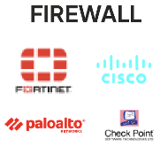
Use Case 1: Playbook for Successful VPN Login and Lateral Movement
5
1
2
3
4
5
Trigger Playbook. When the Alert is triggered in the SIEM platform.
Integration with Threat Intelligence Sources. Determine Severity and Confidence in the Threat. Update Incident Record.
Secure User Revoke all user access, Force reauthentication
Secure Network Block IP Firewall Secure Endpoint Contain Host via EDR
Stratejm Analysts Threat Hunt.
Update ServiceNow Incident Record.
Remove malicious files and reverse any system changes made by the malware.
Close Incident In ServiceNow.
DETECTION
ANALYSIS
CONTAINMENT
INVESTIGATION
ERADICATION
Automation < 5 Mins
Manual <= 1 Day

Slide 8
Use Case 2: Playbook for Malware Detection on EDR Platform
5
1
2
3
4
5
Trigger Playbook. When the Alert is triggered in the EDR platforms.
Integration with Threat Intelligence Sources. Determine Severity and Confidence in the Threat. Update Incident Record.
Secure User Block Malicious Domain
Secure Network Block Domain and IP on Firewall & SWG
Secure Endpoint Contain Host via EDR
Stratejm Analysts Threat Hunt.
Update ServiceNow Incident Record.
Remove malicious files and reverse any system changes made by the malware.
Close Incident In ServiceNow.
DETECTION
ANALYSIS
CONTAINMENT
INVESTIGATION
ERADICATION
Automation < 5 Mins
Manual <= 1 Day

