Slide 1
SECOND QUARTER 2023 RESULTS
NASDAQ: FULT
Data as of or for the period ended June 30, 2023 unless otherwise noted

Slide 2
FORWARD-LOOKING STATEMENTS
This presentation may contain forward-looking statements with respect to the Corporation’s financial condition, results of operations and business. Do not unduly rely on forward-looking statements. Forward-looking statements can be identified by the use of words such as "may," "should," "will," "could," "estimates," "predicts," "potential," "continue," "anticipates," "believes," "plans," "expects," "future," "intends," “projects,” the negative of these terms and other comparable terminology. These forward-looking statements may include projections of, or guidance on, the Corporation’s future financial performance, expected levels of future expenses, including future credit losses, anticipated growth strategies, descriptions of new business initiatives and anticipated trends in the Corporation’s business or financial results. Management’s "2023 Outlook "contained herein is comprised of forward-looking statements.
Forward-looking statements are neither historical facts, nor assurance of future performance. Instead, the statements are based on current beliefs, expectations and assumptions regarding the future of the Corporation’s business, future plans and strategies, projections, anticipated events and trends, the economy and other future conditions. Because forward-looking statements relate to the future, they are subject to inherent uncertainties, risks and changes in circumstances that are difficult to predict and many of which are outside of the Corporation’s control, and actual results and financial condition may differ materially from those indicated in the forward-looking statements. Therefore, you should not unduly rely on any of these forward-looking statements. Any forward-looking statement is based only on information currently available and speaks only as of the date when made. The Corporation undertakes no obligation, other than as required by law, to update or revise any forward-looking statements, whether as a result of new information, future events or otherwise.
A discussion of certain risks and uncertainties affecting the Corporation, and some of the factors that could cause the Corporation’s actual results to differ materially from those described in the forward-looking statements, can be found in the sections entitled “Risk Factors” and “Management’s Discussion and Analysis of Financial Condition and Results of Operations” in the Corporation’s Annual Report on Form 10-K for the year ended December 31, 2022, Quarterly Report on Form 10-Q for the quarter ended March 31, 2023 and other current and periodic reports, which have been, or will be, filed with the Securities and Exchange Commission (the "SEC") and are, or will be, available in the Investor Relations section of the Corporation’s website (www.fultonbank.com) and on the SEC’s website (www.sec.gov).
The Corporation uses certain financial measures in this presentation that have been derived by methods other than generally accepted accounting principles ("GAAP"). These non-GAAP financial measures are reconciled to the most comparable GAAP measures at the end of this presentation.
2

Slide 3
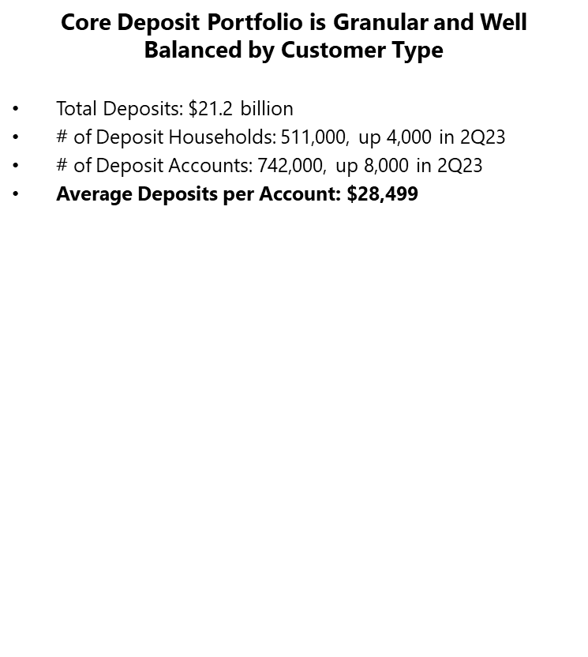
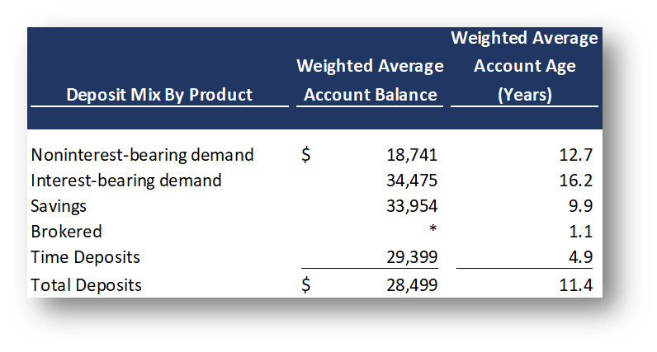
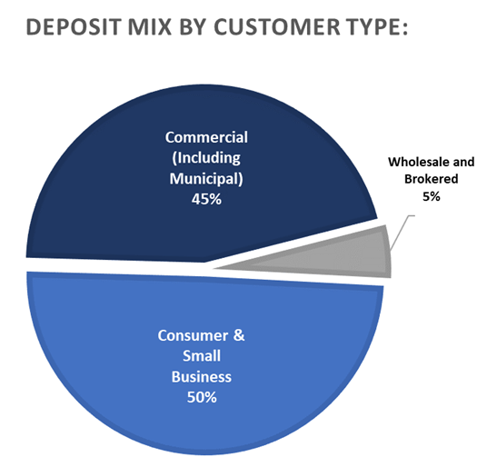
A GRANULAR, TENURED AND DIVERSIFIED DEPOSIT PORTFOLIO
3

Slide 4
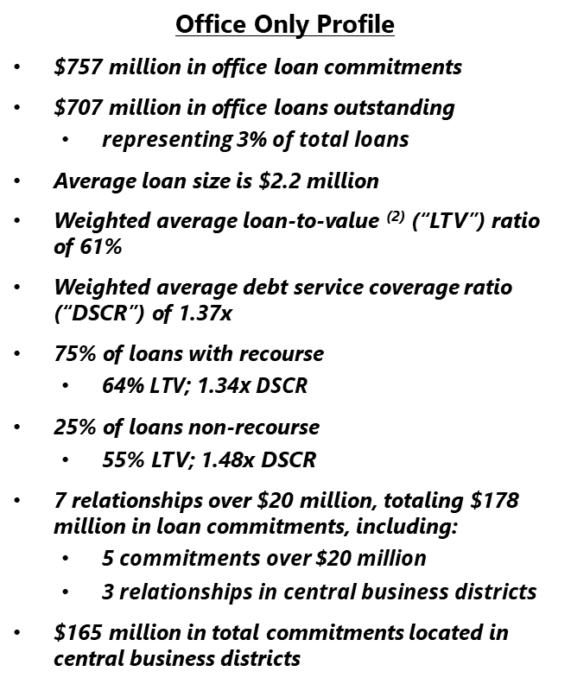
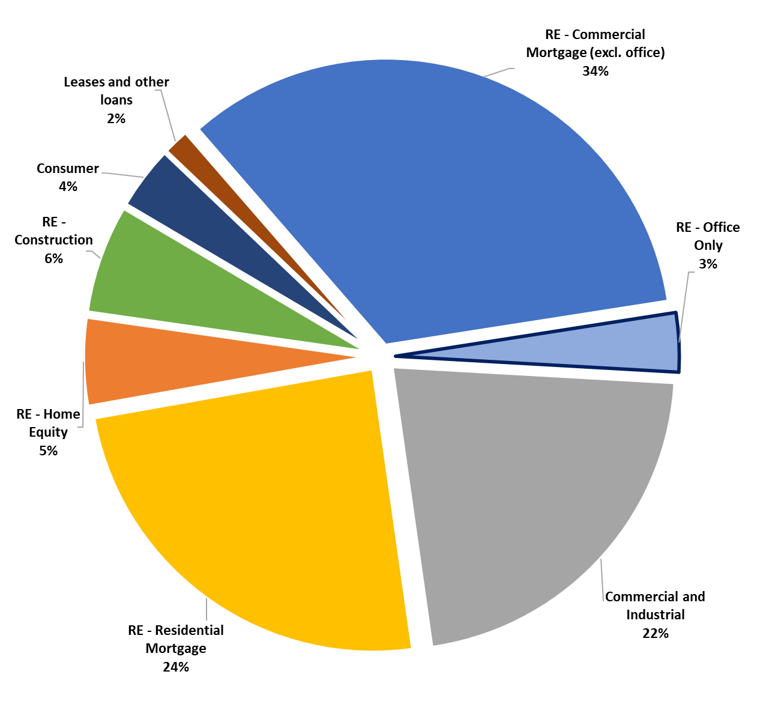
4

Slide 5
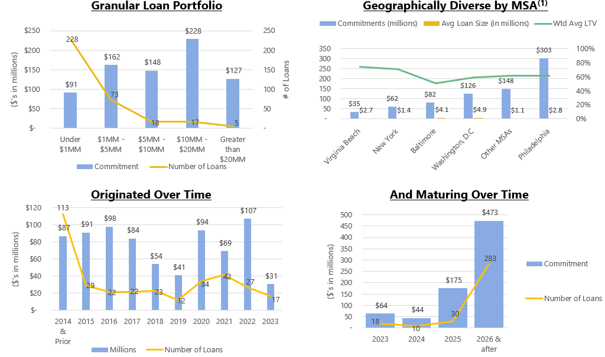
THE OFFICE PORTFOLIO IS GRANULAR, DIVERSIFIED, AND TENURED
5

Slide 6
INCOME STATEMENT SUMMARY
 | 2Q23 | 1Q23 | 2Q22
 | (dollars in thousands, except per-share data)
Net interest income | $212,852 | $215,587 | $178,831
Provision for credit losses | 9,747 | 24,544 | 1,500
Non-interest income | 60,589 | 51,730 | 58,383
Securities gains (losses) | (4) | 23 | 8
Non-interest expense | 168,018 | 159,616 | 148,703
Merger-related expenses | — | — | 1,027
Income before income taxes | 95,672 | 83,180 | 85,992
Income taxes | 16,065 | 14,866 | 16,003
Net income | 79,607 | 68,314 | 69,989
Preferred stock dividends | (2,562) | (2,562) | (2,562)
Net income available to common shareholders | $77,045 | $65,752 | $67,427
Net income available to common shareholders, per share (diluted) | $0.46 | $0.39 | $0.42
Operating net income available to common shareholders, per share (diluted)⁽¹⁾ | $0.47 | $0.39 | $0.42
ROAA | 1.17% | 1.03% | 1.10%
Operating ROAA⁽¹⁾ | 1.18% | 1.04% | 1.11%
ROAE | 12.59% | 11.02% | 11.57%
ROAE (tangible)⁽¹⁾ | 16.52% | 14.46% | 15.23%
Efficiency ratio⁽¹⁾ | 60.1% | 58.5% | 61.4%
⁽¹⁾ Non-GAAP financial measure. Please refer to the calculation and management’s reasons for using this measure on the slide titled “Non-GAAP
Reconciliation” at the end of this presentation.
6

Slide 7
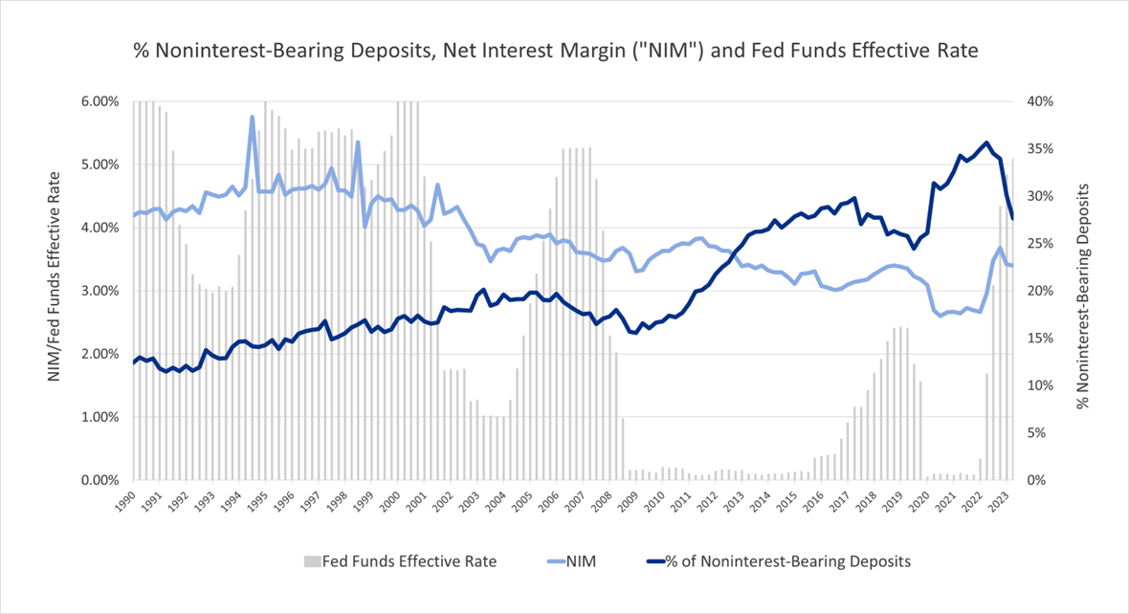
NONINTEREST-BEARING DEPOSIT MIX TREND HAS INCREASED OVER TIME
7

Slide 8
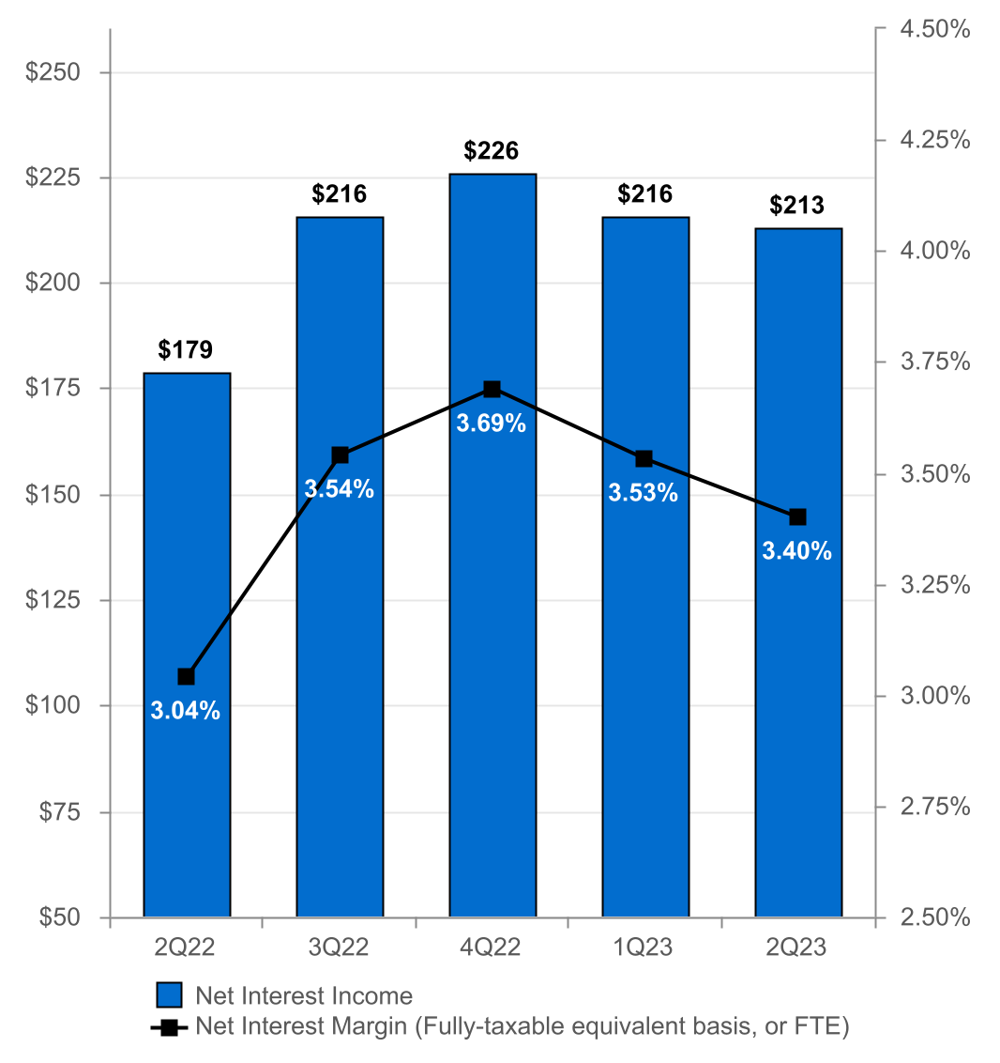
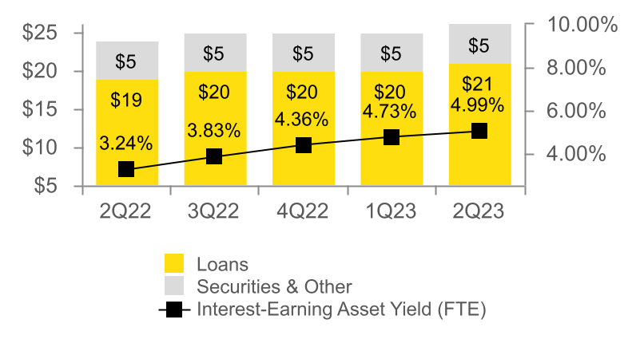
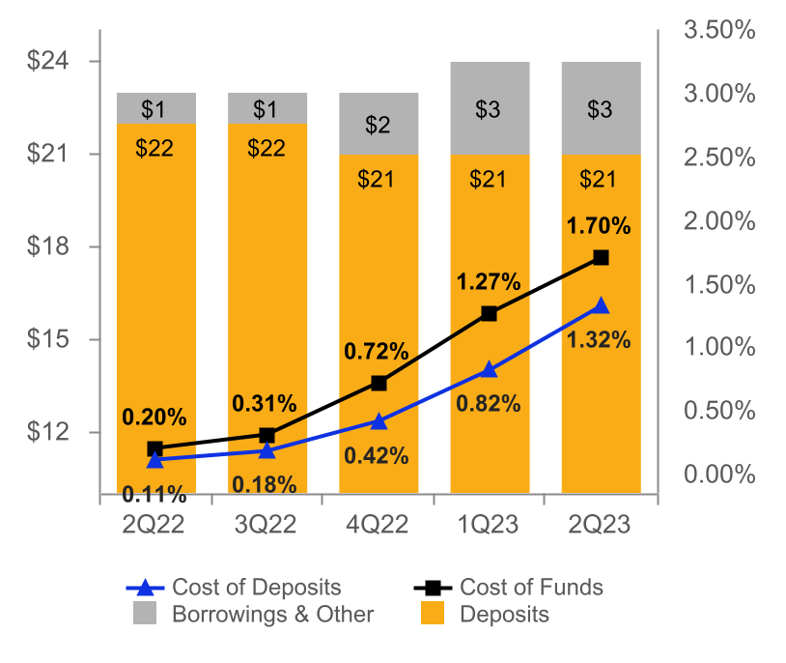
NET INTEREST INCOME AND MARGIN
Net Interest Income & Net Interest Margin
Average Interest-Earning Assets & Yields
(DOLLARS IN MILLIONS)
(DOLLARS IN BILLIONS)
Average Deposits and Borrowings & Other & Cost of Funds
(DOLLARS IN BILLIONS)
8

Slide 9
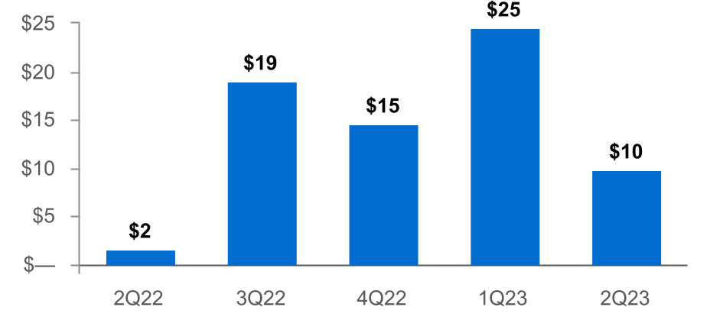
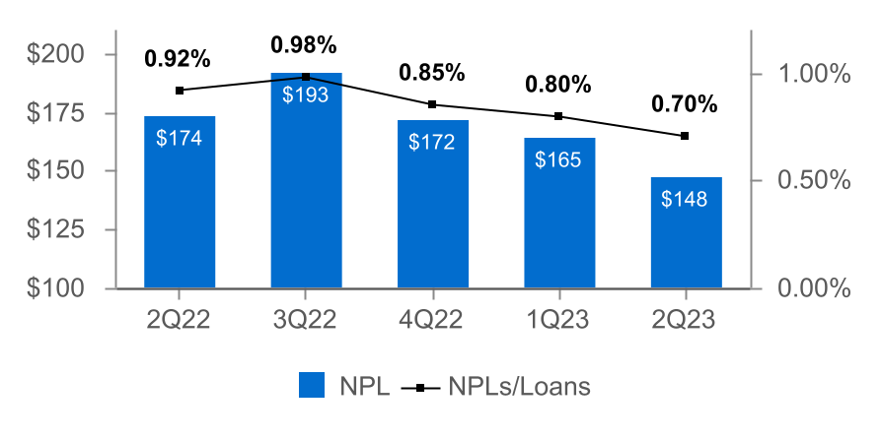
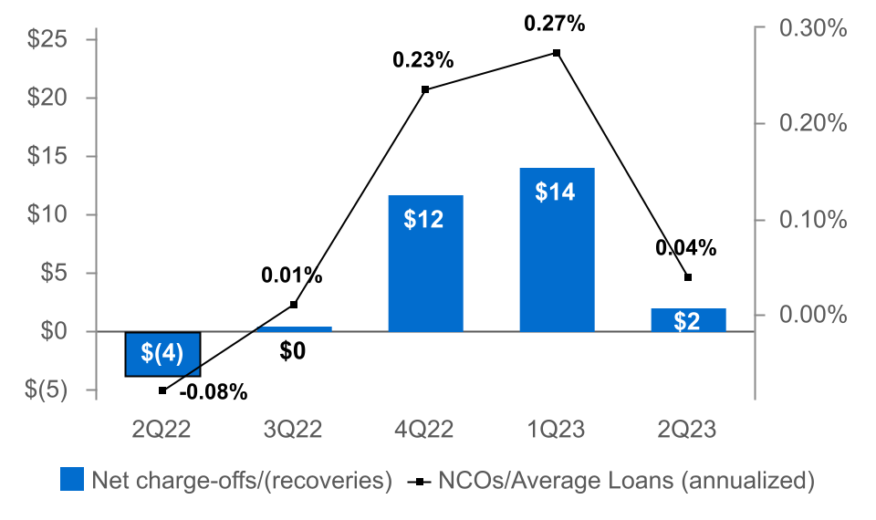
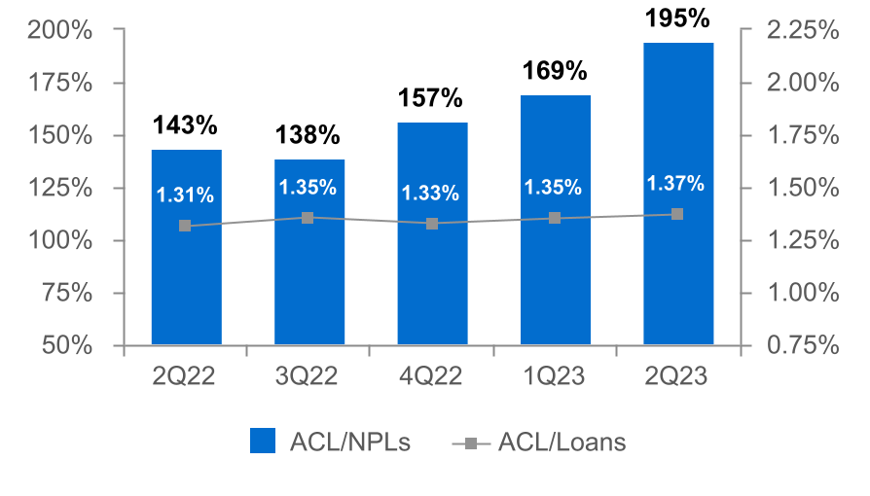
ASSET QUALITY
(DOLLARS IN MILLIONS)
Provision for Credit Losses
Non-Performing Loans (NPLs) & NPLs to Loans
(1)
Net Charge-offs (NCOs) and NCOs to Average Loans
ACL⁽²⁾ to NPLs & Loans
(1) Includes the CECL Day 1 provision for credit losses of $8.0 million for the acquired Prudential Bancorp, Inc. loan portfolio.
(2) The allowance for credit losses (“ACL”) relates specifically to "Loans, net of unearned income" and does not include reserves related to off-balance-sheet credit exposures.
9

Slide 10
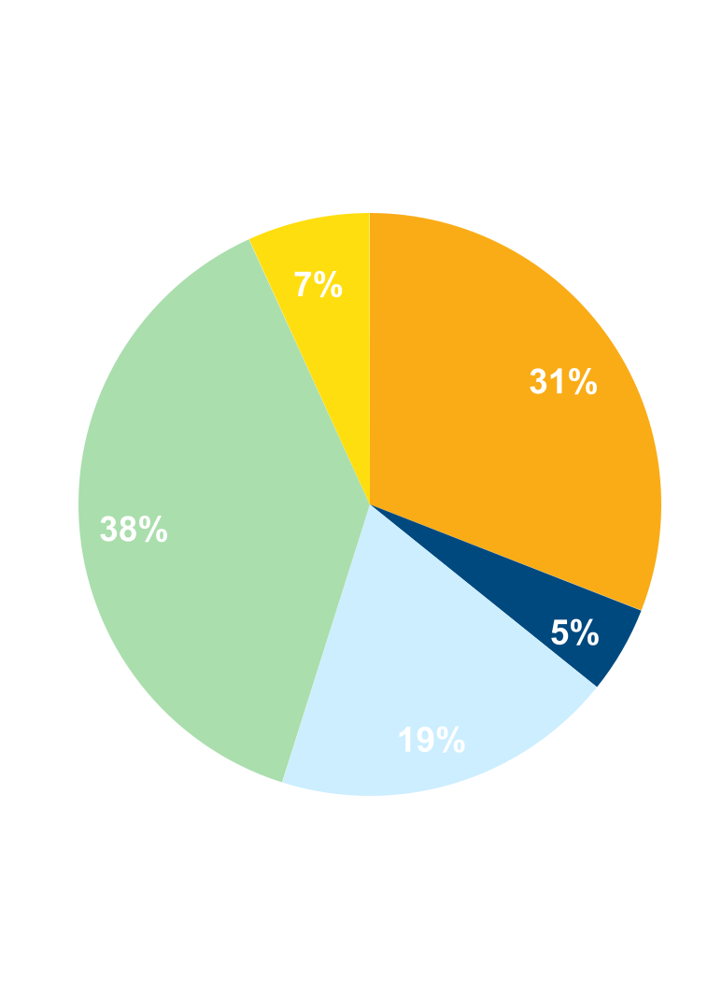
NON-INTEREST INCOME⁽¹⁾
Three months ended June 30, 2023
(percent of total non-interest income)
 |  | 2Q23 | 1Q23 | Change
 |  | (dollars in thousands)
n Commercial Banking |  | $23,145 | $17,513 | $5,632
n Wealth Management |  | 18,678 | 18,062 | 616
n Consumer Banking |  | 11,720 | 11,217 | 503
n Mortgage Banking |  | 2,940 | 1,970 | 970
n Other |  | 4,106 | 2,968 | 1,138
Total |  | $60,589 | $51,730 | $8,859
Non-interest income increased 17% from 1Q23⁽¹⁾
Driven primarily by increases in:
n Commercial banking customer interest rate swap fees and merchant and card fees.
n Higher income from equity method investments.
n Mortgage banking due to an increase in loan volume during the period and higher spreads.
⁽¹⁾ Excluding investment securities gains
10

Slide 11
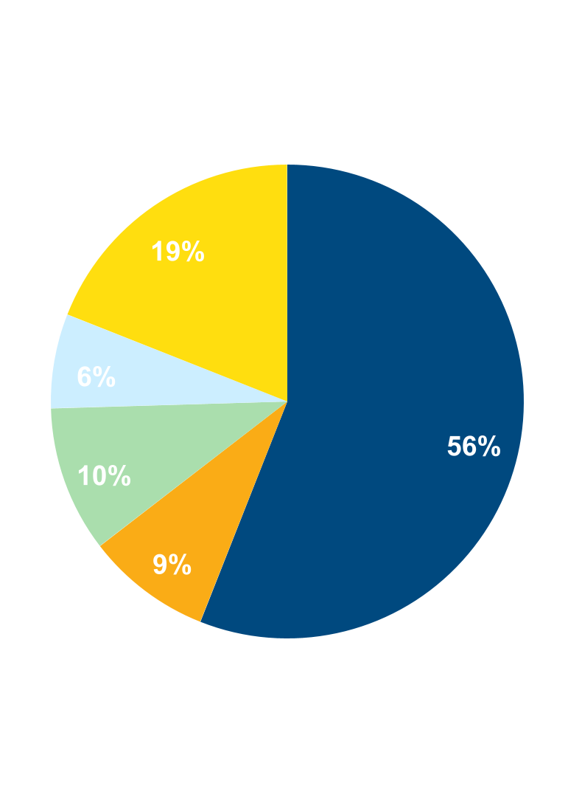
NON-INTEREST EXPENSE
Three months ended June 30, 2023
(percent of total non-interest expense)
 |  | 2Q23 | 1Q23 | Change
 |  | (dollars in thousands)
n Salaries and Benefits |  | $94,102 | $89,283 | $4,819
n Data Processing and Software |  | 16,776 | 15,796 | 980
n Occupancy |  | 14,374 | 14,438 | (64)
n Other Outside Services |  | 10,834 | 10,126 | 708
n Other |  | 31,932 | 29,973 | 1,959
Total |  | $168,018 | $159,616 | $8,402
Non-interest expense increased 5.3% from 1Q23
Driven primarily by increases in:
n Salaries and employee benefits expense primarily due to annual merit increases and one additional calendar day.
n Other primarily due to increases in owned real estate and repossession expenses and state tax expense.
n Data processing and software expense due to timing of work being performed on technology projects.
n Other Outside Services driven by technology-related services.
.
11

Slide 12
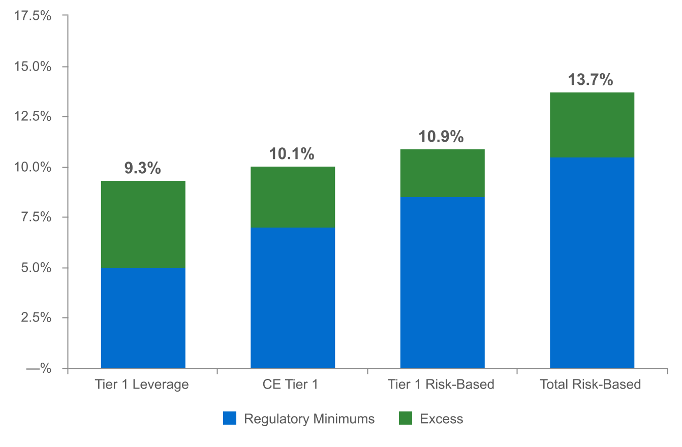
CAPITAL POSITION REMAINS STRONG⁽¹⁾
(as of June 30, 2023)
(dollars in millions)
$736
$547
$1,156
$697
⁽²⁾
(1) Regulatory capital ratios and excess capital amounts as of June 30, 2023 are preliminary.
(2) Excesses shown are to regulatory minimums, including the 250 basis point capital conservation buffer, except for Tier 1 Leverage which is the well-capitalized minimum.
12

Slide 13
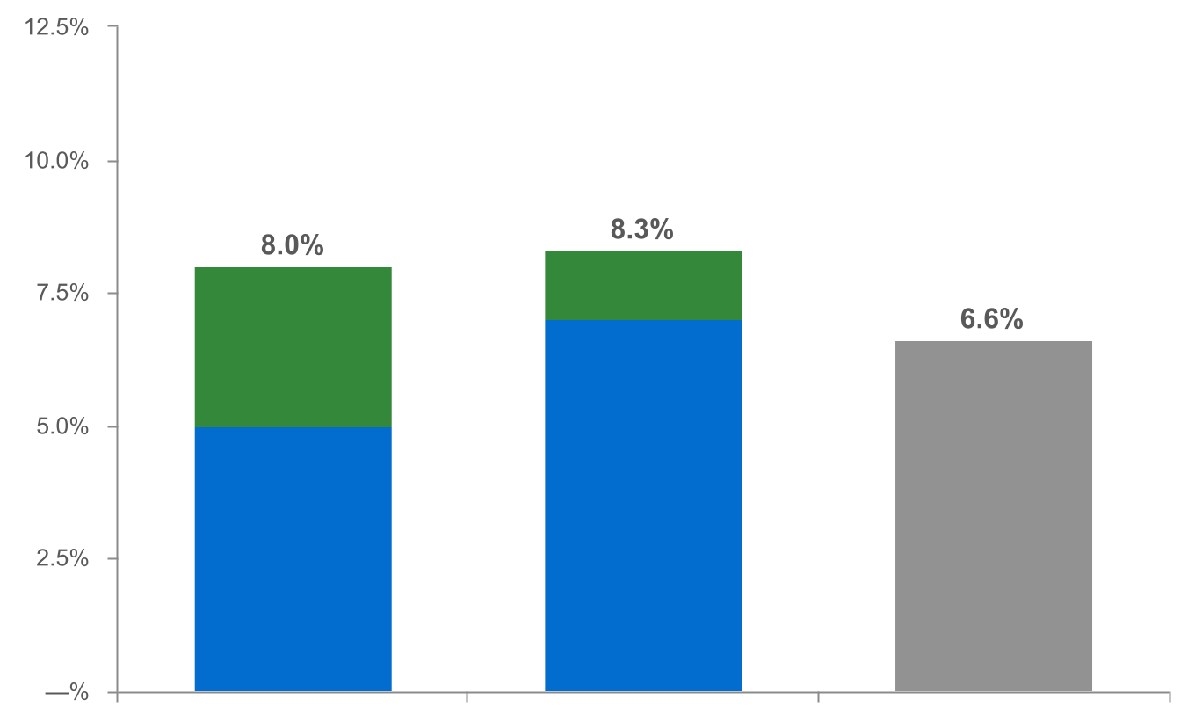
CAPITAL RATIOS ADJUSTED FOR UNREALIZED LOSSES ON INVESTMENT SECURITIES - RATIOS REMAIN STRONG⁽¹⁾
(as of June 30, 2023)
(dollars in millions)
|
|
|
|
|
|
|
|
|
|
|
|
|
$300
$772
Tier 1 Leverage⁽³⁾ CE Tier 1⁽³⁾ TCE⁽⁴⁾
n Regulatory Minimums n Excess⁽²⁾
⁽¹⁾ Regulatory capital ratios and excess capital amounts as of June 30, 2023 are preliminary.
⁽²⁾ Excesses shown are to regulatory minimums, including the 250 basis point capital conservation buffer, except for Tier 1 Leverage which is the well-capitalized minimum.
⁽³⁾ Tier 1 Leverage and CE Tier 1 capital ratios were adjusted to incorporate the unrealized loss, net of tax, on held-to-maturity investment securities of $115.0 million and the unrealized loss, net of tax,
on available-for-sale investment securities of $311.8 million.
⁽⁴⁾ Non-GAAP financial measure. Please refer to the calculation and management’s reasons for using this measure on the slide titled “Non-GAAP Reconciliation” at the end of this presentation.
13

Slide 14
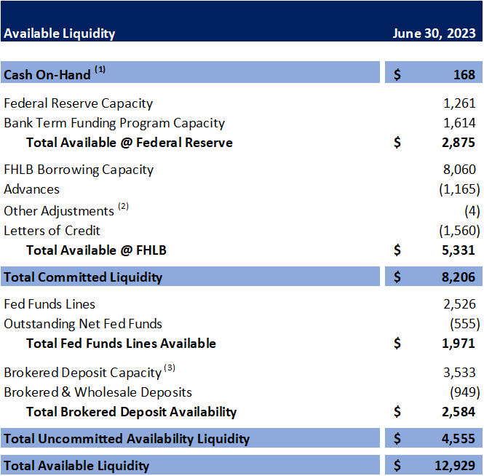
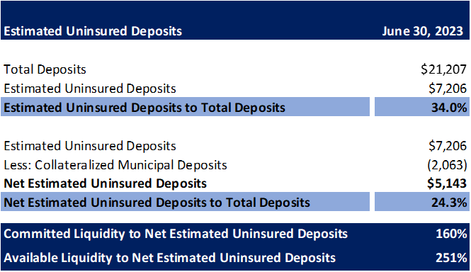
A COMMITTED AND HEALTHY LIQUIDITY PROFILE WITH SIGNIFICANT COVERAGE
14

Slide 15
2023 OUTLOOK
Net interest income: $830 - $840 million⁽¹⁾
Non-interest income: $220 - $230 million⁽²⁾
Provision for credit losses: $55 - $65 million⁽³⁾
Non-interest expense: $645 - $660 million
Effective tax rate: 17.5% +/-⁽⁴⁾
⁽¹⁾ Assumes Fed Funds Rate increase of 25 bps in July 2023. Previously $850 - $870 million.
⁽²⁾ Excludes investment securities gains.
⁽³⁾ Previously $55 - $70 million.
⁽⁴⁾ Previously 18.5% +/-.
15

Slide 16
NON-GAAP RECONCILIATION
Note: The Corporation has presented the following non-GAAP financial measures because it believes that these measures provide useful and comparative information to assess trends in the Corporation's results of operations and financial condition. Presentation of these non-GAAP financial measures is consistent with how the Corporation evaluates its performance internally and these non-GAAP financial measures are frequently used by securities analysts, investors and other interested parties in the evaluation of companies in the Corporation's industry. Investors should recognize that the Corporation's presentation of these non-GAAP financial measures might not be comparable to similarly-titled measures of other companies. These non-GAAP financial measures should not be considered a substitute for GAAP basis measures and the Corporation strongly encourages a review of its condensed consolidated financial statements in their entirety.
 | Three months ended
(dollars in thousands) | Jun 30 |  | Mar 31 |  | Jun 30
 | 2023 |  | 2023 |  | 2022
Operating net income available to common shareholders
Net income available to common shareholders | $77,045 |  | $65,752 |  | $67,427
Plus: Core deposit intangible amortization | 912 |  | 514 |  | —
Plus: Merger-related expenses | — |  | — |  | 1,027
Less: Tax impact of adjustments | (192) |  | (108) |  | (216)
Operating net income available to common shareholders (numerator) | $77,765 |  | $66,158 |  | $68,238
Weighted average shares (diluted) (denominator) | 167,191 |  | 168,401 |  | 162,075
Operating net income available to common shareholders, per share (diluted) | $0.47 |  | $0.39 |  | $0.42
16

Slide 17
NON-GAAP RECONCILIATION
 | Three months ended
(dollars in thousands) | Jun 30 |  | Mar 31 |  | Jun 30
 | 2023 |  | 2023 |  | 2022
Operating return on average assets
Net income | $79,607 |  | $68,314 |  | $69,989
Plus: Core deposit intangible amortization | 912 |  | 514 |  | —
Plus: Merger-related expenses | — |  | — |  | 1,027
Less: Tax impact of adjustments | (192) |  | (108) |  | (216)
Operating net income (numerator) | $80,327 |  | $68,720 |  | $70,800
Total average assets (denominator) | $27,235,567 |  | $26,900,653 |  | $25,578,432
Operating return on average assets | 1.18 % |  | 1.04 % |  | 1.11 %
17

Slide 18
NON-GAAP RECONCILIATION
 |  | Three months ended
(dollars in thousands) |  | Jun 30 |  | Mar 31 |  | Jun 30
 |  | 2023 |  | 2023 |  | 2022
Return on average common shareholders' equity (tangible)
Net income available to common shareholders |  | $77,045 |  | $65,752 |  | $67,427
Plus: Intangible amortization |  | 1,072 |  | 674 |  | 177
Plus: Merger-related expenses |  | — |  | — |  | 1,027
Less: Tax impact of adjustments |  | (225) |  | (142) |  | (253)
Operating net income available to common shareholders (numerator) |  | $77,892 |  | $66,284 |  | $68,378
Average shareholders' equity |  | $2,647,464 |  | $2,613,316 |  | $2,531,346
Less: Average preferred stock |  | (192,878) |  | (192,878) |  | (192,878)
Less: Average goodwill and intangible assets |  | (563,146) |  | (561,744) |  | (537,786)
Average tangible common shareholders' equity (denominator) |  | $1,891,440 |  | $1,858,694 |  | $1,800,682
Return on average common shareholders' equity (tangible) |  | 16.52 % |  | 14.46 % |  | 15.23 %
18

Slide 19
NON-GAAP RECONCILIATION
(dollars in thousands) |  | Three months ended
 |  | Jun 30 |  | Mar 31 |  | Jun 30
Efficiency ratio |  | 2023 |  | 2023 |  | 2022
Non-interest expense |  | $168,018 |  | $159,616 |  | $149,730
Less: Amortization of tax credit investments |  | — |  | — |  | (696)
Less: Merger-related expenses |  | — |  | — |  | (1,027)
Less: Intangible amortization |  | (1,072) |  | (674) |  | (177)
Non-interest expense (numerator) |  | $166,946 |  | $158,942 |  | $147,830
Net interest income |  | $212,852 |  | $215,587 |  | $178,831
Tax equivalent adjustment |  | 4,405 |  | 4,414 |  | 3,427
Plus: Total non-interest income |  | 60,585 |  | 51,753 |  | 58,391
Less: Investment securities (gains) losses, net |  | 4 |  | (23) |  | (8)
Total revenue (denominator) |  | $277,846 |  | $271,731 |  | $240,641
Efficiency ratio |  | 60.1% |  | 58.5% |  | 61.4%
19

Slide 20
NON-GAAP RECONCILIATION
 | Three months ended
(dollars in thousands) | Jun 30
 | 2023
Adjusted tangible common equity to tangible assets (TCE Ratio)
Shareholders' equity | $ 2,642,152
Less: Preferred stock | (192,878)
Less: Goodwill and intangible assets | (561,885)
Less: Unrealized gain/(loss) - HTM | (148,690)
Less: Tax impact of adjustments | 33,678
Adjusted tangible common shareholders' equity (numerator) | $ 1,772,377
Total assets | $ 27,403,163
Less: Goodwill and intangible assets | (561,885)
Less: Unrealized gain/(loss) - HTM | (148,690)
Less: Tax impact of adjustments | 33,678
Adjusted total tangible assets (denominator) | $ 26,726,266
Adjusted tangible common equity to tangible assets | 6.6 %
20

