Slide 1




Slide 2
AFBI Selected Data
Company Highlights
As of 2023Q2
YTD
$877
million in assets
10.8%
growth in assets
$663
million in loans
2.6%
growth in loans
$731
million in deposits
11.2%
growth in deposits

Slide 3
AFBI Selected Data
June 30, 2023 Company Highlights
$3.3 million in YTD earnings
$0.50
YTD diluted earnings per share
$25.1
million in NOO office loans
43%
avg LTV on NOO office loans
12.8%
uninsured deposits
approximately
37%
DDA/Total Deposits

Slide 4
AFBI Selected Data
Tangible Book Value Calculation
(in thousands, other than per-share data)
 | Tangible Equity | Shares Outstanding | Tangible Book Value*
Ending balance December 31, 2022 | $98,545 | 6,605 | $14.92
Stock Activity including repurchase | (2,106)
Unearned stock comp change | 104
AOCI Change | (14)
Effect of goodwill and other intangibles | 96
Adoption of new accounting pronouncement | (460)
Net earnings before stock compensation | 3,821
Stock Compensation, net of taxes | (509)
Ending balance June 30, 2023 | $99,477 | 6,430 | $15.47
* See Non-GAAP Reconciliation

Slide 5
AFBI Selected Data
NIM, NI, and EPS – Adjusted for 1st Quarter 2022 FHLB Advance Prepayments
 | For the six months ended June 30,
 | 2023 | 2022
Adjusted Net Interest Margin* | 3.37% | 3.98%
Adjusted Net Income (in thousands)* | $3,312 | $3,320
Adjusted Earnings Per Share* | $0.50 | $0.49
* See Non-GAAP Reconciliation

Slide 6
AFBI Selected Data
Loan Composition as of June 30, 2023

Slide 7

AFBI Selected Data
Deposit Composition as of June 30, 2023

Slide 8
AFBI Selected Deposit Data
Deposits
Estimated uninsured deposits are approximately $93.9 million or 12.8% of total deposits.*
  Consumer deposits total $19.7 million or 20.9% of estimated uninsured deposits.
  Business deposits total $74.2 million or 79.1% of estimated uninsured deposits.
Demand deposits represent 37% of total deposits.
Consumer and Business demand deposits each represent approximately 48% and 52% of total demand deposits.
Dental deposits total $123.8 million and represent 16.8% of total deposits.
Cost of Funds – 2.17% 2Q23, 1.61% 1Q23, 1.92% YTD
* All deposits are held at AFBI and include the Company’s own funds

Slide 9
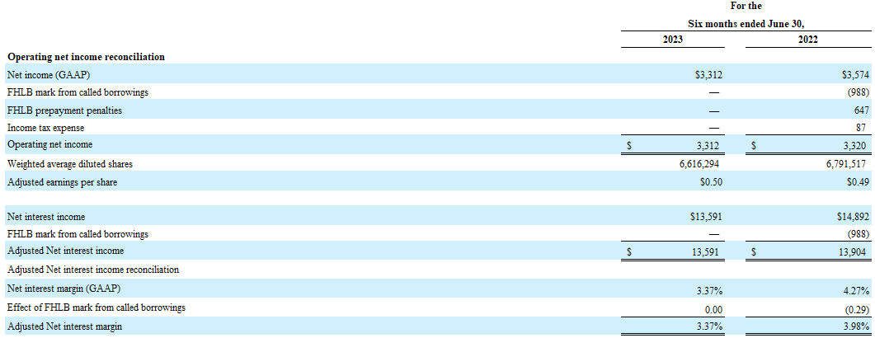
AFBI Share Information
NON-GAAP RECONCILIATION
(in thousands)

