Slide 1
THIRD QUARTER 2023 RESULTS
NASDAQ: FULT
Data as of or for the period ended September 30, 2023 unless otherwise noted

Slide 2
FORWARD-LOOKING STATEMENTS
This presentation may contain forward-looking statements with respect to Fulton Financial Corporation's (the "Corporation") financial condition, results of operations and business. Do not unduly rely on forward-looking statements. Forward-looking statements can be identified by the use of words such as "may," "should," "will," "could," "estimates," "predicts," "potential," "continue," "anticipates," "believes," "plans," "expects," "future," "intends," “projects,” the negative of these terms and other comparable terminology. These forward-looking statements may include projections of, or guidance on, the Corporation’s future financial performance, expected levels of future expenses, including future credit losses, anticipated growth strategies, descriptions of new business initiatives and anticipated trends in the Corporation’s business or financial results. Management’s "2023 Outlook" contained herein is comprised of forward-looking statements.
Forward-looking statements are neither historical facts, nor assurance of future performance. Instead, the statements are based on current beliefs, expectations and assumptions regarding the future of the Corporation’s business, future plans and strategies, projections, anticipated events and trends, the economy and other future conditions. Because forward-looking statements relate to the future, they are subject to inherent uncertainties, risks and changes in circumstances that are difficult to predict and many of which are outside of the Corporation’s control, and actual results and financial condition may differ materially from those indicated in the forward-looking statements. Therefore, you should not unduly rely on any of these forward-looking statements. Any forward-looking statement is based only on information currently available and speaks only as of the date when made. The Corporation undertakes no obligation, other than as required by law, to update or revise any forward-looking statements, whether as a result of new information, future events or otherwise.
A discussion of certain risks and uncertainties affecting the Corporation, and some of the factors that could cause the Corporation’s actual results to differ materially from those described in the forward-looking statements, can be found in the sections entitled “Risk Factors” and “Management’s Discussion and Analysis of Financial Condition and Results of Operations” in the Corporation’s Annual Report on Form 10-K for the year ended December 31, 2022, Quarterly Reports on Form 10-Q for the quarters ended March 31, 2023 and June 30, 2023 and other current and periodic reports, which have been, or will be, filed with the Securities and Exchange Commission (the "SEC") and are, or will be, available in the Investor Relations section of the Corporation’s website (www.fultonbank.com) and on the SEC’s website (www.sec.gov).
The Corporation uses certain financial measures in this presentation that have been derived by methods other than generally accepted accounting principles ("GAAP"). These non-GAAP financial measures are reconciled to the most comparable GAAP measures at the end of this presentation.
2

Slide 3
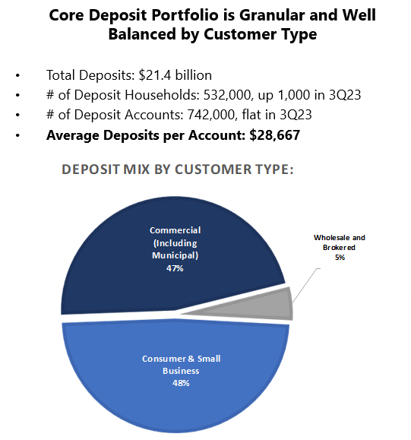
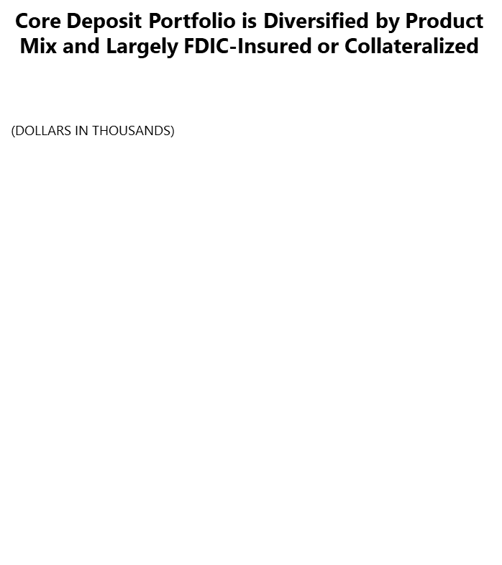
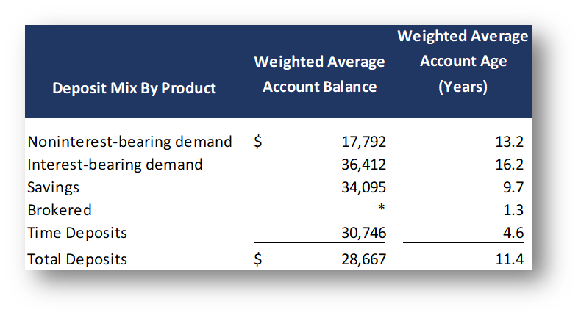
A DEPOSIT PORTFOLIO THAT REMAINS GRANULAR, TENURED AND DIVERSIFIED
3

Slide 4
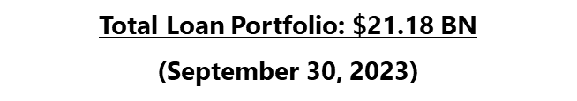
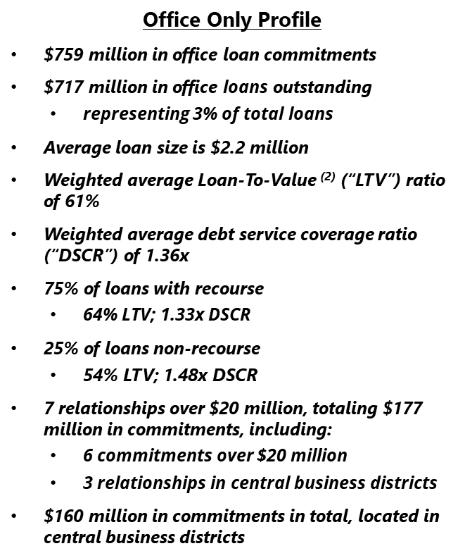

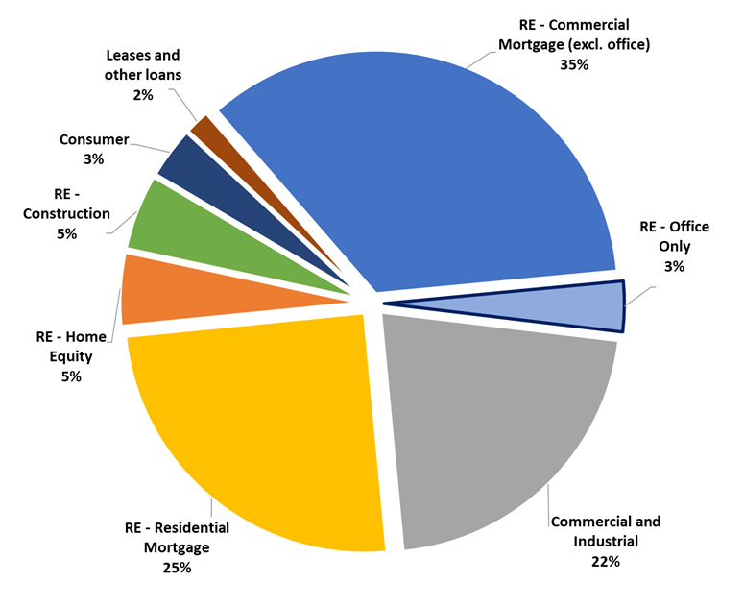
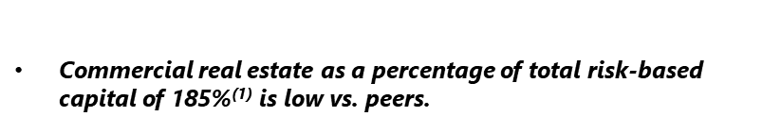
THE LOAN MIX IS DIVERSIFIED, GRANULAR, WITH LOW CRE AND LOW OFFICE CONCENTRATIONS
4

Slide 5
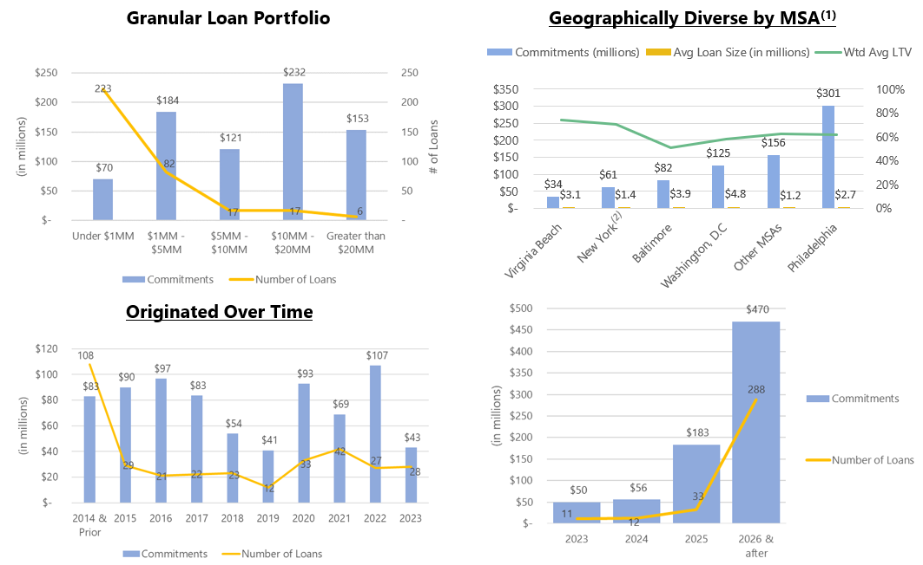
THE OFFICE PORTFOLIO HAS BEEN ORIGINATED OVER TIME, WILL MATURE OVER TIME, AND REMAINS GRANULAR AND DIVERSE
5

Slide 6
INCOME STATEMENT SUMMARY
 | 3Q23 | 2Q23 | 3Q22
 | (dollars in thousands, except per-share data)
Net interest income | $213,842 | $212,852 | $215,582
Provision for credit losses | 9,937 | 9,747 | 18,958
Non-interest income | 55,961 | 60,589 | 59,215
Securities gains (losses) | — | (4) | (53)
Non-interest expense | 171,020 | 168,018 | 162,552
Merger-related expenses | — | — | 7,006
Income before income taxes | 88,846 | 95,672 | 86,228
Income taxes | 16,749 | 16,065 | 15,357
Net income | 72,097 | 79,607 | 70,871
Preferred stock dividends | (2,562) | (2,562) | (2,562)
Net income available to common shareholders | $69,535 | $77,045 | $68,309
Net income available to common shareholders, per share (diluted) | $0.42 | $0.46 | $0.40
Operating net income available to common shareholders, per share (diluted)⁽¹⁾ | $0.43 | $0.47 | $0.48
ROAA | 1.04% | 1.17% | 1.07%
Operating ROAA⁽¹⁾ | 1.08% | 1.18% | 1.25%
ROAE | 11.25% | 12.59% | 11.24%
ROAE (tangible)⁽¹⁾ | 15.17% | 16.52% | 17.31%
Efficiency ratio⁽¹⁾ | 61.5% | 60.1% | 57.8%
⁽¹⁾ Non-GAAP financial measure. Please refer to the calculation and management’s reasons for using this measure on the slide titled “Non-GAAP
Reconciliation” at the end of this presentation.
6

Slide 7
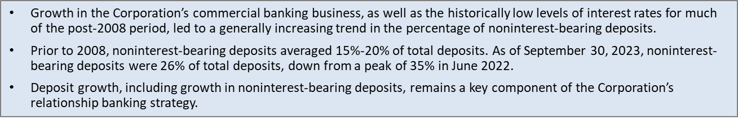
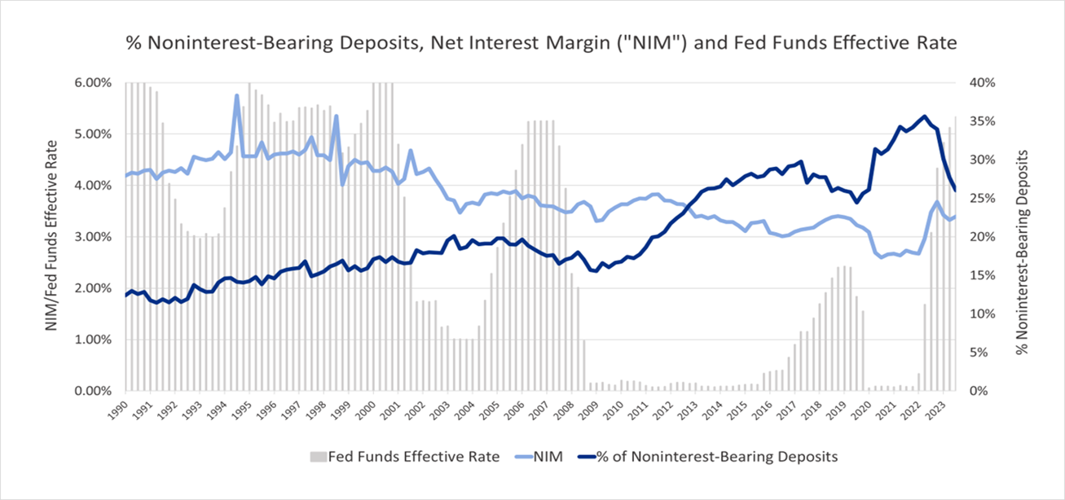
THE NONINTEREST-BEARING DEPOSIT MIX HAS TRENDED UP OVER TIME DESPITE PERIODIC CHANGES IN INTEREST RATES
7

Slide 8
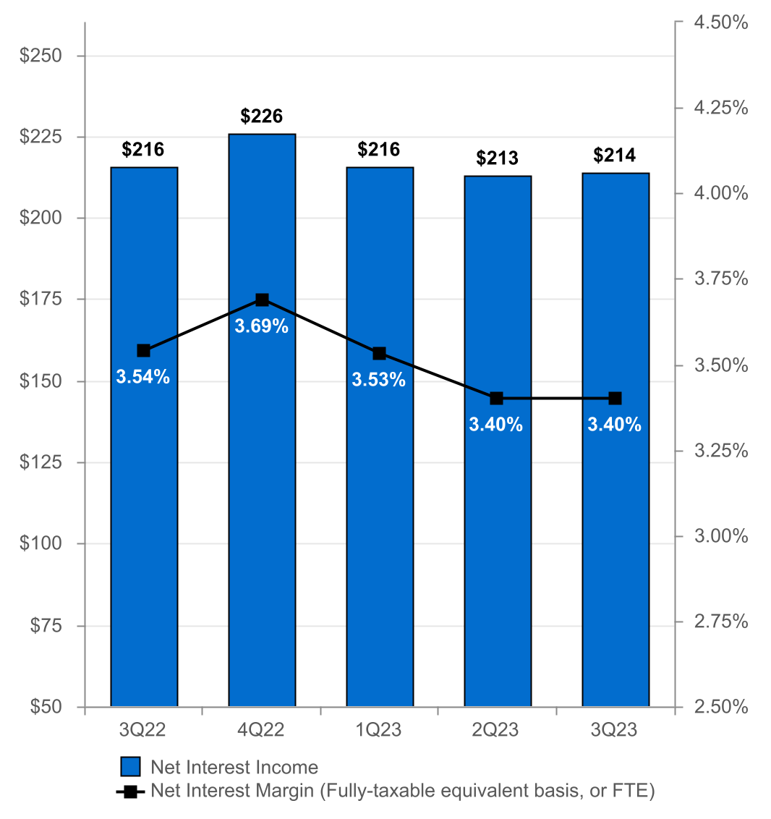
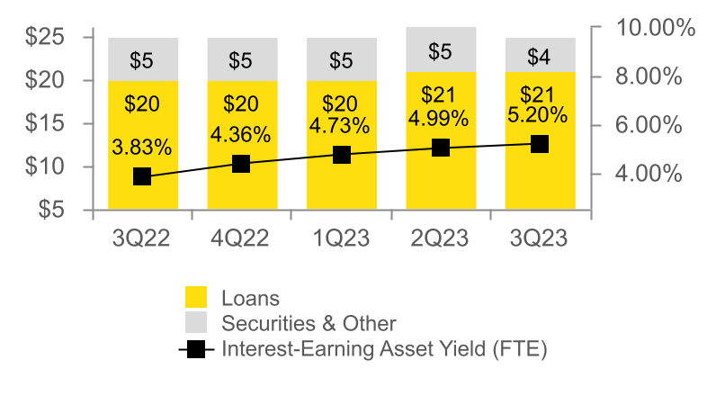
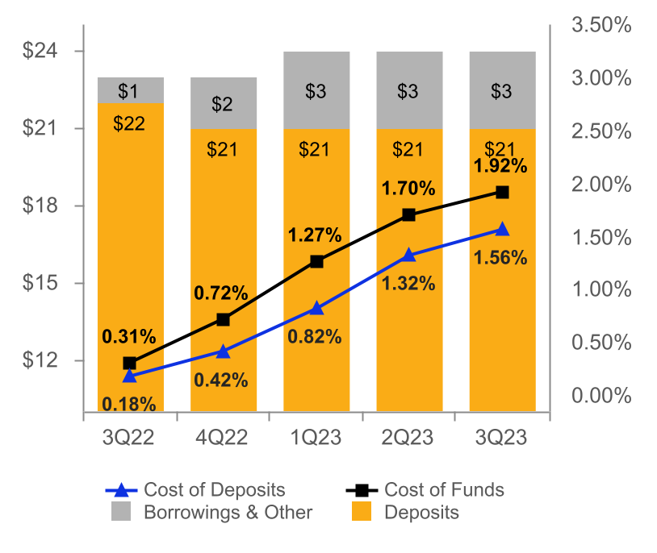
NET INTEREST INCOME AND MARGIN
Net Interest Income & Net Interest Margin
Average Interest-Earning Assets & Yields
(DOLLARS IN MILLIONS)
(DOLLARS IN BILLIONS)
Average Deposits and Borrowings & Other & Cost of Funds
(DOLLARS IN BILLIONS)
8

Slide 9
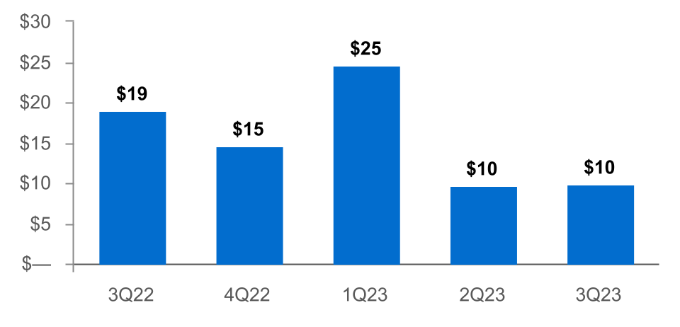
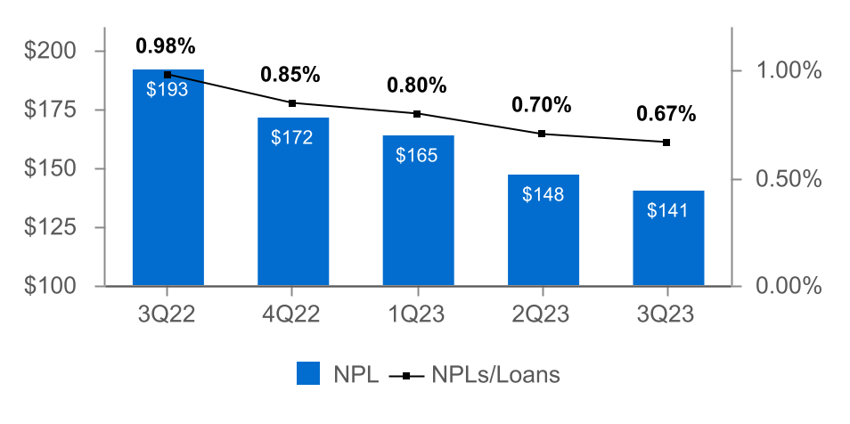
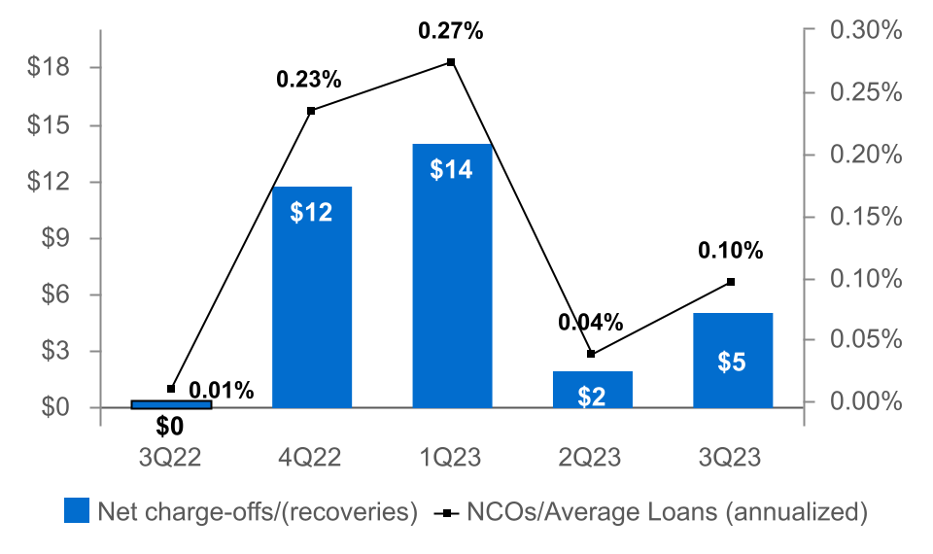
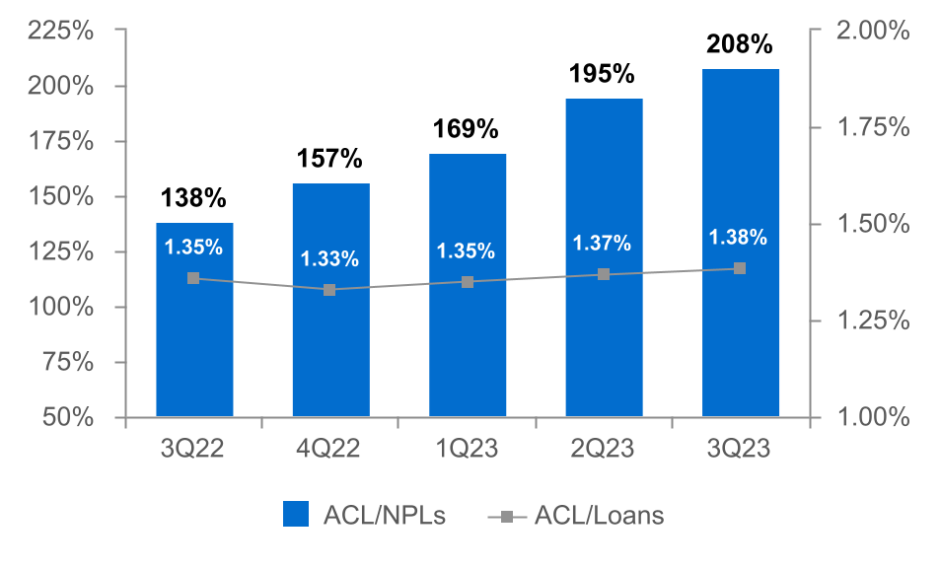
ASSET QUALITY
(DOLLARS IN MILLIONS)
Provision for Credit Losses
Non-Performing Loans ("NPLs") & NPLs to Loans
(1)
Net Charge-offs ("NCOs") and NCOs to Average Loans
ACL⁽²⁾ to NPLs & Loans
(1) Includes the CECL Day 1 provision for credit losses of $8.0 million for the acquired Prudential Bancorp, Inc. loan portfolio.
(2) The allowance for credit losses (“ACL”) relates specifically to "Loans, net of unearned income" and does not include reserves related to off-balance-sheet credit exposures.
9

Slide 10
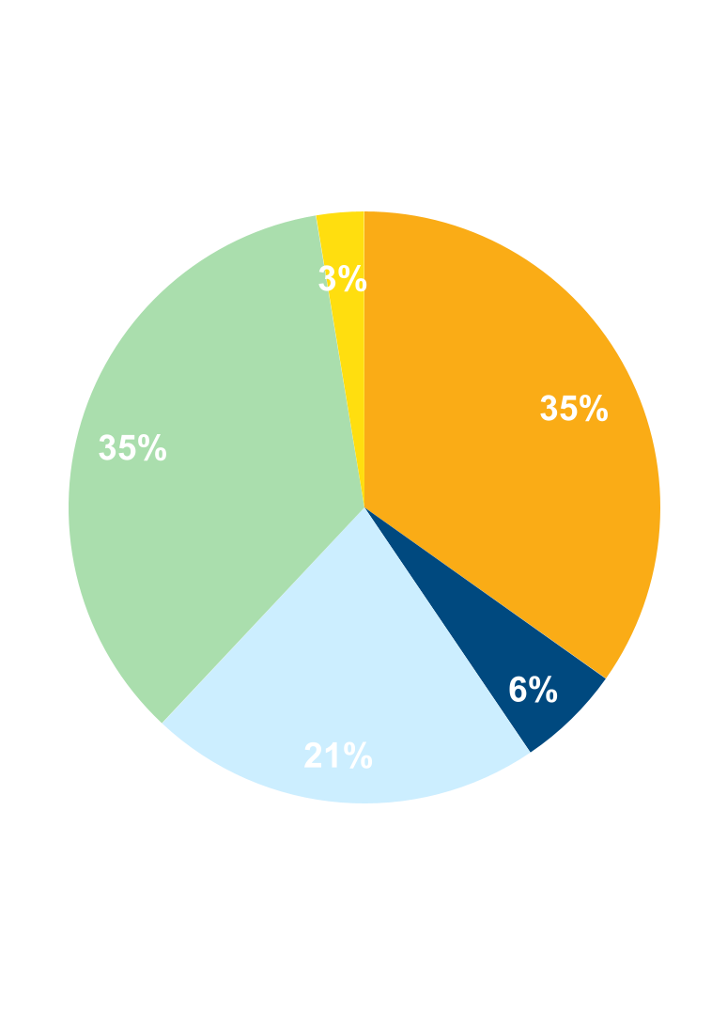
NON-INTEREST INCOME⁽¹⁾
Three months ended September 30, 2023
(percent of total non-interest income)
 |  | 3Q23 | 2Q23 | Change
 |  | (dollars in thousands)
n Commercial Banking |  | $19,722 | $23,145 | ($3,423)
n Wealth Management |  | 19,413 | 18,678 | 735
n Consumer Banking |  | 12,173 | 11,720 | 453
n Mortgage Banking |  | 3,190 | 2,940 | 250
n Other |  | 1,463 | 4,106 | (2,643)
Total |  | $55,961 | $60,589 | ($4,628)
Decreases in:
n Other income from a $3.0 million market valuation movement in our commercial
customer interest rate swap program resulting from the reference rate transition
from the London Inter-Bank Offered Rate ("LIBOR") to the Secured Overnight
Financing Rate ("SOFR").
n Commercial banking customer interest rate swap fees from ongoing operations.
Increases in:
n Wealth management due to a favorable impact from the equity markets for the period and stronger revenues from the Fulton Private Bank division of Fulton Bank, N.A..
n Consumer banking primarily due to overdraft fees.
Non-interest income decreased 7.6% from 2Q23⁽¹⁾ due primarily to:
⁽¹⁾ Excluding investment securities gains.
10

Slide 11
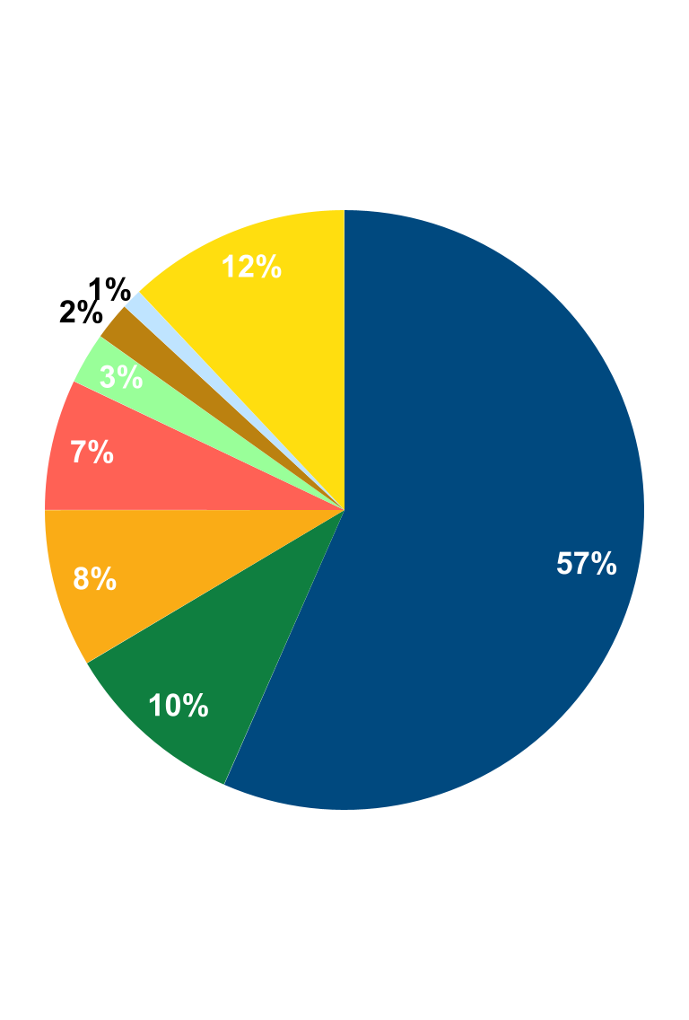
NON-INTEREST EXPENSE
Three months ended September 30, 2023
(percent of total non-interest expense)
 |  | 3Q23 | 2Q23 | Change
 |  | (dollars in thousands)
n Salaries and Benefits |  | $96,757 | $94,102 | $2,655
n Data Processing and Software |  | 16,914 | 16,776 | 138
n Net Occupancy |  | 14,561 | 14,374 | 187
n Other Outside Services |  | 12,094 | 10,834 | 1,260
n FDIC Insurance |  | 4,738 | 4,895 | (157)
n Equipment |  | 3,475 | 3,530 | (55)
n Marketing |  | 1,913 | 1,655 | 258
n Other |  | 20,568 | 21,852 | (1,284)
Total |  | $171,020 | $168,018 | $3,002
Increases in:
n Salaries and employee benefits expense primarily due to one additional calendar day.
n Other outside services driven by a number of corporate initiatives.
Decreases in:
n Other expense primarily due to a decrease in charitable contributions and gain on sales
from fixed asset disposals.
.
Non-interest expense increased 1.8% from 2Q23 due primarily to:
11

Slide 12
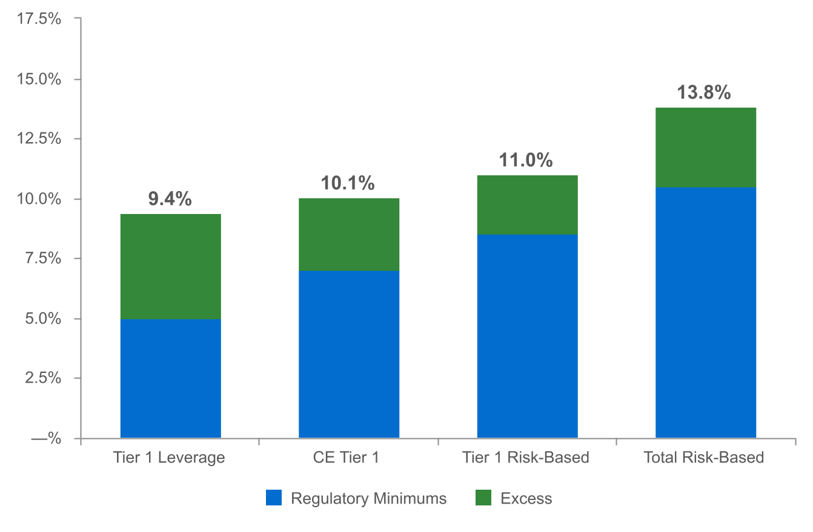
CAPITAL RATIOS⁽¹⁾
(as of September 30, 2023)
(dollars in millions)
$759
$566
$1,168
$716
⁽²⁾
(1) Regulatory capital ratios and excess capital amounts as of September 30, 2023 are preliminary estimates.
(2) Excesses shown are to regulatory minimums, including the 250 basis point capital conservation buffer, except for Tier 1 Leverage which is the well-
capitalized minimum.
12

Slide 13
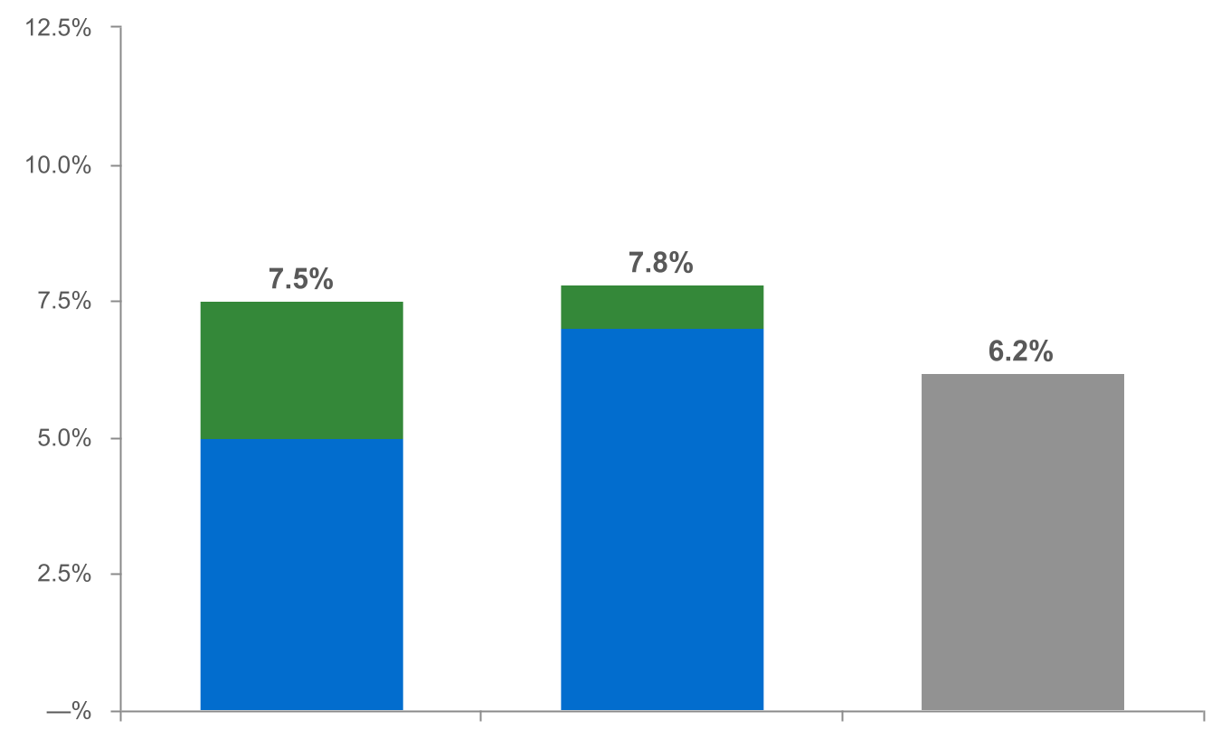
CAPITAL RATIOS ADJUSTED FOR UNREALIZED LOSSES ON INVESTMENT SECURITIES⁽¹⁾
(as of September 30, 2023)
(dollars in millions)
|
|
|
|
|
|
|
|
|
|
|
|
|
$183
$653
Tier 1 Leverage⁽³⁾ CE Tier 1⁽³⁾ TCE⁽⁴⁾
n Regulatory Minimums n Excess⁽²⁾
⁽¹⁾ Regulatory capital ratios and excess capital amounts as of September 30, 2023 are preliminary estimates.
⁽²⁾ Excesses shown are to regulatory minimums, including the 250 basis point capital conservation buffer, except for Tier 1 Leverage which is the well-capitalized minimum.
⁽³⁾ Tier 1 Leverage and CE Tier 1 capital ratios were adjusted to incorporate unrealized losses, net of tax, on held-to-maturity investment securities of $156.7 million and unrealized losses net of tax,
on available-for-sale investment securities of $371.0 million.
⁽⁴⁾ Non-GAAP financial measure. Please refer to the calculation and management’s reasons for using this measure on the slide titled “Non-GAAP Reconciliation” at the end of this presentation.
13

Slide 14
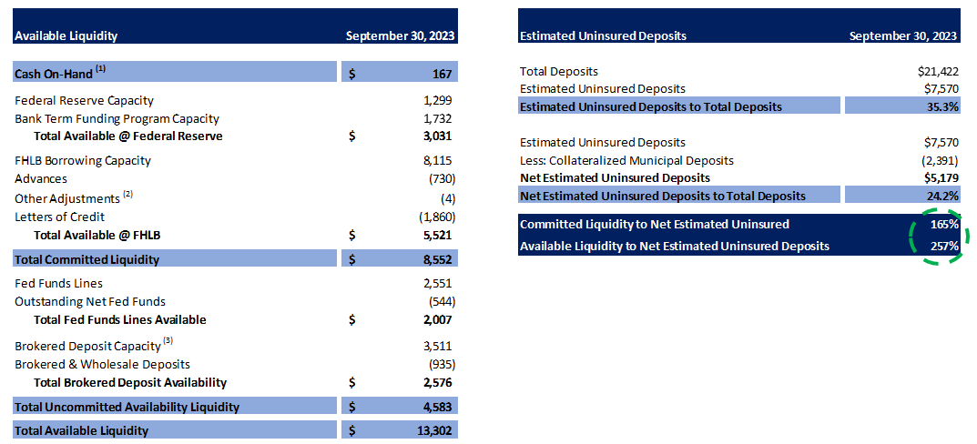
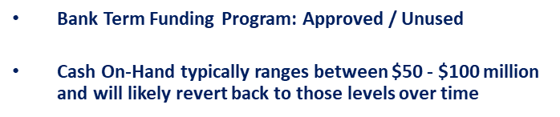
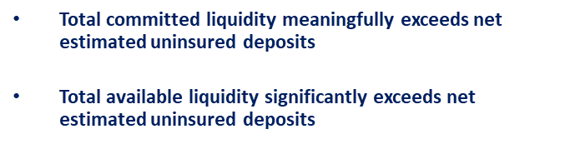
A COMMITTED AND HEALTHY LIQUIDITY PROFILE WITH SIGNIFICANT COVERAGE
(dollars in thousands)
(dollars in thousands)
14

Slide 15
2023 OUTLOOK
Net interest income: $845 - $855 million⁽¹⁾
Non-interest income: $220 - $230 million⁽²⁾
Provision for credit losses: $55 - $65 million
Non-interest expense: $665 million +/-⁽³⁾
Effective tax rate: 17.5% +/-
⁽¹⁾ Assumes Fed Funds Rate increase of 25 bps in November 2023. Updated as of 3Q23, previously: $830 - $840 million.
⁽²⁾ Excludes investment securities gains and the 3Q23 market valuation amount for the movement related to our commercial customer swap
program.
⁽³⁾ Updated as of 3Q23, previously: $645 - $660 million.
15

Slide 16
NON-GAAP RECONCILIATION
Note: The Corporation has presented the following non-GAAP financial measures because it believes that these measures provide useful and comparative information to assess trends in the Corporation's results of operations and financial condition. Presentation of these non-GAAP financial measures is consistent with how the Corporation evaluates its performance internally and these non-GAAP financial measures are frequently used by securities analysts, investors and other interested parties in the evaluation of companies in the Corporation's industry. Investors should recognize that the Corporation's presentation of these non-GAAP financial measures might not be comparable to similarly-titled measures of other companies. These non-GAAP financial measures should not be considered a substitute for GAAP basis measures and the Corporation strongly encourages a review of its condensed consolidated financial statements in their entirety.
 | Three months ended
(dollars in thousands) | Sep 30 |  | Jun 30 |  | Sep 30
 | 2023 |  | 2023 |  | 2022
Operating net income available to common shareholders
Net income available to common shareholders | $69,535 |  | $77,045 |  | $68,309
Plus: Core deposit intangible amortization | 441 |  | 912 |  | 514
Plus: Merger-related expenses | — |  | — |  | 7,006
Plus: CECL Day 1 Provision expense | — |  | — |  | 7,954
Plus: Interest rate derivative transition valuation⁽¹⁾ | 2,958 |  | — |  | —
Less: Tax impact of adjustments | (714) |  | (192) |  | (3,250)
Operating net income available to common shareholders (numerator) | $72,220 |  | $77,765 |  | $80,533
Weighted average shares (diluted) (denominator) | 166,023 |  | 167,191 |  | 168,781
Operating net income available to common shareholders, per share (diluted) | $0.43 |  | $0.47 |  | $0.48
⁽¹⁾ Resulting from the reference rate transition from LIBOR to SOFR in the Corporation's commercial customer interest rate swap program.
16

Slide 17
NON-GAAP RECONCILIATION
 | Three months ended
(dollars in thousands) | Sep 30 |  | Jun 30 |  | Sep 30
 | 2023 |  | 2023 |  | 2022
Operating return on average assets
Net income | $72,097 |  | $79,607 |  | $70,871
Plus: Core deposit intangible amortization | 441 |  | 912 |  | 514
Plus: Merger-related expenses | — |  | — |  | 7,006
Plus: CECL Day 1 Provision expense | — |  | — |  | 7,954
Plus: Interest rate derivative transition valuation⁽¹⁾ | 2,958 |  | — |  | —
Less: Tax impact of adjustments | (714) |  | (192) |  | (3,250)
Operating net income (numerator) | $74,782 |  | $80,327 |  | $83,095
Total average assets | $27,377,836 |  | $27,235,567 |  | $26,357,095
Less: Average net core deposit intangible | (5,548) |  | (6,417) |  | (8,053)
Total average operating assets (denominator) | $27,372,288 |  | $27,229,150 |  | $26,349,042
Operating return on average assets | 1.08 % |  | 1.18 % |  | 1.25 %
⁽¹⁾ Resulting from the reference rate transition from LIBOR to SOFR in the Corporation's commercial customer interest rate swap program.
17

Slide 18
NON-GAAP RECONCILIATION
 |  | Three months ended
(dollars in thousands) |  | Sep 30 |  | Jun 30 |  | Sep 30
 |  | 2023 |  | 2023 |  | 2022
Return on average common shareholders' equity (tangible)
Net income available to common shareholders |  | $69,535 |  | $77,045 |  | $68,309
Plus: Intangible amortization |  | 601 |  | 1,072 |  | 690
Plus: Merger-related expenses |  | — |  | — |  | 7,006
Plus: CECL Day 1 Provision expense |  | — |  | — |  | 7,954
Plus: Interest rate derivative transition valuation⁽¹⁾ |  | 2,958 |  | — |  | —
Less: Tax impact of adjustments |  | (747) |  | (225) |  | (3,287)
Operating net income available to common shareholders (numerator) |  | $72,347 |  | $77,892 |  | $80,672
Average shareholders' equity |  | $2,645,977 |  | $2,647,464 |  | $2,604,057
Less: Average preferred stock |  | (192,878) |  | (192,878) |  | (192,878)
Less: Average goodwill and intangible assets |  | (561,578) |  | (563,146) |  | (562,285)
Average tangible common shareholders' equity (denominator) |  | $1,891,521 |  | $1,891,440 |  | $1,848,894
Return on average common shareholders' equity (tangible) |  | 15.17 % |  | 16.52 % |  | 17.31 %
⁽¹⁾ Resulting from the reference rate transition from LIBOR to SOFR in the Corporation's commercial customer interest rate swap program.
18

Slide 19
NON-GAAP RECONCILIATION
(dollars in thousands) |  | Three months ended
 |  | Sep 30 |  | Jun 30 |  | Sep 30
Efficiency ratio |  | 2023 |  | 2023 |  | 2022
Non-interest expense |  | $171,020 |  | $168,018 |  | $169,558
Less: Amortization of tax credit investments |  | — |  | — |  | (696)
Less: Merger-related expenses |  | — |  | — |  | (7,006)
Less: Intangible amortization |  | (601) |  | (1,072) |  | (690)
Non-interest expense (numerator) |  | $170,419 |  | $166,946 |  | $161,166
Net interest income |  | $213,842 |  | $212,852 |  | $215,582
Tax equivalent adjustment |  | 4,442 |  | 4,405 |  | 3,970
Plus: Total non-interest income |  | 55,961 |  | 60,585 |  | 59,162
Plus: Interest rate derivative transition valuation⁽¹⁾ |  | 2,958 |  | — |  | —
Less: Investment securities (gains) losses, net |  | — |  | 4 |  | 53
Total revenue (denominator) |  | $277,203 |  | $277,846 |  | $278,767
Efficiency ratio |  | 61.5% |  | 60.1% |  | 57.8%
⁽¹⁾ Resulting from the reference rate transition from LIBOR to SOFR in the Corporation's commercial customer interest rate swap program.
19

Slide 20
NON-GAAP RECONCILIATION
 | Three months ended
(dollars in thousands) | Sep 30
 | 2023
Adjusted tangible common equity to tangible assets (TCE Ratio)
Shareholders' equity | $ 2,566,693
Less: Preferred stock | (192,878)
Less: Goodwill and intangible assets | (561,284)
Less: Unrealized gain/(loss) - HTM | (202,590)
Less: Tax impact of adjustments | 45,887
Adjusted tangible common shareholders' equity (numerator) | $ 1,655,828
Total assets | $ 27,380,836
Less: Goodwill and intangible assets | (561,284)
Less: Unrealized gain/(loss) - HTM | (202,590)
Less: Tax impact of adjustments | 45,887
Adjusted total tangible assets (denominator) | $ 26,662,849
Adjusted tangible common equity to tangible assets | 6.2 %
20

