Slide 1
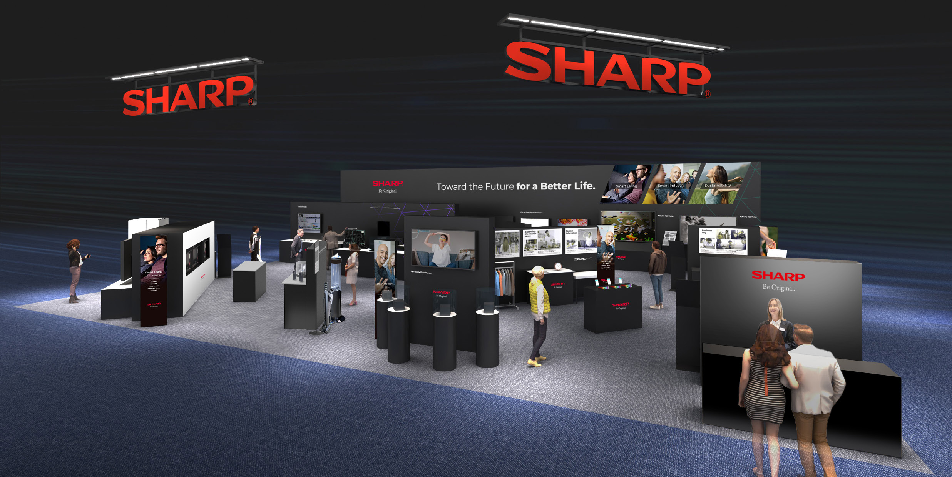
Booth Image

Slide 2
Booth Layout
Smart LIVING
Smart INDUSTRY
SUSTAINABILITY
・AI Olfactory Sensor
・IMS Gas Analyzer
・Gas Decomposition Module
AI
・Space Solar Sheet
・Reflective LCD
・AI Avatar
・XLED 75"
・Driver Monitoring Camera
AI
・XR Glass
XR
・ePoster
・Non-contact Vital Sensor
・Vital Sensors for Wearable Devices
・LC-LH
・ High Speed Oven
Reception
・Hair Dryer _ Low Noise & High Power
・Stick Cleaner _ Low Noise & High Power
・Polymer Lens Camera / Ultra Compact Camera module
XR

