Slide 1
FIRST QUARTER 2024 RESULTS
NASDAQ: FULT
Data as of or for the period ended March 31, 2024 unless otherwise noted

Slide 2
This presentation may contain forward-looking statements with respect to Fulton Financial Corporation's (the "Corporation") financial condition, results of operations and business. Do not unduly rely on forward-looking statements. Forward-looking statements can be identified by the use of words such as "may," "should," "will," "could," "estimates," "predicts," "potential," "continue," "anticipates," "believes," "plans," "expects," "future," "intends," “projects,” the negative of these terms and other comparable terminology. These forward-looking statements may include projections of, or guidance on, the Corporation’s future financial performance, expected levels of future expenses, including future credit losses, anticipated growth strategies, descriptions of new business initiatives and anticipated trends in the Corporation’s business or financial results. Management’s "2024 Outlook" contained herein is comprised of forward-looking statements.
Forward-looking statements are neither historical facts, nor assurance of future performance. Instead, the statements are based on current beliefs, expectations and assumptions regarding the future of the Corporation’s business, future plans and strategies, projections, anticipated events and trends, the economy and other future conditions. Because forward-looking statements relate to the future, they are subject to inherent uncertainties, risks and changes in circumstances that are difficult to predict and many of which are outside of the Corporation’s control, and actual results and financial condition may differ materially from those indicated in the forward-looking statements. Therefore, you should not unduly rely on any of these forward-looking statements. Any forward-looking statement is based only on information currently available and speaks only as of the date when made. The Corporation undertakes no obligation, other than as required by law, to update or revise any forward-looking statements, whether as a result of new information, future events or otherwise.
A discussion of certain risks and uncertainties affecting the Corporation, and some of the factors that could cause the Corporation’s actual results to differ materially from those described in the forward-looking statements, can be found in the sections entitled “Risk Factors” and “Management’s Discussion and Analysis of Financial Condition and Results of Operations” in the Corporation’s Annual Report on Form 10-K for the year ended December 31, 2023 and other current and periodic reports, which have been, or will be, filed with the Securities and Exchange Commission (the "SEC") and are, or will be, available in the Investor Relations section of the Corporation’s website (www.fultonbank.com) and on the SEC’s website (www.sec.gov).
The Corporation uses certain financial measures in this presentation that have been derived by methods other than generally accepted accounting principles ("GAAP"). These non-GAAP financial measures are reconciled to the most comparable GAAP measures at the end of this presentation.
2

Slide 3
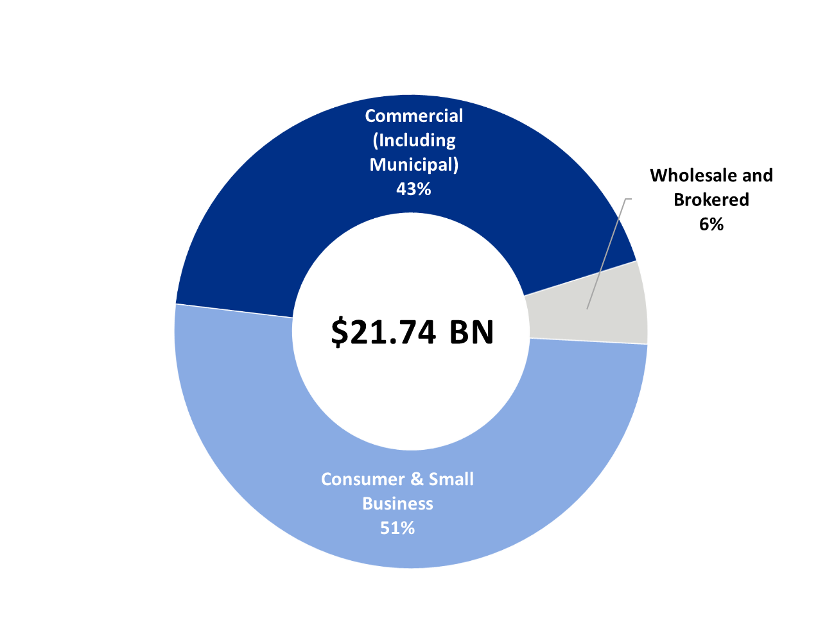
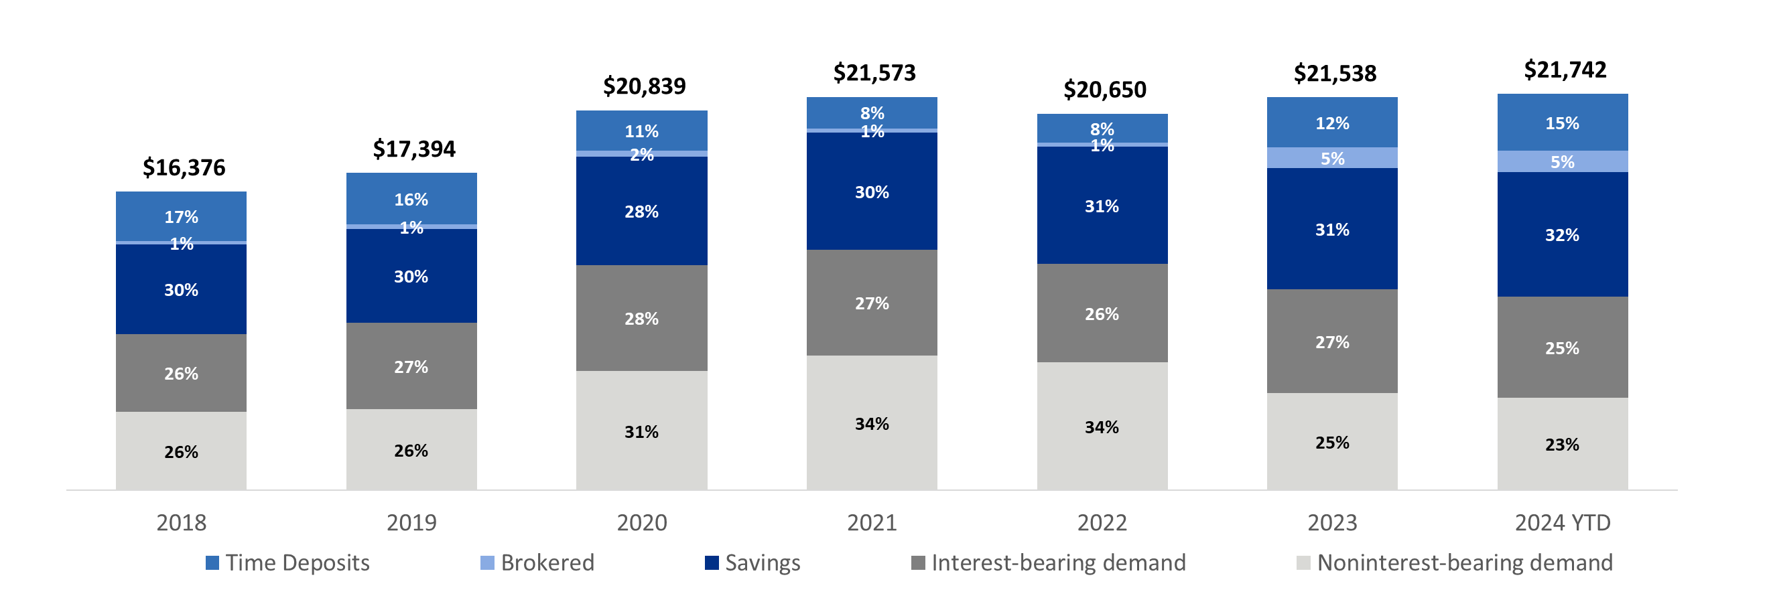
A STABLE DEPOSIT PORTFOLIO THAT REMAINS GRANULAR, TENURED AND DIVERSIFIED WITH SIGNIFICANT LIQUIDITY COVERAGE
Deposit Mix By Customer
(March 31, 2024)
Deposit Portfolio Highlights⁽¹⁾
755,000 deposit accounts
$28,820 average deposit account balance
10+ years average deposit account age
24% estimated uninsured deposits
243% coverage of estimated uninsured deposits
Deposit Mix By Product⁽²⁾
(dollars in millions)
6% Compound Annual Growth Rate in Deposits
⁽¹⁾ As of March 31, 2024. Estimated uninsured deposits net of collateralized municipal deposits and inter-company deposits. For the calculation of the coverage of estimated uninsured deposits, please refer to the slide titled “Liquidity Profile.”
⁽²⁾ Deposit balances are ending balances.
3

Slide 4
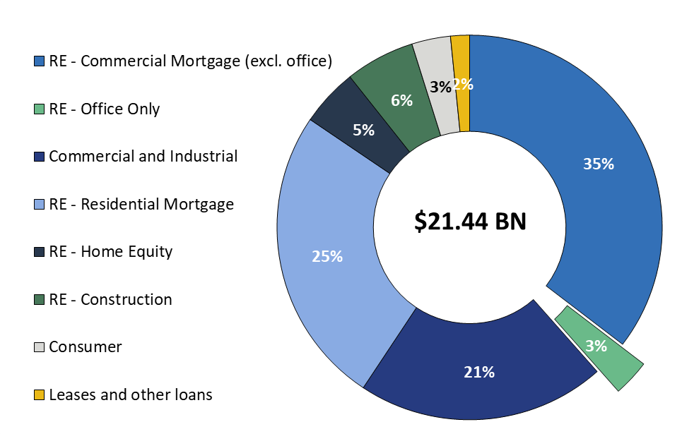
THE LOAN PORTFOLIO IS DIVERSIFIED AND GRANULAR, WITH LOW OFFICE CONCENTRATION AT 3% OF LOANS
Total Loan Portfolio
(March 31, 2024)
Office Only Profile
$694 million in office loan commitments
$662 million in office loans outstanding
  representing 3% of total loans
Average loan size is $2.2 million
Weighted average loan-to-value⁽¹⁾ (“LTV”) ratio of 60%
Weighted average debt service coverage ratio (“DSCR”) of 1.34x
77% of loans with full recourse; 63% LTV; 1.26x DSCR
23% of loans non-recourse; 52% LTV; 1.60x DSCR
Eight relationships over $20 million, totaling $196 million in commitments, including:
  Three relationships in central business districts
$146 million in commitments located in central business districts
Classification
  37% Class A
  23% Class B
  5% Class C
  35% Not Classified
⁽¹⁾ LTV as of most recent appraisal.

Slide 5
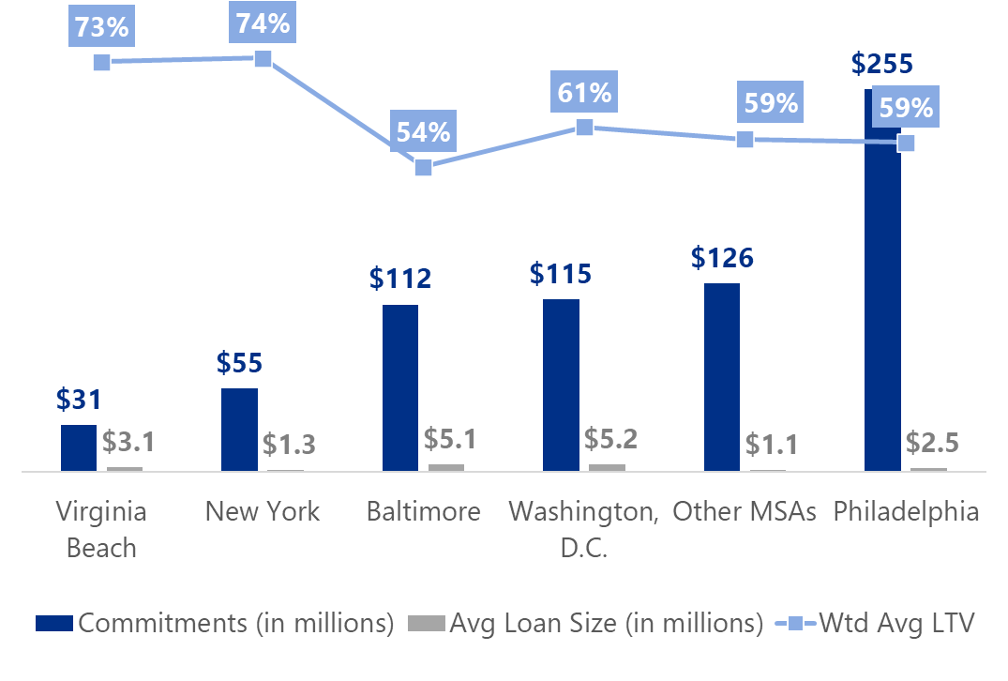
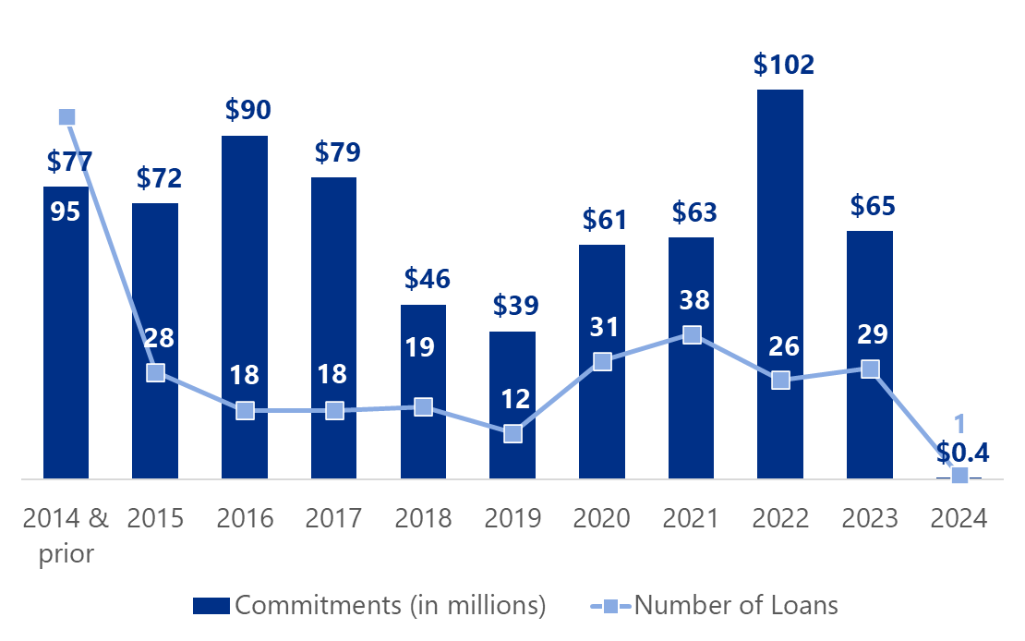
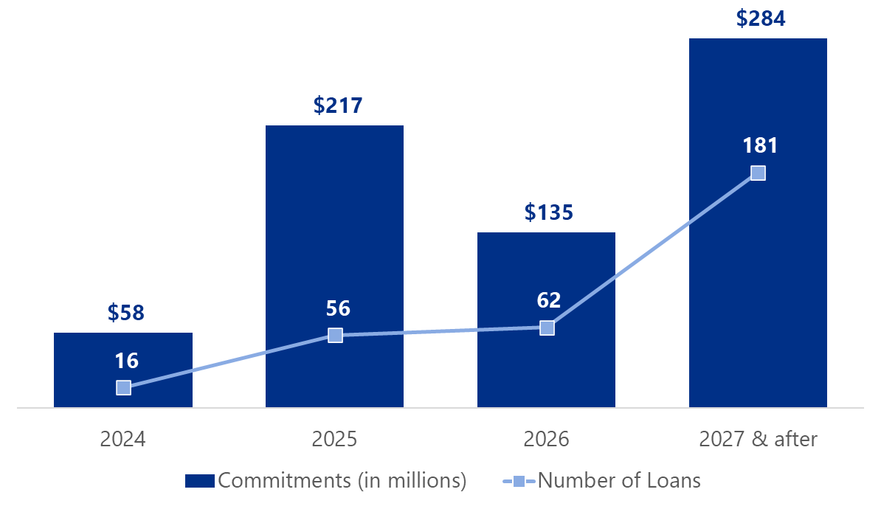
THE OFFICE PORTFOLIO HAS BEEN ORIGINATED OVER TIME, WILL MATURE OVER TIME, AND REMAINS GRANULAR AND DIVERSE
Granular Loan Portfolio
Geographically Diverse by MSA⁽¹⁾
⁽²⁾
Originated Over Time
Maturing Over Time
⁽¹⁾ Metropolitan Statistical Areas or “MSA” titled in short name for presentation purposes.
⁽²⁾ The Corporation’s presence in the New York-Newark-Jersey City MSA extends from central New Jersey into northern New Jersey, and includes zero office loans in the State of New York component of the New York MSA.

Slide 6
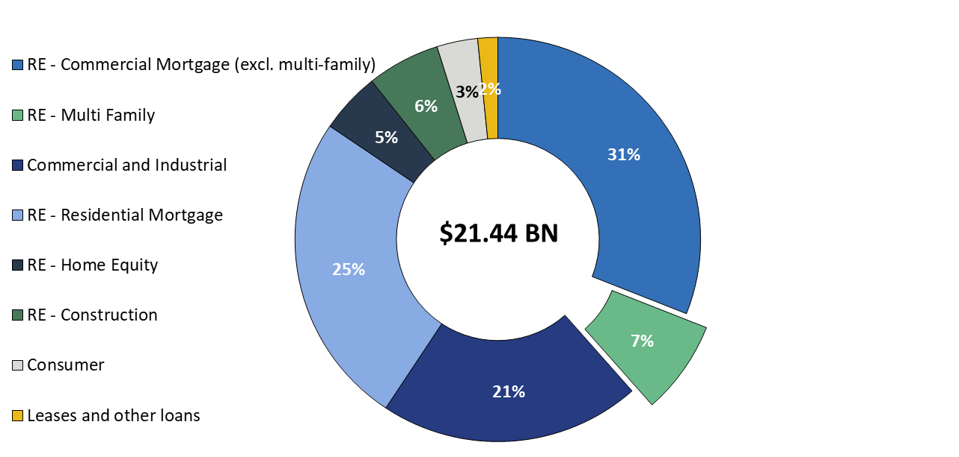
MULTI-FAMILY LOANS REPRESENT 7% OF THE TOTAL LOAN PORTFOLIO WITH A SMALL AVERAGE LOAN SIZE
Total Loan Portfolio
(March 31, 2024)
Multi-Family Profile
$2.1 billion in multi-family loan commitments
$1.6 billion in multi-family loans outstanding
Average loan size is $3.8 million
Weighted average LTV⁽¹⁾ ratio of 59%
Weighted Average DSCR of 1.26x
89% of loans with recourse
39% construction, 61% stabilized
Classification
  48% Class A
  14% Class B
  3% Class C
  35% Not Classified
⁽¹⁾ LTV as of most recent appraisal.

Slide 7
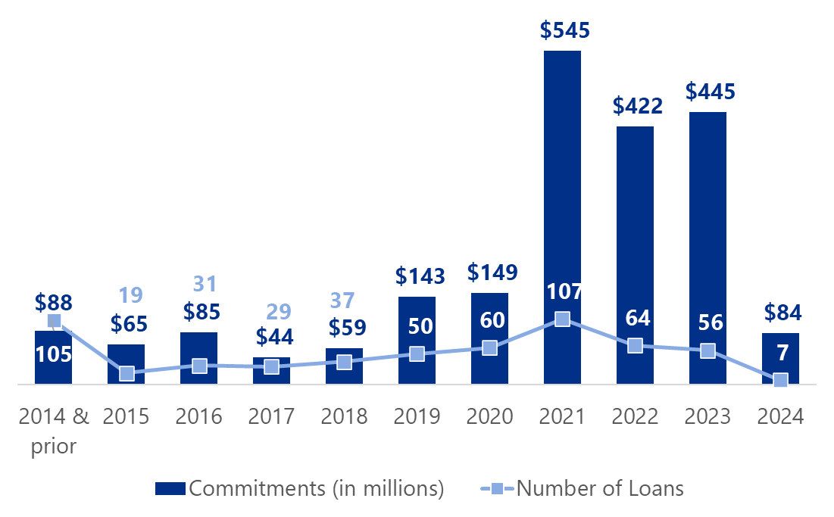
THE MULTI-FAMILY PORTFOLIO HAS BEEN RECENTLY ORIGINATED AND APPRAISED, HAS A LONG-DATED MATURITY HORIZON AND IS ALSO GEOGRAPHICALLY DIVERSE
Diversified by Size
Diversified by Geographical MSA
⁽¹⁾
Recently Originated and Appraised
Maturing Over Time
⁽¹⁾ The Corporation’s presence in the New York-Newark-Jersey City MSA extends from central New Jersey into northern New Jersey and includes one multi-family loan in New York City component of the New York MSA.

Slide 8
 | 1Q24 | 4Q23 | 1Q23
 | (dollars in thousands, except per-share data)
Net interest income | $206,937 | $212,006 | $215,587
Provision for credit losses | 10,925 | 9,808 | 24,544
Non-interest income | 57,140 | 60,130 | 51,730
Securities gains (losses) | — | (752) | 23
Non-interest expense | 177,600 | 180,552 | 159,616
Income before income taxes | 75,552 | 81,024 | 83,180
Income taxes | 13,611 | 16,761 | 14,866
Net income | 61,941 | 64,263 | 68,314
Preferred stock dividends | (2,562) | (2,562) | (2,562)
Net income available to common shareholders | $59,379 | $61,701 | $65,752
Net income available to common shareholders, per share (diluted) | $0.36 | $0.37 | $0.39
Operating net income available to common shareholders, per share (diluted)⁽¹⁾ | $0.40 | $0.42 | $0.39
ROAA | 0.91% | 0.93% | 1.03%
Operating ROAA⁽¹⁾ | 1.00% | 1.03% | 1.04%
ROAE | 9.28% | 10.09% | 11.02%
Operating ROAE (tangible)⁽¹⁾ | 13.08% | 14.68% | 14.46%
Efficiency ratio⁽¹⁾ | 63.2% | 62.0% | 58.5%
⁽¹⁾ Non-GAAP financial measure. Please refer to the calculation and management’s reason for using this measure on the slide titled “Non-GAAP
Reconciliation” at the end of this presentation.
8

Slide 9
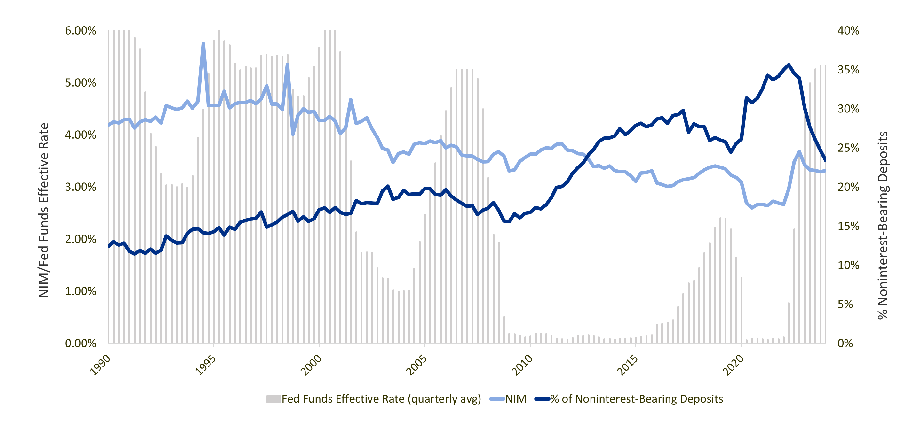
NONINTEREST-BEARING DEPOSIT TRENDS
Growth in the Corporation’s commercial banking business, as well as the historically low levels of interest rates for much of the post-2008 period, led to a generally increasing trend in the percentage of noninterest-bearing deposits.
Prior to 2008, noninterest-bearing deposits averaged 15%-20% of total deposits. As of March 31, 2024, noninterest-bearing deposits were 23.4% of total deposits down from a peak of 35% in June 2022.
Deposit growth, including growth in noninterest-bearing deposits, remains a key component of the Corporation’s relationship banking strategy.
% Noninterest-Bearing Deposits, Net Interest Margin (“NIM”) and Fed Funds Effective Rate
Source: S&P Global Market Intelligence, Federal Reserve Bank of New York and Board of Governors of the Federal Reserve System (US);
Corporation’s reported results for NIM and percentage of noninterest-bearing deposits at March 31,2024.
9

Slide 10
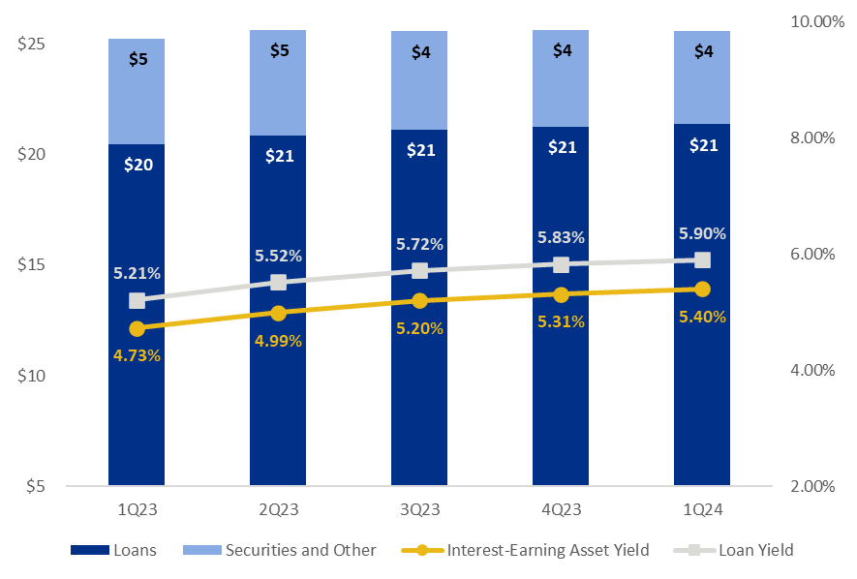
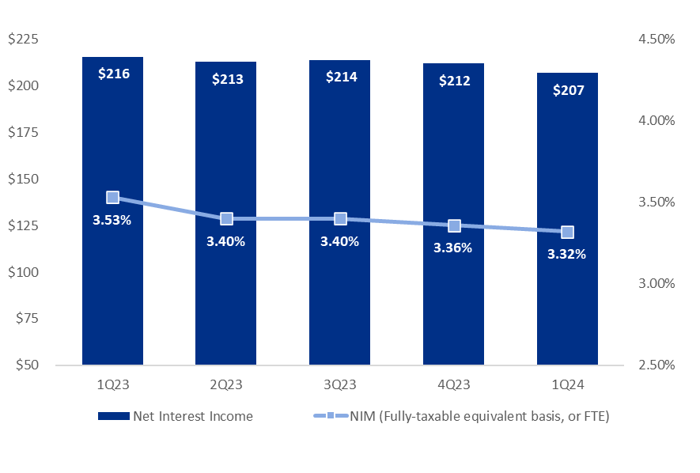
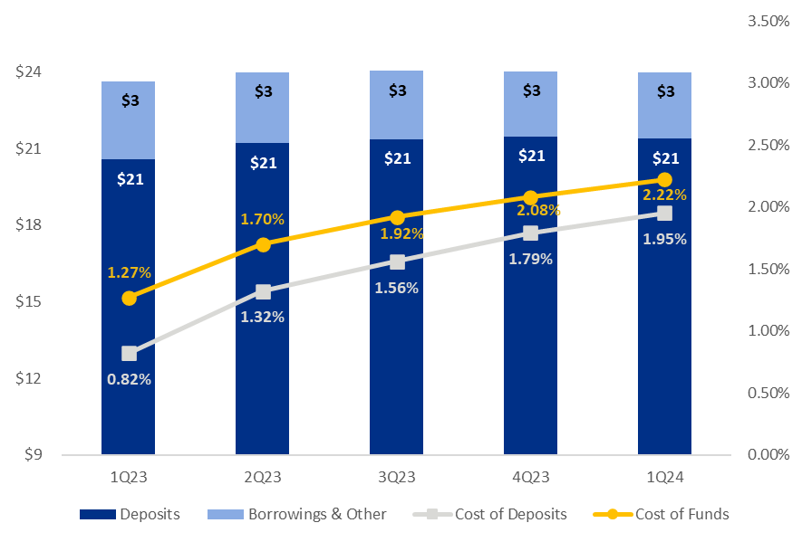
NET INTEREST INCOME AND NIM
NIM was 3.32% in the first quarter of 2024, declining four basis points compared to the fourth quarter of 2023.
Loan yield improved by seven basis points during the first quarter of 2024, increasing to 5.90% compared to 5.83% in the fourth quarter of 2023. Loan yields have benefited from new originations and higher rates.
Total cost of deposits was 1.95% for the first quarter of 2024, an increase of 16 basis points compared to the fourth quarter of 2023, due to continued migration into interest-bearing deposit products.
Average Interest-Earning Assets & Yields
1Q24 Highlights
(dollars in billions)
Net Interest Income & NIM
Average Deposits and Borrowings & Other and Cost of Funds
(dollars in millions)
(dollars in billions)
10

Slide 11
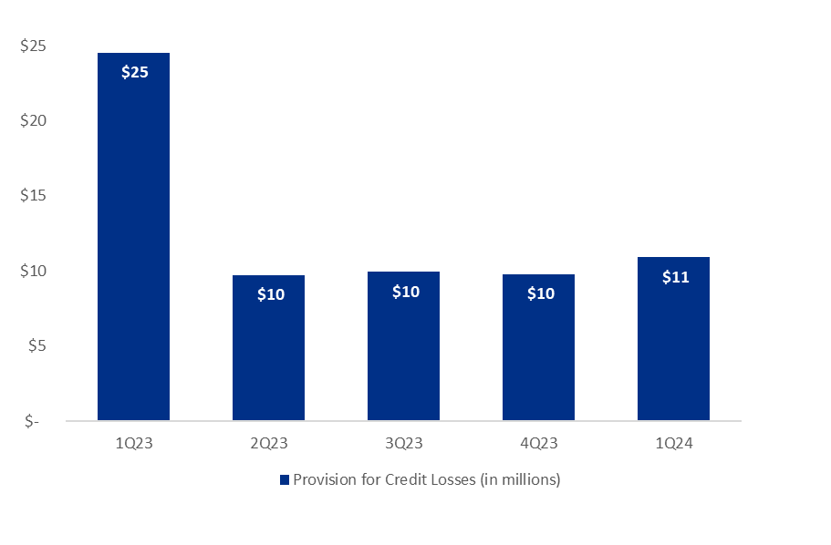
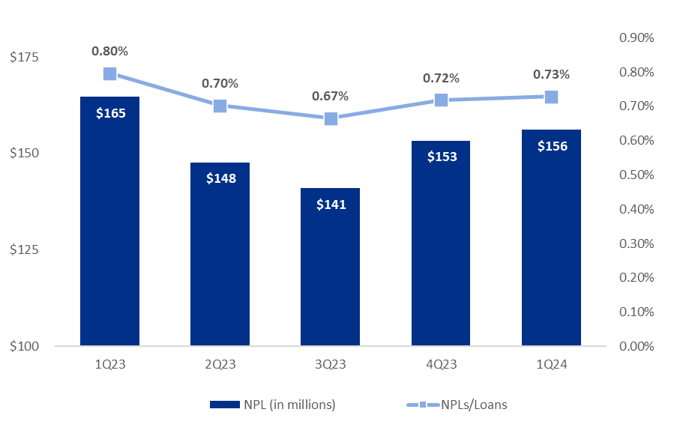
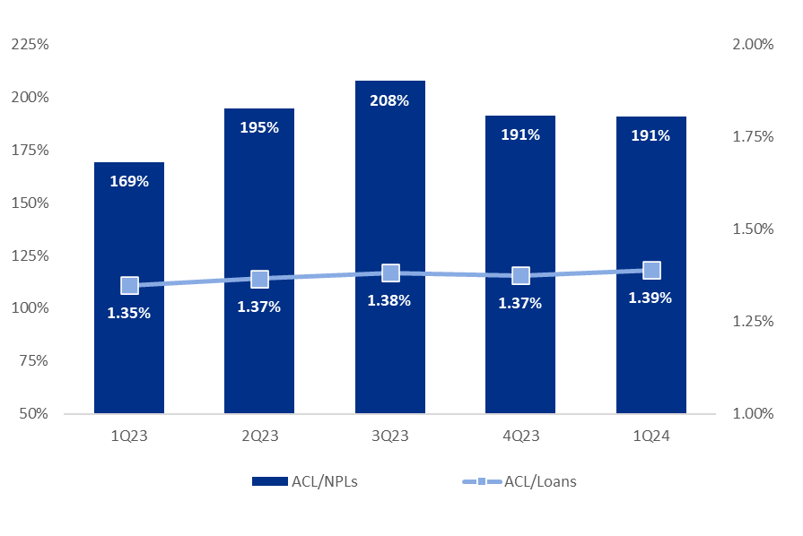
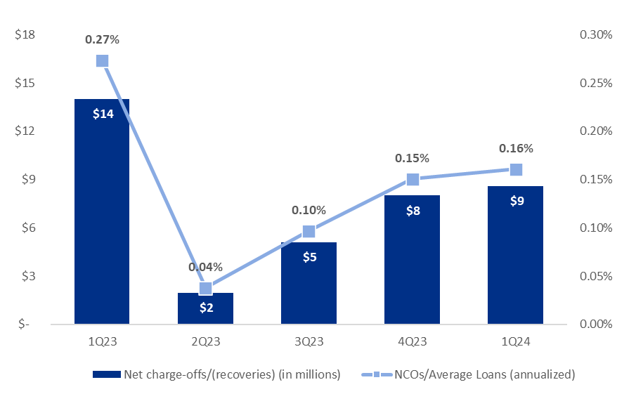
ASSET QUALITY
Provision for Credit Losses
Non-Performing Loans (“NPLs”) & NPLs to Loans
Net Charge-offs (“NCOs”) and NCOs to Average Loans
ACL⁽¹⁾ to NPLs & Loans
⁽¹⁾ The allowance for credit losses (“ACL”) relates specifically to “Loans, net of unearned income” and does not include reserves related to off-balance sheet credit exposures.
11

Slide 12
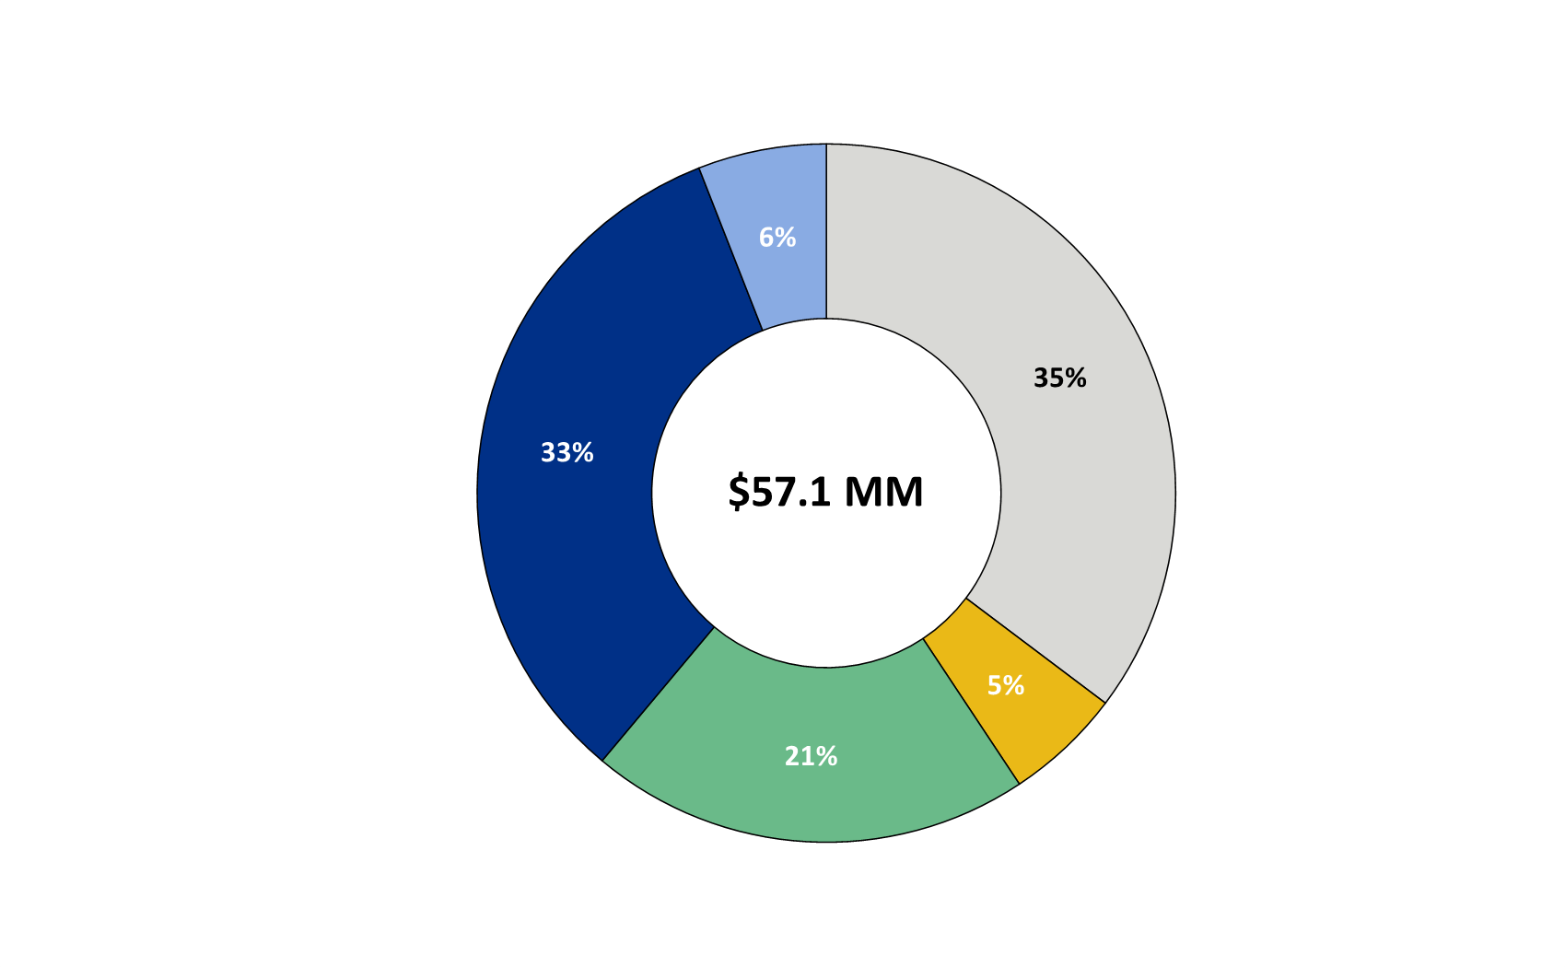
NON-INTEREST INCOME⁽¹⁾
Non-interest Income
(percentage of total non-interest income, three months ended March 31, 2024)
Decreases due to:
$2.0 million decline in commercial customer swap fees
Other fee income attributable to the valuation of certain equity method investments
Increases due to:
Record wealth management income
Gain on sale of mortgage loans on solid originations and spreads
⁽¹⁾ Excluding investment securities gains.
12

Slide 13
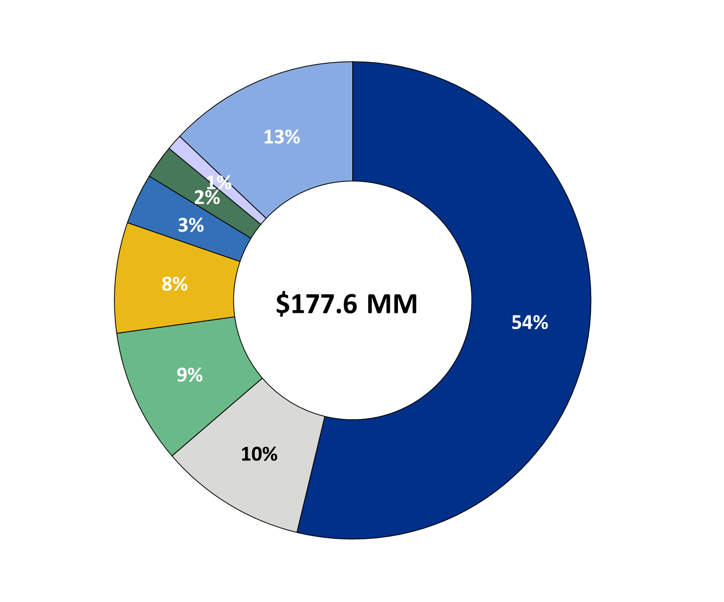
NON-INTEREST EXPENSE
Non-interest Expense
(percentage of total non-interest expense, three months ended March 31, 2024)
Decreases primarily due to:
$1.0 million Federal Deposit Insurance Corporation special assessment in 1Q24 compared to $6.5 million in 4Q23
Reductions in incentive compensation accruals
Increases primarily due to:
  $3.6 million loss due to closure of financial centers
  $2.5 million consulting expenses
  $0.2 million in severance expense
13

Slide 14
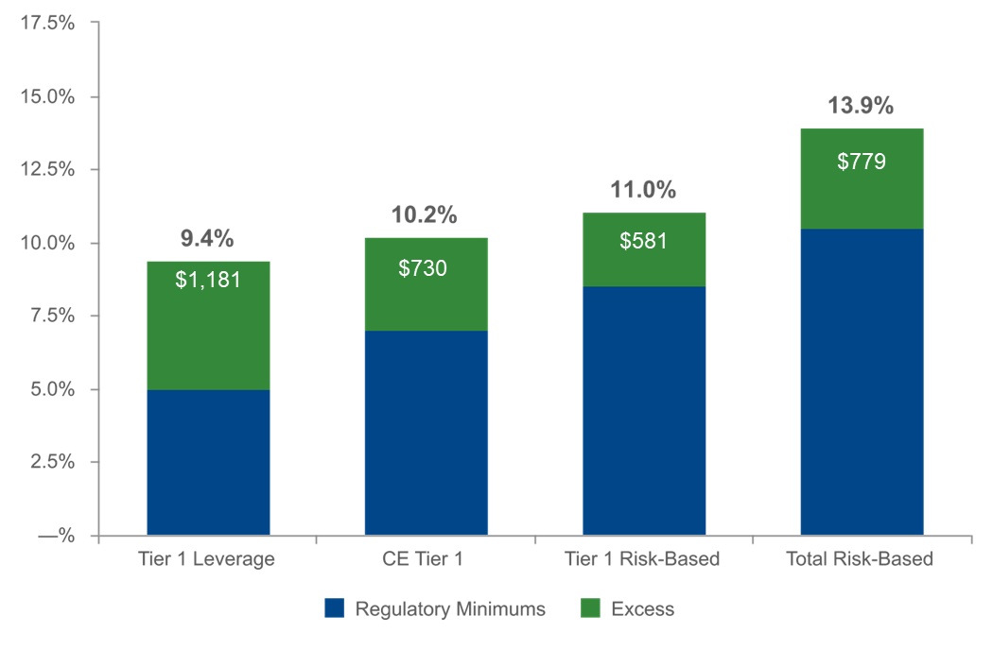
(as of March 31, 2024)
(dollars in millions)
$790
$581
$1,181
$730
⁽²⁾
⁽¹⁾ Regulatory capital ratios and excess capital amounts as of March 31, 2024 are preliminary estimates.
⁽²⁾ Excesses shown are to regulatory minimums, including the 250 basis point capital conservation buffer, except for Tier 1 Leverage which is the well-
capitalized minimum.
14

Slide 15
LIQUIDITY PROFILE
(dollars in thousands)
Cash On-Hand typically ranges between $50 - $100 million
Total committed and available liquidity meaningfully exceeds net estimated uninsured deposits
⁽¹⁾ Includes cash at the FHLB and Federal Reserve and vault cash for liquidity purposes only. ⁽²⁾ Includes accrued interest, fees, and other adjustments. ⁽³⁾ Brokered deposit availability is based upon internal policy limit. ⁽⁴⁾ Net estimated uninsured deposits are net of collateralized municipal deposits and inter-company deposits.
15

Slide 16
2024 OUTLOOK
Net interest income: $790 - $820 million⁽¹⁾
Provision for credit losses: $45 - $65 million
Non-interest income: $235 - $250 million⁽²⁾
Non-interest expense: $670 - $690⁽³⁾
Effective tax rate: 17% - 18%
⁽¹⁾ Assumes Fed Funds Rate decreases of 75 basis points in the second half of 2024
⁽²⁾ Excludes investment securities gains and losses
⁽³⁾ Excludes implementation costs associated with the FultonFirst initiative
16

Slide 17
Note: The Corporation has presented the following non-GAAP financial measures because it believes that these measures provide useful and comparative information to assess trends in the Corporation's results of operations and financial condition. Presentation of these non-GAAP financial measures is consistent with how the Corporation evaluates its performance internally and these non-GAAP financial measures are frequently used by securities analysts, investors and other interested parties in the evaluation of companies in the Corporation's industry. Investors should recognize that the Corporation's presentation of these non-GAAP financial measures might not be comparable to similarly-titled measures of other companies. These non-GAAP financial measures should not be considered a substitute for GAAP basis measures and the Corporation strongly encourages a review of its condensed consolidated financial statements in their entirety.
 | Three months ended
(dollars in thousands, except per share and share data) | Mar 31 |  | Dec 31 |  | Mar 31
 | 2024 |  | 2023 |  | 2022
Operating net income available to common shareholders
Net income available to common shareholders | $59,379 |  | $61,701 |  | $65,752
Plus: Core deposit intangible amortization | 441 |  | 441 |  | 514
Plus: Interest rate derivative transition valuation⁽¹⁾ | (151) |  | (1,102) |  | —
Plus: FDIC special assessment | 956 |  | 6,494 |  | —
Plus: FultonFirst implementation and asset disposals | 6,329 |  | 3,197 |  | —
Less: Tax impact of adjustments | (1,591) |  | (1,896) |  | (108)
Operating net income available to common shareholders (numerator) | $65,363 |  | $68,835 |  | $66,158
Weighted average shares (diluted) (denominator) | 164,520 |  | 165,650 |  | 168,401
Operating net income available to common shareholders, per share (diluted) | $0.40 |  | $0.42 |  | $0.39
⁽¹⁾ Resulting from the reference rate transition from the London Interbank Offered Rate ("LIBOR") to the Secured Overnight Financing Rate
("SOFR") in the Corporation's commercial customer interest rate swap program.
17

Slide 18
 | Three months ended
(dollars in thousands) | Mar 31 |  | Dec 31 |  | Mar 31
 | 2024 |  | 2023 |  | 2023
Operating return on average assets
Net income | $61,941 |  | $64,263 |  | $68,314
Plus: Core deposit intangible amortization | 441 |  | 441 |  | 514
Plus: Interest rate derivative transition valuation⁽¹⁾ | (151) |  | (1,102) |  | —
Plus: FDIC special assessment | 956 |  | 6,494 |  | —
Plus: FultonFirst implementation and asset disposals | 6,329 |  | 3,197 |  | —
Less: Tax impact of adjustments | (1,591) |  | (1,896) |  | (108)
Operating net income (numerator) | $67,925 |  | $71,397 |  | $68,720
Total average assets | $27,427,626 |  | $27,397,671 |  | $26,900,653
Less: Average net core deposit intangible | (4,666) |  | (5,106) |  | (6,937)
Total average operating assets (denominator) | $27,422,960 |  | $27,392,565 |  | $26,893,716
Operating return on average assets | 1.00 % |  | 1.03 % |  | 1.04 %
⁽¹⁾ Resulting from the reference rate transition from LIBOR to SOFR in the Corporation's commercial customer interest rate swap
program.
18

Slide 19
 |  | Three months ended
(dollars in thousands) |  | Mar 31 |  | Dec 31 |  | Mar 31
 |  | 2024 |  | 2023 |  | 2023
Operating return on average common shareholders' equity (tangible)
Net income available to common shareholders |  | $59,379 |  | $61,701 |  | $65,752
Plus: Intangible amortization |  | 573 |  | 597 |  | 674
Plus: Interest rate derivative transition valuation⁽¹⁾ |  | (151) |  | (1,102) |  | —
Plus: FDIC special assessment |  | 956 |  | 6,494 |  | —
Plus: FultonFirst implementation and asset disposals |  | 6,329 |  | 3,197 |  | —
Less: Tax impact of adjustments |  | (1,618) |  | (1,929) |  | (142)
Adjusted net income available to common shareholders (numerator) |  | $65,468 |  | $68,958 |  | $66,284
Average shareholders' equity |  | $2,766,945 |  | $2,618,024 |  | $2,613,316
Less: Average preferred stock |  | (192,878) |  | (192,878) |  | (192,878)
Less: Average goodwill and intangible assets |  | (560,393) |  | (560,977) |  | (561,744)
Average tangible common shareholders' equity (denominator) |  | $2,013,674 |  | $1,864,169 |  | $1,858,694
Operating return on average common shareholders' equity (tangible) |  | 13.08 % |  | 14.68 % |  | 14.46 %
⁽¹⁾ Resulting from the reference rate transition from LIBOR to SOFR in the Corporation's commercial customer interest rate swap
program.
19

Slide 20
(dollars in thousands) |  | Three months ended
 |  | Mar 31 |  | Dec 31 |  | Mar 31
Efficiency ratio |  | 2024 |  | 2023 |  | 2023
Non-interest expense |  | $177,600 |  | $180,552 |  | $159,616
Less: Intangible amortization |  | (573) |  | (597) |  | (674)
Less: FDIC special assessment |  | (956) |  | (6,494) |  | —
Less: FultonFirst implementation and asset disposals |  | (6,329) |  | (3,197) |  | —
Less: Debt extinguishment |  | — |  | 720 |  | —
Non-interest expense (numerator) |  | $169,742 |  | $170,984 |  | $158,942
Net interest income |  | $206,937 |  | $212,006 |  | $215,587
Tax equivalent adjustment |  | 4,592 |  | 4,549 |  | 4,414
Plus: Total non-interest income |  | 57,140 |  | 59,378 |  | 51,753
Plus: Interest rate derivative transition valuation⁽¹⁾ |  | (151) |  | (1,102) |  | —
Less: Investment securities (gains) losses, net |  | — |  | 752 |  | (23)
Total revenue (denominator) |  | $268,518 |  | $275,583 |  | $271,731
Efficiency ratio |  | 63.2% |  | 62.0% |  | 58.5%
⁽¹⁾ Resulting from the reference rate transition from LIBOR to SOFR in the Corporation's commercial customer interest rate swap
program.
20

