Slide 1
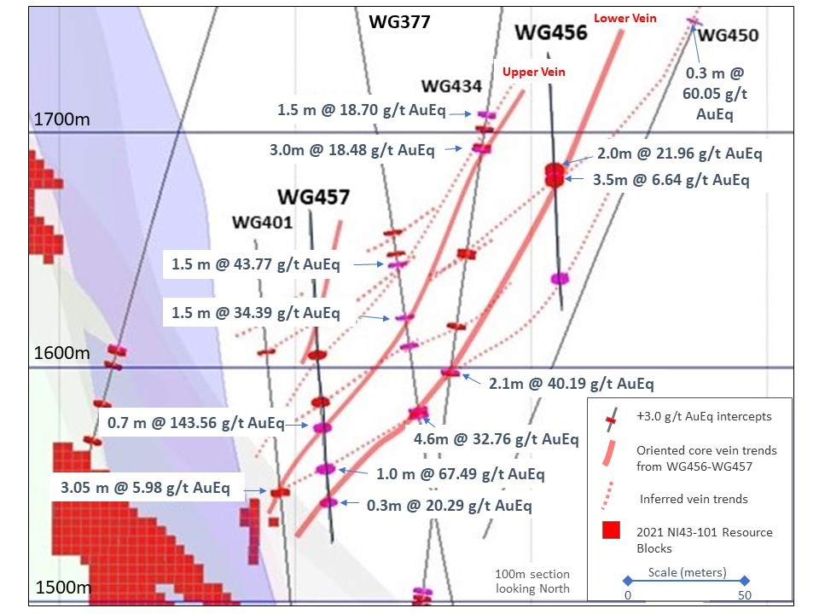
Figure 1. Cross section through drill holes WG456, WG457 and legacy holes showing continuity of +20.0 g/t AuEq grades on a dip length of potentially +200 meters (AuEq calculated at 85:1 Ag: Ag and assays are uncut).

Slide 2
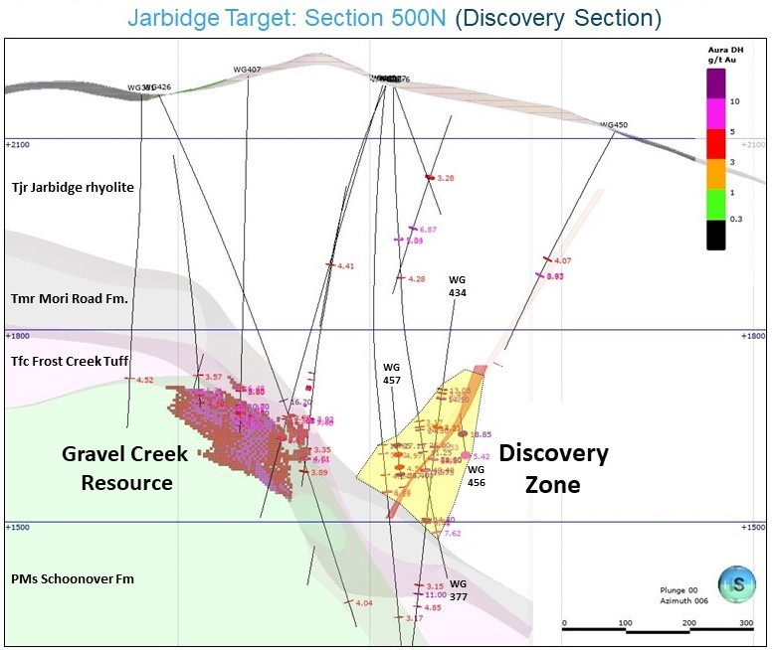
Figure 2. Cross section 500N, showing Discovery Zone adjacent to the Gravel Creek resource outline.

Slide 3
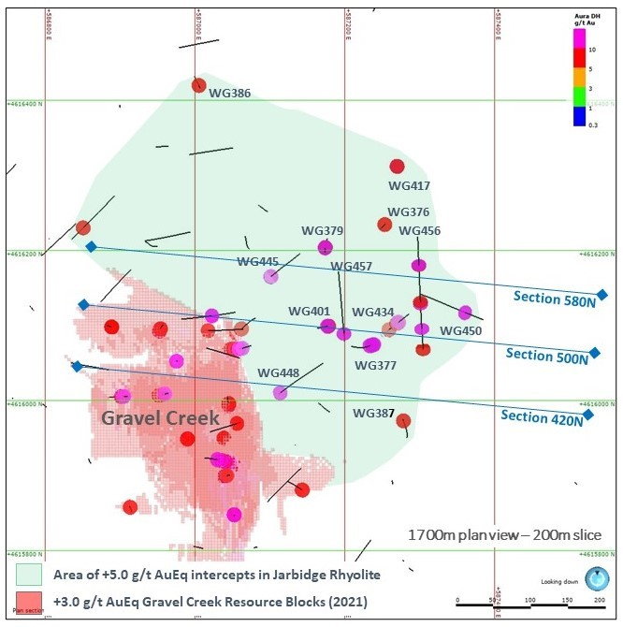
Figure 3. Plan view of 1700-meter elevation, showing Gravel Creek resource zone, +5.0 g/t Au legacy intercepts and location of cross sections for 2024 oriented core drilling.

Slide 4
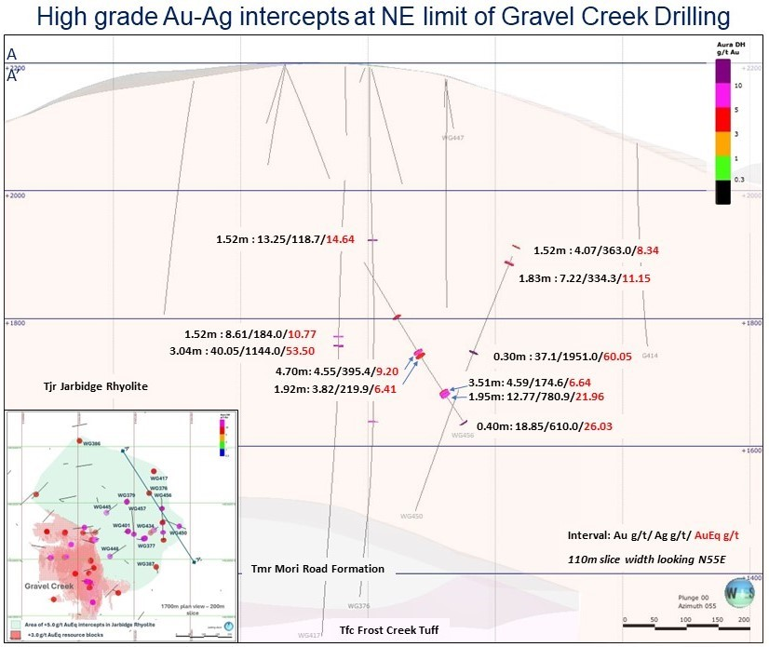
Figure 4. Section shows multiple high-grade Au-Ag intercepts are present at the northeast extent of drilling in Jarbidge rhyolite, including 3.04m @ 53.50 g/t AuEq, 0.3m @ 60.05 g/t AuEq and 1.95m @ 21.96 g/t AuEq (AuEq calculated at 85:1 Ag: Ag and assays are uncut).

