Slide 1
National rent growth retreats in February

Slide 2
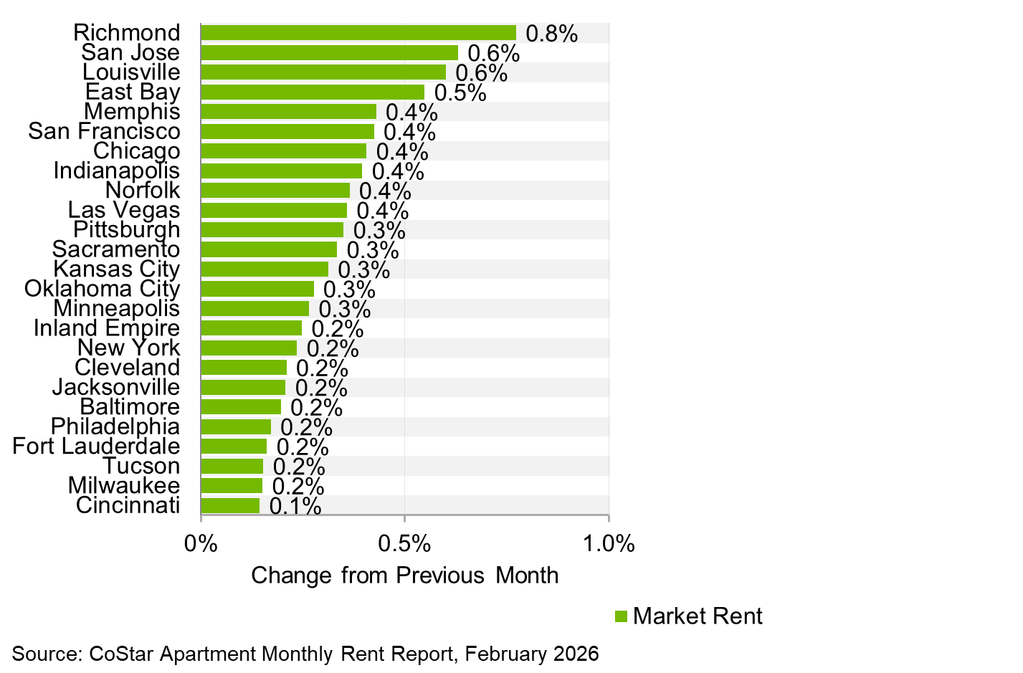
Most markets continue to see rent gains in February

Slide 3
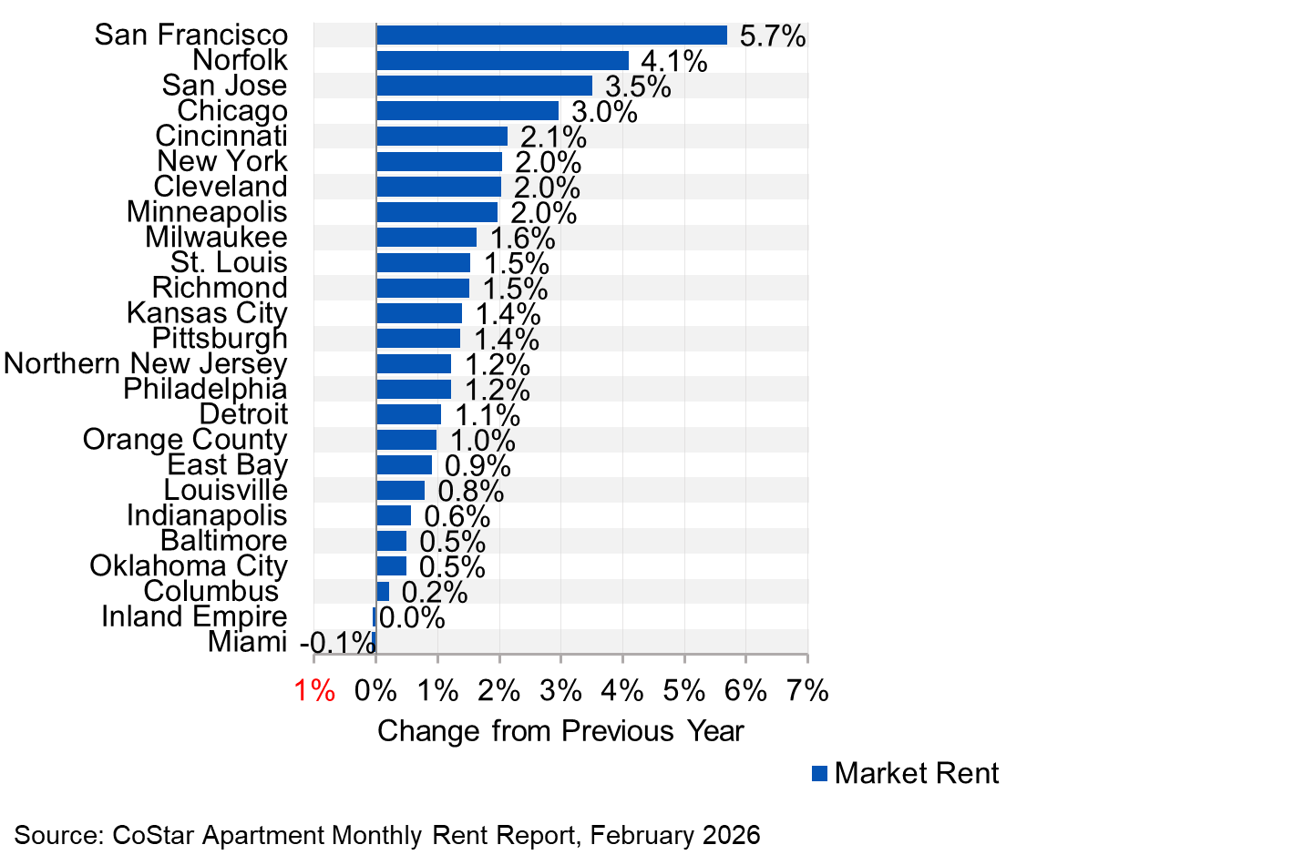
Many markets still face negative year-over-year rent growth

