Slide 1
OTCQX: CIZN

Slide 2
Strategic focus
Drive sustainable earnings growth through loan expansion, net interest margin improvement, diversification of noninterest revenue streams, and continued operational efficiency initiatives.
Expand core funding relationships by growing noninterest-bearing deposits through treasury management solutions and enhanced commercial banking services.
Accelerate mortgage production through growth in secondary market and portfolio mortgage lending while continuing strategic lending hires across key operating markets.
Optimize the balance sheet by redeploying securities portfolio cash flows into higher-yielding loan assets and expanding liquidity capacity through reciprocal deposit programs.
Maintain strong capital levels through disciplined earnings retention to support future growth opportunities, balance sheet flexibility, and long-term shareholder value.

Slide 3
Balance sheet*
* Bank Only Financial Information

Slide 4
LOAN COMPOSITION*
Commercial Real Estate 53%
Residential Real Estate 23%
Commercial & Construction 18%
Consumer & Other 6%
* Bank Only Financial Information

Slide 5
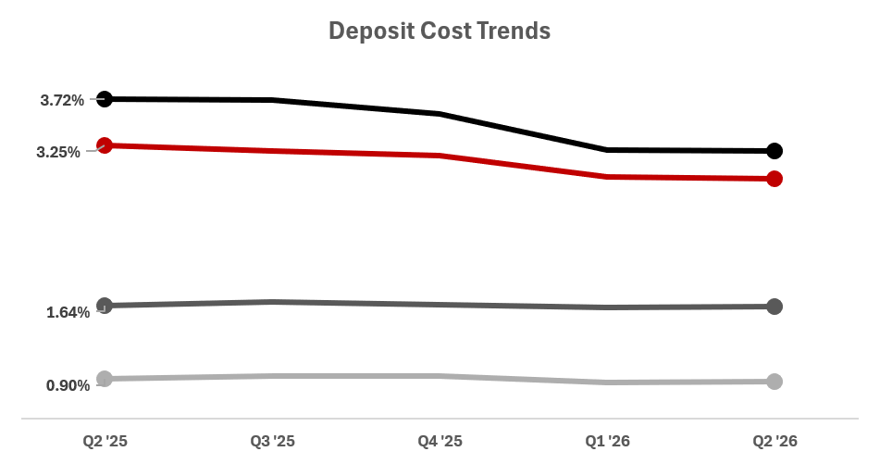
DEPOSIT COMPOSITION*
Reciprocal Deposits 3.20%
Time Deposits 2.91%
Interest Bearing DDA 1.63%
Money Market and Savings 0.87%
* Bank Only Financial Information

Slide 6
Historical NIM analysis*
Quarterly Yields & Costs (%)
* Bank Only Financial Information

Slide 7
Profitability ratios*
* Quarter to date – Bank Only Financial Information

Slide 8
Capital
Strategic shift to loans from securities impacted capital ratios coupled with balance sheet growth to offset the impact of bond portfolio, capital accretion began to accelerate in 2Q ‘25
AOCI significantly impacts TBV, however, history of consistent TBV ex OCI / share.
11.9% TBV growth in 2Q ‘26 from prior quarter, should see TBV accelerate in the coming quarters
* Bank Only Financial Information; **Consolidated Financial Information

