Slide 1
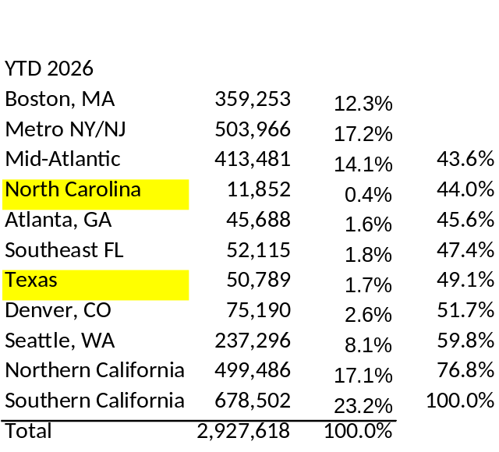
Vivmark Residential (NYSE: VMRK)
At-a-Glance⁽¹⁾
636
~185,000
$65B
EV = XXB
Equity Mkt cap (ER)
Total Debt ER
+Cash ($0.111B)
Rounded to $B
Communities
Apartment
Homes
Total Market
Capitalization
S&P 500
$4.4B
A | A3
>$2.2B
Constituent
Development
Underway
Credit Rating
(S&P | Moody’s)
Dividends Paid
(3Q26 Annualized)
Operating Portfolio
YTD 2026 NOI By Region⁽²⁾
Merged Same Store Residential | 157,377 Homes
8%
Seattle
12%
Boston
17%
Northern
California
17%
NY / NJ
Metro
14%
Mid-Atlantic
Denver 3%
23%
Southern
California
Raleigh <1%
Charlotte <1%
Dallas 1%
Atlanta 2%
Austin <1%
Southeast Florida 2%
(1) Total Market Capitalization, Merged Same Store Residential NOI and Development Underway are non-GAAP financial measures or other terms defined by the Company. See Attachment 13, “Additional Reconciliations and Definitions of Non-GAAP Financial Measures and Other Terms”.
(2) Bubble area proportional to each region’s share of YTD 2026 Merged Same Store Residential NOI by Region. See Attachment 6(c) for additional information.
Notes:
Option 1 – Refined: original layout and white page, tightened into an aligned 3-over-4 KPI grid with hairline dividers; labeled, area-proportional bubbles replace the table.

Slide 2
EV = XXB
Equity Mkt cap (ER)
Total Debt ER
+Cash ($0.111B)
Rounded to $B
Notes:
Option 1 – Refined: original layout and white page, tightened into an aligned 3-over-4 KPI grid with hairline dividers; labeled, area-proportional bubbles replace the table.

