Slide 1
Secure Channels Encryption Technology

Slide 2
committed to providing simpler, faster & stronger encryption to protect all things digital
What We Do
Create simple and efficient cryptographic solutions that truly protect data from end-to-end
Leadership
5 cybersecurity experts
5 executives with strong US government backgrounds.
Accomplishments
12 patents filed for cybersecurity related technologies
12 awards won for innovation in cybersecurity and encryption
Headquarters
Founded in 2014, located in Irvine, California, United States

Slide 3
Cryptosystem Information

Slide 4
XOTIC Core Cryptosystem
Patent-pending crypto-agile software encryption component
Scalable One-Time Pad (S-OTP) style software-efficient symmetric cipher
Adaptable to work in various applications or embedded into devices where traditional encryption would be Size/ CPU/ Bandwidth/ Memory prohibitive
Uses Cryptographically Secure Random Number Generator (CSRNG) or Quantum Random Number Generation (QRNG) to protect against upcoming advances in Quantum computing for long-term deployment
Ultra-lightweight cipher delivers efficient M2M communication and encrypted streaming of data
Design benefits:
10-30x faster vs. non-hardware accelerated AES
Encryption strength can fixed or modulated between DIAL-1 (512-bit) to DIAL-5 (8,192) settings
S-OTP Enables XOTIC to generate ciphertext that is longer or shorter than the plaintext, depending on security requirements
CSRNG and QRNG generated values are ephemeral, significantly reducing the risk of side channel attacks
Uniquely strong, fast & flexible encryption
* XOTIC keys are composed of 64-bit word elements with the number of elements determined by the selected key strength. Each 64-bit element provides 2^⁶³ -1 possible values. For example, the default 512-bit key has eight 64-bit elements for 2^{^512} -1 possible values, or 10¹⁵⁴ possible values.
Notes:
XOTIC Core (“cryptosystem”) is an embeddable encryption algorithm that hybridizes extreme levels of encipherment (bit strength) with unmatchable processing speeds. XOTIC is referred to as “cryptosystem” because of it’s configurability and versatility that spans direct file and disk encryption, streaming media / network, as well as API programmable and direct database protection.
Sharing performance characteristics of “stream ciphers” like ChaCha20 (a leading 128bit algorithm), XOTIC is ideal for encrypting live audio/video, high volumes of data in transit, sensor data, and streaming backups. Natively constructed with “block cipher” characteristics (similar to AES 256) as part of its core, XOTIC dramatically stands apart from other encryption with the unique ability to flex its own encryption strength to extreme levels. XOTIC comes pre-packaged with a “dial” mechanism that allows operators to modify the default minimum 512bit strength to ranges greater than 8,192bits of symmetric enciphering power. XOTIC dial settings for extreme encipherment have been approved for US Export.
Designed to be modular and simple to integrate, XOTIC SDK is available in Java, C++, and Verilog for direct hardware (FPGA or ASIC) integration. XOTIC Core can be deployed on Windows, Unix, Mac, and IOT devices (Raspberry PI) with zero configuration and as little as 2 lines of code. XOTIC is also accessible via command-line operations and can be accessed directly using Python or shell scripts.

Slide 5
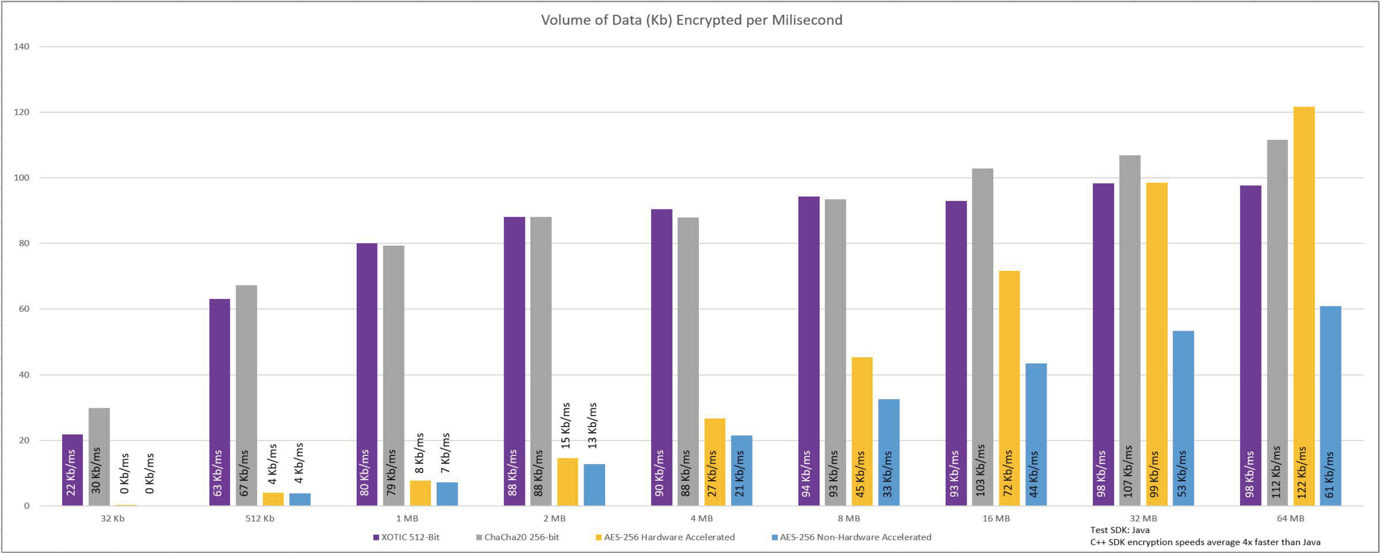
XOTIC 512-bit Encryption vs Leading 256-bit Ciphers

Slide 6
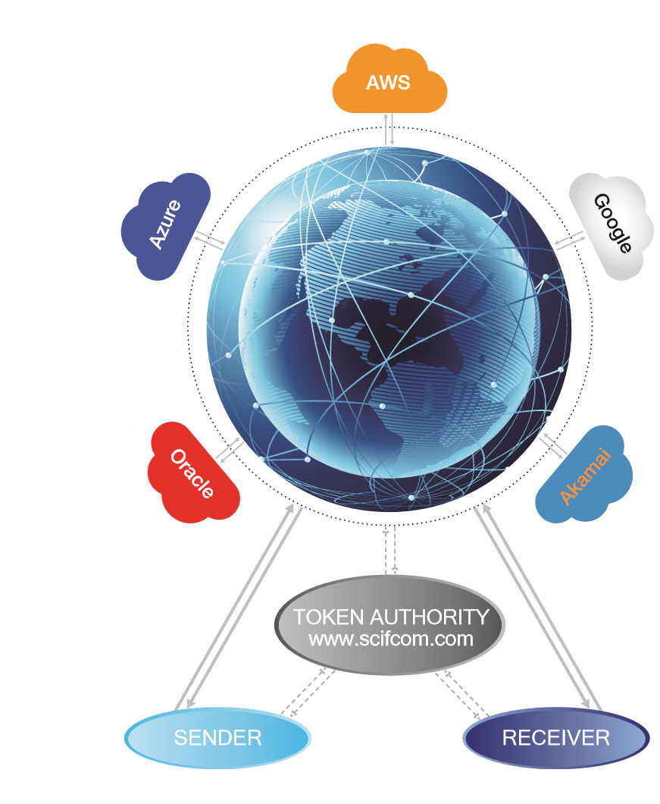
Secure Key Infrastructure
The Secure Key Infrastructure (SKI) is a secure patent-pending ephemeral key distribution protocol that delivers a continuous stream of re-keyed data.
SKI is designed to mitigate “man-in-the-middle” and DDOS/DOS attacks.
SKI Process:
Data encryption begins and symmetric encryption keys are sharded into key segments.
Key segments and unique ephemeral tokens are sent to repeaters on a cloud or private network. (Double-blind randomization process).
Cloud services network sends token to Token Authority (TA) for verification. TA generates new token and sends it to cloud network. (The token is nonidentifying and only pertains to the data to encrypt)
Recipient connects with TA to receive a new token and connects with cloud services network to receive key segments
Recipient is now able to successfully decrypt data
* Repeaters are defined as a network of relays where key fragments are distributed to and are recognized by the TA.
Notes:
Secure Key Infrastructure (SKI)
Secure Key Infrastructure (“SKI”) is a scalable protocol for exchanging symmetric encryption keys securely “out of band.” SKI was originally designed to support XOTIC encryption across distributed systems and environments; however, SKI also works directly with virtually any other symmetric encryption key methodology (such as AES 256). SKI infrastructure is comprised of a series of lightweight server-side components that can be rapidly deployed to public/private cloud as well as internal devices or datacenter infrastructure.
Wave Form Encryption
When deployed together, the unique combination of SKI with XOTIC Core (variable-strength) enables an entirely new approach to encrypting data whereby the strength is continuously modulated down to the “packet” level. Continuous change of encryption strength over a streaming signal is known as Wave Form Encryption (WFE), a concept that removes attack surfaces and is not feasible with other forms of encryption algorithms.

Slide 7
Animated Token Exchange (SKI) Process
This section uses security cameras as an example. All devices will distribute keys in a similar manner.
This is an animated section that is best viewed in presentation mode

Slide 8
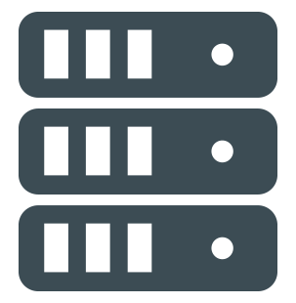
Multiple Consumers: XOTIC® Encryption Using Secure Key Infrastructure™ (SKI)
DEVICE 3
DEVICE 4
DEVICE 5
DEVICE 6
DEVICE 7
DEVICE 10
DEVICE 3
DEVICE 4
DEVICE 13
DEVICE 14
DEVICE 15
DEVICE 17
DEVICE 18
DEVICE 19
DEVICE 14
DEVICE 15
REPEATER
REPEATER
REPEATER
DEVICE 2
REPEATER
REPEATER
REPEATER
REPEATER
REPEATER
REPEATER
REPEATER
REPEATER
REPEATER
REPEATER
REPEATER
Key 2
Key 1
Key 1
Key 1
Key 2
Key 2
REPEATER
Key 2
REPEATER
REPEATER
REPEATER
REPEATER
REPEATER
REPEATER
REPEATER
REPEATER
REPEATER
REPEATER
REPEATER
REPEATER
REPEATER
Key 2
Key 1
REPEATER
Key 2
Key 1
REPEATER
Key 1
Key 2
Key
Key
Key 1
TOKEN
AUTHORITY
Start Key Transfer
Poll for Key Ready
Key 1
Key 2
XOTIC
CAMERA 1
VIEWPORT 1
MEDIA SERVER
Poll for All Clear
Request Status
Viewport Queued
Return_ACK
XOTIC
SendACK
SIPs SERVER
VIEWPORT 2
REQUEST KEY
Notes:
Overview: This slide represents a common closed/LAN deployment with several viewports requiring access to a single data feed. The SKI network in this example is based on local network repeaters that will transact ephemeral keys “out of band” which are then relayed to the intended recipient device.
Not represented in this slide: Once established, the signal will continue to re-keyed with random key-lengths ranging from 512-bit to over 8,192-bit at specified intervals. The process represented in this slide occurs every time the feed is re-keyed.
Several of the steps represented in this slide happen simultaneously. This slides has been broken down to help explain the value of each step in the process.
Step 1: The transmitting device (security camera) sends an encrypted feed to the recipient (viewport) – This video feed is encrypted until the key has been received. Any data being transmitted will be in cipher text and represented as static until this point in time. The camera will also be requesting any acknowledgement for a feed distribution at the same time by requesting the status of any requests via the SIPs server. Should a new recipient be added to the list in a one-to-many scenario, or the recipient device change altogether, this would redistribute the keys to ensure that the feed is reaching the appropriate devices.
Step 2: Once a feed is established the endpoint device will initiate a key transfer, requesting the key that is associated with the feed.
Step 3: The recipient (viewport) will now be queued up on the SIPs server, awaiting a key to be distributed from the source (security camera). This is the point where a key is requested from the source.
Step 4: The camera/transmitting device sends a sharded key (key 1 and key 2) to random repeaters (server instances in this example). The keys are ephemeral and hashed.
Step 5: At random intervals the keys will be “shuffled” and duplicated from one repeater/instance to another, significantly reducing the ability to identify and target a key shard’s location. This process continually takes place until the key has been successfully delivered to the intended recipient.
Step 6: All versions of the key shards are “burned” once they are shuffled, ensuring that no repeater contains key material for elongated periods of time. While the key shards are being shuffled, the source sends an acknowledgement to the recipient device through the SIPs server, notifying it that the key shards have been distributed and are ready for delivery.
Step 7: The receiving device receives the all clear from the SIPs server and contacts the Token Authority for the key transfer to be initiated. Each server is then queried for key material.
Step 8: The key shards are delivered to the recipient device and all duplicate shards are burned, ensuring that there is now means to reconstruct a key and obtain limited access to the data feed.
Step 9: The encrypted video feed is now established and the appropriate device(s) can now view the clear picture while any third party that taps the line will see nothing but static.

